Slide 1
LINUX ON AN FPGA
Chris Major
CSCI460 – Operating Systems
Fall 2019

Slide 2
IMPLEMENT AN OS ONTO AN FPGA
Develop a custom hardware design to support Yocto Linux

Slide 3

WHAT IS AN FPGA?
Field Programmable Gate Array
Create custom digital logic design
Can create Softcore Processors
Image from https://www.coursera.org/learn/intro-fpga-design-embedded-systems

Slide 4
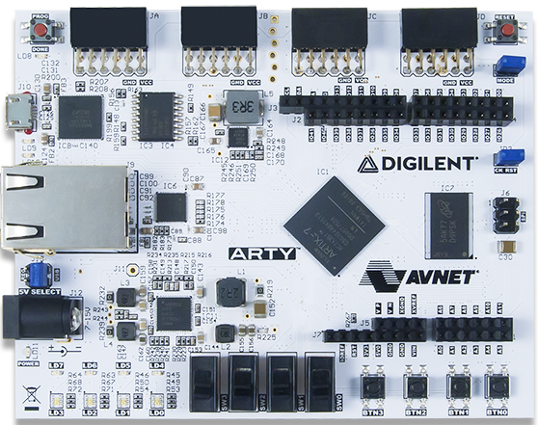
THE DEVELOPMENT BOARD
Artix-7 “Arty” Board
5 V power source
Ethernet support
GPIO for additional functionality
Image from https://store.digilentinc.com/arty-a7-artix-7-fpga-development-board-for-makers-and-hobbyists/

Slide 5
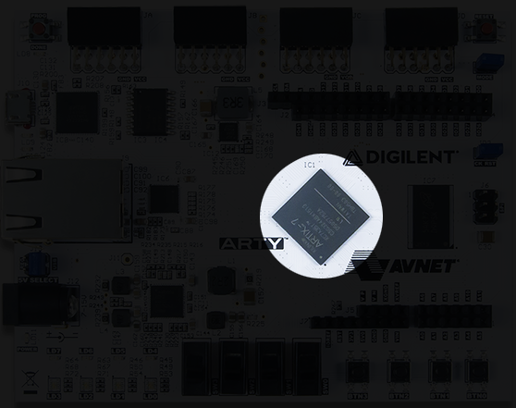
THE DEVELOPMENT BOARD
Uses a Xilinx Artix-7 XC7A35T FPGA chip
Image from https://store.digilentinc.com/arty-a7-artix-7-fpga-development-board-for-makers-and-hobbyists/

Slide 6
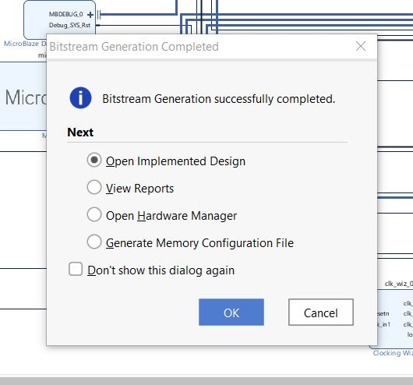
WORKFLOW
Generate design
Synthesis
Implementation
Bitstream Generation
Code Development
Linux Implementation
Concurrency Demonstration
Memes

Slide 7
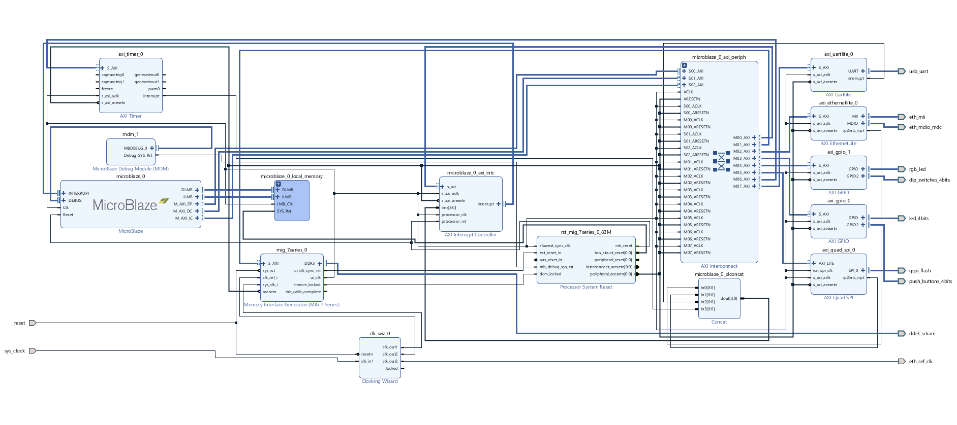

Slide 8
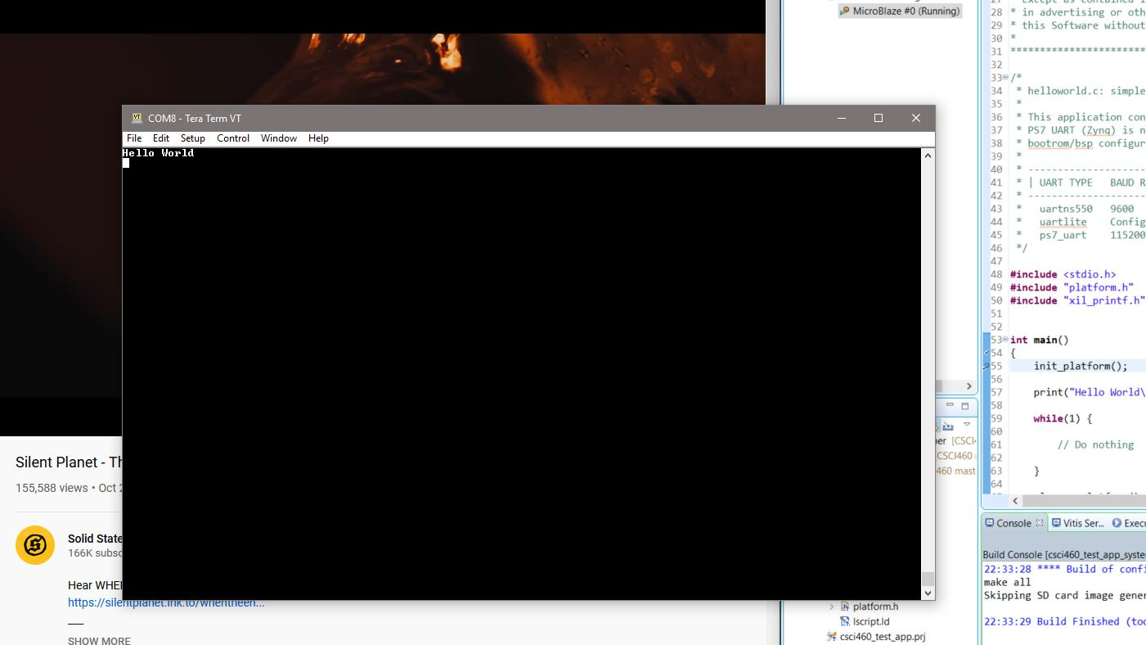

Slide 9


Slide 10
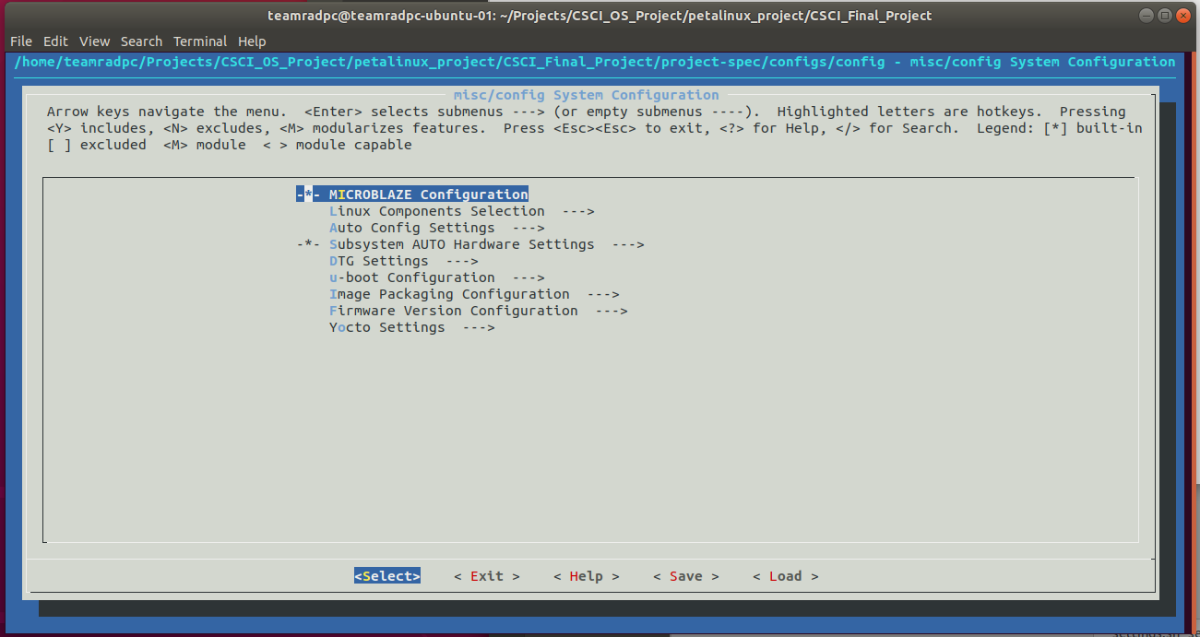

Slide 11
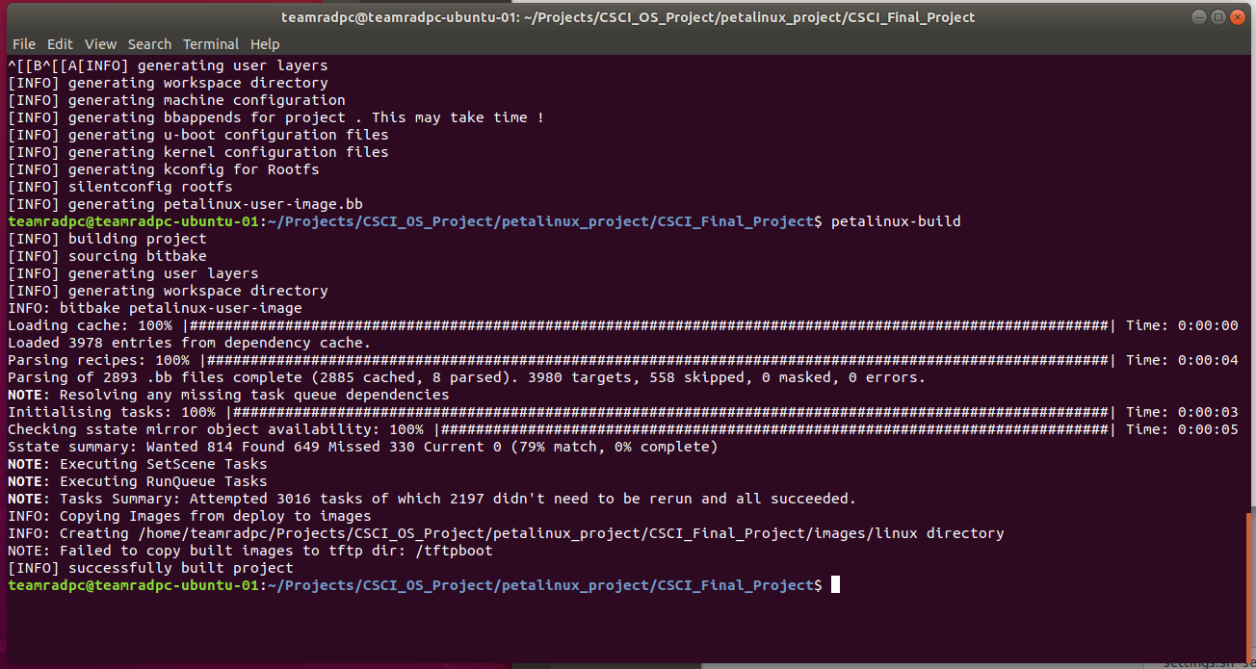

Slide 12
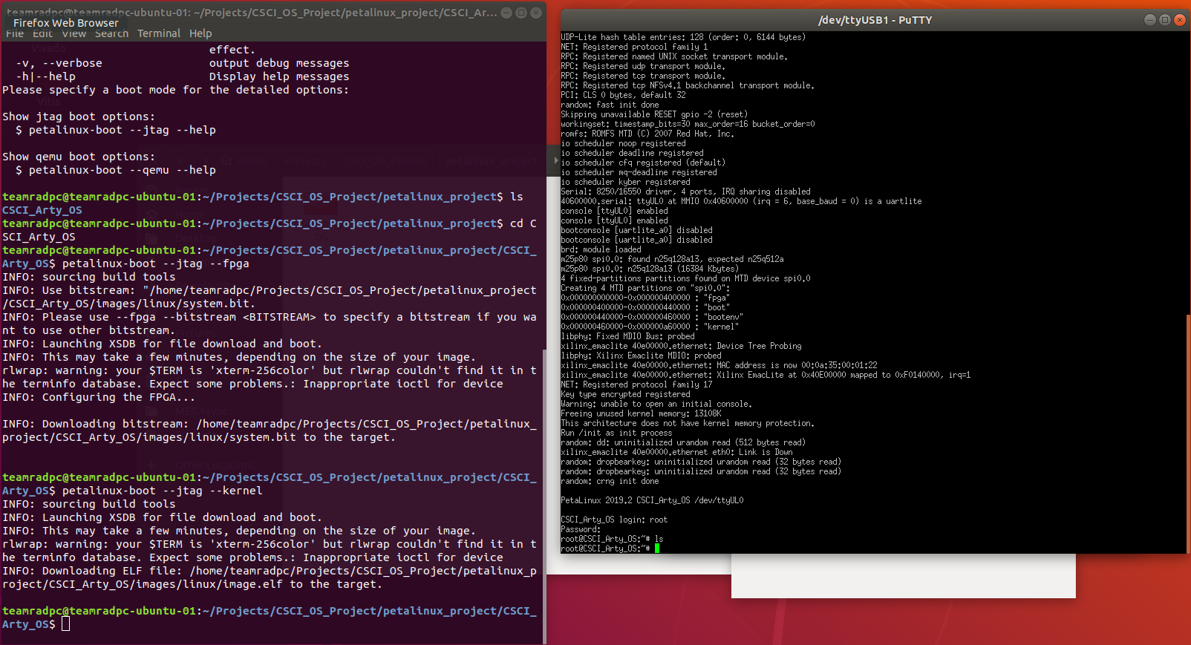

Slide 13
TITLE
Content
Image from https://store.digilentinc.com/arty-a7-artix-7-fpga-development-board-for-makers-and-hobbyists/

Slide 14
TITLE
Content
Image from https://store.digilentinc.com/arty-a7-artix-7-fpga-development-board-for-makers-and-hobbyists/

