Slide 1
Waimea Bay Wave Forecasting
Enriched Proof of Concept for World Surf League Decision-Making

Slide 2
Why This Problem Matters
Waimea Bay is one of the most iconic and dangerous big-wave surf breaks
Contest-ready conditions are rare and costly to mobilize
Better forecasts reduce wasted spend and missed opportunities

Slide 3
Business Objective
Forecast when waves will exceed 3 meters
Provide advance notice for contest scheduling
Enable data-driven operational decisions

Slide 4
Data Overview
Daily observations from 5 Pacific Ocean buoys
Metrics include wave height, wave period, air temperature
Upstream buoys capture swell generation and travel

Slide 5
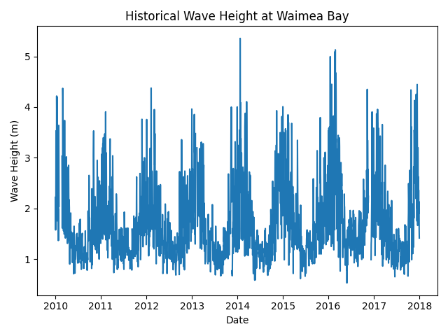
Historical Wave Heights at Waimea Bay
Strong seasonality with rare extreme events.
Big-wave days cluster during winter.

Slide 6
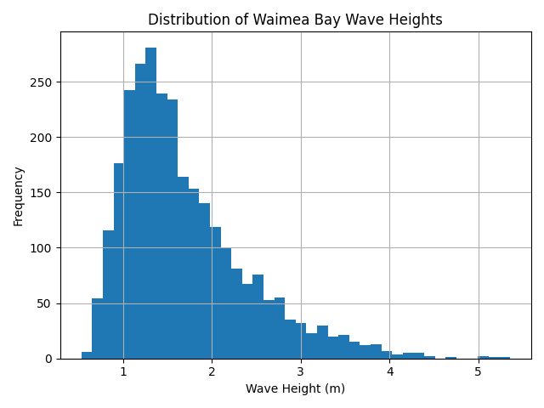
Distribution of Wave Heights
Most days are below the contest threshold.
Highlights class imbalance for ≥3m events.

Slide 7
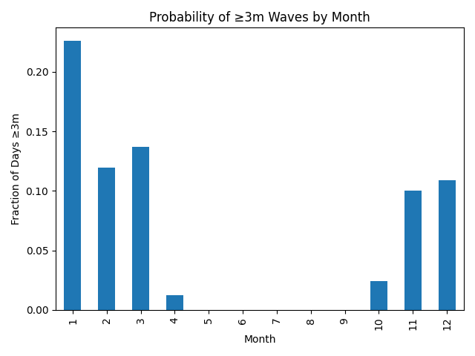
Seasonality of ≥3m Events
Winter months dominate contest-ready conditions.
Supports seasonal staffing and planning.

Slide 8
Framing the Problem (Q1)
What forecast horizon is most valuable?
What is the acceptable risk tradeoff?
Should forecasts be probabilistic or binary?

Slide 9
Data Enrichment (Q2)
Physics-based wave model outputs (NOAA)
Wind direction and storm intensity
Climate regime indicators (ENSO, PDO)

Slide 10
Data Integrity (Q3)
Forward-fill short gaps in buoy data
Median imputation for remaining missing values
Missing indicators retained as features

Slide 11
Forecasting Approach (Q4)
Baseline regression for transparency
Tree-based ML for nonlinear dynamics
Threshold-based contest decision support

Slide 12
Proof of Concept Model
Target: next-day wave height at Waimea Bay
Lagged and rolling features across buoys
Time-aware train/test split

Slide 13
Model Outputs
Predicted wave height (meters)
≥3m contest-ready indicator
RMSE, MAE, precision, recall

Slide 14
Communication Strategy (Q5)
Daily dashboard with uncertainty
Automated alerts when threshold likely
Weekly executive outlook summaries

Slide 15
One-Month Expansion Plan
Add physics-based forecasts
Extend to multi-day horizons
Deploy monitored API and dashboard

Slide 16
Key Takeaways
Big-wave forecasting is achievable and valuable
Multi-buoy data captures swell propagation
POC is a strong foundation for production

