Slide 1
Housing Prices
Chris Malasics

Slide 2

Proposal
Investigate which features best predict housing prices in Philadelphia

Slide 3
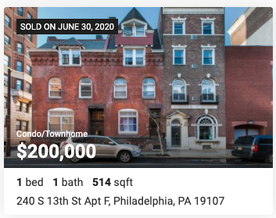
Hypothesis
Can predict housing prices based on using these common features:
Livable sqft
Lot sqft
Bedrooms
Bathrooms
HVAC
School Systems
Annual Tax
Build Year
Neighborhood
Zip Code

Slide 4
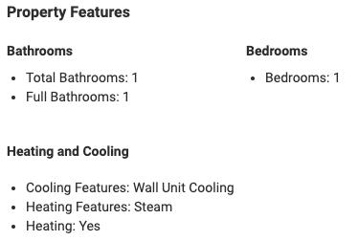
Data Collection
Website:
www.Realtor.com
Processes/Tools:
Selenium
BeautifulSoup
Regex

Slide 5
Performance
Focused on properties with less/fewer than:
Price - $800k
Lot size - 2,000 sqft
Bedrooms - 6
Bathrooms - 5
Other features modeled:
Master Bath
Taxes
Mean price by zip code
Air Conditioning
House Type
Regression | Test R^2
Linear | 0.794
Lasso | 0.803
MAE: $52,046
(mean absolute error)

Slide 6
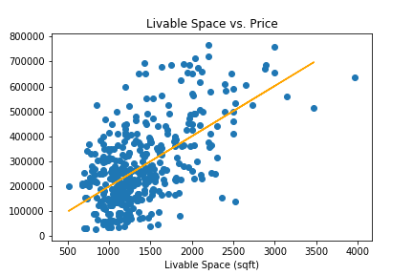
Analysis
Livable space:
Best predictor of price
Need more location data to reduce MAE error
Price ($)

Slide 7
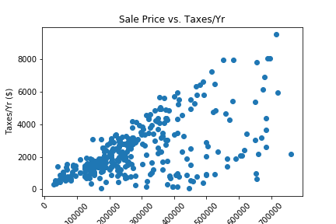
Interesting Finds
Property tax is 1.3998% of assessed value.
Some people are paying disproportionately lower taxes than others.

Slide 8
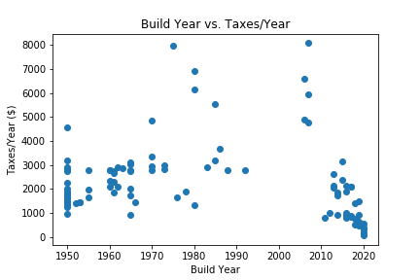
Interesting Finds
Philadelphia has a tax abatement on new construction.
Owners only pay taxes on the value of the land for the first 10 years.
Allows people to afford more house than other areas.
May have revived the housing market.

Slide 9
Future Work
Collect more data to increase model predictions using a multiple listing system (MLS)
Bright MLS = $296/yr
Add census data to see what areas are growing to predict price increases
Compare with mortgage rates
Find relationships between features that could help builders produce more profitable homes
Find houses that would benefit the most from a remodel
Notes:
A few things I would like to do to make this model more effective.

Slide 10
Thank You

