Slide 1
TREC 2015 Dynamic Domain Track
Grace Hui Yang, Georgetown University
John Frank, MIT/Diffeo
Ian Soboroff, NIST

Slide 2
Motivation
Underexplored subsets of Web content
Limited scope and richness of indexed content, which may not include relevant components of the deep web
temporary pages,
pages behind forms, etc.
Basic search interfaces, where there is little collaboration or history beyond independent keyword search
Complex, task-based, dynamic search
Temporal dependency
Rich interactions
Complex, evolving information needs
Professional users
A wide range of search strategies

Slide 3
Domain-Specific Search Strategies
Browsing
Boolean search & proximity search
Entity Search
Forward and backward search
Date/location search
Number/range search
Personal collection search
Expert search
Forum Search
Image search, multi-media search

Slide 4
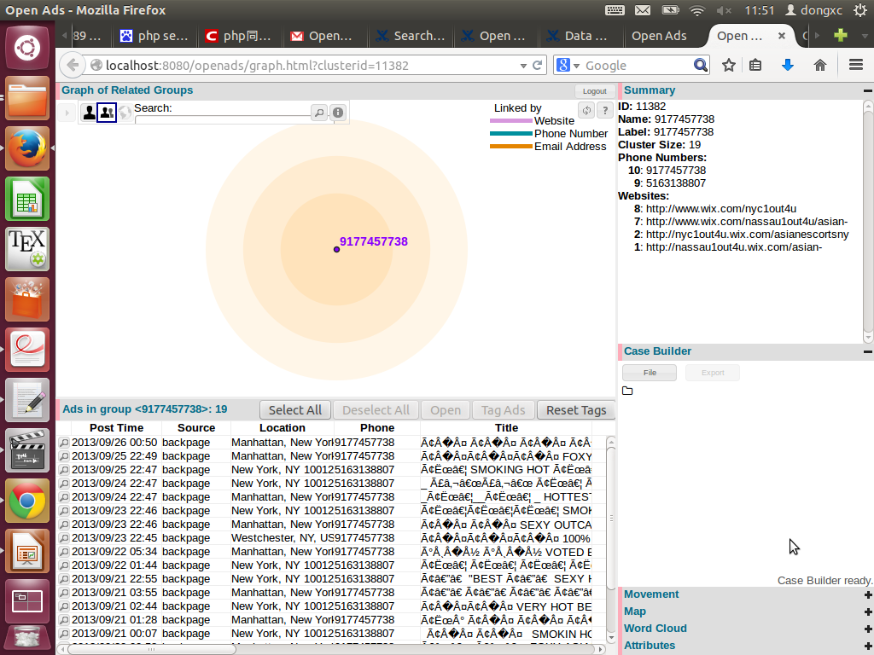
Why “Dynamic domain”?
Domain-specific Search
Deep Web
Under explored data
Professional users
Complex information needs

Slide 5
Dynamic Information Retrieval
Users change behavior over time, user history
Temporal change of Documents, Deep Web, emerging topics
Dynamic Users
Dynamic Documents
Domain-specific SE
Dynamic Relevance
Dynamic Queries
Time, geolocation and other contextual change, change in user perceived relevance
Rich user-system interaction through queries
Dynamic Information Needs
Knowledge evolves over time

Slide 6
Our Goal
The TREC Dynamic Domain Track envisions a new paradigm, where one can quickly and thoroughly search and organize a subset of the Internet relevant to one's interests.
We aim to encourage new research and new systems that provide
Fast, flexible, and efficient access to domain-specific content
Valuable insight into a domain that previously remained unexplored
and addresses shortcomings of centralized Web search
We develop evaluation methodologies for
systems that discover, organize, and present domain relevant content
Technologies for cross-domain adaptation

Slide 7
Outline
Introduction
Domains
Task
Evaluation
Timeline
Discussion

Slide 8
domains
Domain | Corpus
Counterfeit Pharmaceuticals (Pharma) | 30k forum posts from 5-10 forums (total ~300k posts) Which users are working together to sell illicit goods?
Ebola | One million tweets 300k docs from in-country web sites (mostly official sites) Who is doing what and where?
Local Politics | 300k docs from local political groups in Pacific Northwest and British Columbia. Who is campaigning for what and why?

Slide 9
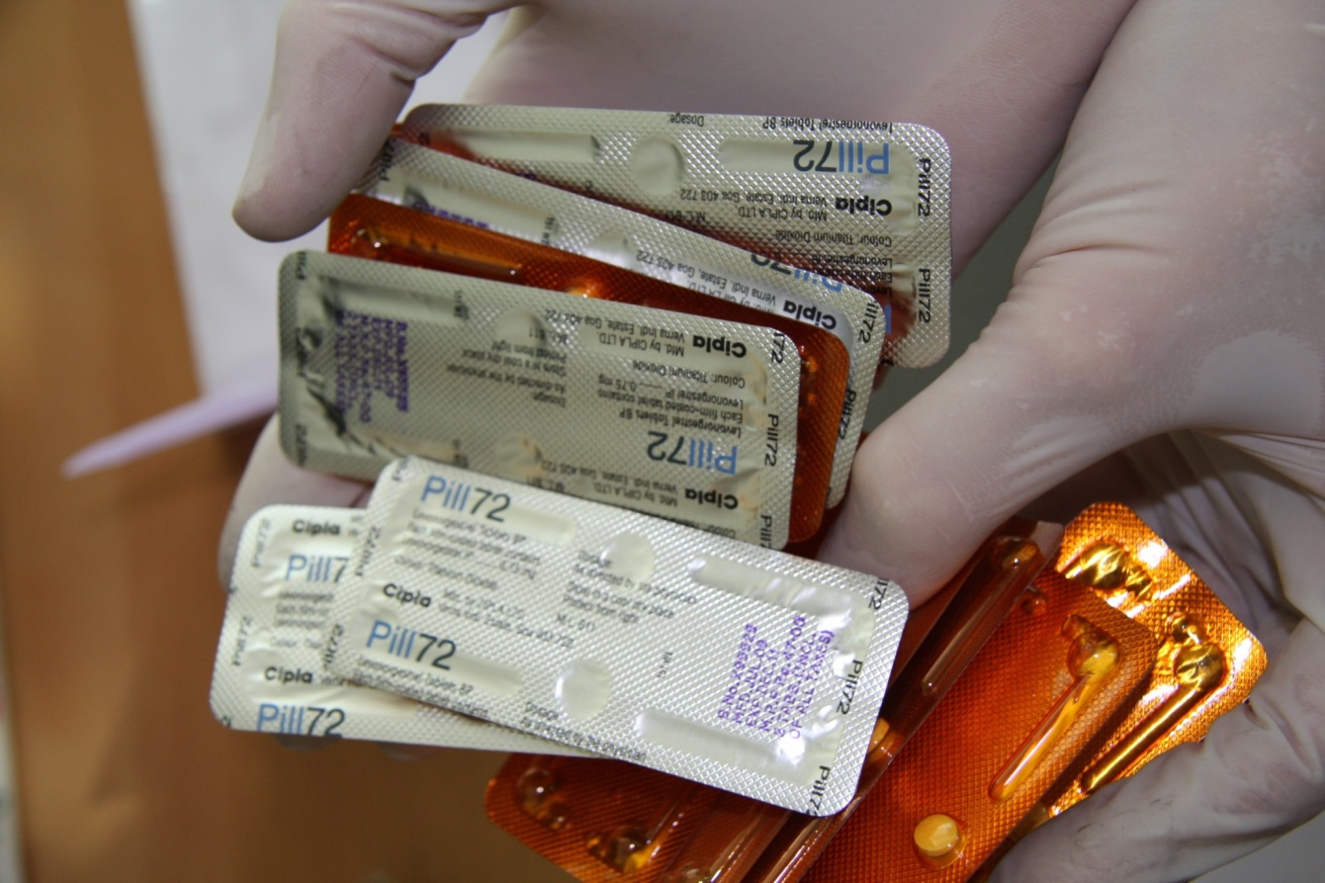
Domain I Counterfeit pharmaceuticals
Sell ineffective or deadly medications
Sell Addictive drugs
Indirectly fund botnets and hackers

Slide 10

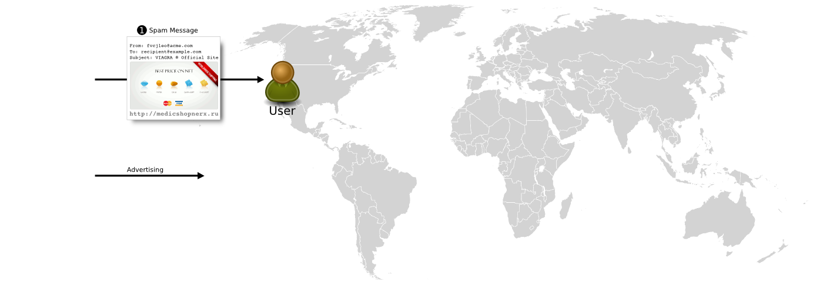

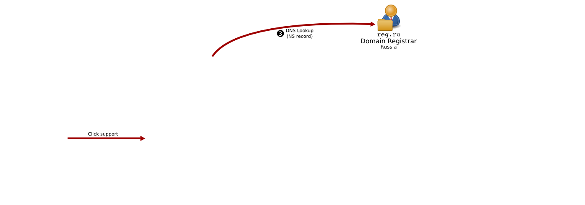
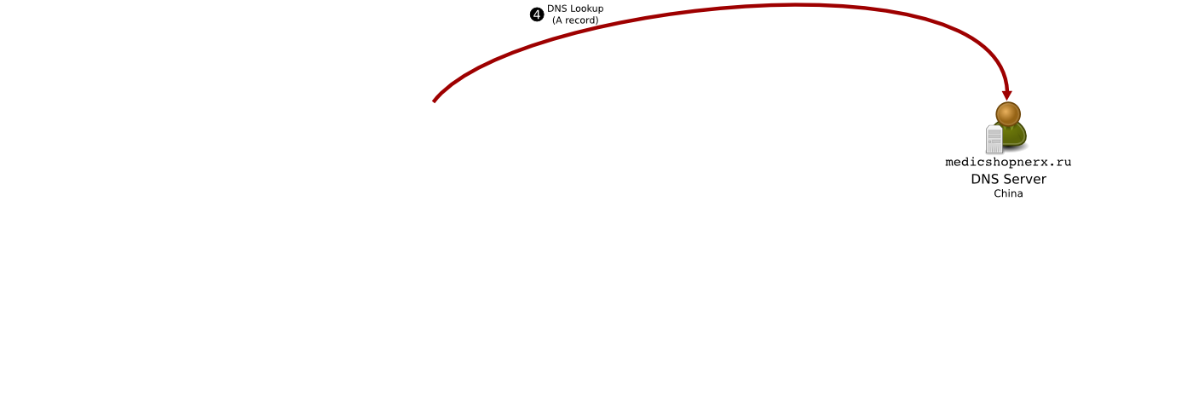

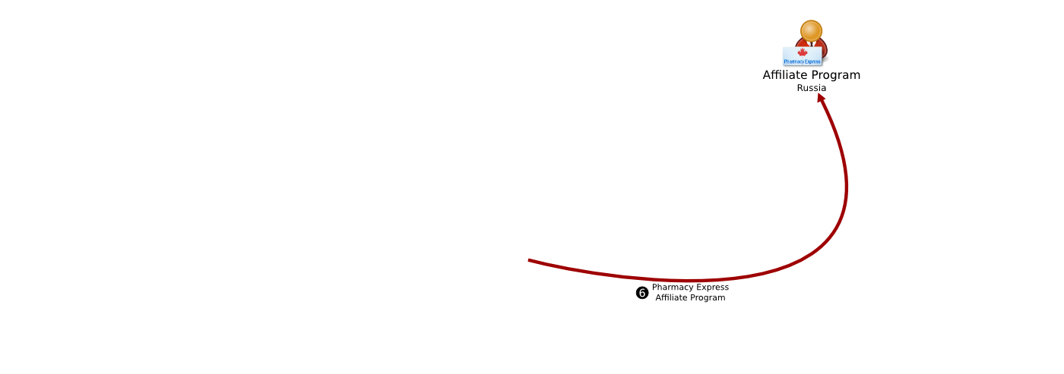
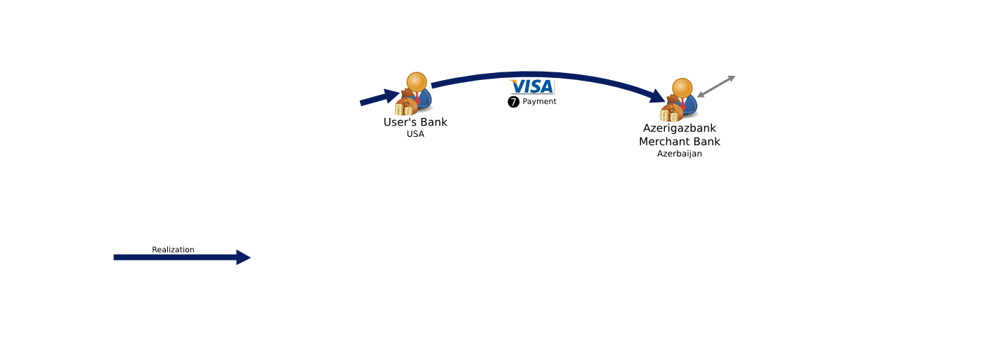
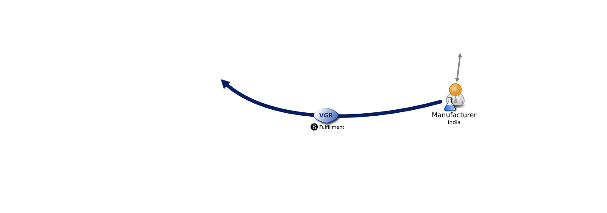
Online Pharmaceutical Value Chain
Notes:
In the pharma arena, that chain is awfully complex. Some of it we can observe with tools like those being developed here.
Some we cannot and so need to draw on other sources to inform our interpretation of what we see here.

Slide 11
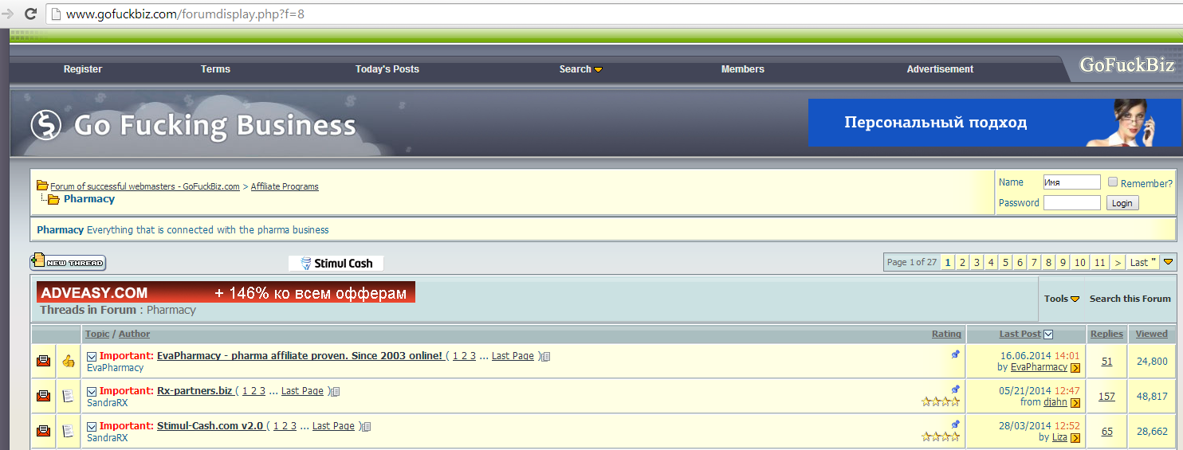
Under Ground Forum Ads
Learn about major affiliation programs
Handles of employees and connections
Activities

Slide 12
Domain II – Ebola (Crisis IR)
Ongoing crisis
3.3 million Tweets over five days for GPS tagged conversations about Ebola around the globe.
300k docs from in-country web sites (mostly official sites)
A set of questions:
Where (counties / country) are personalities organizing support of Ebola Viral Disease (EVD) success or perceived failure? What is causing the population to report or not report cases of flu-like symptoms within current or future Ebola Treatment Unit (ETU) sites? How will the local population conduct EVD awareness based off religious, ethnic and tribal education? Where will individuals attempt to garner support and build trust within Liberia?

Slide 13
Domain III – Local Politics
Public personas
Elected officials
School boards
First Nation activism
KBA StreamCorpus:
19 months of timestamped news, blogs, forums
>500M tagged by quality NER (BBN Serif)
Investigating re-using the KBA query entities
Part of ground truthing is already complete
Subtopic truthing still required
86 online personas (people) from the Seattle – Vancouver area

Slide 14
Outline
Introduction
Domains
Task
Evaluation
Timeline
Discussion

Slide 15
Task
An interactive, multiple runs of search
Starting point: System is given a search query
Iterate
System returns a ranked list of 5 documents
API returns relevance judgments
go to next iteration of retrieval
until done (system decides when to stop)
The goal of the system is to find relevant information for each topic as soon as possible
One-shot ad-hoc search is included
If system decides to stop after iteration one
Notes:
A debate of size of the returned documents: 1, 5, 10.

Slide 16
Topics
Assessors know topic descriptions
Topics contain multiple subtopics
Chief Sean Atlio
S1: Who did he meet with
S2: Issues he is pushing
S3: What crises are affecting his tribe
The systems are given the topic/query to start the search
Not the subtopics
Notes:
The importance of each subtopic can be weighted ??

Slide 17
Multiple runs of Relevance Judgments
Graded relevance judgments
0, 1, 2, 3
Multiple runs of relevance judgments
Suppose a topic with 3 subtopics
Run 1:
Systems returns d1, d2, d3, d4, d5
Relevance judgments:
d1: s1 4, s2 2, s3 0
d2: s1 1, s2 0, s3 0
d3: s1 0, s2 0, s3 0
d4: s1 0, s2 0, s3 2
d5: s1 0, s2 0, s3 3
Run 2:
Systems returns another set of d1, d2, d3, d4, d5
Another set of relevance judgments
…
Run N

Slide 18
Outline
Introduction
Domains
Task
Example Topics
Evaluation
Timeline
Discussion

Slide 19
Pharma
Nick Danger, aka HellRaiser
Who is he selling to
What is he selling
What are other aliases in other forums
Tools and Techniques
Motivations?

Slide 20
Ebola
Where are untrained health professionals going to provide care?
Find health care locations
Figure out how to tell an untrained health professional from trained
Identify individuals
Track them

Slide 21
Local politics
Chief Sean Atlio
Who did he meet with
Issues he is pushing
What crises are affecting his tribe
Background knowledge (childhood, etc)
Protests or events being planned
Continue from KBA

Slide 22
Outline
Introduction
Domains
Task
Evaluation
Timeline
Discussion

Slide 23
Evaluation metrics
Find relevant information as much as possible and as fast as possible
The system decides when to stop
Metrics handle relevance, novelty, time/effort, and task completion
Multi-dimensional evaluation
Candidate Evaluation Metrics:
Cube Test (Luo et al., CIKM 2013)
u-ERR – cascades as user gathers results
Session nDCG (Kanoulas et al., SIGIR 2011)

Slide 24
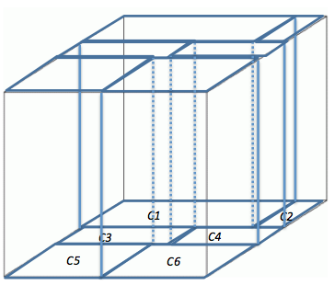
Evaluation - Cube Test
Task Cube
[Luo et al. CIKM 2013]
An empty
task cube for
a search task
with 6 subtopics
24

Slide 25
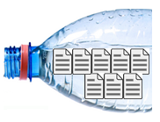



Evaluation - Cube Test
[Luo et al. CIKM 2013]
An empty task cube for a search task with multiple subtopics
A stream of “document water” fills into the task cube
A new coming relevant document will increase waters in all its relevant subtopics
The total height of the water in one cuboid represents the accumulated relevance gain for a subtopic
There is a cap for Gains
Total volume in the task Cube is the total Gain
Cube Test (CT) calculates the rates of how fast a search system can fill up the task cube as much as possible

Slide 26
Unexpected Expected Reciprocal Rank (u-ERR)
Variant of ERR for multiple search iterations with feedback:
Submit query to search engine
Receive ranked list of results
Start reading through the list:
User examines position n
If user finds new knowledge:
Update profile
Go to 1 with updated topic as query
else
n += 1
Go to 4
u-ERR = 1 / (expected list position of surprise)
Figure of merit: depth in the list
where user discovers new knowledge

Slide 27
TIME Line
TREC Call for Participation: January 2015
Data Available: March
Detailed Guidelines: April/May
Topics, Tasks available: June
Systems do their thing: June-July
Evaluation: August
Results to participants: September
Conference: November 2015

Slide 28


Why you should participate
Unique, underexplored research direction
Good for academics
New research
Great funding opportunities
Easy and Exciting!

Slide 29
Familiar, Easy | Hard = Exciting
Unit of retrieval = Document Corpus tiny: 1-2 M docs Specific domains with rich, interesting content features Content is cleansed, deduplicated, utf8, NER tagged, sentence parses | Iterative, explicit relevance judgment (feedback) from user (API) Three different domains Systems submit ranked lists in small batches of five at a time Relevance judgment consists of: On topic: True or False Passage(s): Char offsets Subtopics_id Graded relevance judgment

Slide 30
Discussion
Cross-domain
Tasks & Procedures

Slide 31
References
Jiyun Luo, Christopher Wing, Hui Yang, and Marti Hearst. The Water Filling Model and The Cube Test: Multi-Dimensional Evaluation for Professional Search. CIKM 2013.
Evangelos Kanoulas, Ben Carterette, Paul D. Clough, Mark Sanderson. Evaluating Multi-Query Sessions. SIGIR 2011.

Slide 32
Thank you
TREC Dynamic Domain Website:
http://www.trec-dd.org
Google group:
https://groups.google.com/forum/#!forum/trec-dd/

Slide 33
Domain I Counterfeit pharmaceuticals
Simple product space (though various dosages)
Viagra
Cialis
Vicodin
Percocet
Complex online advertising space
Thousands of online pharmacy storefronts
Spam advertising

Slide 34
Web Search
Domain-specific Search
everyday users
one-shot query
large user query logs
relevance at document level
a single, straightforward information need
keyword search
professional searchers
a sequence of queries or actions (e.g. click a node to browse)
rich interaction data within the session
stricter requirements for relevance - evidence
multiple. complex and task-based information needs
a wide range of search strategies

Slide 35
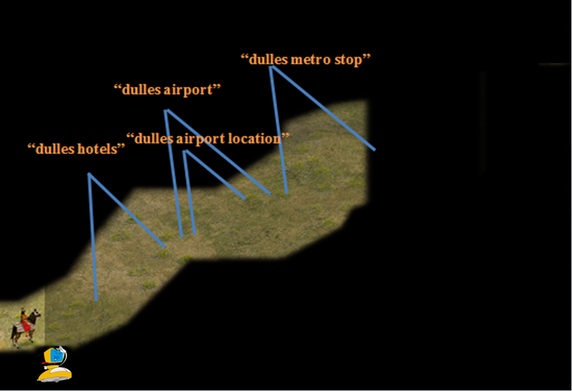
An Exploratory Process
Find what city and state Dulles airport is in, what shuttles ride-sharing vans and taxi cabs connect the airport to other cities, what hotels are close to the airport, what are some cheap off-airport parking, and what are the metro stops close to the Dulles airport.
Information
need
User
Search Engine

Slide 36
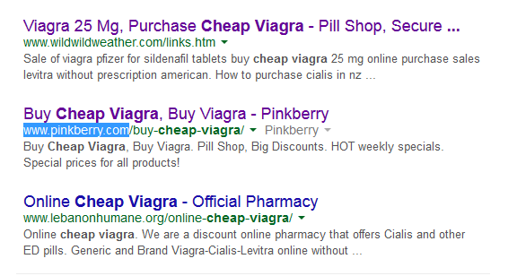
Compromised Websites

Slide 37
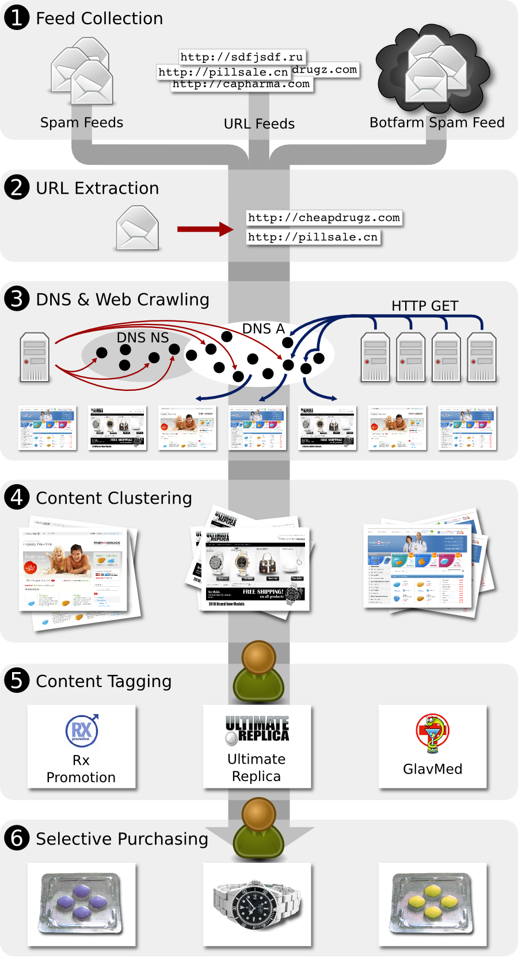
Data Gathered
Aug 1 – Oct 31, 2010
7 URL/spam + 5 botnet feeds
968M URLs
17M domains
Crawled domains for 98% of URLs with
1000s of Firefox instances
Significant IP diversity (overcome blacklisting)
~200 purchases from all major programs
Notes:
What was required to do this at the scale you did?
What would be required to do this on an ongoing basis as part of Memex?
Why purchasing cannot be scaled – security measures they put in place: they call, identity backstops, etc..

Slide 38
Search Engines and Pharma
But the real problem is even worse….
Ephemeral websites – multiple URLs all link to one site
Compromised websites
Hacked sites redirect to pharmacy stores
Need to ID underlying sites and hacking patterns
Crawler evasion
Cloaking to only show site to customers
Simple crawlers won’t get to sales sites

Slide 39
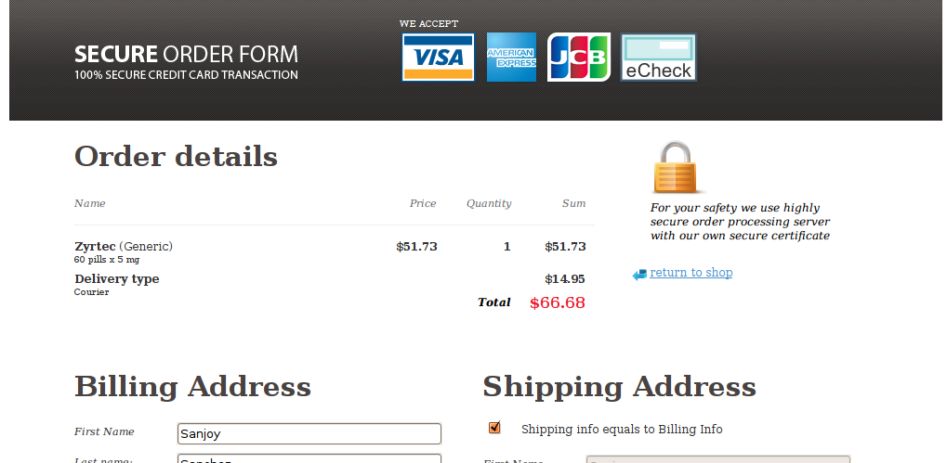
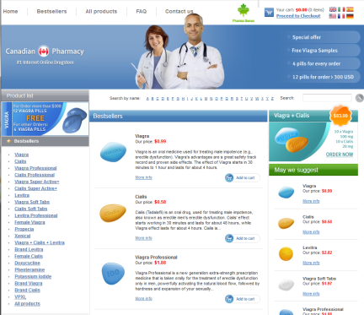

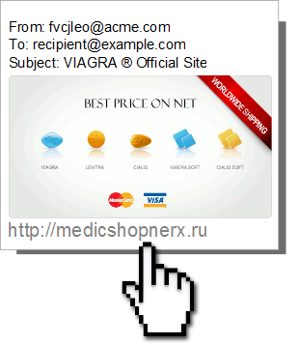


Online Pharmaceutical Economy
(Customer)
39
Notes:
As in many settings tracking the train from user to underlying entity mapping what the user does in cyber space to some thing that happens in the real world.

