Slide 1
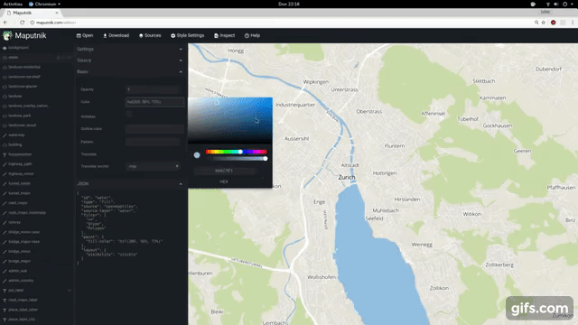
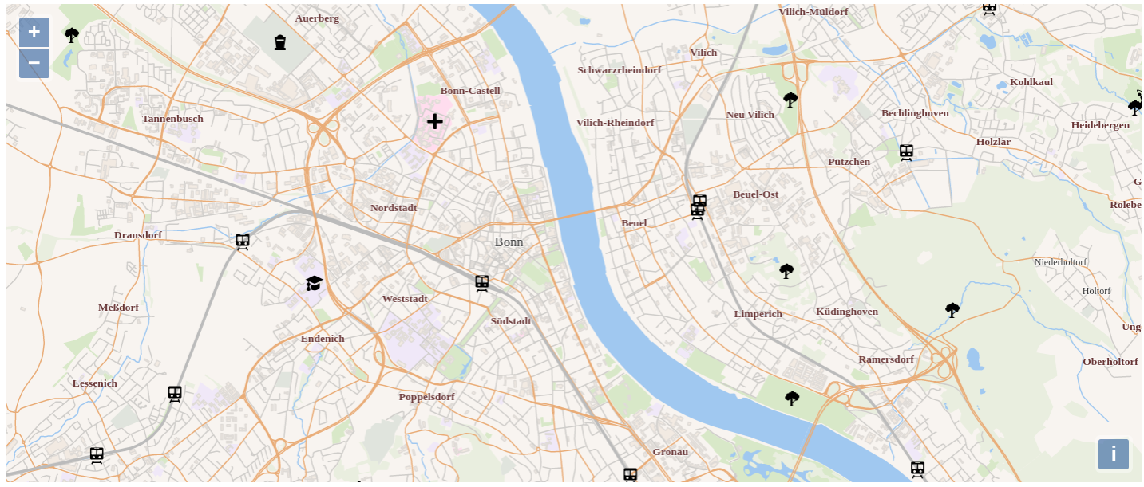


Maputnik
Geodaten
ol-mapbox-style
OpenLayers

