Slide 1


Slide 2
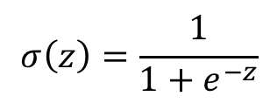

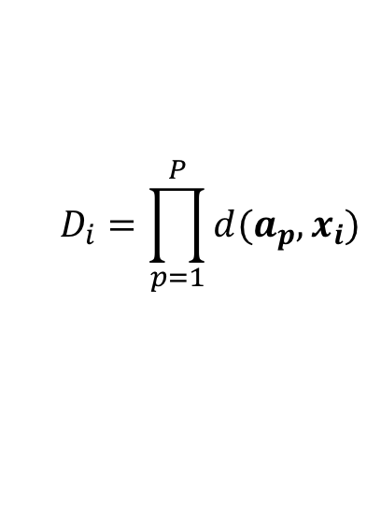
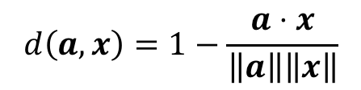
$${\hat{y}}_{i}\left(D_{i},w, b\right)=σ\left(b+wD_{i}\right)$$
$$σ\left(z\right)=\frac{1}{1+e^{−z}}$$
$$D_{i}=\prod_{p=1}^{P}{d(a_{p}, x_{i})}$$
$$d\left(a, x\right)=1−\frac{a⋅x}{\left\|a\right\|\left\|x\right\|}$$

Slide 3
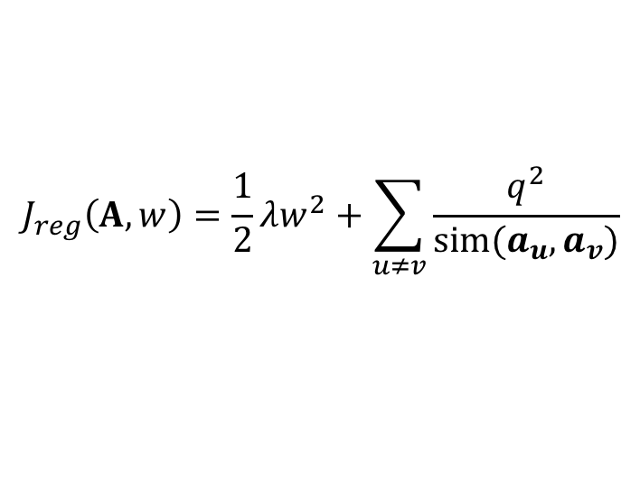

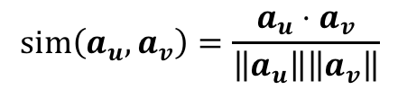
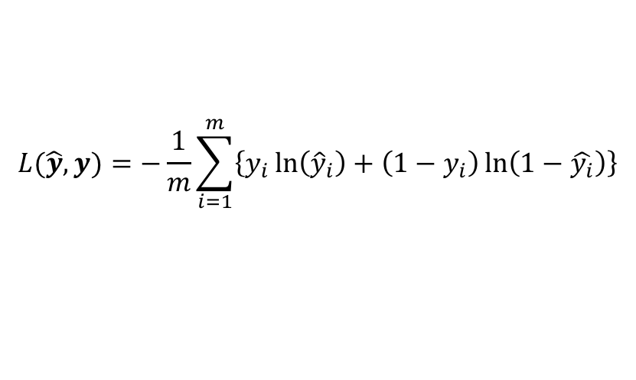
$$J\left(\hat{y}, y,A,w\right)=L\left(\hat{y},y\right)+J_{reg}(A,w)$$
$$L(\hat{y},y)=−\frac{1}{m}\sum_{i=1}^{m}{\left\{y_{i}\ln\left({\hat{y}}_{i}\right)+\left(1−y_{i}\right)\ln\left(1−\hat{y_{i}}\right)\right\}}$$
$$J_{reg}\left(A,w\right)=\frac{1}{2}{λw}^{2}+\sum_{u≠v}{\frac{q^{2}}{sim(a_{u}, a_{v})}}$$
$$sim\left(a_{u}, a_{v}\right)=\frac{a_{u}⋅a_{v}}{\left\|a_{u}\right\|\left\|a_{v}\right\|}$$

Slide 4
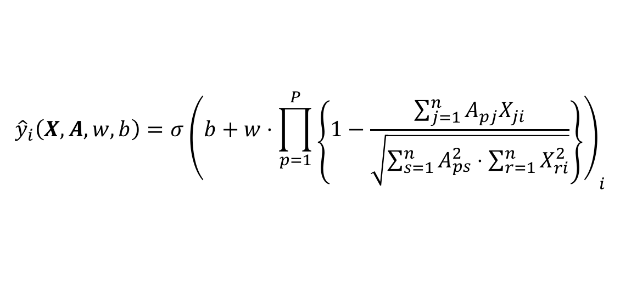
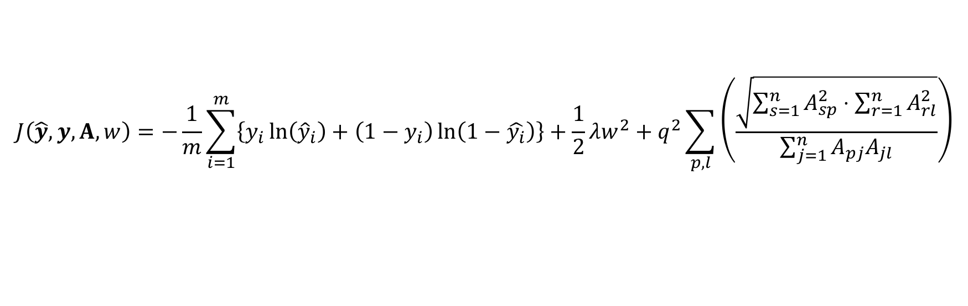
$${\hat{y}}_{i}\left(X, A,w, b\right)=σ{\left(b+w⋅\prod_{p=1}^{P}{\left\{1−\frac{\sum_{j=1}^{n}{A_{pj}X_{ji}}}{\sqrt{\sum_{s=1}^{n}{A_{ps}^{2}}⋅\sum_{r=1}^{n}{X_{ri}^{2}}}}\right\}}\right)}_{i}$$
$$J\left(\hat{y}, y,A,w\right)=−\frac{1}{m}\sum_{i=1}^{m}{\left\{y_{i}\ln\left({\hat{y}}_{i}\right)+\left(1−y_{i}\right)\ln\left(1−\hat{y_{i}}\right)\right\}}+\frac{1}{2}λw^{2}+q^{2}\sum_{p, l}{\left(\frac{\sqrt{\sum_{s=1}^{n}{A_{sp}^{2}⋅\sum_{r=1}^{n}{A_{rl}^{2}}}}}{\sum_{j=1}^{n}{A_{pj}A_{jl}}}\right)}$$
Technically, J is off by an additive factor of P*K (which comes from the diagonal elements of the similarity matrix all equaling 1; a vector’s similarity with itself is 1) if I sum over all p and l.

Slide 5






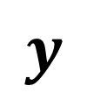



$$X$$
$$y$$
$$A$$
$$x_{1}$$
$$x_{2}$$
$$x_{3}$$
$$⋮$$
$$⋮$$
$$⋮$$
$$⋮$$
$$⋮$$
$$⋮$$
$$x_{m}$$
$$y_{1}$$
$$y_{2}$$
$$y_{3}$$
$$⋮$$
$$⋮$$
$$⋮$$
$$⋮$$
$$⋮$$
$$⋮$$
$$y_{m}$$
$$a_{1}$$
$$a_{2}$$
$$⋮$$
$$⋮$$
$$⋮$$
$$a_{P}$$
$$m$$
$$P$$
$$m$$
$$n$$
$$n$$

Slide 6









$$X$$
$$Y$$
$$A$$
$$x_{1}$$
$$x_{2}$$
$$x_{3}$$
$$⋮$$
$$⋮$$
$$⋮$$
$$⋮$$
$$⋮$$
$$⋮$$
$$x_{m}$$
$$y_{1}$$
$$y_{2}$$
$$y_{3}$$
$$⋮$$
$$⋮$$
$$⋮$$
$$⋮$$
$$⋮$$
$$⋮$$
$$y_{m}$$
$$K$$
$$a_{K1}$$
$$a_{11}$$
$$a_{12}$$
$$⋮$$
$$⋮$$
$$⋮$$
$$a_{1P}$$
$$m$$
$$P$$
$$m$$
$$n$$
$$n$$
$$K$$

Slide 7








$$X$$
$$y$$
$$x_{1}$$
$$x_{2}$$
$$x_{3}$$
$$⋮$$
$$⋮$$
$$⋮$$
$$⋮$$
$$⋮$$
$$⋮$$
$$x_{m}$$
$$y_{1}$$
$$y_{2}$$
$$⋮$$
$$⋮$$
$$⋮$$
$$⋮$$
$$y_{K}$$
$$a_{1}$$
$$a_{2}$$
$$⋮$$
$$⋮$$
$$⋮$$
$$a_{P}$$
$$K$$
$$P$$
$$m$$
$$n$$
$\left\|a_{1}\right\| { a_{1}⋅a}_{2} ⋯ ⋯$
$a_{2}⋅a_{1}$
$a_{3}⋅a_{1}$ $⋱$
$⋱$
$⋮$ $⋱$
$$n$$
$$a_{1} a_{2} ⋯ ⋯ ⋯ a_{P}$$

Slide 8
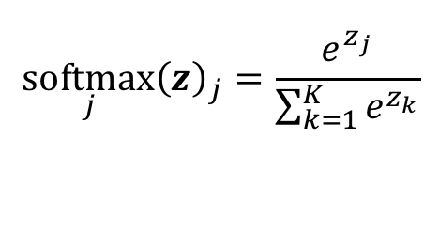
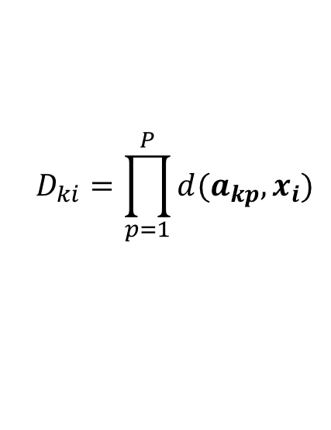
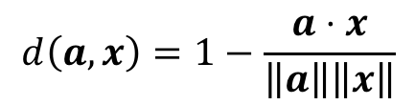
$${\hat{Y}}_{ki}\left(D,w, b\right)=softmax\left(Br{\left(b_{k}\right)}_{i}+w_{k}⋅D_{ki}\right)$$
$$\underset{j}{softmax}{{\left(z\right)}_{j}}=\frac{e^{z_{j}}}{\sum_{k=1}^{K}{e^{z_{k}}}}$$
$$D_{ki}=\prod_{p=1}^{P}{d(a_{kp}, x_{i})}$$
$$d\left(a, x\right)=1−\frac{a⋅x}{\left\|a\right\|\left\|x\right\|}$$

Slide 9
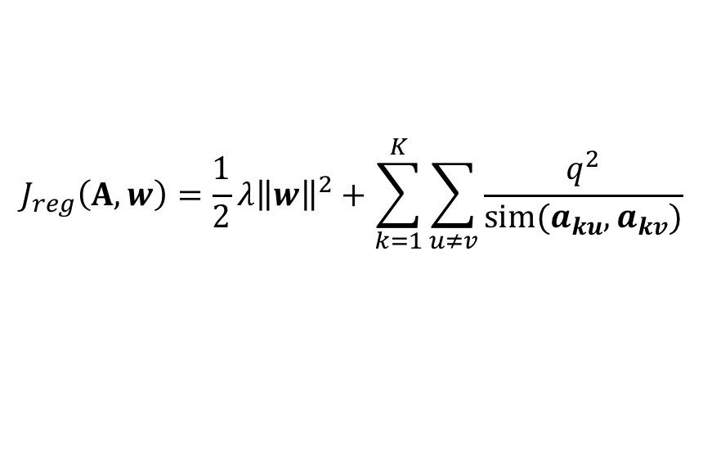

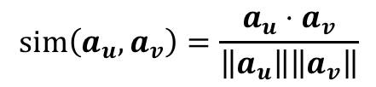
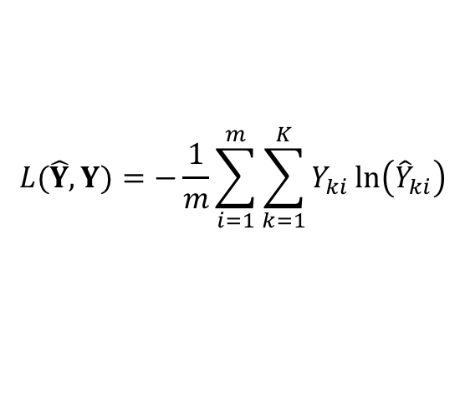
$$J\left(\hat{Y}, Y,A,w\right)=L\left(\hat{Y},Y\right)+J_{reg}(A,w)$$
$$L(\hat{Y},Y)=−\frac{1}{m}\sum_{i=1}^{m}{\sum_{k=1}^{K}{Y_{ki}\ln\left({\hat{Y}}_{ki}\right)}}$$
$$J_{reg}\left(A,w\right)=\frac{1}{2}{λ\left\|w\right\|}^{2}+\sum_{k=1}^{K}{\sum_{u≠v}{\frac{q^{2}}{sim(a_{ku}, a_{kv})}}}$$
$$sim\left(a_{u}, a_{v}\right)=\frac{a_{u}⋅a_{v}}{\left\|a_{u}\right\|\left\|a_{v}\right\|}$$

Slide 10
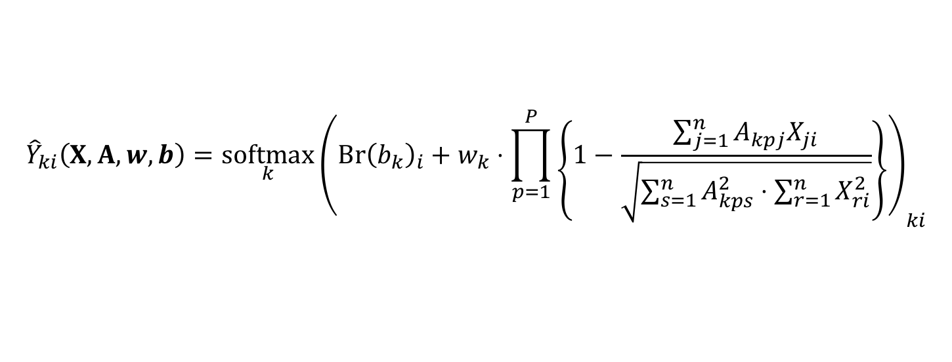
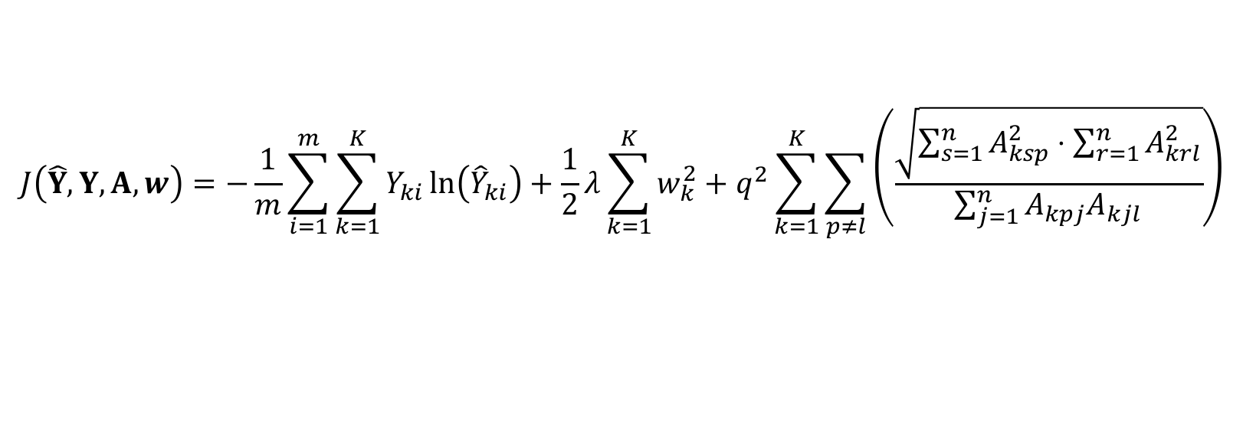
$${\hat{Y}}_{ki}\left(X, A,w, b\right)={\underset{k}{softmax}\left(Br{\left(b_{k}\right)}_{i}+w_{k}⋅\prod_{p=1}^{P}{\left\{1−\frac{\sum_{j=1}^{n}{A_{kpj}X_{ji}}}{\sqrt{\sum_{s=1}^{n}{A_{kps}^{2}⋅\sum_{r=1}^{n}{X_{ri}^{2}}}}}\right\}}\right)}_{ki}$$
$$J\left(\hat{Y}, Y,A,w\right)=−\frac{1}{m}\sum_{i=1}^{m}{\sum_{k=1}^{K}{Y_{ki}\ln\left({\hat{Y}}_{ki}\right)}}+\frac{1}{2}λ\sum_{k=1}^{K}{w_{k}^{2}}+q^{2}\sum_{k=1}^{K}{\sum_{p≠l}{\left(\frac{\sqrt{\sum_{s=1}^{n}{A_{ksp}^{2}⋅\sum_{r=1}^{n}{A_{krl}^{2}}}}}{\sum_{j=1}^{n}{A_{kpj}A_{kjl}}}\right)}}$$
Technically, J is off by an additive factor of P*K (which comes from the diagonal elements of the similarity matrix all equaling 1; a vector’s similarity with itself is 1) if I sum over all p and l.

Slide 11
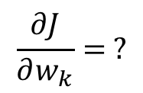
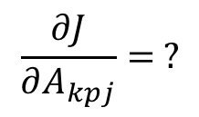
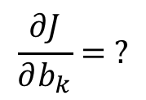
$$\frac{∂J}{∂A_{kpj}}= ?$$
$$\frac{∂J}{∂w_{k}}= ?$$
$$\frac{∂J}{∂b_{k}}= ?$$

