Slide 1
From prospect to member in one application
Navy Federal · Experience Cloud, Service Cloud and Agentforce
Notes:
Today I want to show you a member relationship that started from nothing. Ethan Carter has never banked with Navy Federal. In one online application he joined, opened his first accounts, and handed the contact center everything it needs to finish the job.
I'll start where your team would see him first, his member record, and then go back and show how he got there.

Slide 2
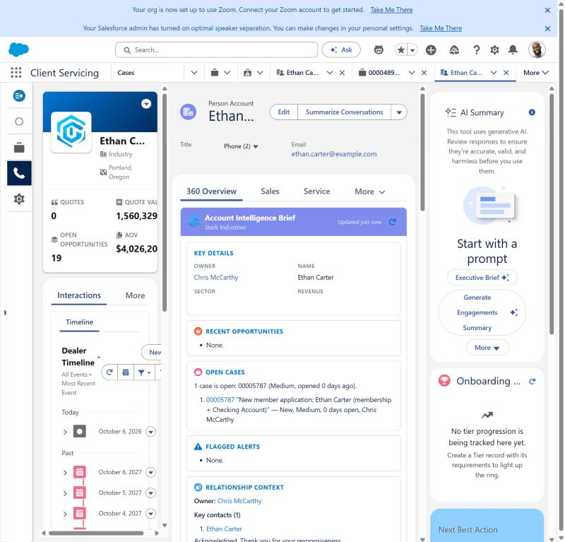
Ethan is a member record, not a web form
PERSON ACCOUNT FOR ETHAN CARTER
1
Person Account created from his application
2
Owned by a Navy Federal rep, not a guest user
3
Intelligence brief already shows his open case
Notes:
This is Ethan's Person Account, the single record Navy Federal keeps for him as a member. Nobody keyed this in. It was created the moment he submitted his application online.
Notice the intelligence brief already knows about him: one open case, his new member application. Your rep doesn't have to go looking for what's happening with this person.

Slide 3
Prospect to member, automatically
PROSPECT
CONVERTED
MEMBER
Lead
10/6/2026
Person Account
Ethan Carter
Source: Website
Status: New
Same transaction
as the submission
Ethan Carter
Account + Contact
Owned by a Navy Federal rep
CREATED IN THE SAME SUBMISSION
Case
Product application
Member onboarding
Documents on the case
00005787
APP-00081
AF-00033
ID + proof
Notes:
Behind that record is the moment Ethan stopped being a prospect. When he submitted, Salesforce captured him as a Lead, from the website, and immediately converted that Lead into a Person Account and Contact.
That matters for Navy Federal because your prospect data and your member data are the same data. Marketing can see where new members came from, and service sees a real member from the first minute, with no re-keying and no duplicate records.
In the same transaction the system created his membership onboarding record, his product application, the case for your contact center, and attached his documents.

Slide 4
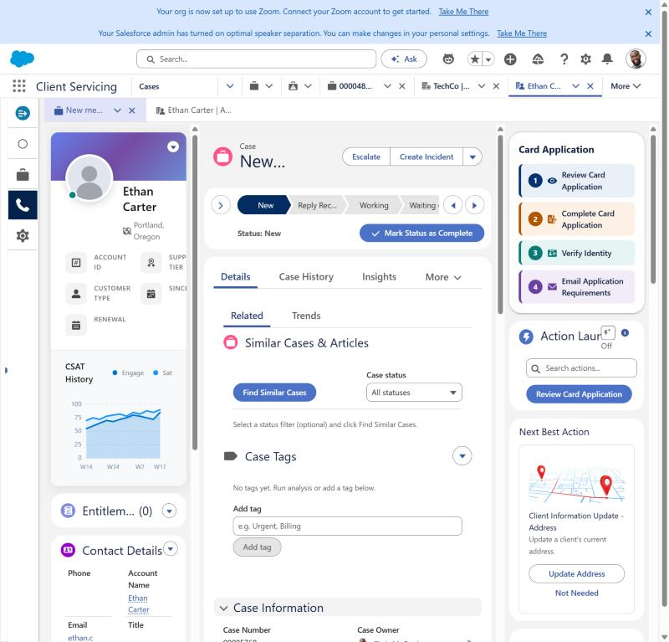
The work arrives ready for a member service rep
NEW MEMBER APPLICATION CASE IN THE SERVICE CONSOLE
1
Routed by your case assignment rules
2
Card Application actions 1 to 4 on the right
3
Service Rep Assistant guided by the Member Onboarding topic
Notes:
Here's the case. It's routed like any other case, and it arrives complete: who Ethan is, how he's eligible, what he applied for, and his ID and proof of eligibility already attached.
On the right, the rep's guided actions are numbered one to four: review the application, complete it, verify identity, and email anything that's missing. The Service Rep Assistant is set up with a Navy Federal Member Onboarding topic, so its plan follows the same five steps: confirm eligibility, gather what's needed, submit, verify identity, then activate the account.
So the question for your team becomes, how fast can we verify and open this account, not, who is this person and what did they send us.

Slide 5
How Ethan got here
The Experience Cloud application, start to finish
Notes:
Now let's go back to the beginning and see what Ethan saw on Navy Federal's website.

Slide 6
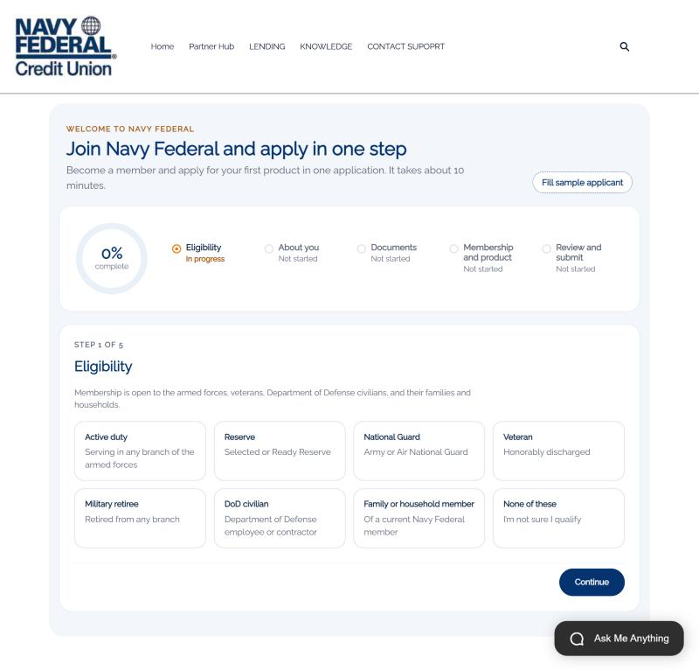
One application to join and apply
STEP 1 OF 5: ELIGIBILITY
1
Five steps with progress the member can see
2
Eligibility comes first, before any personal data
3
“None of these” stops the application politely
Notes:
Ethan lands on one page: join Navy Federal and apply in one step. The progress ring and the five steps tell him exactly how long this will take.
We start with eligibility, because that's the first question a credit union has to answer. He sees every way to qualify, and if he picks none of these, we stop and offer help instead of collecting data we can't use.

Slide 7
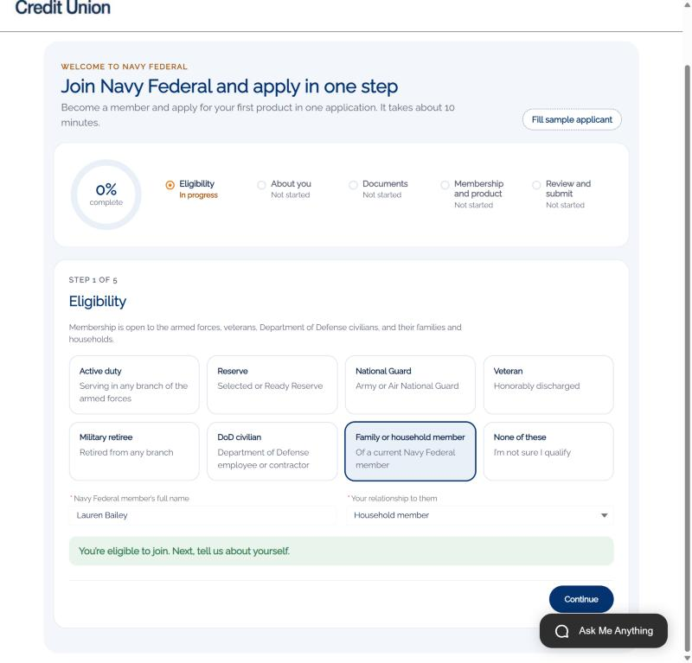
Household eligibility grows membership
FAMILY OR HOUSEHOLD MEMBER OF LAUREN BAILEY
1
Ethan qualifies through Lauren Bailey
2
Confirmed on the spot: “You’re eligible to join”
3
Existing members become the path to new ones
Notes:
Ethan isn't military himself. He qualifies as a household member of Lauren Bailey, an existing member and his fiancée. He names her, picks the relationship, and gets an immediate answer: you're eligible to join.
For Navy Federal, this is how existing members bring their households with them.

Slide 8
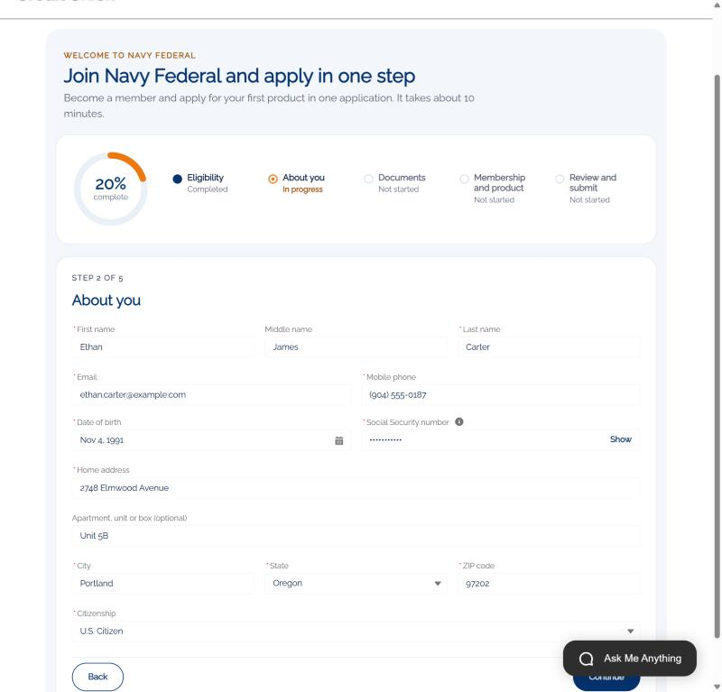
About you, captured once
STEP 2 OF 5: ABOUT YOU
1
Name, contact, date of birth, address, citizenship
2
SSN masked on screen and stored encrypted
3
Becomes the member record and the application
Notes:
Next, the basics: name, contact details, date of birth, address and citizenship. His Social Security number is masked as he types and stored encrypted.
He enters this once. The same details become his member record and his product application, so nobody asks him again.

Slide 9
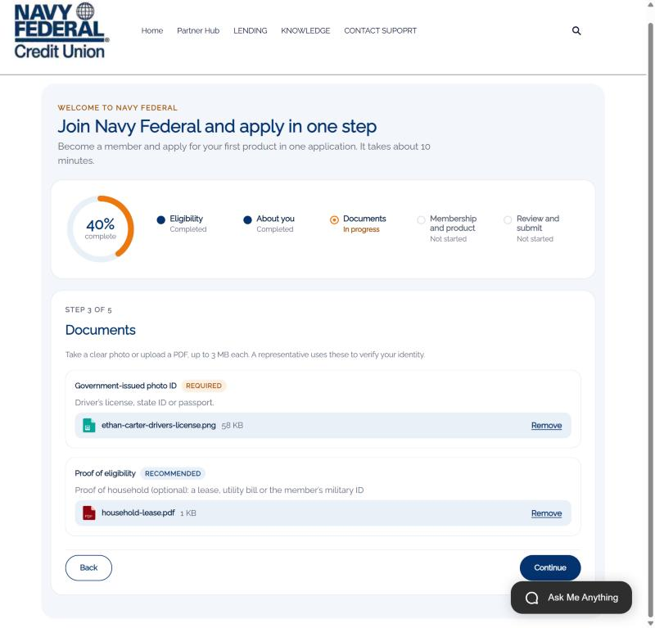
Documents up front, not by email later
STEP 3 OF 5: DOCUMENTS
1
Photo ID required, proof of eligibility recommended
2
Attached to the case automatically
3
Verify Identity finds them without searching
Notes:
Then documents. He uploads a photo of his driver's license and proof that he lives in the same household.
Those files go straight onto the case. When your rep opens Verify Identity, the ID and proof are already there, side by side. No email back and forth, no "can you send that again."

Slide 10
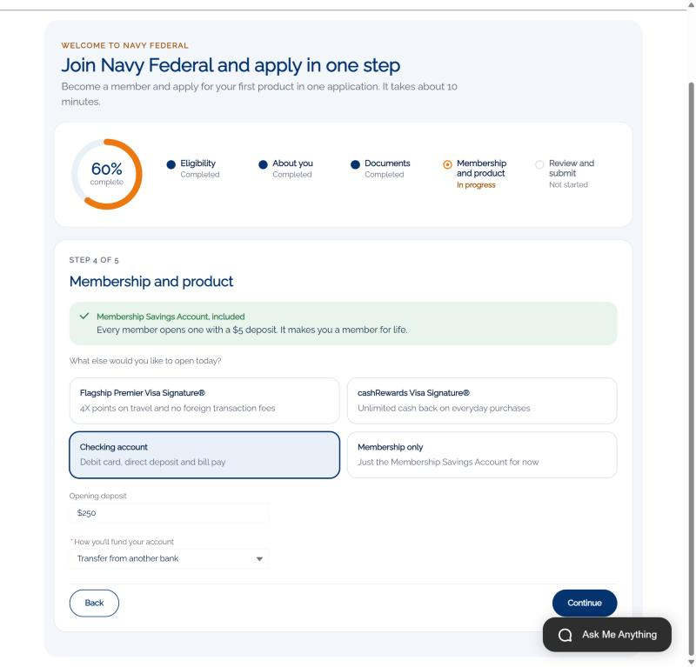
Membership and a product, together
STEP 4 OF 5: MEMBERSHIP AND PRODUCT
1
Membership Savings Account always included
2
Add a card or checking in the same flow
3
Funding method captured for account opening
Notes:
Here's the heart of it. Every member opens a Membership Savings Account with five dollars, and that's included automatically.
In the same flow, Ethan adds the product he actually came for. He picks checking with a $250 opening deposit, transferred from his current bank. If he'd picked a credit card, we'd ask for income and housing right here.
That's the difference between joining and then applying, and joining by applying.

Slide 11
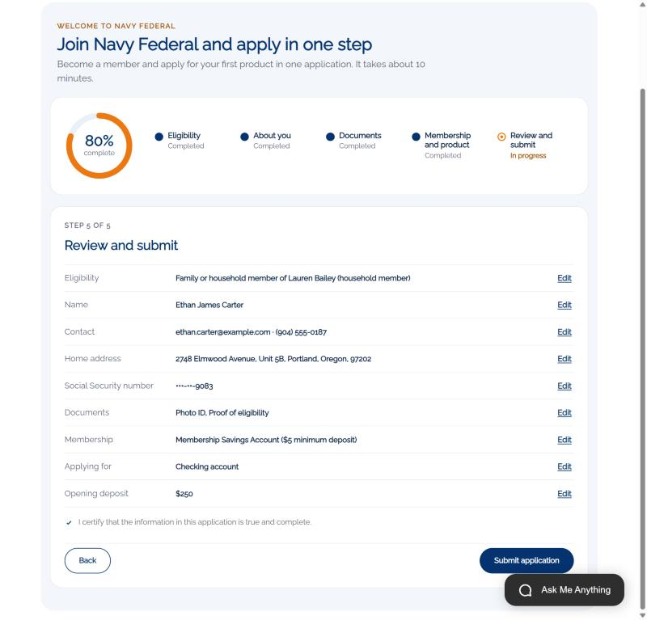
Review, certify, submit
STEP 5 OF 5: REVIEW AND SUBMIT
1
Everything on one screen with Edit links
2
SSN shows only the last four digits
3
Certification before submit
Notes:
Before he submits, Ethan sees everything on one screen, can edit any section, and certifies that it's accurate.

Slide 12
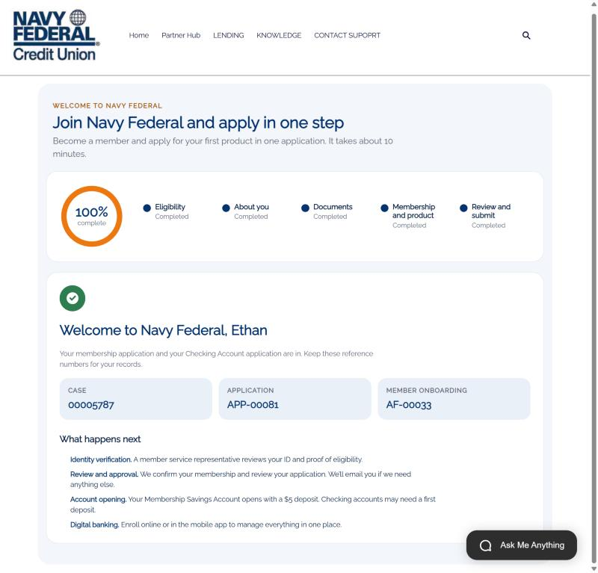
Welcome to Navy Federal
CASE 00005787 · APP-00081 · AF-00033
1
Reference numbers for the member
2
What happens next, in plain language
3
Same records your rep opened earlier
Notes:
And he's in. Welcome to Navy Federal, Ethan. He gets his reference numbers and a plain explanation of what happens next: identity verification, review, account opening, then digital banking.
Those numbers are the same case and application we opened at the start. One submission, and the member, the application, the onboarding record, the documents and the case all exist and are linked.

Slide 13
What this means for Navy Federal
1
One application, not two
2
Prospect to member automatically
3
Work arrives ready
Joining and applying happen together, so fewer prospects drop off between steps.
The Lead converts to a Person Account, so prospect and member data stay one record.
The case carries eligibility, the application and documents, with a guided plan for the rep.
4
Faster identity verification
5
Household growth
6
Secure by design
ID and proof of eligibility are on the case before the rep opens it.
Members’ families and households can join from the same front door.
SSN masked and encrypted; checks run on the server; guest access limited to this form.
Notes:
So what does this mean for Navy Federal? First, one application instead of two, which means fewer people abandon between joining and applying.
Second, prospects become members automatically, so you have one record per person from the first click. Third, work arrives at the contact center ready, with a guided plan, so reps spend their time verifying and opening accounts, not chasing information.
Fourth, identity verification is faster because the evidence is already there. Fifth, every member becomes a path for their household to join. And it's secure by design: sensitive data is masked and encrypted, and everything is checked on the server.
That's a brand-new relationship, prospect to member to product, in one integrated flow.

