Slide 1
NAVY FEDERAL CREDIT UNION
A brand-new member, start to finish
Prospect to funded, primary member in one connected journey
Experience Cloud · Service Cloud · Financial Services Cloud · Agentforce
Notes:
Today I want to show you a member relationship that started from nothing. Ethan Carter has never banked with Navy Federal. By the end of this story he's a member with a funded savings and checking account, an active debit card and his paycheck on its way.
We'll follow him through five moments: how we reach him, how he joins and applies, how a banker opens his accounts, his first 30 days, and how Navy Federal measures the whole funnel.

Slide 2
THE JOURNEY
Five moments in a new deposit relationship
1
2
3
4
5
Targeting
Join and apply
Open accounts
First 30 days
Measure and grow
Reach the households of existing members
Membership and checking in one application
KYC, identity checks, open and fund
Card, direct deposit, digital banking
One funnel from prospect to primary
CONCEPT
EXPERIENCE CLOUD
SERVICE CLOUD
EXPERIENCE CLOUD
REPORTS
Notes:
Here's the whole journey on one page. Everything you'll see runs on one platform and one member record, so each step hands off to the next without re-keying.
The first moment, targeting, is the strategy we'd recommend. The four after it are working in the demo org today.

Slide 3
01
ACT 1 · TARGETING
Reach the people closest to membership
1 Targeting
2 Join and apply
3 Open accounts
4 First 30 days
5 Measure and grow
Notes:
Act one is targeting: who Navy Federal reaches, and where they land.

Slide 4
ACT 1 · TARGETING · RECOMMENDED APPROACH · NOT BUILT IN THE DEMO ORG
Start with the people closest to membership
SEGMENT 1
SEGMENT 2
SEGMENT 3
Household members of members
Members’ children turning 18
Transitioning service members
Fiancés, spouses, parents and roommates of existing members already qualify to join.
Life-event trigger to open their own membership and checking.
Separation date and PCS moves signal a new banking need.
HOW A SEGMENT BECOMES A MEMBER
Data Cloud segment
Personalized email or member referral
Open account page
Join and apply
Notes:
Ethan's story starts before he ever visits the website. The best prospects for Navy Federal are the people already next to a member: spouses, fiancés, adult children and roommates. They're eligible on day one.
With Data Cloud, Navy Federal can build those segments from the household data it already has, then reach them with a personalized email or a member referral that lands on the open account page. To be clear, this targeting piece is our recommended approach, it isn't built in the demo org.
Ethan is exactly that prospect: he's Lauren Bailey's fiancé, and he's been with the same bank since high school.

Slide 5
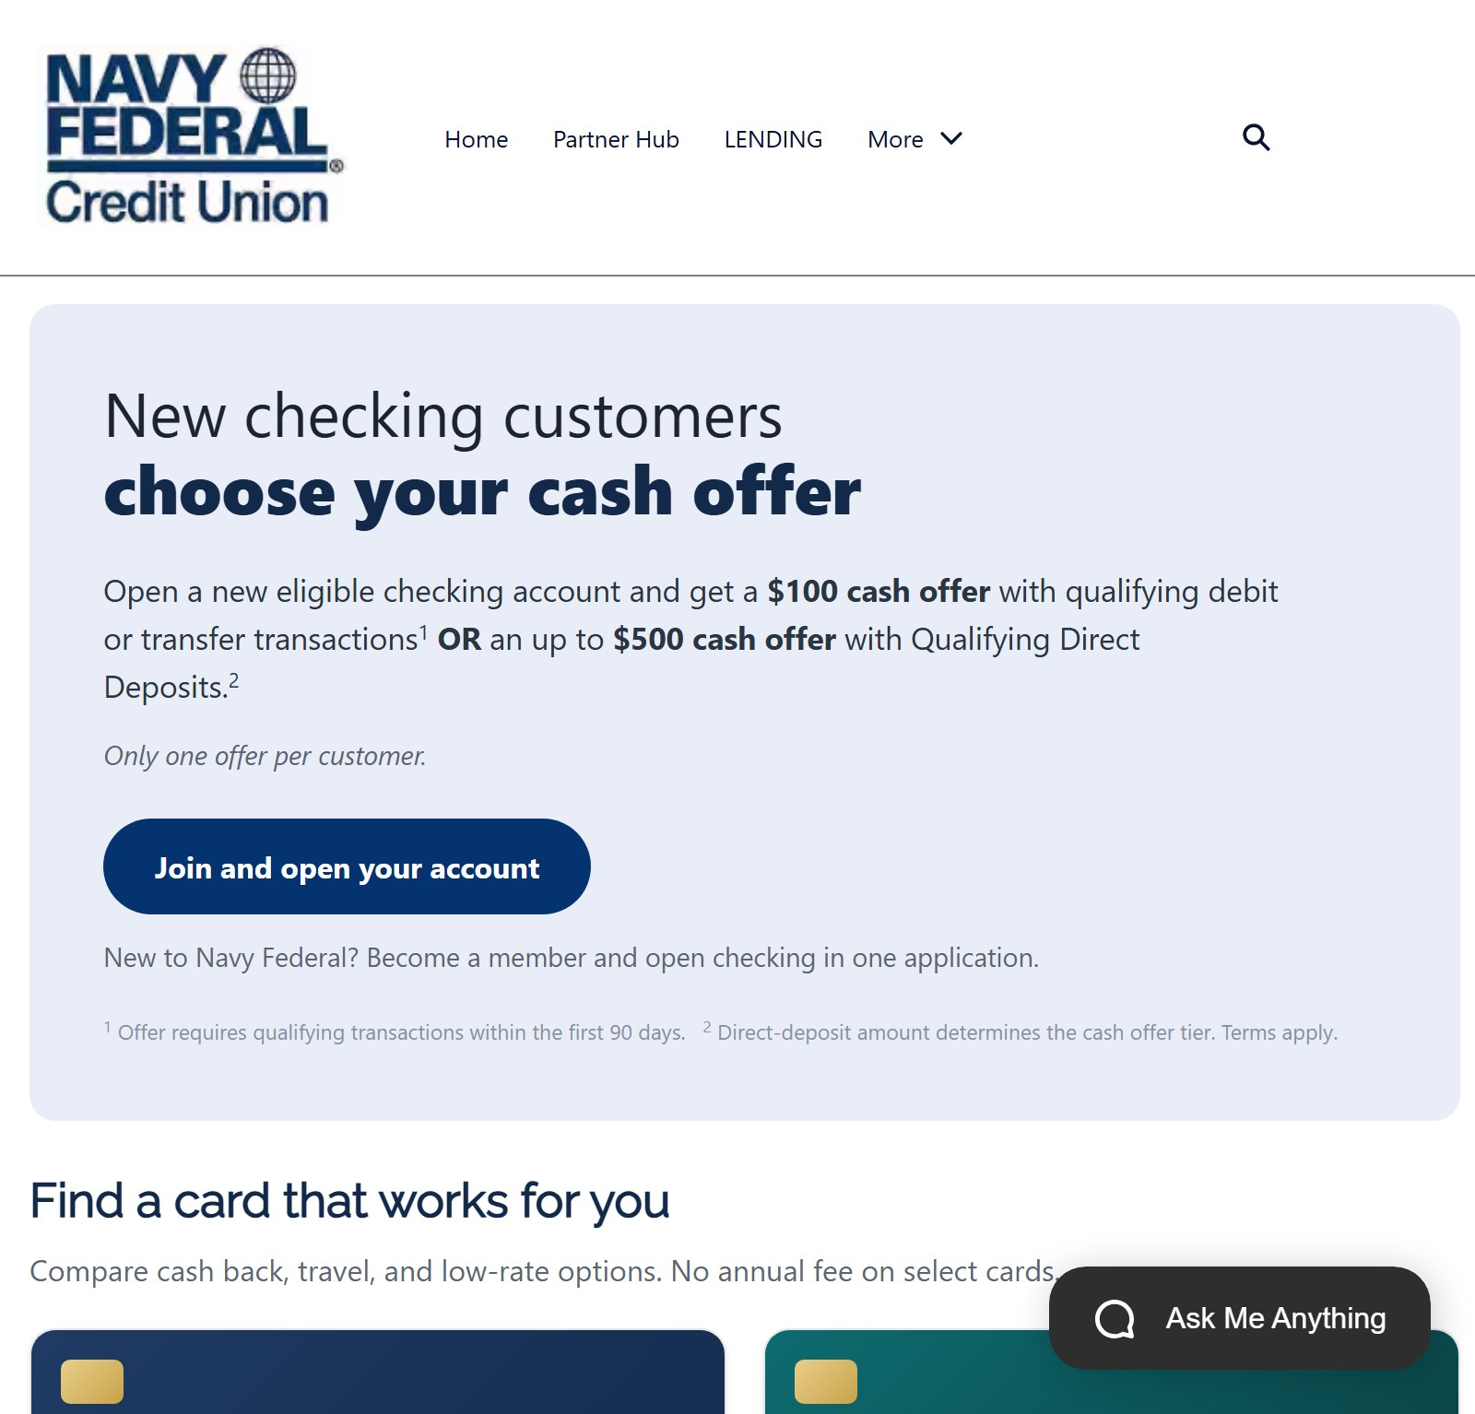
storm-6269dbe2d00053.my.site.com/consumer/s/open-account
ACT 1 · TARGETING
The offer lands on one front door
Open account page · SDO - Consumer site
1
Checking cash offer for new members
2
“Join and open your account” goes straight to the application
3
Every campaign link points to the same page
Notes:
This is where the campaign lands: the new checking offer. One button, join and open your account, and it goes straight to the application we're about to see.
Because every campaign uses the same front door, Navy Federal can see which segment and which message brought each new member in.

Slide 6
02
ACT 2 · EXPERIENCE CLOUD
Join and apply in one application
1 Targeting
2 Join and apply
3 Open accounts
4 First 30 days
5 Measure and grow
Notes:
Act two: Ethan joins Navy Federal and applies for checking in a single application.

Slide 7
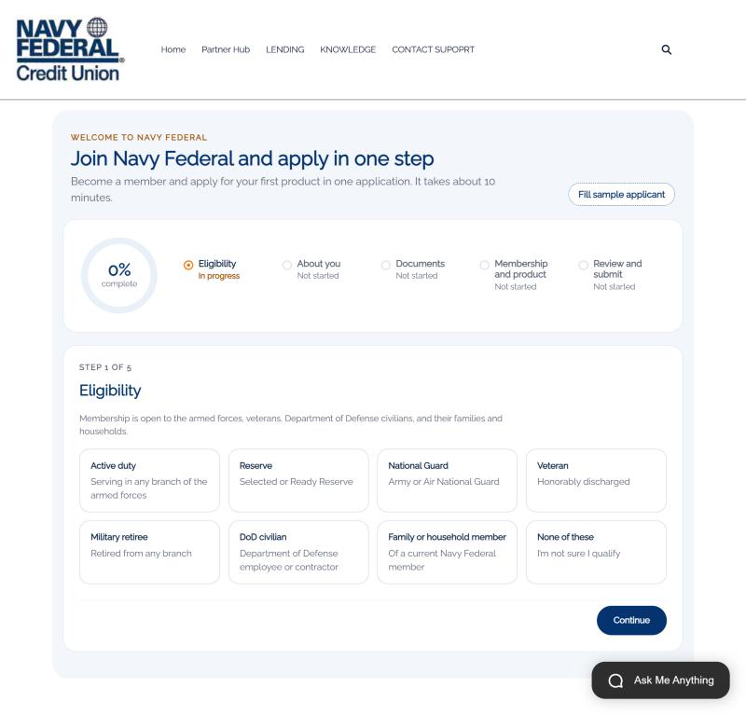
storm-6269dbe2d00053.my.site.com/consumer/s/join
ACT 2 · JOIN AND APPLY
One application to join and apply
Step 1 of 5: Eligibility
1
Five steps with progress the member can see
2
Eligibility comes first, before any personal data
3
“None of these” stops the application politely
Notes:
Ethan lands on one page: join Navy Federal and apply in one step. The progress ring and the five steps tell him exactly how long this will take.
We start with eligibility, because that's the first question a credit union has to answer. He sees every way to qualify, and if he picks none of these, we stop and offer help instead of collecting data we can't use.

Slide 8
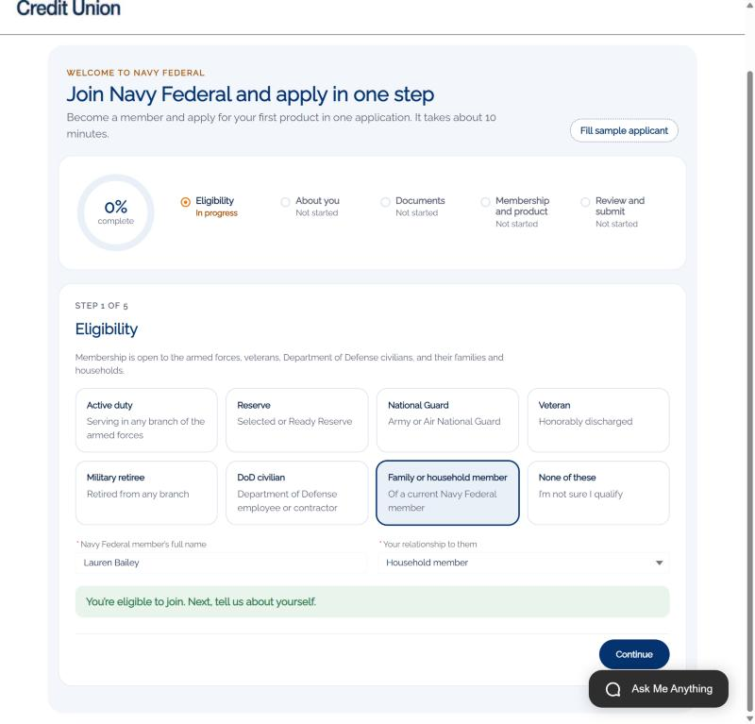
storm-6269dbe2d00053.my.site.com/consumer/s/join
ACT 2 · JOIN AND APPLY
Household eligibility grows membership
Family or household member of Lauren Bailey
1
Ethan qualifies through Lauren Bailey
2
Confirmed on the spot: “You’re eligible to join”
3
Existing members become the path to new ones
Notes:
Ethan isn't military himself. He qualifies as a household member of Lauren Bailey, an existing member and his fiancée. He names her, picks the relationship, and gets an immediate answer: you're eligible to join.
That's the targeting segment paying off. Existing members bring their households with them.

Slide 9
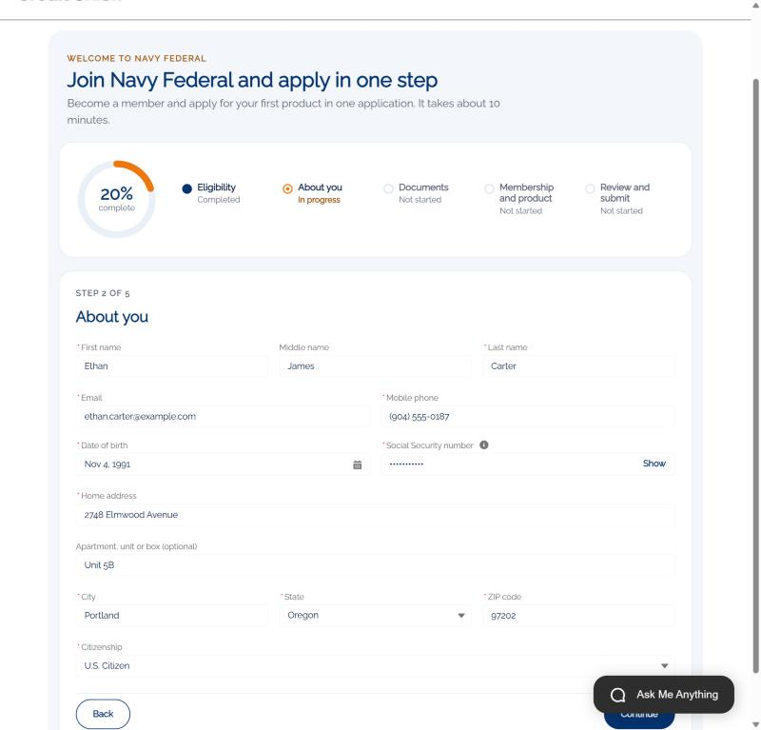
storm-6269dbe2d00053.my.site.com/consumer/s/join
ACT 2 · JOIN AND APPLY
About you, captured once
Step 2 of 5: About you
1
Name, contact, date of birth, address, citizenship
2
SSN masked on screen and stored encrypted
3
Becomes the member record and the application
Notes:
Next, the basics: name, contact details, date of birth, address and citizenship. His Social Security number is masked as he types and stored encrypted.
He enters this once. The same details become his member record and his account application, so nobody asks him again.

Slide 10
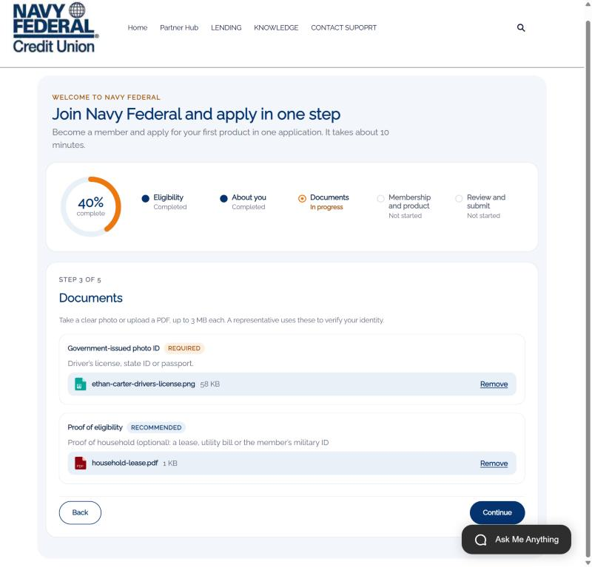
storm-6269dbe2d00053.my.site.com/consumer/s/join
ACT 2 · JOIN AND APPLY
Documents up front, not by email later
Step 3 of 5: Documents
1
Photo ID required, proof of eligibility recommended
2
Attached to the case automatically
3
The banker finds them without searching
Notes:
Then documents. He uploads a photo of his driver's license and proof that he lives in the same household.
Those files go straight onto the case. When the banker opens his accounts, the ID is already there. No email back and forth, no "can you send that again."

Slide 11
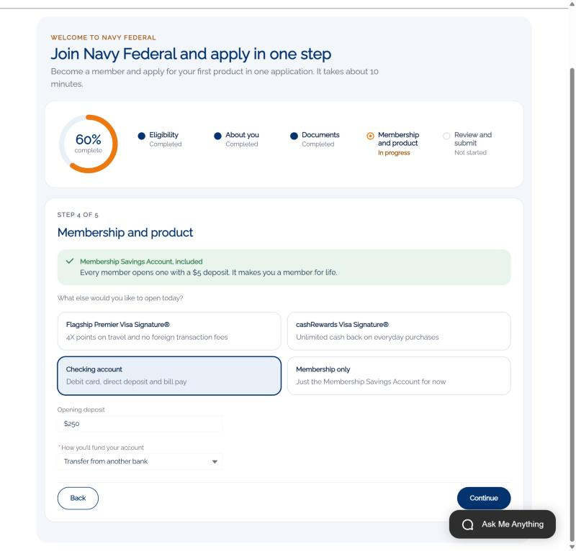
storm-6269dbe2d00053.my.site.com/consumer/s/join
ACT 2 · JOIN AND APPLY
Membership and checking, together
Step 4 of 5: Membership and product
1
Membership Savings Account always included
2
Checking with a $250 opening deposit
3
Funding method captured for account opening
Notes:
Here's the heart of it. Every member opens a Membership Savings Account with five dollars, and that's included automatically.
In the same flow, Ethan adds the product he came for: checking, with a $250 opening deposit transferred from his current bank, and a debit card.
That's the difference between joining and then applying, and joining by applying.

Slide 12
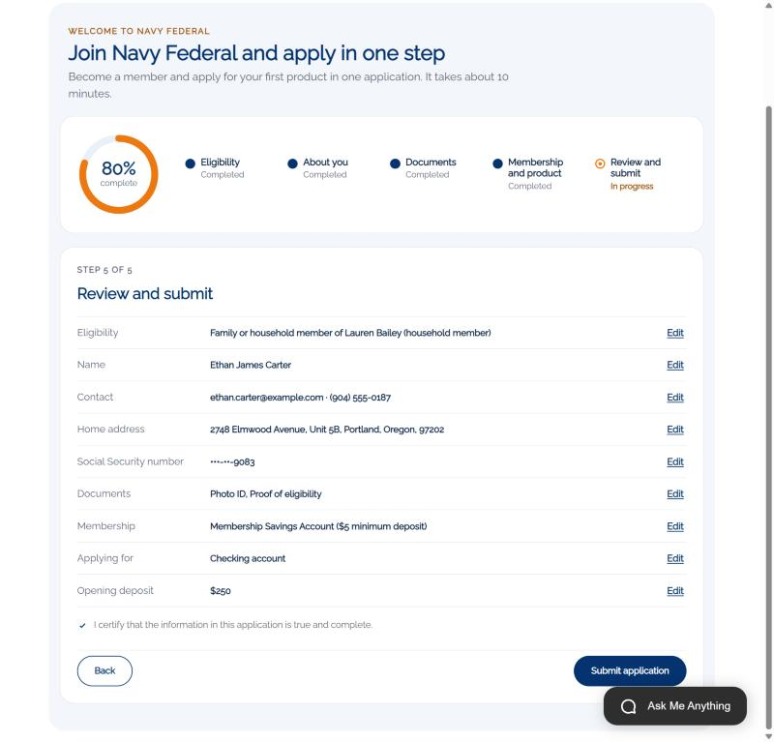
storm-6269dbe2d00053.my.site.com/consumer/s/join
ACT 2 · JOIN AND APPLY
Review, certify, submit
Step 5 of 5: Review and submit
1
Everything on one screen with Edit links
2
SSN shows only the last four digits
3
Certification before submit
Notes:
Before he submits, Ethan sees everything on one screen, can edit any section, and certifies that it's accurate.

Slide 13
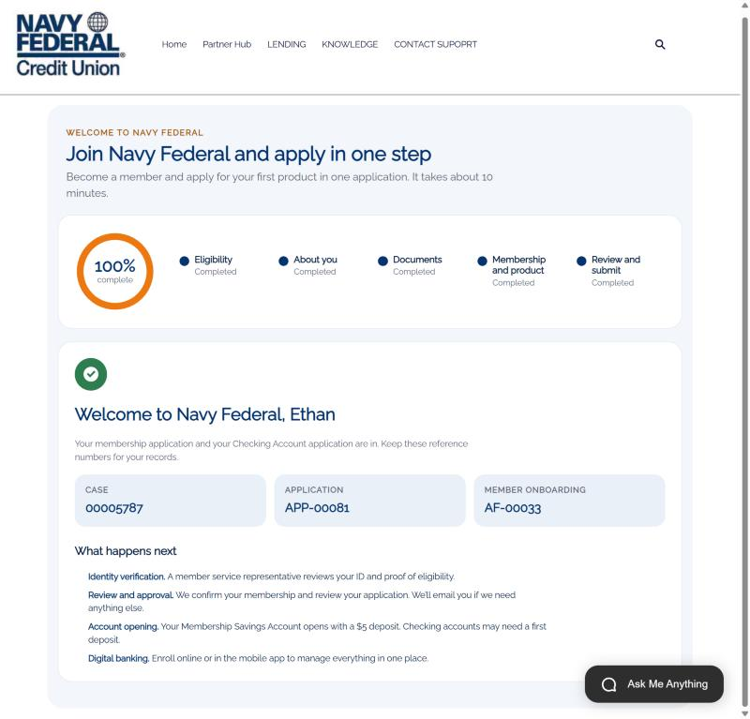
storm-6269dbe2d00053.my.site.com/consumer/s/join
ACT 2 · JOIN AND APPLY
Welcome to Navy Federal
Case 00005787 · APP-00081 · AF-00033
1
Reference numbers for the member
2
What happens next, in plain language
3
A private link to his first 30 days checklist
Notes:
And he's in. He gets his reference numbers, a plain explanation of what happens next, and a private link to his first 30 days checklist. The same link arrives in his welcome email; in the demo every welcome email goes to the shared demo inbox, so you can open it live.

Slide 14
ACT 2 · JOIN AND APPLY · LEAD CONVERTED ON 10/6/2026
Prospect to member, automatically
PROSPECT
SAME CLICK
MEMBER
Lead
Converted
Person Account
Source: Website
In the submit transaction
Account + Contact, owned by a rep
CREATED IN THE SAME SUBMISSION
Case
Deposit application
Onboarding record
Documents
For the banker
Savings + checking
With private link
ID + proof on the case
Notes:
Behind that one click, Salesforce captured Ethan as a Lead from the website and immediately converted him into a Person Account. Navy Federal's prospect data and member data are the same data.
In the same transaction the system created his deposit application for savings and checking, his onboarding record, the case for the contact center, and attached his documents.

Slide 15
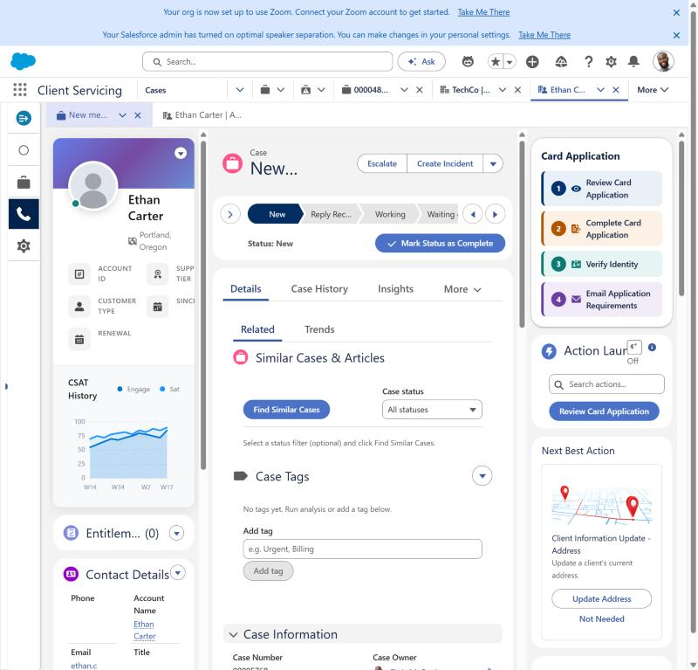
Service Console · Case
ACT 2 · JOIN AND APPLY
The work arrives ready for a banker
New member application case in the service console
1
Routed by your case assignment rules
2
Guided actions on the right, Open Deposit Accounts first
3
Service Rep Assistant follows the Member Onboarding topic
Notes:
Here's the case your banker receives. It's routed like any other case, and it arrives complete: who Ethan is, how he's eligible, what he applied for, and his documents.
The Service Rep Assistant is set up with a Navy Federal Member Onboarding topic, so its plan follows the same steps: confirm eligibility, gather what's needed, verify identity, then open the accounts.

Slide 16
03
ACT 3 · SERVICE CLOUD
The banker opens the accounts
1 Targeting
2 Join and apply
3 Open accounts
4 First 30 days
5 Measure and grow
Notes:
Act three moves to the banker, who verifies Ethan and opens his accounts in one conversation.

Slide 17
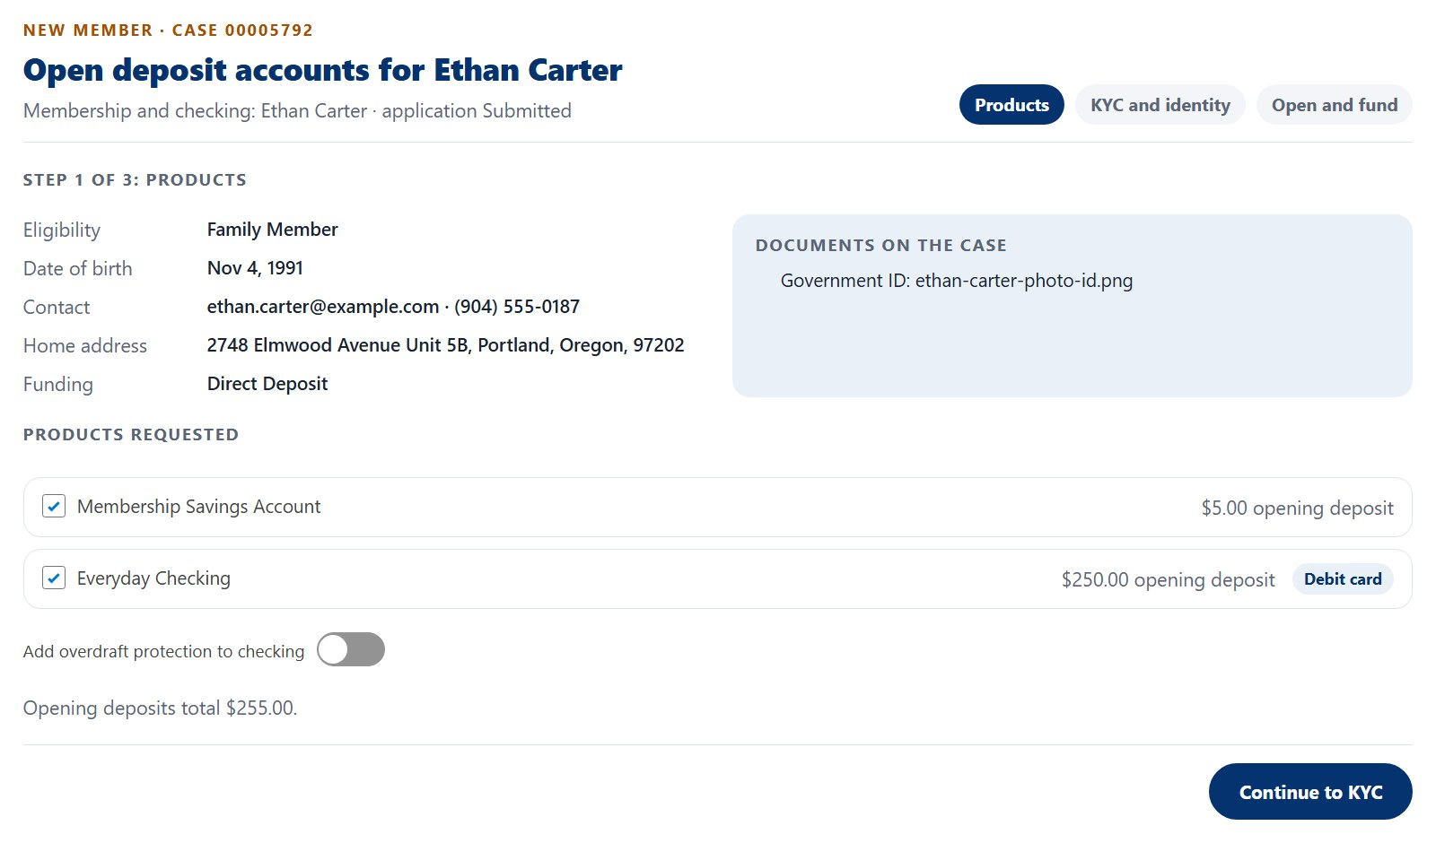
Service Console · Open Deposit Accounts
ACT 3 · OPEN ACCOUNTS
The banker confirms the products
Open Deposit Accounts · Step 1 of 3: Products
1
Member, eligibility and documents in one view
2
Savings and checking from his application
3
Overdraft protection offered here
Notes:
Over a video appointment, the banker opens the Open Deposit Accounts action. Step one shows what Ethan applied for: the Membership Savings Account and Everyday Checking with a debit card, his eligibility, and the ID he uploaded.
The banker can drop a product or add overdraft protection with Ethan right there.

Slide 18
ACT 3 · OPEN ACCOUNTS · STEP 2 OF 3
KYC and identity in one step
ONE CLICK RUNS
THE BANKER ASKS
Identity verification
Pass
Occupation and employer
Document authentication
Pass
Source of funds
Sanctions screening (OFAC)
Clear
Expected monthly deposits
Deposit account history
Low risk
Purpose of the account
Address verification
Verified
ID read from the document on file
Checks are simulated in the demo. In production they call Navy Federal’s identity, sanctions and deposit-history vendors through MuleSoft.
Notes:
Step two is KYC. The banker asks the customer identification questions: occupation and employer, source of funds, expected deposits and the purpose of the account. The ID details are read from the document Ethan already uploaded.
Then one click runs five checks: identity, document authentication, OFAC sanctions screening, deposit account history and address verification. In the demo these are simulated. In production they'd be the vendors Navy Federal already uses, called through MuleSoft, with results stored on the member's profile.

Slide 19
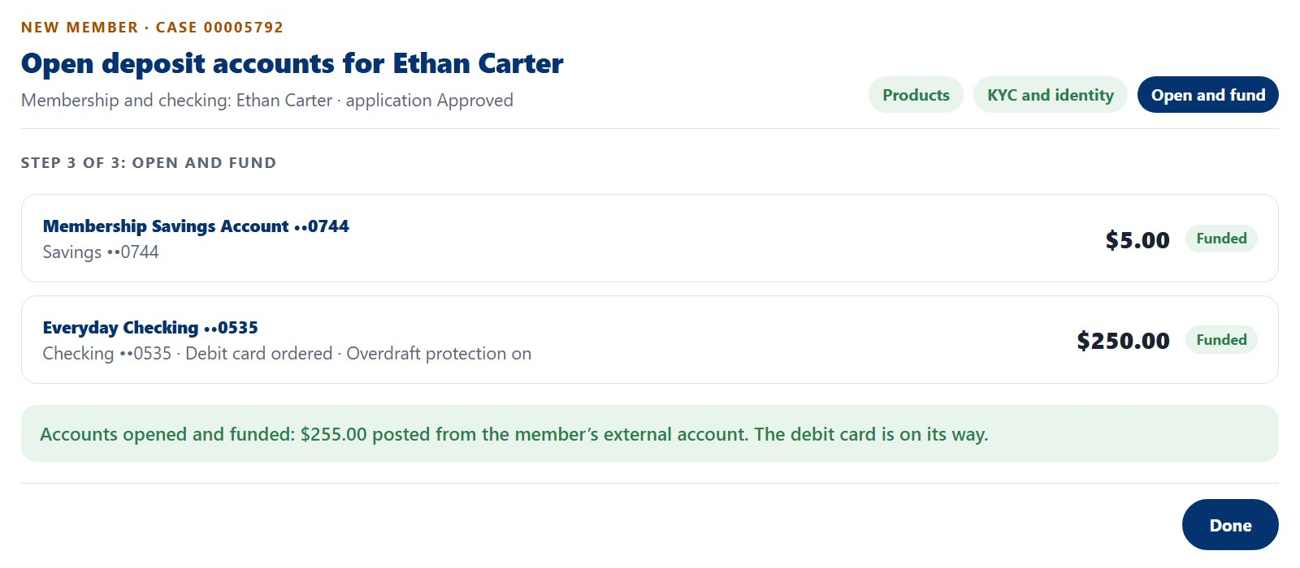
ACT 3 · OPEN ACCOUNTS · OPEN DEPOSIT ACCOUNTS · STEP 3 OF 3: OPEN AND FUND
Opened and funded in the same conversation
Service Console · Open Deposit Accounts
1
Financial accounts created with Ethan as owner
2
$255 posted from his external account
3
Debit card ordered automatically
Notes:
Step three opens the accounts. Salesforce creates his savings and checking as financial accounts with Ethan as the owner, marks the application approved, and records the KYC result.
Then the opening deposits post: $255 from his external account. The debit card is ordered in the same step. Ethan leaves the call as a funded member.

Slide 20
04
ACT 4 · EXPERIENCE CLOUD
The first 30 days
1 Targeting
2 Join and apply
3 Open accounts
4 First 30 days
5 Measure and grow
Notes:
Act four is what happens after the accounts open, the part that turns a new account into a primary relationship.

Slide 21
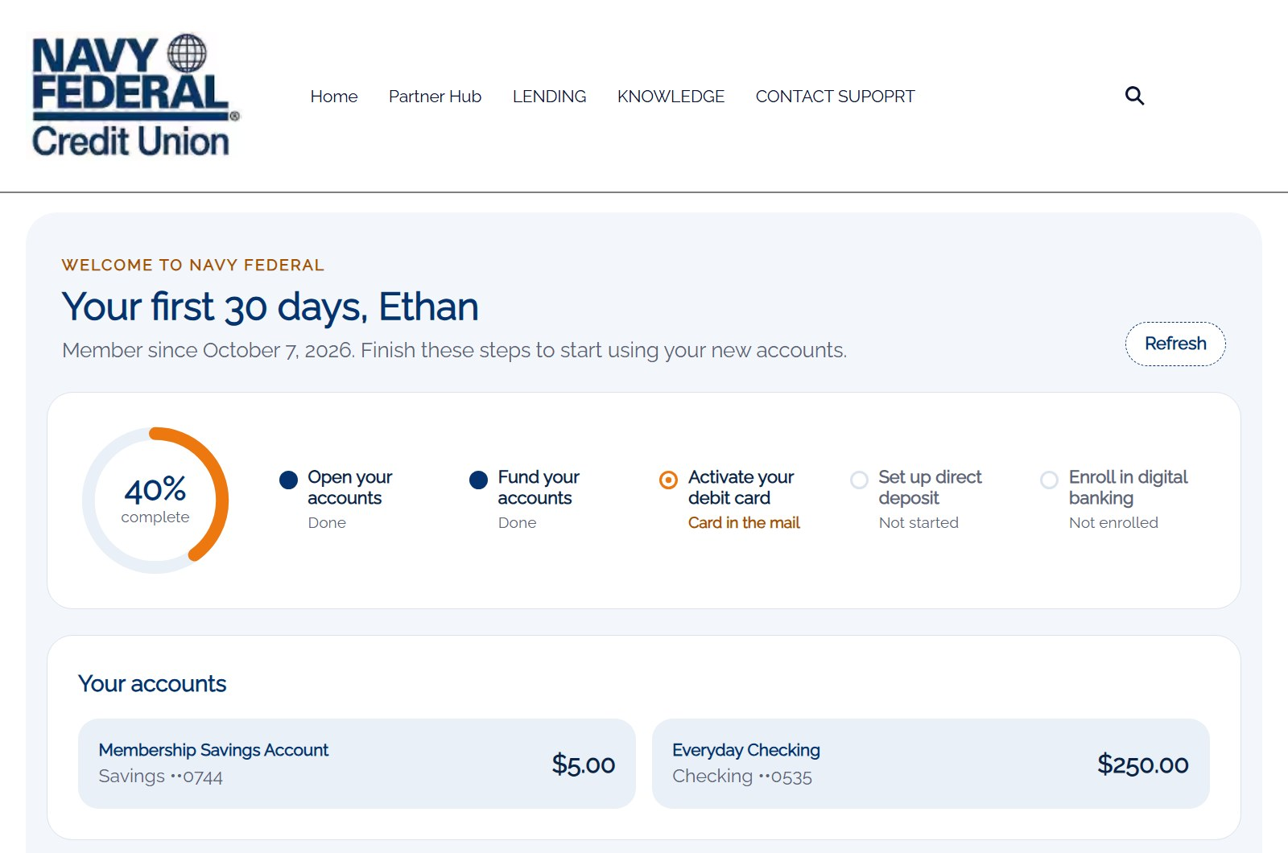
storm-6269dbe2d00053.my.site.com/consumer/s/welcome?t=••••••
ACT 4 · FIRST 30 DAYS
His first 30 days, in one place
Your first 30 days · private link from the welcome email
1
Progress ring across five steps
2
Live balances from the accounts the banker opened
3
No portal login needed
Notes:
Now the part most banks leave to a stack of mail: the first 30 days. Ethan opens the private link from his welcome email. No login to set up yet.
He sees his progress, his two accounts and live balances, and the three things left to do: activate his card, move his paycheck, and set up digital banking.

Slide 22
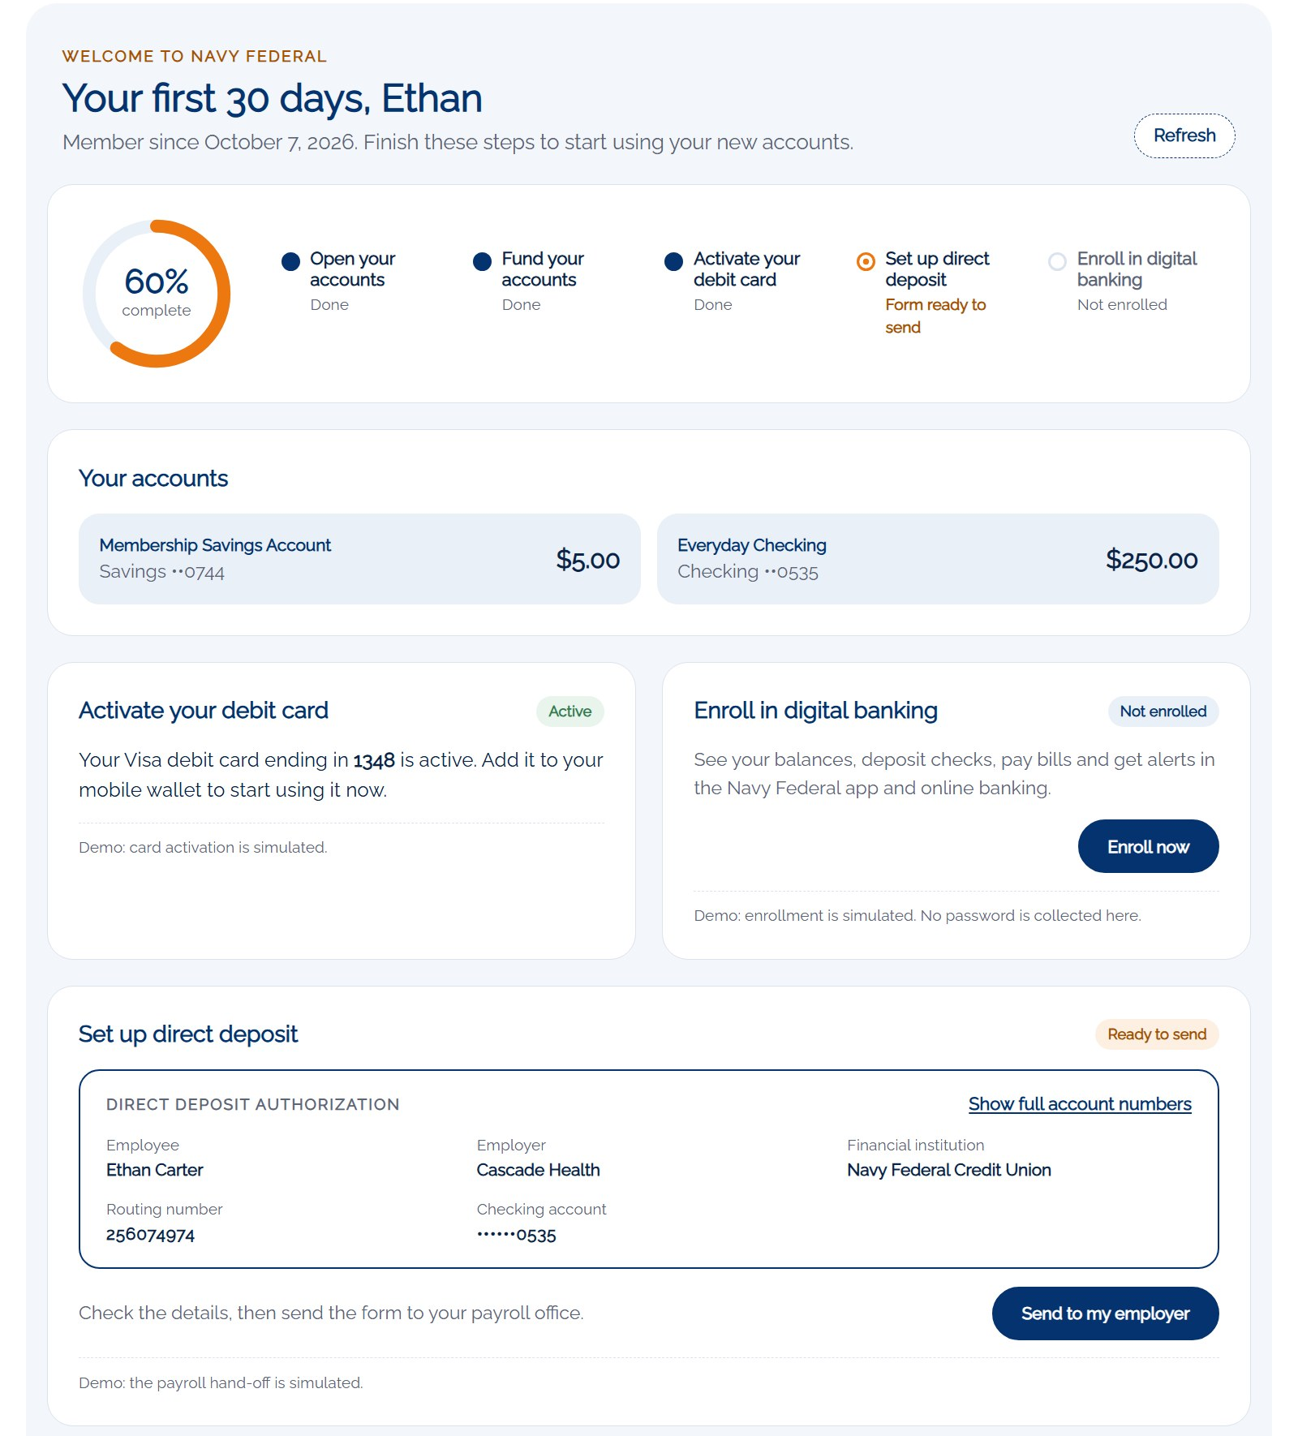
storm-6269dbe2d00053.my.site.com/consumer/s/welcome?t=••••••
ACT 4 · FIRST 30 DAYS
Card active, paycheck on its way
Debit card activation and direct deposit
1
Activates with the card’s last 4 digits and date of birth
2
Direct deposit form filled in for his employer
3
Routing and account numbers, nothing to look up
Notes:
When the card arrives, he activates it with the last four digits and his date of birth.
Then the step that keeps people at their old bank: switching direct deposit. We fill in the form for him with his employer, Navy Federal's routing number and his checking account, and he sends it to payroll. If he has questions, the Ask Me Anything agent answers from the "How do I switch my direct deposit" knowledge article.
Card activation and the payroll hand-off are simulated in the demo.

Slide 23
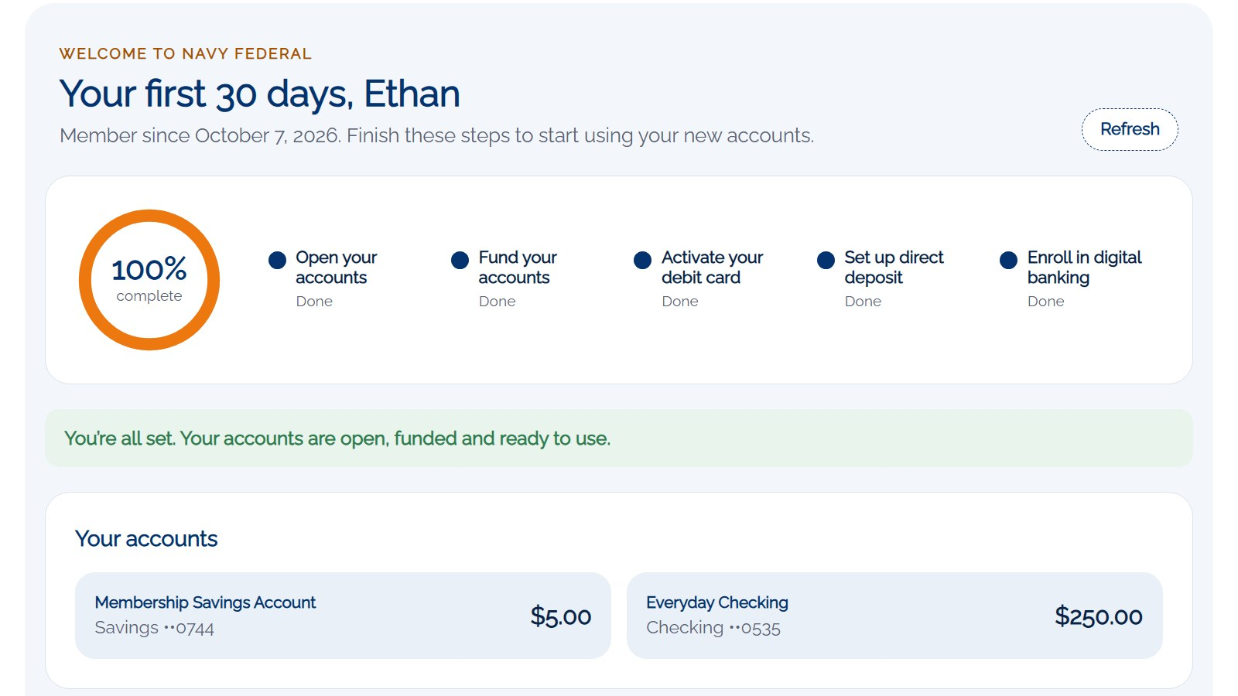
storm-6269dbe2d00053.my.site.com/consumer/s/welcome?t=••••••
ACT 4 · FIRST 30 DAYS
Fully onboarded
Your first 30 days · 100% complete
1
Every step logged on the case for the banker
2
Digital banking enrollment without collecting a password
3
A primary relationship, not just an account
Notes:
And he's done. Every step Ethan finished was logged on his case, so the banker and the Service Rep Assistant know exactly where he is without calling him.
This is the moment that matters: Ethan isn't just a new account, his paycheck lands here. That's a primary relationship.

Slide 24
05
ACT 5 · MEASURE AND GROW
One funnel from prospect to primary
1 Targeting
2 Join and apply
3 Open accounts
4 First 30 days
5 Measure and grow
Notes:
Act five is how Navy Federal measures the whole journey and what it means for the business.

Slide 25
ACT 5 · MEASURE AND GROW · EVERY STAGE IS A FIELD ON RECORDS THE DEMO ALREADY CREATES
One funnel from prospect to primary
Prospect
Lead · Source: Website
Member
Lead converted to Person Account
Applied
Application Form · Submitted
Verified
Party Profile · KYC Verified
Opened and funded
Financial Account · opening transaction
Card active
Debit Card Status · Active
Primary
Direct Deposit Status · Sent to employer
Notes:
Because everything lives on one platform, Navy Federal can measure the whole journey as one funnel. Every stage you just saw is a field on a record the demo creates: the lead, the conversion, the application, the KYC result, the financial account, the card status and the direct deposit status.
So you can see where new members stall. If people open accounts but never switch their paycheck, you know where to put the next nudge, whether that's an email, a banker call or an agent message.

Slide 26
ACT 5 · MEASURE AND GROW
What this means for Navy Federal
01
02
03
Grow through households
One application, not two
KYC in the conversation
Members’ families and households join from the same front door.
Joining and applying happen together, so fewer prospects drop off.
Questions, identity checks and sanctions screening in one banker step.
04
05
06
Funded on day one
Primary, not just open
One record, one funnel
Accounts open and opening deposits post before the call ends.
Card activation and direct deposit happen in the first 30 days.
Prospect, member and accounts stay connected and measurable.
Notes:
So what does this mean for Navy Federal? You grow through the households you already serve. You replace two applications with one. KYC happens inside the conversation instead of in a back-office queue.
Accounts are funded on day one, and the first 30 days turn a new account into a primary relationship. And because it's one record from prospect to member, you can measure every step.
That's a brand-new relationship, prospect to member to primary, in one integrated flow.

Slide 27
APPENDIX · SDO - CONSUMER SITE · HTTPS://STORM-6269DBE2D00053.MY.SITE.COM/CONSUMER
Appendix A · Experience Cloud pages and LWCs
Experience Cloud page | URL | What it uses
Open account | /consumer/s/open-account | HTML hero: Join and open your account → /join
Join Navy Federal | /consumer/s/join | c:nfcuJoinAndApply
Your First 30 Days | /consumer/s/welcome?t=<token> | c:nfcuFirstThirtyDays
Personal Banking | /consumer/s/personal-banking | Open account link → /join
Bank Canvas | /consumer/s/bank-canvas | Open account link → /join
Lightning web component | Where it runs | What it does
nfcuJoinAndApply | Experience page /join | Five-step join and apply form
nfcuFirstThirtyDays | Experience page /welcome | First 30 days checklist
nfcuOpenDepositAccounts | Flow NFCU_Open_Deposit_Accounts · Case quick action | Products, KYC and identity, open and fund
cardActionBar · cardActionFlowModal | Case record page (service console) | Guided card application action bar
cardApplicationWizard | Flow screen · Case quick action | Card Application Wizard
ccApplicationReview · ccApplicationWizard | Flow screens · Case quick actions | Review and complete the card application
ccIdentityDocuments | Flow MSR_Identity_Verification | Verify Identity: ID and proof of eligibility
ccRequirementsEmail | Flow screens · Case quick action | Email application requirements
Notes:
For the technical team: every Experience Cloud page in the journey with its URL, and every Lightning web component and where it runs.

Slide 28
APPENDIX · STANDARD: CORE SALESFORCE AND FINANCIAL SERVICES CLOUD · CUSTOM: DEMO-SPECIFIC
Appendix B · Salesforce objects
Standard object | Role in the journey
Lead | Prospect from the website, converted on submit
Account (Person Account) · Contact | The member record
Case · CaseComment | Banker work item; onboarding steps logged as comments
ContentVersion · ContentDocumentLink | Photo ID and proof of eligibility on the case
Product2 | Membership Savings Account, Everyday Checking
ApplicationForm · ApplicationFormProduct | Deposit application and requested products
PartyProfile · IdentityDocument | KYC result and the ID used
FinancialAccount · FinancialAccountParty | Opened accounts and their owner
FinancialAccountTransaction · FinancialAccountBalance | Opening deposits and balances
AppFormProdtFinclAccount | Links each application line to its account
Knowledge__kav (Knowledge) | Direct deposit and eligibility FAQs for the agents
Custom object / field | Role in the journey
ApplicantForm__c | Member onboarding record: KYC, onboarding token, debit card, direct deposit and digital banking status
Application__c | Product application (bank card or consumer onboarding)
Case.Application__c | Lookup from the case to the application
Notes:
And the data model: standard Financial Services Cloud objects carry the deposit relationship, and two demo objects carry the onboarding record and the product application.

Slide 29
APPENDIX · EVERYTHING ELSE THE JOURNEY USES
Appendix C · Automation, agents and access
APEX
FLOWS AND ACTIONS
NfcuJoinApplyController · join and apply
NfcuDepositOpeningController · KYC, open and fund
NfcuOnboardingController · first 30 days
NfcuWelcomeEmail · welcome email
NfcuActivateDebitCard · agent action (not attached)
CardApplicationFileService · ID and eligibility files
NFCU_Open_Deposit_Accounts flow
Case.Open_Deposit_Accounts quick action
Card_Application_Actions (Action Launcher)
MSR_Identity_Verification and CC_QA_* flows
AGENTFORCE AND KNOWLEDGE
ACCESS AND EMAIL
Service Rep Assistant topic NFCU_Member_Onboarding
NFCU Member Portal Agent (Ask Me Anything)
KB: How Do I Switch My Direct Deposit to Navy Federal?
KB: Who Is Eligible to Join Navy Federal?
NFCU_Join_Apply_Guest (site guest user)
SDO_Community_Consumer_Community_Access (members)
NFCU_Onboarding_Fields (bankers)
Welcome email always to c.service.sfdemo25@gmail.com
Notes:
Finally, the Apex, flows, agent topics, knowledge articles and permission sets behind it, plus the demo rule that welcome emails always go to the shared demo inbox.

