Slide 1
Facial Reconstruction
Using an AI to reconstruct a subject's face from local features

Slide 2

Facial Recognition?
Babies can identify human faces to people from a very early age (1-3 days old).
Neuroscientists in the 1940’s developed very good theories about how faces are recognized.
We’ve since used the human-face recognizer neural model that the scientists discovered and developed some other more non-natural methods as well.

Slide 3
How do we do this?
Using various algorithms, we can train a model to learn information about face data.
The basic algorithms we've decided to use are Eigenfaces, Fisherfaces, and Linear Binary Histogram Patterns.
With enough data and the correct algorithm, we've had relatively excellent success using the Eigenfaces method for multiple sources of data. It's been the most successful in our project.

Slide 4
Before we Continue
First, I want to establish the points of data we use.
The first data set we use is the AT&T facedatabase. This is also sometimes called the ORL Database of Faces. It is a favorite because the faces are all the same size and facing in the same exact direction.
The second data set we use is the Sheffield University face database. It has been harder to get as good success with this due to the varying angles of the faces but it still works pretty decently.

Slide 5
Eigenfaces Method
Holistic Approach to Facial Recognition
Uses Principal Component Analysis.
Obviously focuses on lower dimensionality, since higher dimensionality is bad and harder to work with in Facial Recongition.
The Most Successful.

Slide 6
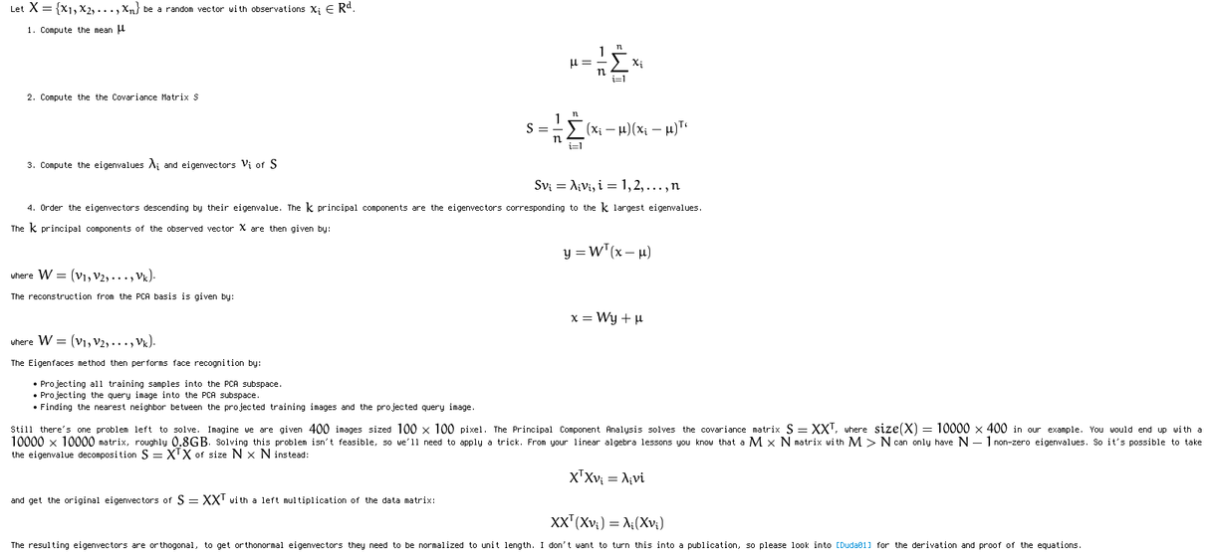
Algorithmic Description

Slide 7

Fisherfaces
The Principal Component Analysis (PCA), which is the core of the Eigenfaces method, finds a linear combination of features that maximizes the total variance in data.
While this is clearly a powerful way to represent data, it doesn’t consider any classes and so a lot of discriminative information may be lost when throwing components away. Imagine a situation where the variance in your data is generated by an external source, let it be the light.
The components identified by a PCA do not necessarily contain any discriminative information at all, so the projected samples are smeared together and a classification becomes very difficult.
To alleviate this, Fisherfaces actually focuses on wider classification groups.
Fisherfaces maximizes the ratio of between-classes to within-classes scatter, instead of maximizing the overall scatter. This makes classification easier in some instances, particularly when there is more variation in illumination.
To do this, we focus more heavily on Linear Discriminant Analysis, invented by the Statistician, Sir. Ronald A. Fisher. This is why the algorithm is named after him.
Fisherfaces is very similar to Eigenfaces. It still measures eigenvalues of image vectors.

Slide 8
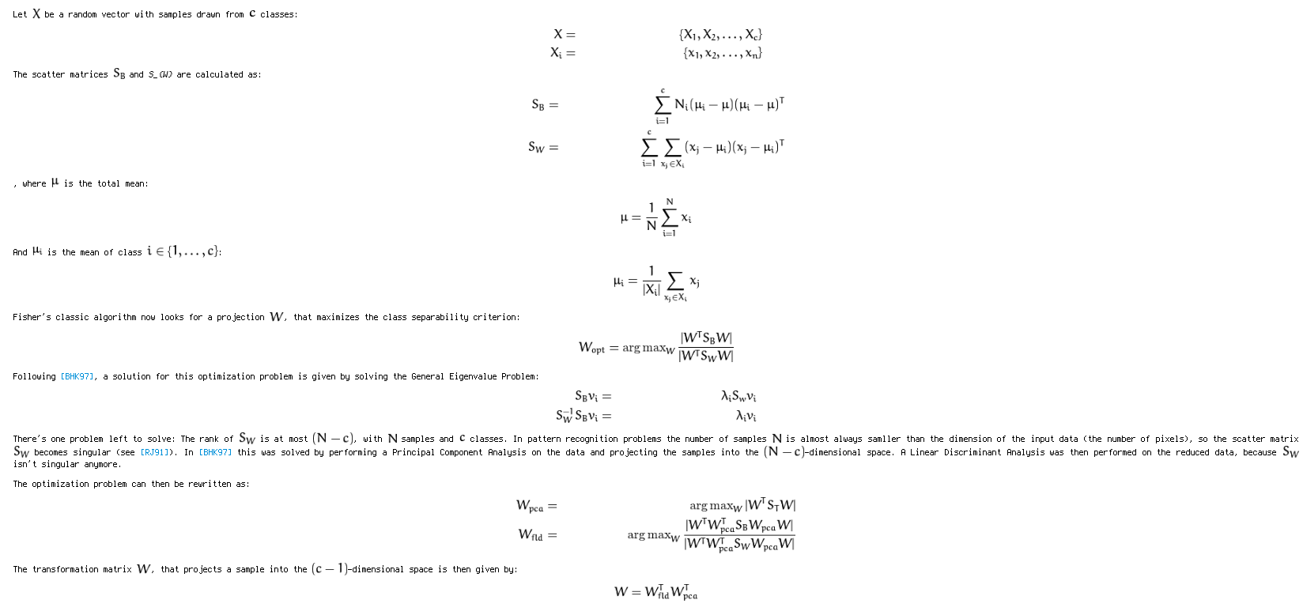
Algorithmic Description

Slide 9
Local Binary Patterns Histograms
Very different approach than previous two methods
Some research concentrated on extracting local features from images. The idea is to not look at the whole image as a high-dimensional vector, but describe only local features of an object. The features you extract this way will have a low-dimensionality implicitly.
But you’ll soon observe the image representation we are given doesn’t only suffer from illumination variations. Think of things like scale, translation or rotation in images - your local description has to be at least a bit robust against those things.
The basic idea of Local Binary Patterns is to summarize the local structure in an image by comparing each pixel with its neighborhood. Take a pixel as center and threshold its neighbors against. If the intensity of the center pixel is greater-equal its neighbor, then denote it with 1 and 0 if not. You’ll end up with a binary number for each pixel, just like 11001111. So with 8 surrounding pixels you’ll end up with 2^8 possible combinations, called Local Binary Patterns or sometimes referred to as LBP codes.

Slide 10
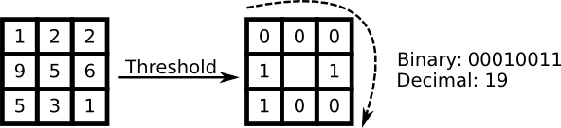
LBPH Continued:
The first LBP operator described in literature actually used a fixed 3 x 3 neighborhood just like this:

Slide 11
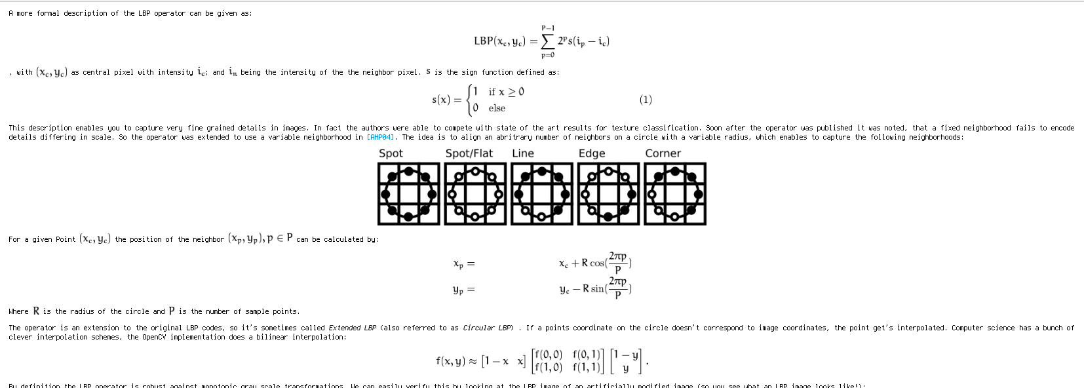
Formal Description of LBPH

Slide 12
OK, but math is hard!
So, even though we've researched and developed the math behind it in our heads and understand it (almost perfectly), implementing something like this in C++ would be a real pain.
So, we've actually found a pretty awesome class in OpenCV called FaceRecognizer, which can implement some of these algorithms and we wrote our code using this class quite extensively. It also allows custom values for feature thresholding as described.
Our code only works for OpenCV 3.1, as earlier versions are incompatible with the new function calls and such.
This code also can't run if you don't have OpenCV compiled with contrib libs. So, you're gonna need to build OpenCV from source for your platform.
We have tested and developed the code extensively in OSX and GNU/Linux but it should work in Windows just fine assuming you're using the Cygwin environment.

Slide 13



Dependencies
A UNIX-like system (Cygwin works)
GCC or Clang
Cmake and GNU Make
OPTIONAL: Python (optional for csv generation but if you have it you can import your own facial databases!)
OpenCV 3.1 explicitly built with contrib and libpng

Slide 14
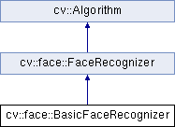
FaceRecongizer

Slide 15
Quick Demo!
Now we will show you our software.

Slide 16
Questions?
I am happy to answer any questions pertaining to the software or algorithms we use.
Yes, I do plan to release our code on Github publicly after the final project is due (May 25).
Yes, I can show you how to build it and run it with your own images or sets of images.
Yes, we use a platform independent way to store the subject lists! (csv ← plain text format). NO SQL KNOWLEDGE REQUIRED!

