Slide 1
Data Structures and Algorithms Tutorial 3
Ting Cao

Slide 2
Topics:
Lab 1 & 2 Solutions
clone
Assignment 1

Slide 3
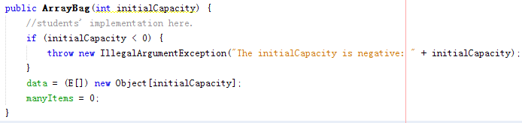
Lab 1 Solution
Task 1: Constructor for ArrayBag:

Slide 4
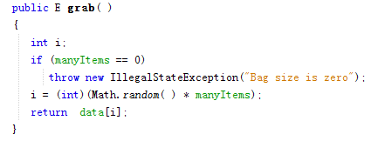
Task 2: grab()

Slide 5
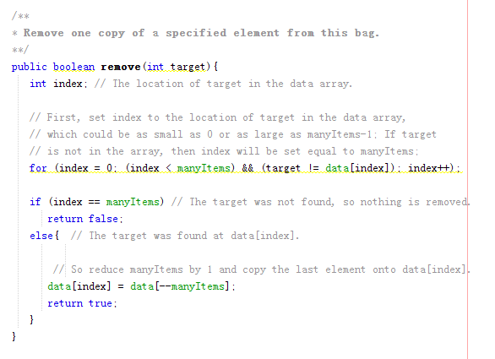
remove() in IntArrayBag:

Slide 6
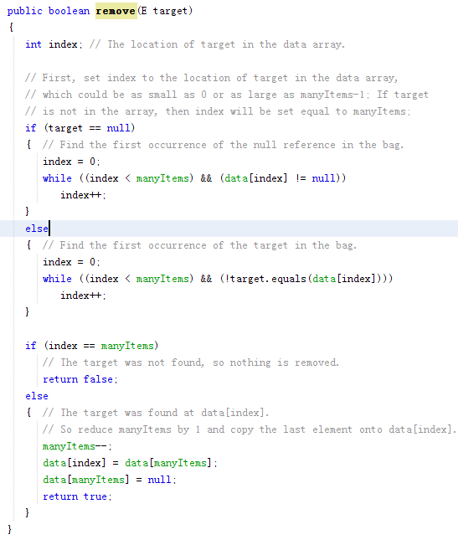
Task 3: remove() in ArrayBag:

Slide 7
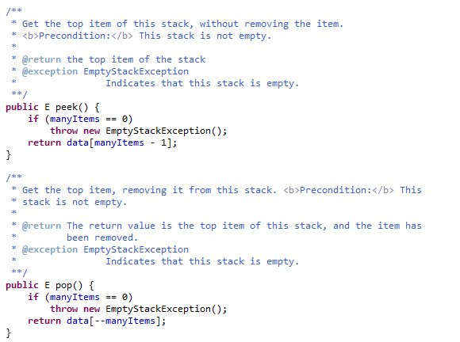
Lab 2 Solution : peek() and pop()

Slide 8
Clone object in java
Shallow cloning
Deep cloning
…

Slide 9
Shallow clone/shallow copy
Implement java.lang.Cloneable interface.
Override clone() method.
Code example
Notes:
Copies the object and primitive values.
Java.lang.Cloneable = Marker Interface
Can’t call clone() without implementing it.
Obj1.getData() == Obj2.getData() returns true b/c primitive data is copied.

Slide 10
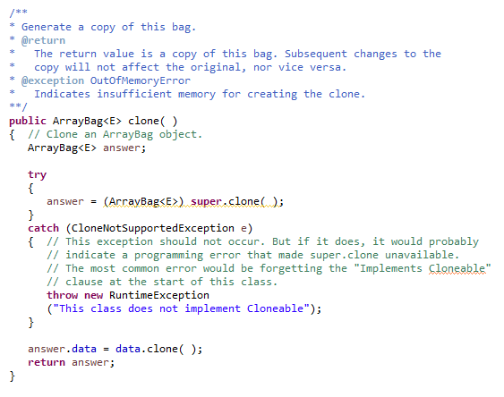
Deep clone/Deep copy

Slide 11
Assignment 1
To Do
Using the techniques learnt from our Data Structures & Algorithms module, develop in Java a subclass of List with type parameter that includes the methods described below. Specifically, develop an algorithm for each method. Finally, write in Java a program that implements the following methods and a main program that accepts user input to test these methods.
Notes:
List Interface
Subclass of List means implement List interface (not recommended), would have to implement all List interface methods.
2nd way extend from ArrayList, LinkedList, AbstractList, … (recommended), then just have to write 3 methods.
Elements inside your list have to be Comparable ( <T/E whatev. extends Comparable).
Can’t put Integer and Boolean inside the same list!

Slide 12
Due date
Due date: 12pm-3pm 04/19,
at Lab SD546, SD554
Submit e-version : Including your .java files and your .pdf report file, to ICE before 12pm(at noon) of 04/19
Bring a hard-copy : Including your .java files and your .pdf report file, and submit to your lab demonstrator(TA)

Slide 13
What to submit
.java file: 1-3 will be enough.
Your list class
Your testing class with main method
Your user inputting class.
(2 and 3 can be in the same class. )
.pdf : Assignment Report
Title page:
module title, your name and student number.
“I confirm that this work complies with the plagiarism policy of XJTLU. ”
Your signature and date.
Summary page: explain your data structures/algorithms, strategy, methods explanation etc.
Please staple your report file and .java files together(report file up front).
Notes:
3. Small simple Scanner (can add validation and a small menu in console to print out)
Go through the structures and pick one!
In main create int array
Or user input from scanner (choose int, string, etc.) and then create list / add it to list

Slide 14
What to do during the assessment hour during the due date?
Sign for attendance.
Hand in the hard-copy to your TA
Demonstrate and explain to the lab demonstrator that your program works for these 3 problems for different types of input e.g. integer, string, etc.

