Slide 1
Data Structures and Algorithms Tutorial 4
Ting Cao

Slide 2
Topics:
ArrayList vs LinkedList
Code example – LinkedQueque

Slide 3
ArrayList vs LinkedList
ArrayList and LinkedList both implements List interface and maintains insertion order.
ArrayList:
implements List interface.
a resizable array.
It's elements can be accessed directly by using the get and set methods.
LinkedList:
implements List interface and Queue interface.
a double linked list.
more methods, such as offer(), peek(), poll(), etc.
Notes:
Uses “Node” to implement a list.

Slide 4
Performance
Insertion
Removal
Search
Memory Overhead
Notes:
Doubly linked list is fast because new node just added to end of list.
If ArrayList isn’t full – same speed to add at end (otherwise ensureCapacity())
If we add to array in the middle: all remaining elements have to be shifted to the right.
LinkedList has more overhead than ArrayList

Slide 5
In brief, LinkedList should be preferred if:
there are no large number of random access of element
there are a large number of add/remove operations
…
Otherwise ArrayList.
Notes:
If you have a lot of data (have to store thousands of rel.)

Slide 6
Code example - LinkedQueue
Data stored: E
generic type
Data structure used: linked list
linked structure
ADT: Queue
What is a queue in real life?
What functions/characteristics?
Notes:
Queues typically, but do not necessarily, order elements in a FIFO (first-in-first-out) manner.
Stack is FILO

Slide 7
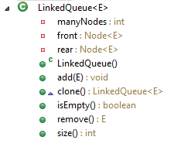
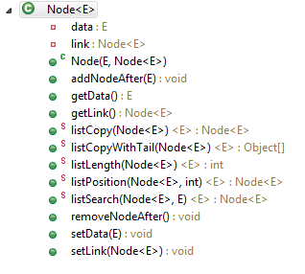
LinkedQueue & Node
Notes:
In Node: two main properties (global variable)
Simply linked list b/c we only maintain one node and the next one.
For doubly-linked we need a “prev” global var.
For LinkedQueue – don’t need an array to store all the data. Data in between is found through the link between each node.
If creating ArrayQueue – we need only 1 class. (data stored in array just like ArrayBag)
For LinkedQueue we need two classes (one Node class for node structure).
Enqueue() = add at end
Dequeue() = remove
Node is kind of like a utility class -> helpful to implement the structure.
Public class myStack<T> {
private LinkedList<T> storage = new LinkedList<>();
public void push(T v) { storage.addFirst(v) };
public T peek() { return storage.getFirst(); }
public T pop() { return storage.removeFirst(); }
public boolean empty() {return storage.isEmpty();}

