Slide 1
Data Structures and Algorithms Tutorial 6
Ting Cao

Slide 2
Topics
Binary Heap
Complete Binary Tree
Check if a binary tree is a complete tree
Binary Heap
Check if a binary tree is a binary heap

Slide 3
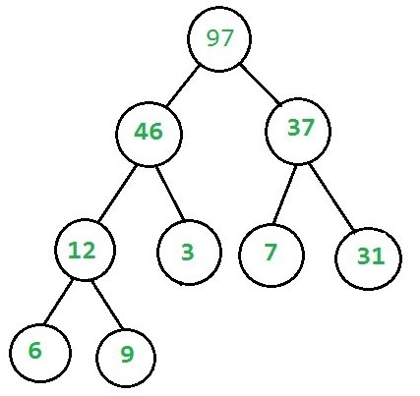
Binary Heap
It should be a complete tree (i.e. all levels except last should be full).
Every node’s value should be greater than or equal to its child node (considering max-heap).

Slide 4
Complete binary tree
Types of binary trees
Full binary tree : each node has either 0 or 2 children
Perfect binary tree : all interior nodes has two children and all leaves at the same level.
Complete binary tree : every level, except possibly the last, is completely filled, and all nodes in the last level are as far left as possible.
…

Slide 5






Which ones are complete binary tree?
(1) (2) (3) (4) (5) (6)

Slide 6
If we use array to represent complete binary tree
If we represent the complete binary tree as an array from top to down and left to right.
If root is at index [0], one node is at index [i],
the parent of this node is at [(i-1)/2].
the left child is at [2i + 1], and the right child is at [2i + 2].

Slide 7
How to check if a tree is a complete tree?
Algorithm :
Calculate the number of nodes in the binary tree.
Start recursion of the binary tree from the root node of the binary tree with index being set as 0.
Empty tree. Return true.
If index (i) of the current node is greater than or equal to the number of total nodes. Return false.
Recursively check the left and right sub-trees for same condition. For the left sub-tree use the index as (2*i + 1), for the right sub-tree use the index as (2*i + 2).

Slide 8
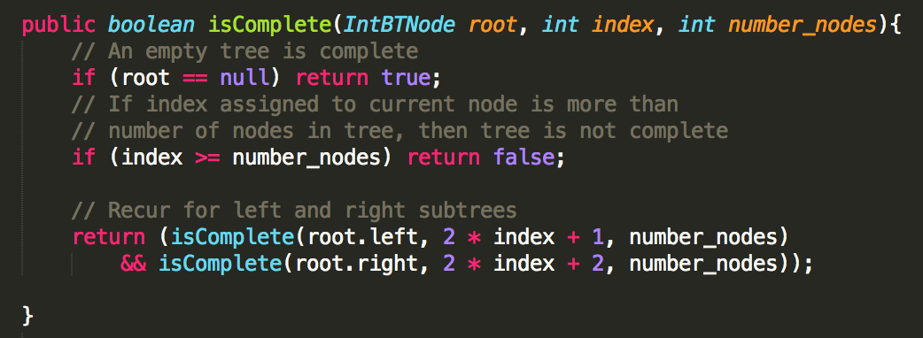
Notes:
Debug to see the algorithm steps or draw the steps in the white board.

Slide 9
Binary Heap
How do we check if a tree is a binary heap?
It should be a complete tree
Every node’s value should be greater than or equal to its child node (considering max-heap).

Slide 10
How to heck if a complete tree is a Heap?
Algorithm:
Every Node can have 2 children, 0 child (last level nodes) or 1 child (there can be at most one such node).
If Node has no child then it’s a leaf node and return true (Base case)
If Node has one child (it must be left child because it is a complete tree), compare this node with its left child.
If Node has both child then check heap property at Node at recur for both subtrees.

Slide 11
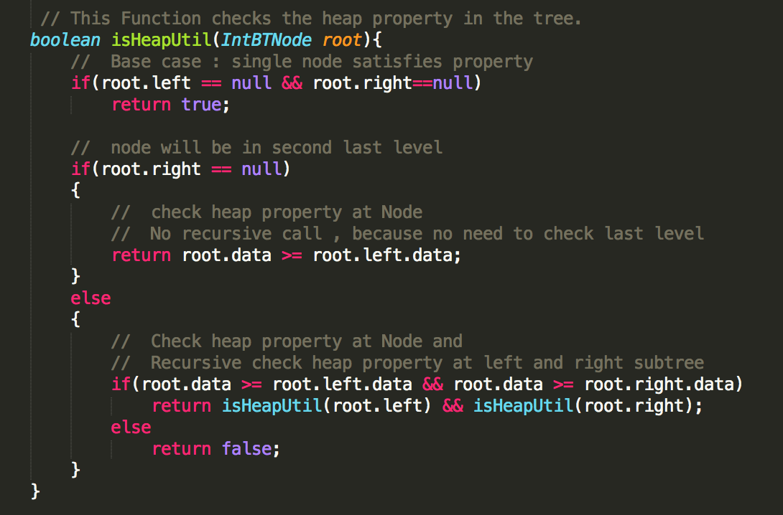

Slide 12
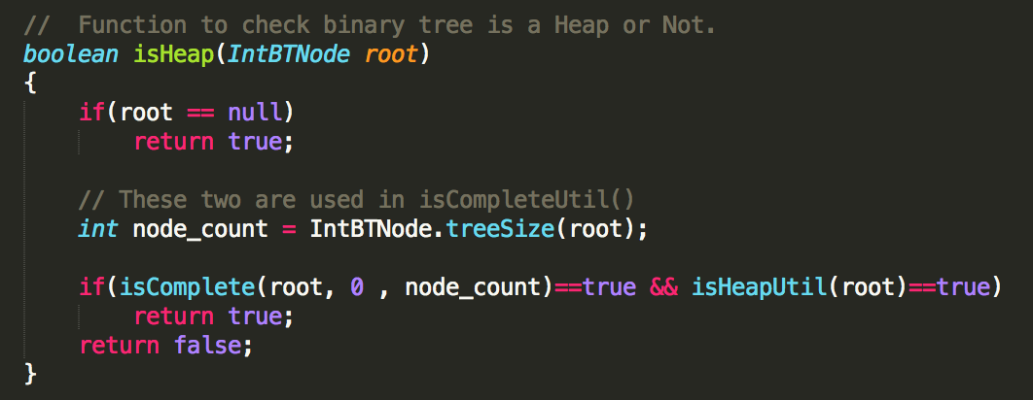

Slide 13
Run code…

