Slide 1
Data Structures and Algorithms Tutorial 7
Ting Cao

Slide 2
Topics
Quick Sort
Heap Sort
Notes:
https://www.hackerearth.com/zh/practice/algorithms/sorting/merge-sort/visualize/

Slide 3
Quick sort
Classic quicksort algorithm recall
Implementation example

Slide 4
Classic quicksort algorithm recall
Divide and conquer.
Find a Pivot which divides the array into two parts.
Elements in the left part are smaller than pivot and elements in the right are greater than pivot.

Slide 5
Three steps:
Bring the pivot to its appropriate position.
Quick sort left part.
Quick sort right part.

Slide 6
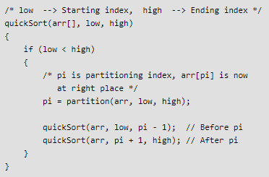

Slide 7
Pick the pivot:
Always pick first element as pivot.
Always pick last element as pivot.
Pick a random element as pivot.
Pick median as pivot.
…

Slide 8
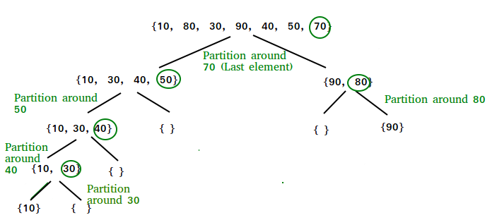
Example: Choose last element as pivot

Slide 9
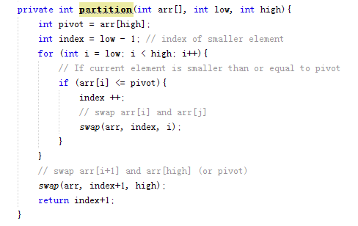
Code example for partition method.

Slide 10
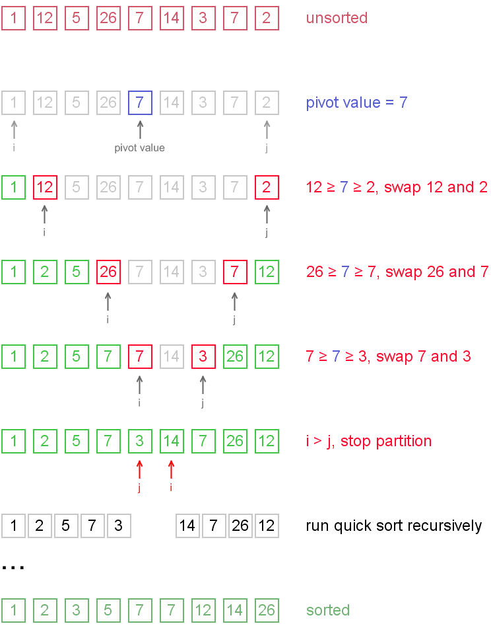
Another example:

Slide 11
Heap Sort
Binary Heap recall (tutorial 6)
Complete binary tree
Max Heap

Slide 12
Key property
If we represent the complete binary tree as an array from top to down and left to right.
If root is at index [0], one node is at index [i],
the parent of this node is at [(i-1)/2].
the left child is at [2i + 1], and the right child is at [2i + 2].

Slide 13
Heap Sort algorithm:
Build a max heap from the input data.
How? -- bottom up
At this point, the largest item is stored at the root of the heap. Replace it with the last item of the heap followed by reducing the size of heap by 1. Finally, heapify the root of tree.
Repeat above steps while size of heap is greater than 1.

Slide 14
Code example.

