Slide 1
What is an Agile Methodology?

Slide 2
Waterfall is a late-learning strategy
Growth of knowledge with big-bang integration
cost
Knowledge comes at the “moment of truth”: final integration.
Delivers nearly no knowledge
(or risk reduction)
time

Slide 3
We can pay to learn early in the project
Growth of knowledge with early, continuous integration
Development sequence
indifferent (with respect to knowledge)
cost
Delivers knowledge
(risk reduction)
time

Slide 4
Develop for business value once risks are down
Business value growing
cost
Knowledge growing (risk reduction)
Growth of
business value
time

Slide 5
Trim the Tail: Choose to deliver by value or date
Trim to deliver
on-time (or early)
Delay to get more
or better

Slide 6
Crystal’s “Genetic Code (DNA)”

Slide 7
‘Methodology’ is only the set of conventions people agree to follow -- it changes every few months!
As the people on the team change, the conventions of the team change, also.
As the project evolves from start to middle to end, the strategies and conventions change, also.
The methodology of the team needs to change along with the situation.
This is natural is we view the methodology only as the conventions the team uses, and nothing more!
(Most people try to use ‘methodology’ as required development technique and also project management -- this is too much burden to place on a methodology)

Slide 8
Methodology: who, what, when of interactions
Process
Milestones
Planning
Team Values
Testing
Quality
Activities
Teams
Regression tests
Project manager
MBWA
Documenter
Object model
Use cases
Project plan
Designer
CRC cards
Tester
Use cases
Products
Techniques
Roles
People
Microsoft Project
Envy/Developer
JAD facilitation
3month increments
STP
Java programming
Microsoft Project
Modeling
Personality
UML / OMT
C++
Standards
Tools
Skills

Slide 9
But people are stuffed full of personality
Methodology
Ecosystem
Values
Activities
Milestones
Values
Jim
Quality
Process
Teams
Tester
Designer
Peter
Documenter
Jenny
Project manager
Annika
Products
Techniques
Roles
People
Standards
Tools
Skills
Personality

Slide 10
Standard methodologist errors: One size, intolerant, embellished, heavy, wrong.
e1. One size methodology (projects vary)
e2. Intolerant methodology (people vary)
e3. Embellished ('did do' or 'should have done'?)
e4. Heavy (more writing /= more safety)
e5. Untried (lots of errors)
e6. Tried once (limited applicability)
(e 3-6 also apply to expert methodologists!)
"Embellishment is the pitfall of the methodologist"

Slide 11
Crystal is the lightest, least intrusive set of rules that puts a project in the safety zone.
Crystal’s purpose: Keep people from hurting each other, keeping each other informed
Crystal’s nature: A set of conventions that gets updated
Crystal’s Philosophy:
People differ in working styles
Projects differ in needs
Software development is communication-intensive, experiment-based, needing lots of feedback in all directions
Less is generally better (for methodologies)
Techniques / technologies change over time
People learn in class or on the job, not from the methodology

Slide 12
Crystal is a family of methodologies because every project is slightly different and needs its own.
Life
(L)
Technologies change techniques.
Cultures change norms.
Distances change communication.
L6
L20
L40
L100
L200
Essential
money
(E)
Criticality
(defects cause loss of...)
E6
E20
E40
E100
E200
Discretionary
money
(D)
D6
D20
D40
D100
D200
Comfort
(C)
C6
C20
C40
C100
C200
Clear
Yellow
Orange
Red
1 - 6
- 20
- 40
- 100
- 200
Number of people involved

Slide 13
Crystal is a family of methodologies with a common genetic code.
1 Cooperative Game Mindset:
SD is a series of resource-limited cooperative games of communication and invention.
2 Methodology Design Priorities:
Project safety
Development efficiency
Habitability (tolerates humans!)
3 Methodology Design Principles:
(7 of them, including:
face-to-face work,
concurrent development,
& different rules for different circumstances)
4 Project Properties: Frequent delivery Close communication Reflective Improvement
5 Techniques:
Discretionary but with a starter set.
6 Sample Methodology Designs:
Crystal Clear
Crystal Orange
Crystal Orange-web

Slide 14
1: Crystal’s Mindset
“Software development is a (resource-limited) finite, goal-seeking
cooperative game of invention and communication.”

Slide 15
The game has a primary and secondary goal: Two Games in One !
Primary Goal
Deliver working software.
(Mess up the first goal => no software.
Secondary Goal
Set up for the next game.
Mess up the secondary goal => disadvantaged next project

Slide 16
2: Crystal’s Project Properties
Frequent Delivery
Osmotic Communication
Reflective Improvement
Personal Safety
Focus
Easy Access to Expert Users
Technical Environment with - Frequent integration - Automated testing - Configuration management

Slide 17
Frequent Delivery
Have you delivered running, tested, usable functions to your user community at least twice in the last six months?

Slide 18
Reflective Improvement
Did you get together at least once within the last three months for a half hour, hour, or half day to compare notes, reflect, discuss your group's working habits, and discover what speeds you up, what slows you down, and what you might be able to improve?

Slide 19
Osmotic Communication
Does it take you 30 seconds or less to get your question to the eyes or ears of the person who might have the answer?
Do you overhear something relevant from a conversation among other team members at least every few days?

Slide 20
Personal Safety
Can you tell your boss you mis-estimated by more than 50 percent, or that you just received a tempting job offer?
Can you disagree with him or her about the schedule in a team meeting?
Can people end long debates about each other’s designs with friendly disagreement?

Slide 21
Focus
Do all the people know what their top two priority items to work on are?
Are they guaranteed at least two days in a row and two uninterrupted hours each day to work on them?

Slide 22
Easy Access to Expert Users
Does it take less than three days, on the average, from when you come up with a question about system usage to when an expert user answers the question?
Can you get the answer in a few hours?

Slide 23
Technical Environment with Automated Tests, Configuration Management, and Frequent Integration
Can you run the system tests to completion without having to be physically present?
Do all your developers check their code into the configuration management system?
Do they put in a useful note about it as they check it in?
Is the system integrated at least twice a week?

Slide 24
Timeboxing is a critical element in iteration scheduling
2-week, 1-month (,quarterly) timeboxes.
Each timebox ends with integrated, tested code.
Cut scope as needed but complete on time.
Deliver whatever you have
Whatever you accomplished this time is a predictor of what you will accomplish next time
(“Yesterday’s Weather”)
(some timeboxing fixes requirements, some don’t)

Slide 25
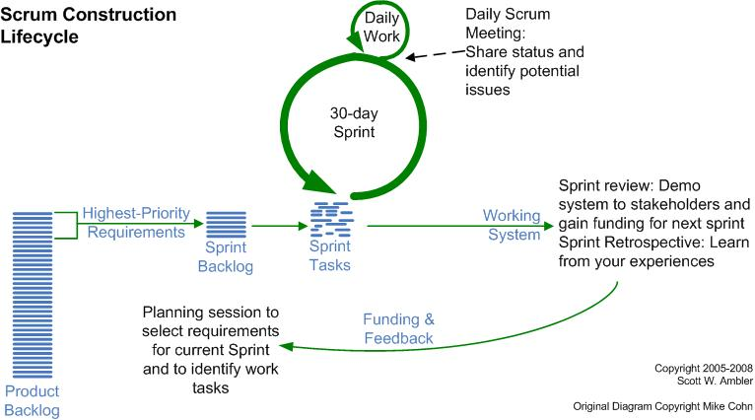
Run the project with nested cycles.
ent-->

Slide 26
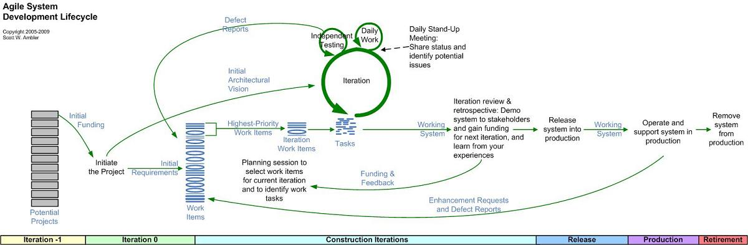
There are Activities Outside Construction!
ent-->

Slide 27
3: Crystal’s Starter Strategies & Techniques
Exploratory 360°
Early Victory
Walking Skeleton
Incremental Re-architecture
Information Radiators
Methodology Shaping
Reflection Workshop
Blitz Planning
Delphi Estimation
Daily Stand-ups
Agile Interaction Design
Process Miniature
Side-by-Side Programming
Burn Charts

Slide 28
4: Crystal’s Design Priorities
Project Safety
Development Efficiency
Process Habitability

Slide 29
5: Crystal’s Design Principles
1. Prefer face-to-face communication
Interactive face-to-face communication is the cheapest and fastest channel for exchanging information
2. Methodology weight is costly
3. Use heavier methodologies for larger / distributed teams
4. Use More ceremony for more criticality
5. Use more feedback & communications, with fewer intermediate deliverables
6. Discipline, skills, understanding counter process, formality, documentation
7. Efficiency is expendable at non-bottleneck activities.
Notes:
9. Efficiency Is Expendable in Non-Bottleneck Activities Effective concurrent development requires calculating the moment at which to start a downstream activity. Goldratt's process theory [3] and theory of constraints [4] provide advice here.
Suppose that one requirements gatherer feeds information to five designers, who in turn feed their results to a single database analyst (DBA, see Figure 2). It is clear that the DBA will not be able to keep up with the work (and rework). Prudence insists that the designers get their work to a complete and stable state before passing it to the DBA.
Figure 2: The Database Analyst (DBA) Bottlenecking Five Designers [2] (Click on image above to show full-size version in pop-up window.)
Figure 3 illustrates this idea. The vertical axis indicates how complete and stable each group's work is. Completeness refers to how much they have done, and stability refers to how unlikely they are to make changes. For simplicity, the figure illustrates them as joint: The work becomes more complete and more stable over time, shown in an S-type of curve. For each curve, the solid downward-arrow indicates at what point a dependent activity gets initiated.
Figure 3: Completeness and Stability Over Time
If the designers take work from a single requirements gatherer as in Figure 2, they can start work on their assignments when the requirements are only slightly complete and stable and still handle the consequential rework. Figure 3 shows the trigger event (the solid vertical arrow from requirements to design) occurring close to the left, while the requirements are not yet very complete or very stable. This figure also shows information continuing to pass from the requirements gatherer to the designers as the requirements work progresses. Once requirements become complete and stable, it will not take long to finalize work. The designers can complete the extra rework because there are five of them to one requirements gatherer.
The DBA, having no excess capacity, needs to be handed work that is more complete and more stable. The solid rightmost vertical arrow in Figure 3, which shows when the DBA's work gets initiated, starts higher on the designer's completeness and stability scale.
Note that in Figure 3 each designer uses much more time than the DBA. This is appropriate, since there is only one DBA for five designers.
The principle says that rework is an expendable commodity everywhere except at the bottleneck station (the DBA, in the above example). Rework can be expended to improve a design, to investigate multiple designs, or to get a head start on a downstream activity. Applying this principle to different circumstances produces different optimal project strategies [2].
Although this is the most complicated principle presented so far, I find that most project leaders have, in fact, used this principle in responding to standard project pressures through common sense and intuition.

Slide 30
Base technique in Crystal: Methodology-tuning interviews, workshops
Build the control system first.
Settle increment size,
Hold interview & workshop before/after each.
Preload the system.
Interview projects to learn key issues, hazards, tricks.
Ask what they did, liked, didn't, would change or keep.
Identify fears, priorities, success factors, hazards.
Ask the group.
Let the group influence first increment's methodology.

Slide 31
Base technique in Crystal: Post-iteration reflection workshop
Hang a flipchart, create two columns
“Keep these”
“Try these”
(Create a small area for “Recurring Problems”)
(Don’t create an area for “Don’t Like These”!)
Spend 30 minutes filling in the chart
HANG THE CHART IN A PUBLIC, VISIBLE FREQUENTLY SEEN PLACE !!!!!
Make sure you actually try some of the Try These ideas !
Repeat after each iteration

Slide 32
Crystal Clear : scope
For D6 projects:
3-6 people, close or in same room
Loss of discretionary moneys
(may extend to: E8 project)
Not for large projects
(insufficient group coordination)
Not for life-critical projects
(insufficient verification)
(Described in Crystal Clear, Cockburn, 2002
also in Agile Software Development, Cockburn 2001)
E6
E10
D6
D10
C6
C10

Slide 33
Crystal Clear : roles & teams
Must have: sponsor, senior designer, designer/programmer, user (part-time)
Combined roles: coordinator, business expert, requirements gatherer
Teams: single team of designers/programmers
Seating: single big room, or adjacent offices

Slide 34
Crystal Clear : Products and Milestones
Products
Release sequence, Schedule of user viewings, deliveries
Actors-goals list & Annotated use cases
Design sketches & notes as needed, screen drafts
Common object model
Running code, Migration code, Test cases
User manual
Publish: each
Review: each
Methodology (pre- and mid-increment)
Declare:
Requirements stable enough to design to,
UI stable enough to document to,
Application correct enough to deliver.

Slide 35
Crystal Clear : standards
Policy:
Delivery increments every 2 + 1 months
Tracking by milestones, not by work products
Requirements in annotated usage scenarios (use cases)
Mandatory regression testing of application function
Peer code reviews
Direct user involvement
Ownership model for work products
Local standards (up to the team):
Coding style
UI style
Regression test framework

Slide 36
Crystal Clear : tolerance
Policy standards are mandatory, but equivalent substitution are permitted (e.g. "Scrum")
Full tolerance on techniques: any technique allowed
Quite wide tolerance on work products
Many alternatives to intermediate products accepted
e.g., paper, whiteboard, online notes
Low precision in early stages
High precision only required for production work products
Assess the Quality of the communications, not the quality of the work products (except Test Cases).

Slide 37
Crystal Orange : scope
For D40 projects:
Up to 40 people, same building
Loss of discretionary moneys (May extend to E50)
Not for very large projects
(insufficient sub-teaming)
Not for life-critical projects
(insufficient verification)
(Described in Surviving OO Projects, Cockburn, 1998, pp. 77-93)
L6
L20
L40
L80
E6
E20
E40
E80
D6
D20
D40
D80
Amber
C6
C20
C40
C80

Slide 38
Crystal Orange : roles & teams
Roles: Sponsor, Business expert, Usage expert, Technical facilitator, Business analyst/designer, Project Manager, Architect, Lead designer/programmer, Designer/programmer, Design Mentor, Reuse Point, Writer, Tester, UI designer.
Teams: System planning, Project monitoring, Architecture, Technology, Functions, Infrastructure, External test.

Slide 39
Crystal Orange : standards
Policy:
Delivery increments every 3 + 1 months
Tracking by milestones, not by work products
Mandatory regression testing of application function
Direct user involvement
Ownership model for work products
2 user viewings per release
Use cases completed down to failure cases
Single, common object (not analysis & design models)
Downstream activities start as soon as upstream is "stable enough to review"
Local standards (set and maintained by team):
Work product templates, Coding style, UI style
Regression test framework

Slide 40
Crystal Orange : products
Ownership assignment is negotiable,
Every product has an owner.
* Requirements doc
* Release sequence, schedule, status report
* UI design doc
* Common object model
* Inter-team specs
* Usage manual
* Code
* Test cases

Slide 41
Crystal Orange : tolerance
Policy standards are mandatory, but equivalent substitution are permitted (e.g. "Scrum")
Full tolerance on techniques: any technique allowed
>Recommended techniques
Semantic modeling, RDD, facilitated sessions
Tolerance on work products
Minor deviation from templates permitted
Few alternatives to intermediate products accepted

Slide 42
Crystal Orange : activities & milestones
Workshop:
Mid- & post-increment methodology review
Publish:
Each work product,
Iteration & increment deliveries
Review:
Each work product, Iteration deliveries, Test cases, Final delivery
Declare:
Each work product stable enough to review,
Application correct enough to deliver.

