Slide 1
Adjusting for Cell Type Composition in Methylation Data
Chris McKennan
Dan Nicolae
Michelle Stein
Carole Ober

Slide 2
Methylation Data
Collected on 450K Illumina arrays
Measure the intensity of methylated and unmethylated cytosines
Measure ~350,000 CpGs
Data are analyzed as M-values
M-value = log(m) – log(u)

Slide 3
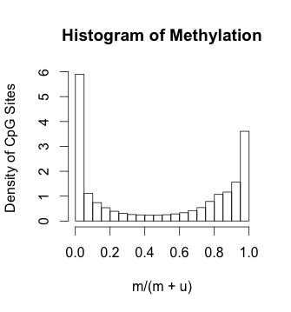
Motivating Data Example
Whole blood methylome for 60 children: 30 Amish, 30 Hutterite
Interested in methylation differences across populations
Have cell type proportions

Slide 4
Experimental Setup
X: Covariate of interest (e.g, Amish vs. Hutterite) for each sample.
C: Cell type composition for each sample.
Notes:
----- Meeting Notes (6/1/16 10:50) -----
Amish vs. Hutterite. Basic stufff

Slide 5
Full Data Model
Cell composition
Amish vs. Hutterite
[ Y ]_{nxp} = [X]_{nxd} [ B ]_{dxp} + [C]_{nxk} [ L ]_{kxp} + E_{nxp}
Nuisance Parameters
Effects of Interest
Residuals
Response (M-values)

Slide 6
Statistical Questions
[ Y ]_{nxp} = [X]_{nxd} [ B ]_{dxp} + [C]_{nxk} [ L ]_{kxp} + E_{nxp}
When can we estimate C from the data Y?
When do we need to measure C?
If we need to measure C, can we get away with measuring C on only a fraction of the individuals

Slide 7
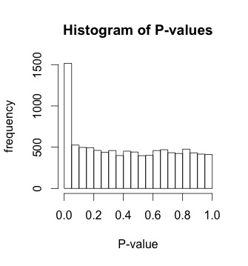
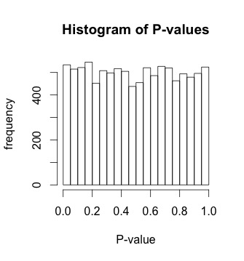
Special Structure in C
[ Y ]_{nxp} = [X]_{nxd} [ B=0 ]_{dxp} + [C]_{nxK} [ L ]_{Kxp} + E_{nxp}
Observed
Unobserved
C is uncorrelated with X
C is correlated with X
Notes:
When C is uncorrelated with X, CL becomes a part of the error term. We can get consistent estimates for B. If C is correlated with X, we DO NOT get consistent estimates. Why is this?

Slide 8
Adding Correlation to the Model
i) [ Y ]_{nxp} = [X]_{nxd} [ B ]_{dxp} + [C]_{nxK} [ L ]_{Kxp} + E_{nxp}
ii) [C]_{nxK} = [X]_{nxd} [Ω]_{dXK} + [F]_{nxK}
iii) Y_{nxp} = X_{nxd} (B_{dxp} + Ω_{dxK}L_{Kxp}) + (F_{nxK}L_{Kxp} + E_{nxp})
Notes:
----- Meeting Notes (6/1/16 10:50) -----
typo. B + OmegaL = composition effect.
Add biology to L (magnitudes of entries of L, informativeness of cell type)

Slide 9
Ignoring the Correlation Between C, X
Y = XB + CL + E
Y = X (B + ΩL) + (FL + E)
If we IGNORE the correlation:
Estimate (B + ΩL)
If Ω ≠ 0, we do POOR INFERENCE for B.
Notes:
----- Meeting Notes (6/1/16 10:50) -----
per cell changes are harder. testing as opposed to estimaton for geneticists

Slide 10
How Can We Correct This?
i.) Y = XB + CL + E
ii.) C = XΩ + F
iii.) Y = X (B + ΩL) + (FL + E)
Measure C
Then i) is just OLS
Expensive/Impossible
Correct for C using ONLY Y, X
Houseman, 2014
Zhou, 2014
Wang, 2015 (CATE)
Notes:
If we knew C, the problem is just OLS. Zhou uses an inappropriate model and can only handle a single covariate at a time. Houseman is very ad-hoc; cannot do accurate inference with Houseman.

Slide 11
Correcting for C Using ONLY Y and X
Y = X (B + ΩL) + (FL + E)
Regress out X
R_{nxp} = F_{nxK}L_{Kxp} + E_{nxp}
Compute L.hat using PCA
Compute Ω.hat_{dxK} via Y ~ X_{nxd} Ω_{dxK} L.hat_{Kxp}

Slide 12
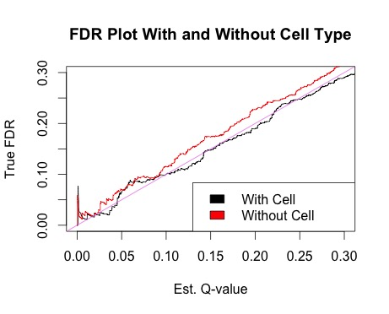
Performance
Y = XB + CL + E
Y = X (B + ΩL) + (FL + E)
Ω.hat : Y ~ X Ω L.hat
L.hat a good estimate for L, can estimate Ω.
Even for Ω large.
Ω_{sim} = Ω_{Amish/Hutterite}
Notes:
Simulation parameters: n = 200, Omega, E taken from Amish Hutterite data, standardized effect size for L (w.r.t Omega) is 2; tie it back to biology (informativeness of cell CpGs for cell type, additional information about C ); separate data from parameters (english vs. greek). Make scenarios clear earlier in the presentation (maybe with amish hutterite)
----- Meeting Notes (6/1/16 10:50) -----
FDP; pi0

Slide 13
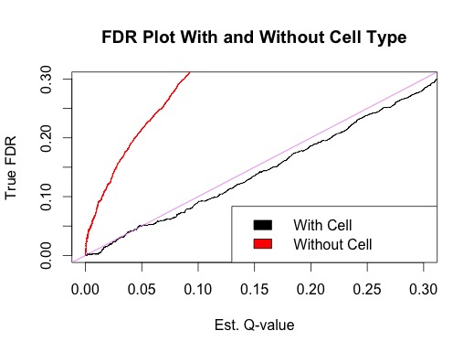
Performance (cont.)
Y = XB + CL + E
Y = X (B + ΩL) + (FL + E)
Ω.hat : Y ~ X Ω L.hat
If L.hat is a POOR estimate for L, tend to UNDERESTIMATE Ω.
Regression towards the mean
Notes:
Simulation parameters: n = 200, Omega, E taken from Amish Hutterite data, standardized effect size for L (w.r.t Omega) is 0.4
----- Meeting Notes (6/1/16 10:50) -----
Bring it back to biology

Slide 14
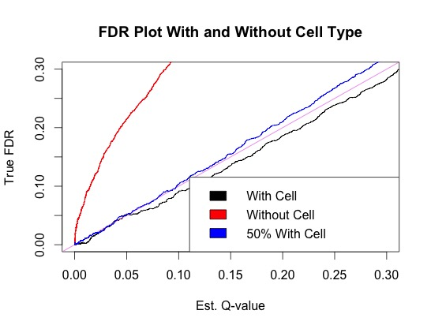
Correcting for C Using only a Fraction of the Cell Type Data
i.) Y = XB + CL + E
ii.) C = XΩ + F
iii.) Y = X (B + ΩL) + (FL + E)
If Y is not informative enough to estimate Ω, can use ii) to estimate Ω
Measure C for a fraction of samples
Use those samples to estimate Ω.
Notes:
----- Meeting Notes (6/1/16 10:50) -----
measure C

Slide 15
Conclusions
Y = XB + CL + E
Y = X (B + ΩL) + (FL + E)
In some settings, we can estimate C from the data.
In others, we benefit from observing a part of C.
Future work:
What are ALL the scenarios where we need to measure C and what is the smallest fraction we need for optimal performance?
Notes:
Remove matrix dimensions
----- Meeting Notes (6/1/16 11:02) -----
Add a note about phase transition (what it depends on, etc.)

