Slide 1
Stable-Baselines3 Atari Mini Project
Chris McKie

Slide 2
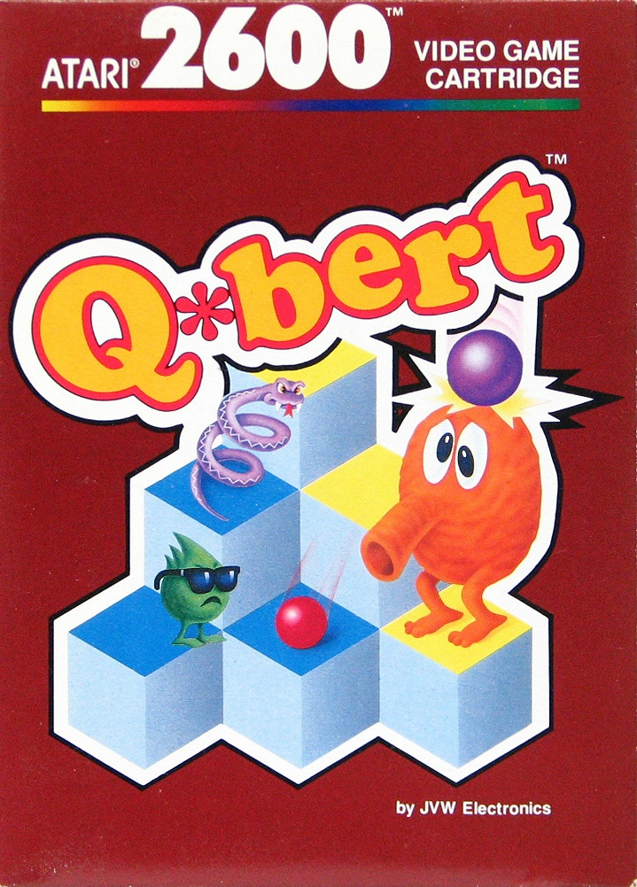
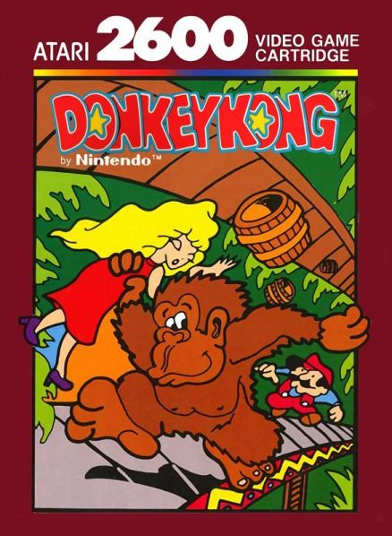
Selected Domains & Algorithms
Atari Domains:
Q*bert: Change the tile colors while avoiding obstacles
Donkey Kong: Climb to the top of the level while avoiding barrels
Algorithms:
Deep Q-Network (DQN)
Proximal Policy Optimization (PPO)

Slide 3
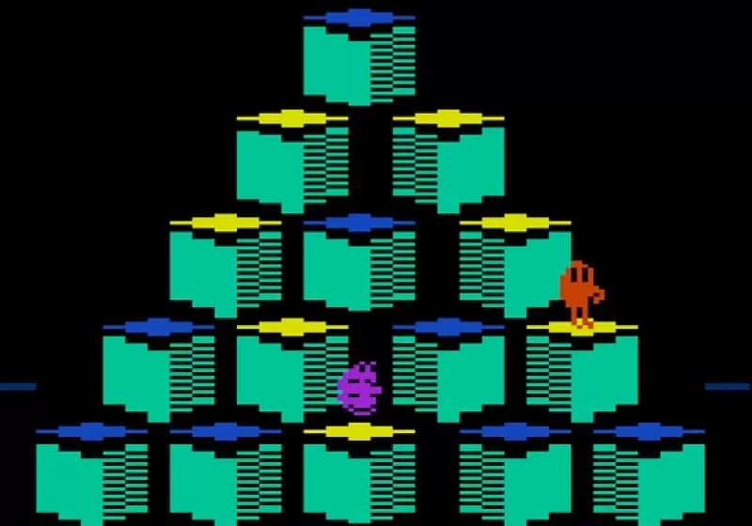
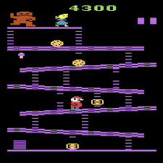
Hyperparameters
Learning Rate was the primary hyperparameter variation across both domains and algorithms
DQN
Learning Rate = 1e-4
Learning Rate = 5e-5
PPO:
Learning Rate = 3e-4
Learning Rate = 1e-4

Slide 4
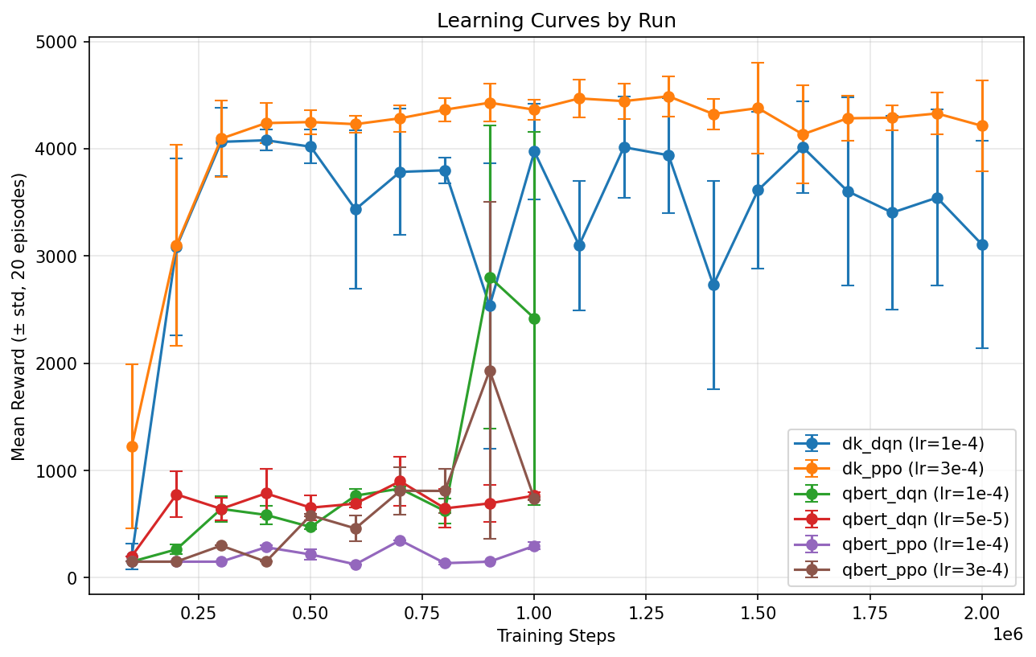
Performance & Analysis
Q*bert:
Progress was slow initially
Appears to have made new discoveries towards the end of training (especially with higher learning rates)
Donkey Kong:
Learned to exploit jumping over barrels for points early on
Never progressed up ladders, regardless of algorithm or parameters

Slide 5
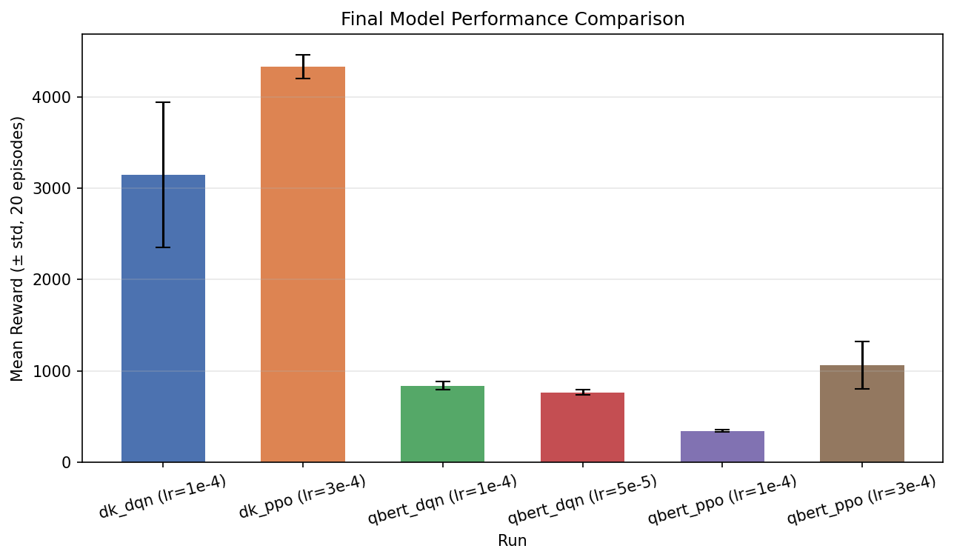
Performance & Analysis
Domain | Algorithm | Learning Rate | Mean Reward | Std. Dev.
Q*Bert | DQN | 1e-4 | 938.8 | ±47.7
Q*Bert | DQN | 5e-5 | 762.5 | ±29.0
Q*Bert | PPO | 3e-4 | 1062.5 | ±259.0
Q*Bert | PPO | 1e-4 | 342.5 | ±11.5
Donkey Kong | DQN | 1e-4 | 3145.0 | ±797.2
Donkey Kong | PPO | 3e-4 | 4330.0 | ±130.8

Slide 6
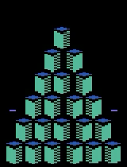
Q*Bert Videos
Early Model
Middle Checkpoint
Best Model

Slide 7
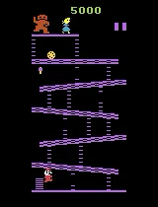
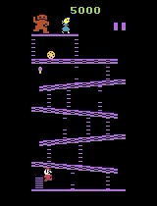

Donkey Kong Videos
Early Model
Middle Checkpoint
Best Model

Slide 8
Thank You!

