Slide 1
Personal Health App
Group 1

Slide 2

Personal Health App - Background
Thanks to advances in medicine, Americans have the opportunity to be healthier than they have been in the past. Polio and smallpox, for instance, have been largely eradicated.
However, preventable diseases such as high blood pressure and high cholesterol are still killing many Americans. The impact of such diseases are felt indirectly by other Americans in the form of healthcare costs.
For these reasons, preventive medicine is an increasingly important way to take care of ourselves and the people that we love.

Slide 3

Personal Health App - Background
We created a database that acts as the foundation for an app that will aid an individual in getting and staying healthy with the help of his/her community.
This app would allow the user to keep track of his/her current health while allowing his/her friends and doctors to add input.

Slide 4

Design Concepts
Our personal health application will have the following functionality:
Contain information for each user regarding contact information and health statistics such as height, weight, and blood type.
Keep track of all medications that the user is currently taking. That information will include the type and quantity of medicine.
Record and update levels of various measures of health status such as blood sugar levels, blood pressure, and/or hormone levels.
Allow users to modify which levels are being recorded by the app.
Maintain information regarding doctors’ appointments including location, date, and which doctor the appointment is with.
Allow user to select which types of information is accessible to each friend in the user’s friend list.
Allow doctors to see medications that a user is taking in order to prescribe medication that isn’t harmful when mixing with other medications and to track the benefits of certain quantities of meds.
Allow doctors to see a user’s health stats readings in order to monitor how the patient is responding to treatment.

Slide 5
Design Concepts
The database implements the application’s functionality by:
Storing information for each user. The user relation contains attribute types for height, weight, blood type, and contact info.
Each user in the database can also be a friend in the Social Media relation.
Medicine data is stored in the MedSchedule entity which is associated with the Medication entity which in turn is associated with the MedFunction.
Readings for vitals is stored in the Readings entity which is populated by the TakeReadings entity.
The user is able to add or delete which types of readings will be recorded by setting the TakeReadings entity’s attribute type.
An Appointment entity records the doctor that the appointment is with, as well as the location, date, and time.
The access level that another user has in seeing a “friends” information is set by the Access entity type.

Slide 6
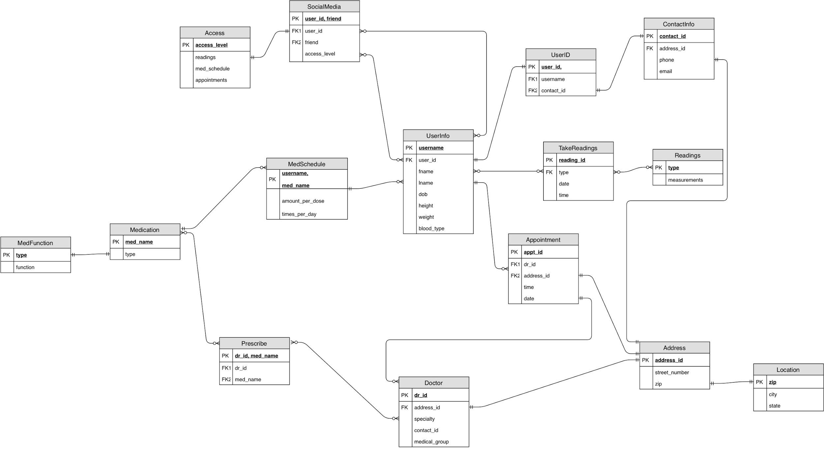
Logical Design

Slide 7
Challenges
The challenges that we’ve faced while making this project:
Implement the social media aspect on our database.
Think of a way on how to combine all the queries together so they can run properly on our health care database.
Fix our EER diagram and UML diagram so that entities and attributes can be linked together.

Slide 8
Lessons Learned
The lessons we’ve faced while making this project were:
How to design Entity-Relationship Diagram and implement it into UML Diagram.
How to find the functional dependency and use them to apply the normalization forms.
Use the concepts learned in lecture to help define the Entity, Attributes, Relations and mapping the diagram.
Skills learned by labs and lectures can be used in the implementation of SQL in Oracle. (Create, View, Update, Functions in writing queries)
Teamwork and Communication

Slide 9
Examples
Some important use cases for our personal health app:
A person with a certain condition, such as high blood pressure, who is trying to reduce the medications that he/she is taking through diet and/or exercise. Friends will be able to give encouragement as they see the impact of the lifestyle choices on both the amount of meds taken and the levels of the blood pressure readings, for example.
The way that the database is set up, the app can also act as a calendar/reminder for doctors’ appointments.
If a person’s doctor is also his/her friend, the doctor is able to see, in close-to-real time the effects of the doctors care on important health readings, such as blood sugar levels.

Slide 10
Examples
The following query returns detailed information of the user. This will be helpful for any medical to get information on a list of clients.
CREATE VIEW
User_med_schedule
AS SELECT
ms.username, ui.fname, ui.lname, c.phone, c.email, ui.dob, ui.height, ui.weight, ui.blood_type, ms.med_name,
ms.amount_per_dose, ms.times_per_day
FROM
med_schedule ms, userid u, user_info ui, contact_info c
WHERE
u.username = ui.username and ms.username = u.username and u.contact_id = c.contact_id;
The following query returns a list of prescriptions, which doctor prescribed them, and what the meds do for the user.
SELECT
p.dr_id, d.specialty, d.phone, d.email, d.medical_group, p.med_name, m.med_type, mf.med_function
FROM
prescribe p left join doctor d on p.dr_id = d.dr_id left join medication m on p.med_name = m.med_name left join
med_function mf on m.med_type = mf.med_type;

Slide 11
Thank You for Listening!

Slide 12
Sources
Leonhardt, M. (2019, November 4). Rising health-care costs stall Americans’ dreams of buying homes, building families and saving for retirement. CNBC.com. https://www.cnbc.com/2019/11/04/health-care-costs-are-preventing-many-americans-from-hitting-life-milestones.html
Marshfield Clinic Health System. (n.d.). Why preventive care is important. MarshfieldClinic.org. https://www.marshfieldclinic.org/specialties/primary-care/preventive-care/why-important
Morgan, K. (2018, October 24). These are the top 10 health conditions affecting Americans. USA Today. https://www.usatoday.com/story/sponsor-story/blue-cross-blue-shield-association/2018/10/24/these-top-10-health-conditions-affecting-americans/1674894002/

