Slide 1
Advanced React Development
copyright 2024, Chris Minnick
version 1.3.0,
March 2024
Notes:
Welcome to Professional React.js Web App Development

Slide 2

Introduction
Objectives
Who am I?
Who are you?
Daily Schedule
Course Schedule and Syllabus

Slide 3
The Big Picture
Some of the Topics Covered in this Course
Redux
Component Lifecycle
Server-side Rendering
Code Splitting
Micro-frontends
React Router
Performance
Security

Slide 4
The Labs
Instructions: advanced-react-labs.pdf
Working in small groups.
Let me know if something doesn't work.
If you finish a lab early:
try lab challenges,
help other students,
do additional reading,
take a break.

Slide 5
Bootstrapping React Apps
Create React App is dead.
Exploring Alternatives
Converting from CRA to Vite

Slide 6
React Frameworks
Next
Remix
Astro
React Query

Slide 7
A Deeper Dive into React Fundamentals

Slide 8

React Component Lifecycle
Mounting
The component renders in the browser.
Updating
The component receives new props or sets its state.
Unmounting
The component is removed from the browser.

Slide 9
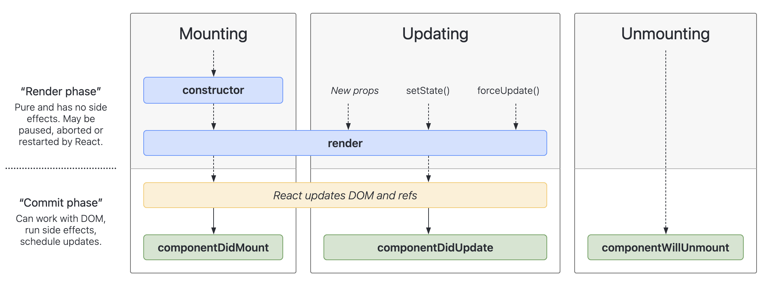
React Lifecycle

Slide 10
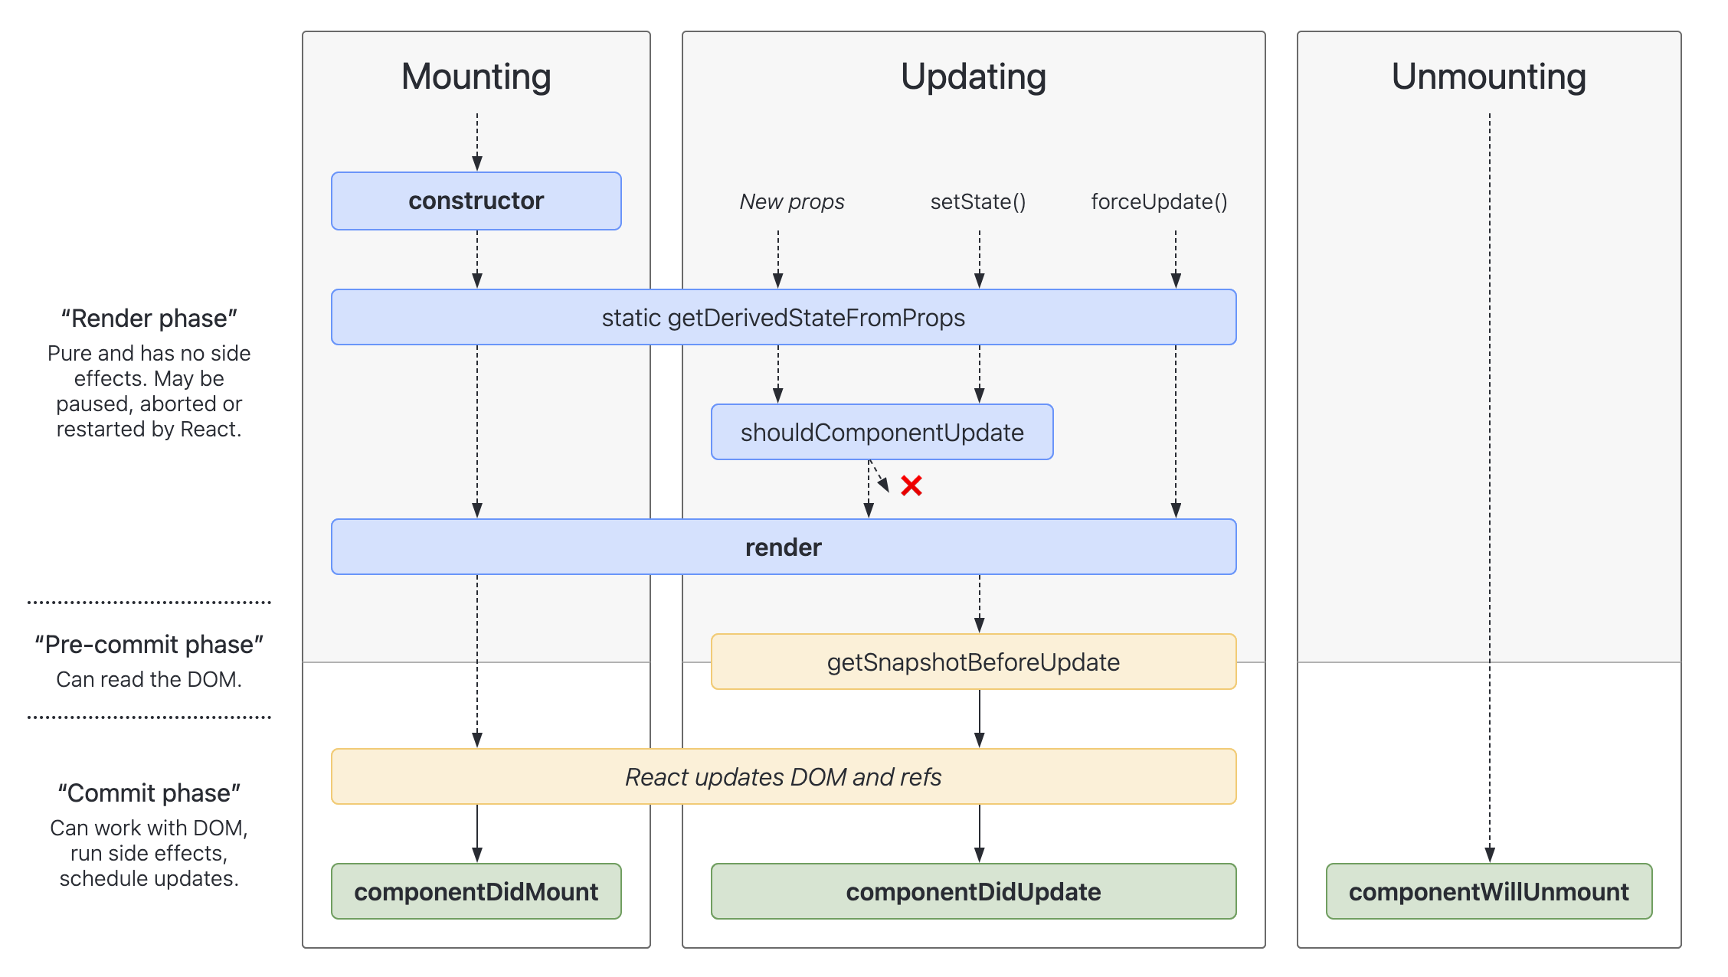
React Lifecycle

Slide 11
Introduction to Component Lifecycle
What is Component Lifecycle?
Importance in React Development
Notes:
The Component Lifecycle in React is a series of methods that get executed at different stages of a component’s life in the application. Understanding this lifecycle allows developers to control side effects, manage state, and optimize performance.
Key Lifecycle Phases:
Mounting: The process where the component is being created and inserted into the DOM.
Updating: Occurs when a component's state or props change, leading to a re-render.
Unmounting: The final phase, where the component is removed from the DOM.
By utilizing lifecycle methods like componentDidMount, componentDidUpdate, and componentWillUnmount, you can run code at specific times in a component's life, making your application more robust and maintainable.

Slide 12
Mounting Phase
constructor()
static getDerivedStateFromProps()
render()
componentDidMount()

Slide 13
Updating Phase
static getDerivedStateFromProps()
shouldComponentUpdate()
render()
getSnapshotBeforeUpdate()
componentDidUpdate()

Slide 14
Unmounting Phase
componentWillUnmount()
Called just before the component is removed from the DOM
Best practices
Use for cleaning up side-effects initiated in other lifecycle methods (timers or event listeners).

Slide 15
Error Handling Phase
static getDerivedStateFromError()
componentDidCatch()

Slide 16
Lifecycle Methods in Hooks
useEffect()
useState()

Slide 17
Lifecycle Best Practices
Avoid Heavy Computations in render Method: Offload heavy calculations to lifecycle methods to avoid unnecessary re-renders.
Use componentDidMount for API Calls: Fetching data in this method ensures that the component has mounted before attempting network requests.
Optimize Child Components: Utilize React.memo or PureComponent for functional and class components, respectively.
Cleanup in componentWillUnmount: Always remove event listeners, cancel network requests, and invalidate timers before a component unmounts.

Slide 18
Class Components
JavaScript classes that extend React.Component
Can hold and manage state.
Have access to lifecycle methods.
Must have a render method.
Useful for more complex components or components that require direct access to lifecycle methods.

Slide 19

State Management with setState() in Class Components
Takes an object or a function that returns an object as its argument.
Merges the object with this.state
Is asynchronous
If you pass a function, the function always receives the latest state.
If the new state depends on the previous state, always use a function

Slide 20
Function Components
Basically, the render() method from a class component.
Cannot access lifecycle methods.
Cannot maintain its own state.
Access to lifecycle and state from functions is done using Hooks.

Slide 21
Hooks
Functions provided by React that give functions access to internal workings of React.
Useful for simulating component lifecycle and associating state with function components.

Slide 22
How to think about Hooks
Hooks seem magical at first.
Using them correctly requires a deeper understanding.
Important Points:
Hooks store data outside of a function.
A Hook is associated with an “instance” of a function component

Slide 23
How to think about Hooks (cont.)
Function components don’t technically have instances, and they don’t technically render.
A function component is just a function that returns a piece of the UI when it’s invoked.
Unless you store data outside of the function and access it when the function runs, functions have no way of persisting data between invocations.

Slide 24
Understanding useState
The useState hook sets a persistent value in React and associates it with the “instance” of the function component.
Every time the function runs, each call to useState() gets its latest value from the React library (except the first time, when the value passed to useState() initializes the value).
useState() returns an array with 2 elements
the latest value
a function for updating the value
this is called the “state dispatch function”

Slide 25
Understanding useEffect
The useEffect takes a function as its first argument, and an array of dependencies as its second argument.
Each time the function component renders, useEffect compares the previous values of the dependencies with the new values.
If the new values of any dependencies have changed, the function passed to useEffect runs.

Slide 26
Understanding useEffect (cont.)
If no dependency array is passed, the function passed to useEffect will run every time the function component “instance” renders.
If an empty array is passed, the effect will only run on the first invocation of the “instance” of the function component.
If the effect function returns a function, that function will run when the component is “unmounted.”

Slide 27
useCallback vs. useMemo
useCallback: caches a function.
useCallback(fn, dependencies)
React will return the cached function with each render, provided that the dependencies haven’t changed.
useMemo:
useMemo(()=>calculateValue, dependencies)
React will call the function on first render, and return the cached value on subsequent renders, unless the dependencies have changed.

Slide 28
useDeferredValue
Can be used with <Suspense> to show stale content while fresh content is loading.
Requires use of Relay (GraphQL), Next.js, or Lazy-loading components.
https://react.dev/reference/react/useDeferredValue

Slide 29
useTransition
Lets you update the state without blocking the UI
Allows you to mark a state update as a non-blocking transition

Slide 30
useLayoutEffect
A version of useEffect that fires before the browser repaints the screen.
Use sparingly - can hurt performance.
Demo: https://react.dev/reference/react/useLayoutEffect

Slide 31

Lab: React Fundamentals
Add new features to an existing real-time chat application

Slide 32
React Router
Route Configuration
Navigation
Protected Routes

Slide 33
Introduction to React Router
What is React Router?
dynamic routing library built on top of the React framework. React Router uses a component-based structure to define routing rules.
Why is it important?
SPA Navigation
Declarative routing
Code splitting

Slide 34
Router Component
Wraps around the Routes component
data APIs
version 6.4+
createBrowserRouter
recommended for browser-based apps
createHashRouter
createMemoryRouter
createStaticRouter
pre-6.4 (still supported)
<BrowserRouter>
<MemoryRouter>
<HashRouter>
<NativeRouter>
<StaticRouter>

Slide 35

Routes Component
Wraps around a group of Route components.

Slide 36

Route Component
Matches paths to elements
Must be a direct child of a Routes component

Slide 37
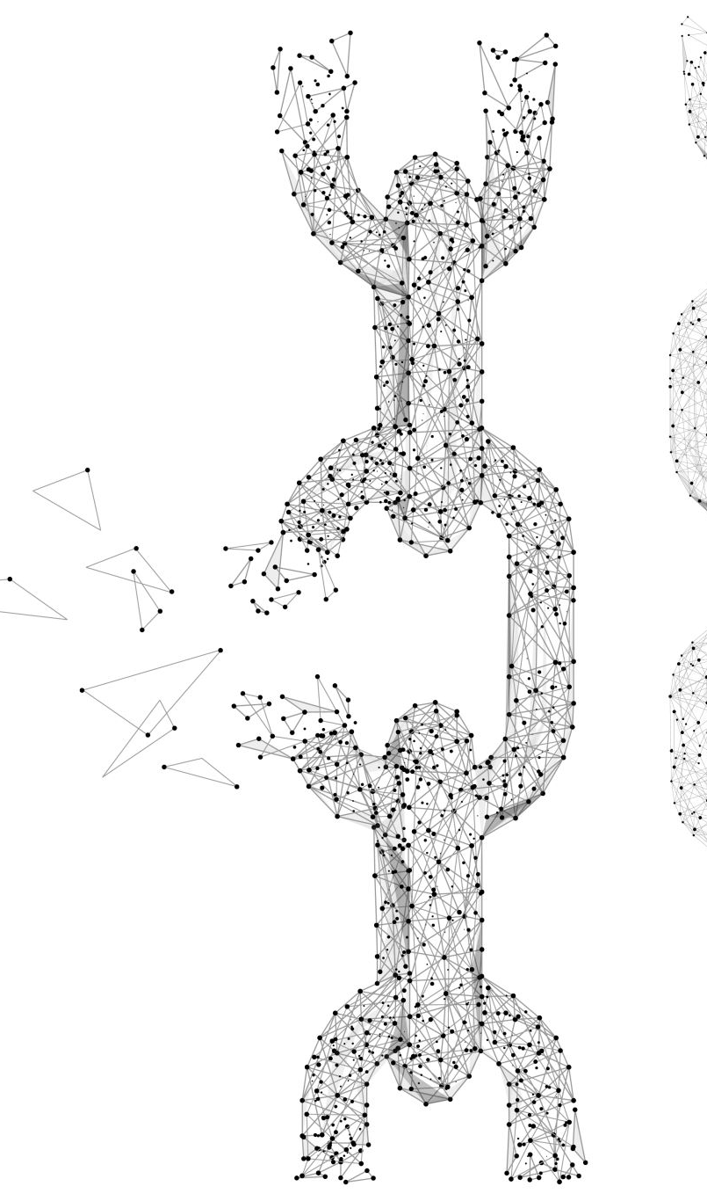
Link and NavLink Components
Explanation and differences

Slide 38
redirect
Redirects to a new location.
import { redirect } from "react-router-dom";
const loader = async () => {
const user = await getUser();
if (!user) {
return redirect("/login");
}
return null;
};

Slide 39
Dynamic Routing
Route parameters
define routes with variable parts
/users/:userId matches /users/123, /users/abc, etc
Query Strings and URL parsing
/search?query=react allows the component to access query

Slide 40
Hooks in React Router
useHistory
provides access to the history object
push(path)
replace(path)
useParams
const {userId} = useParams();
useLocation
Provides access to the location object
const location = useLocation();
return <div>Current path: {location.pathname}</div>;

Slide 41
Outlet Components
Used in a parent route element to render its child route elements.

Slide 42
Nested Routes
Create a component that renders an Outlet
Nest Route elements inside the Outlet route.
function Dashboard() {
return ( <Outlet /> );
}
function App() {
return (
<Routes>
<Route path=“/” element={<Dashboard />}>
<Route path=“inbox” element={<Inbox />} />
<Route path=“tasks” element={<Tasks />} />
</Route>
</Routes>
);
}

Slide 43
Implementing Protected Routes
import { Navigate, Outlet } from 'react-router-dom’
const PrivateRoutes = () => { let auth = {'token’:false}
return ( auth.token ? <Outlet/> : <Navigate to='/login’/> ) }
function App() {
return (
<Routes>
<Route element={<PrivateRoutes />}>
<Route path=“inbox” element={<Inbox />} />
<Route path=“tasks” element={<Tasks />} />
</Route>
<Route path=”/login” element={<Login />} />
</Routes>
);
}

Slide 44
Alternatives to React Router
wouter
Next JS
React Location

Slide 45
Next.js
Folder-based routes (App router)
Server-side Components
Streaming
Much more!

Slide 46
Lab: Routing and Authentication
Create a signup component and a login component
Use react router to create the following routes:
/login
/signup
/logout

Slide 47
Redux: Introduction to Redux
What is Redux?
Why Use Redux?

Slide 48
Redux: Redux Architecture
Basic Architecture
Store
Actions
Reducers
Flow of Data
Action -> Store -> Reducer -> New State -> View Update

Slide 49
Redux: Actions
Information payloads that send data from the application to the store.
Plain JavaScript objects containing a type property to indicate the type of action being performed.
Optionally contain additional data.

Slide 50
Redux: Dispatching Actions
How to Dispatch
const increment = () => {
return {
type: 'INCREMENT',
};
};
// Dispatching Action
dispatch(increment());

Slide 51
Dispatching Async Actions (Thunk)
const fetchData = () => {
return (dispatch) => {
fetch('https://api.example.com/data')
.then((response) => response.json())
.then((data) => dispatch({ type: 'FETCH_DATA_SUCCESS', payload: data }))
.catch((error) => dispatch({ type: 'FETCH_DATA_ERROR', payload: error }));
};
};
// Dispatching Async Action
dispatch(fetchData());

Slide 52
Redux: Reducers
Functions that determine how the state will change in response to an action.
Receive the current state and an action as arguments, and return a new state.
Must remain pure functions – no side effects or mutations.

Slide 53
Redux: Store
Single source of truth.
Holds the state of the entire application.
Created using the createStore method.

Slide 54
Redux: Redux Middleware
What is Middleware?
Common Middleware Examples

Slide 55
Redux: Redux Thunk
Async Actions
Thunk Middleware

Slide 56
Redux: Redux Toolkit
What is Redux Toolkit?
Official toolset for efficient Redux development
Benefits
Simplifies common use cases
Provides good defaults for store setup
Write “mutative” immutable update logic
Create “slices” automatically

Slide 57
Redux: createAction
Generates action creators based on the given action type.
Basic Example:
const increment = createAction('counter/increment');
Dispatch:
dispatch(increment());
or dispatch(increment(5));

Slide 58
Redux: createReducer
Simplifying Reducer Creation
const myReducer = createReducer(initialState, {
[actionType]: (state, action) => {
// reducer logic
}
});

Slide 59
createReducer with Payload
const add = createAction('ADD');
const counterReducer = createReducer(0, {
[add]: (state, action) => state + action.payload,
});

Slide 60
createSlice
import { createSlice } from '@reduxjs/toolkit';
const counterSlice = createSlice({
name: 'counter',
initialState: 0,
reducers: {
increment: (state) => state + 1,
decrement: (state) => state - 1,
}
});
const { increment, decrement } = counterSlice.actions;
dispatch(increment());

Slide 61
Redux: createSelector
What is createSelector?
creates memoized selectors
Benefits of Using
helps to optimize re-rendering and re-computation by caching the result of complex calculations based on the Redux state.
const selector = createSelector(
[inputSelector1, inputSelector2],
(output1, output2) => {
// perform computation
}
);
Notes:
The createSelector function in Redux Toolkit allows you to create memoized selectors. Memoization helps to optimize re-rendering and re-computation by caching the result of complex calculations based on the Redux state.

Slide 62
Redux: Use with React
react-redux
Official React bindings for Redux
<Provider>
useSelector
useDispatch

Slide 63

Lab: Implementing Redux
Convert the social media app to use Redux

Slide 64
Micro Frontends
Micro Frontends decompose frontend applications into independent units in the same way that microservices decompose the back end.
Gives teams the ability to independently develop, test, and deploy each micro frontend.

Slide 65
Introduction to Micro-frontends
Why consider using them?
Deploy microfrontends independently
Use multiple frameworks on the same page
Lazy load code for improved initial load

Slide 66
React Micro Frontends
Challenges:
Overhead: Each micro frontend needs to access the same libraries, CSS, routes
Can create massive problem of duplication of code and poor performance
Cross-cutting concerns: Each frontend needs to share authentication, for example.
Communication between micro frontends is more complex than between components in an app.

Slide 67
Common strategies for React Micro frontends
Use a container application to handle rendering and routing between the micro frontends.
Use a CDN to host shared frontend libraries and resources.

Slide 68
Shared State in React Micro Frontends
Four strategies
Web workers
Props and callbacks
Custom events
Pub Sub library

Slide 69
Tools for Implementing Micro-frontends
iFrames
Web Components
Server-Side Includes
Single SPA (single-spa.js.org)
Module Federation (Webpack 5)
Tailor.js
Piral

Slide 70
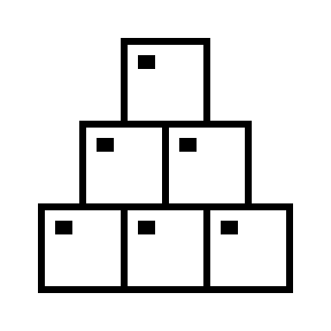
Lab: Micro frontends with Single SPA

Slide 71
Performance Optimization

Slide 72
Measuring Performance
Lighthouse
React DevTools Profiler
reportWebVitals();

Slide 73
How Code Splitting Works
Code Splitting is a feature supported by bundlers like Webpack and Browserify which can create multiple bundles that can be dynamically loaded at runtime. It helps in reducing the initial load time by splitting the application into smaller chunks which are loaded as they are needed.

Slide 74
Dynamic Imports
The import() syntax is a function-like expression that allows loading an ECMAScript module asynchronously and dynamically.
import (‘./SomeComponent’)
Import declarations (import SomeComponent from ‘./SomeComponent) is static. The imported module is evaluated at load time.

Slide 75
React.lazy() and Suspense
React.lazy() lets you render a dynamic import as a regular component.
const SomeComponent = lazy(() => import(‘./SomeComponent’));
The component won’t be loaded until it’s rendered the first time.
Wrap a lazy-loaded component with <Suspense> to specify what should display while the component is loading.

Slide 76
Lazy & Suspense Example
const SomeComponent = React.lazy(() => import('./SomeComponent'));
function App() {
return (
<Suspense fallback={<div>Loading...</div>}>
<SomeComponent />
</Suspense>
);
}

Slide 77
Route-based Code Splitting
Delay loading components for Routes until those Routes are rendered.
function App() {
return (
<Router>
<Suspense fallback={<div>Loading...</div>}>
<Routes>
<Route exact path="/" element={<Home />} />
<Route path="/about" element={<About />} />
</Routes>
</Suspense>
</Router>
);
}

Slide 78
Performance Optimization in Class Components
shouldComponentUpdate(). Returning false from this lifecycle method will skip render().
PureComponent. Extend (instead of React.Component) to indicate that a component’s output is wholly dependent on its props (it’s “pure”). Render will be skipped if props are the same.

Slide 79
Performance Optimization in Functions
useMemo memorizes values. Use it to memorize the output of expensive calculations.
useCallback memorizes functions. Use it to avoid unnecessary renders.
React.memo: pass function components to React.memo() to cause them to skip re-rendering if the props passed are unchanged.

Slide 80
Batching Updates
Avoid extra renders by taking advantage of state’s asynchronous nature.
const handleUpdate = () => {
setState(prevState => ({
…prevState, count1: prevState.count1 + 1
}));
setState(prevState => ({
…prevState, count2: prevState.count2 + 1
}));
}
Starting with React 18, React automatically batches updates.

Slide 81
Lazy Initialization
Avoids recalculating or refetching initial state on every render.
Instead of:
const initialState = expensiveCalculation(props)
const [state, setState] = useState(initialState);
Do this:
const getInitialState = () => window.localStorage.getItem(‘state’);
const [state, setState] = useState(getInitialState);

Slide 82
Data Fetching Libraries / Hooks
SWR
React Query

Slide 83
Web Workers
Off-the-main-thread calculations

Slide 84
Use Throttling to Limit Event Handlers
Throttling is used to create a throttled function that can only call the func parameter once per every wait milliseconds.
import React, { useEffect } from 'react';
import { throttle } from 'lodash';
https://codesandbox.io/s/throttling-dr695r?file=/src/ThrottlingExample.js

Slide 85
Debouncing
The Lodash debounce function returns a debounced function that will execute a function after X milliseconds pass since its last execution.
Use for limiting API requests.
https://codesandbox.io/s/throttling-dr695r?file=/src/DebouncingExample.js

Slide 86
Introduction to Server-Side Rendering
What is SSR?
Why is it important?

Slide 87
Client-Side Rendering vs Server-Side Rendering
Key differences
Pros and Cons

Slide 88
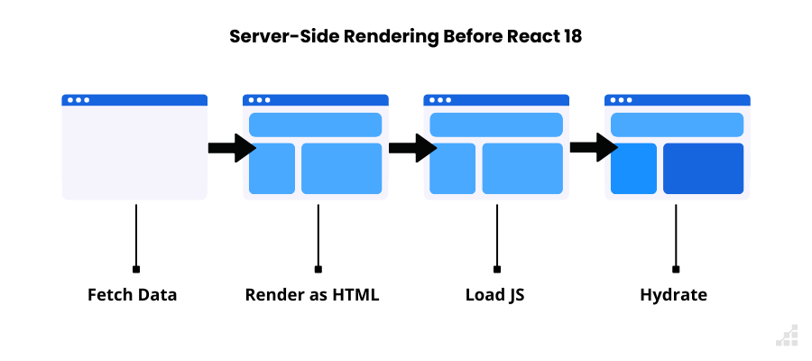
How SSR Works (< React 18)
Process
Diagrammatic representation

Slide 89
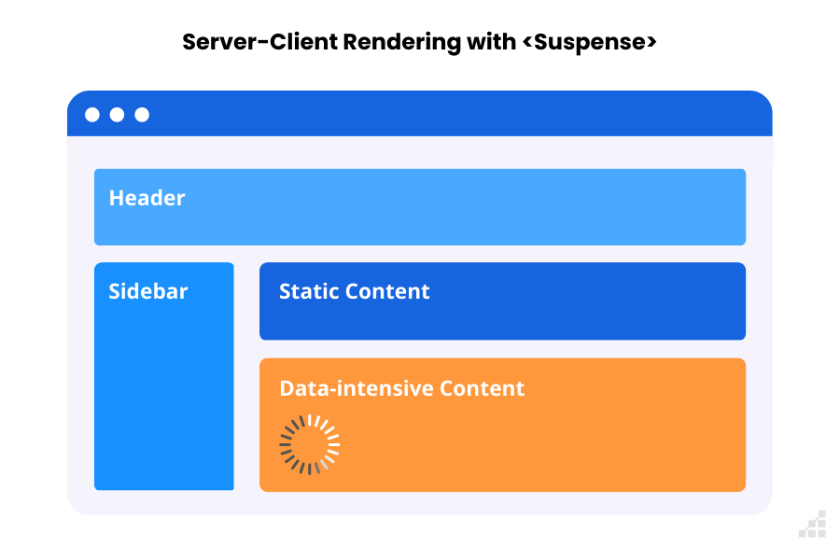
How SSR works in React 18

Slide 90

Introducing Server Components

Slide 91
Tools for SSR in React
Next.js
Gatsby

Slide 92
Advantages of SSR
SEO benefits
Faster initial page loads

Slide 93
Drawbacks of SSR
Server load
Complexity

Slide 94
Hydration
What is Hydration?
Using client-side JavaScript to add application state and interactivity to server-rendered HTML
How it works
import { hydrateRoot } from 'react-dom/client';
hydrateRoot(document.getElementById('root'), <App />);
https://codesandbox.io/s/hydrate-qyy2mr?file=/public/index.html

Slide 95
Lab: Performance Optimizations

Slide 96
Security Best Practices

Slide 97
Use the Latest Version of React
Always make sure you're using the latest version of React and its associated libraries. This ensures that you benefit from the latest security patches and updates.

Slide 98
Escape User Input
React automatically escapes content rendered with JSX to prevent Cross-Site Scripting (XSS) attacks. However, when you use methods like dangerouslySetInnerHTML, you're bypassing this protection. Use this method sparingly, and always sanitize any user input or content that might be rendered.

Slide 99
Avoid Inline Event Handlers with User Data
Do not inject user data directly into inline event handlers in JSX. It could create potential security risks if not properly sanitized.

Slide 100
Beware of Third-party Components
Not all npm packages or third-party React components follow best security practices. Always audit and review the code of third-party components before including them in your project.

Slide 101
Use HTTPS
Serve your React application over HTTPS to ensure that data exchanged between the client and the server remains encrypted and secure.

Slide 102
Manage Secrets Properly
Never hard-code sensitive information or secrets in your React code. Use environment variables or server-side configurations for this.

Slide 103
Validate and Sanitize Prop Data
If you're passing data to components via props, ensure the data is validated and sanitized, especially if the data originates from user input or external sources.

Slide 104
Handle Redirections Carefully
If your application includes redirections based on user input, validate the input to ensure that it doesn't lead to unintended or malicious URLs.

Slide 105
Use Tokens for Authentication
When implementing authentication, consider using JWT (JSON Web Tokens) or similar token-based methods, and store them securely. Avoid storing them in local storage due to potential XSS attacks; instead, use HttpOnly cookies.

Slide 106
Keep Dependencies Updated
Regularly update all your project's dependencies. This helps patch vulnerabilities that might exist in older versions of libraries you're using.

Slide 107
Regularly Audit Dependencies
Use tools like npm audit or yarn audit to identify and fix vulnerabilities in your project's dependencies.

Slide 108
Implement Rate Limiting and Throttling
If your React app communicates with an API or server, implement rate limiting to prevent abuse.

Slide 109
Use Strong CORS Policies
If your React app communicates with an API, ensure that Cross-Origin Resource Sharing (CORS) policies are correctly set up to limit which domains can access your resources.

Slide 110
Q&A

