Slide 1
Cracking the Attrition Code: Predicting IBM Employee Attrition
By : Christopher Le

Slide 2
Understanding the Problem
Employee Attrition – loss of employees from an organization due to voluntary or involuntary reasons.
Rate at which employees leave a company’s workforce and are not immediately replaced over a specific time.
Employee Attrition impacts organizations in several ways:
Time-consuming and costly in terms of hiring and training new employees
Lose experienced employees
Impacts profits and productivity
Stakeholders: HR department, supervisors, managers
Develop strategies to minimize employee attrition rates and motivate employees to stay in their jobs.
Identify factors and insights important for employee retention
Notes:
Employees are the foundation of a strong and successful company as they are essential to providing the goods and services that the company offers.
Employee attrition basically refers to the loss of employees, similar to employee turnover.
It can be measured as the rate at which employees leave the company’s workforce and aren’t immediately replaced.
Why is this important or relevant?
Employee attrition can be a big issue for organizations due to capital and time costs used to hire and train new employees, lost of experienced employees with high levels of knowledge, and ultimately reduction in profits due to loss of productivity.
Predicting employee attrition before it happens will allow employers and managers to develop strategies to minimize employee attrition rates and motivate employees to stay in their jobs.
This project can also help determine the underlying factors and insights important for employee retention.

Slide 3
Problem Statement
How can companies such as IBM reduce their rate of employee attrition and better manage their workforce by identifying what types of employees are leaving, and predicting employee attrition?
Goal: build a supervised classification model to predict attrition of employees for the company
Success Criteria: reduce employee attrition by 10% by building an attrition prediction model that can predict whether employees will attrition with at least 75% accuracy.

Slide 4
Dataset
Dataset was retrieved from Kaggle
Column Description
• Demographic Information: 'Age', 'DistanceFromHome', 'Education', 'EducationField', 'Gender', 'MaritalStatus', 'Over18’
• Work Characteristics: 'BusinessTravel', 'Department', 'JobInvolvement', 'JobLevel', 'JobRole', 'OverTime', 'PerformanceRating', 'StandardHours’
• Salary-Related: 'DailyRate', 'HourlyRate', 'MonthlyIncome', 'MonthlyRate', 'PercentSalaryHike', 'StockOptionLevel’
• Satisfaction: 'EnvironmentSatisfaction', 'JobSatisfaction', 'RelationshipSatisfaction', 'WorkLifeBalance’
• Time-Related: 'NumCompaniesWorked', 'TotalWorkingYears', 'TrainingTimesLastYear', 'YearsAtCompany', 'YearsInCurrentRole', 'YearsSinceLastPromotion', 'YearsWithCurrManager
• Other: 'EmployeeCount', 'EmployeeNumber'
1470 rows x 35 columns
This is a fictional data set created by IBM data scientists and its main purpose was to demonstrate the IBM Watson Analytics tool for employee attrition.
Notes:
https://www.kaggle.com/datasets/pavansubhasht/ibm-hr-analytics-attrition-dataset
Data sourced from Human Resources Department of IBM
CSV file

Slide 5
01
Data Wrangling

Slide 6
Data Wrangling
Initial Shape: 1470 rows x 35 columns
No duplicates or missing values
Four columns were dropped:
‘EmployeeCount’
‘EmployeeNumber’
‘StandardHours’
‘Over18’
Potential outliers:
‘YearsInCurrentRole’, ‘YearsSinceLastPromotion’, and ‘YearsWithCurrManager’
Outlier values were kept in data because they may help with model prediction
Final shape: 1470 rows x 31 columns
Target Variable: Attrition
Notes:
'EmployeeCount' and 'EmployeeNumber' were dropped because they were irrelevant features to our analysis.
'StandardHours' and 'Over18' were features with only one unique value for all employees
Outlier values were kept in data because they may be legitimate data points,
So they would help with model prediction in terms of providing valuable information on whether time at company or long-term stability impacts a person's behavior and attitude towards attrition.
Outliers can sometimes represent legitimate data points that are not errors or anomalies but are actually representative of the underlying population.
these points could distort your analysis or lead to incorrect conclusions.

Slide 7
02
Exploratory Data Analysis

Slide 8
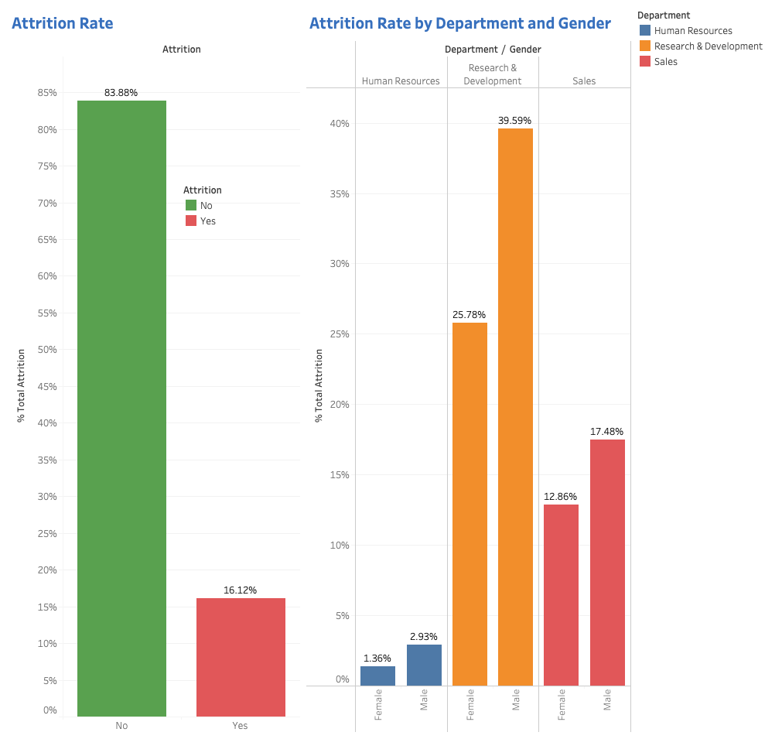
The Distribution of Attrition
16.12% of employees left the company overall
Of those employees who left the company, males were more likely to attrition
The Research & Development and Sales departments made up the majority of employees leaving the company
The Research & Development department had the highest rate of attrition.
Notes:
This graph shows that the overall attrition rate was 16.12%
As you can see, there is a significant class imbalance, 84% employees who did not attrition compared 16% attrition.
When breaking down the attrition by gender, we can see that regardless of department males were more likely to attrition than females.
Most employees who left the company were from the Research & Development or Sales departments.
The Research & Development had the highest rate of attrition overall, but this may be partly attributed to the department having more employees in total.

Slide 9
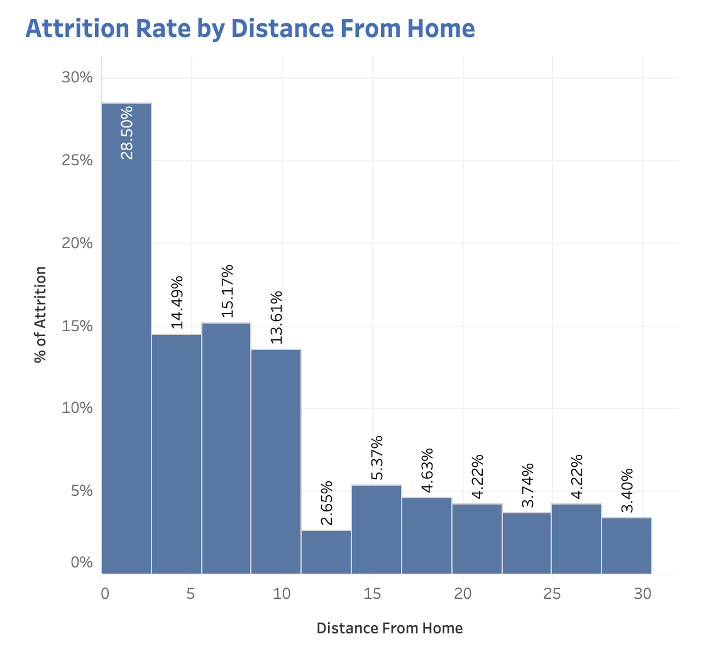
Attrition Rate and Distance From Home
The attrition rate was higher for employees who live within 10 miles of the company.

Slide 10
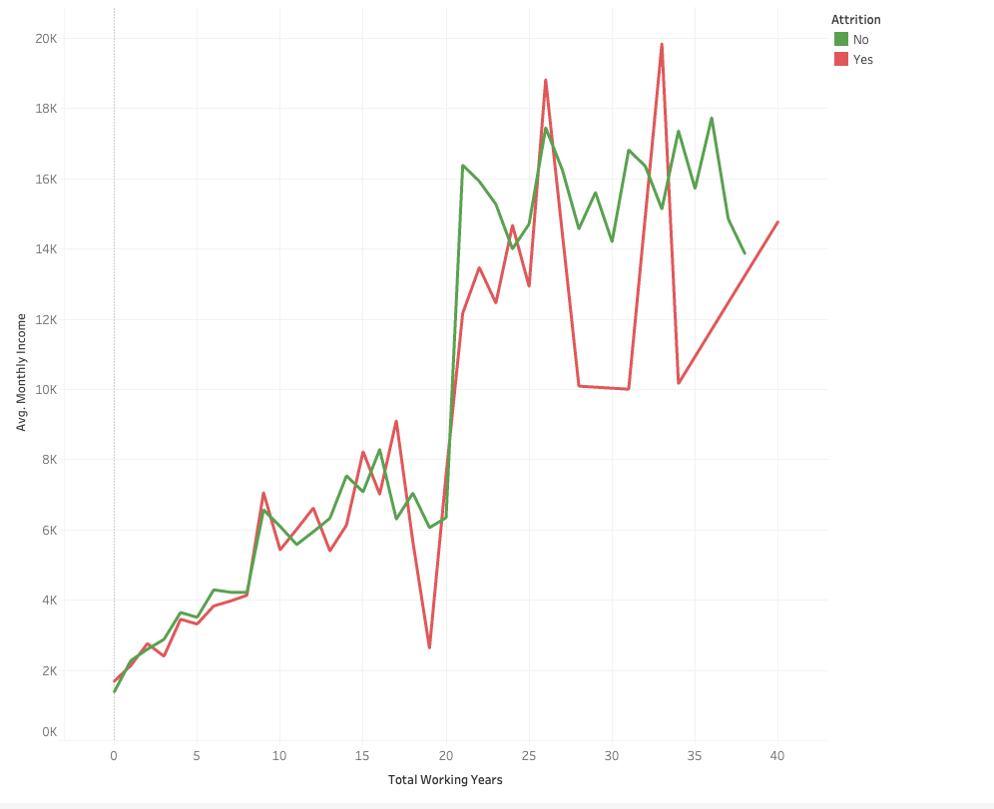
Monthly Income and Years Worked
Average monthly income generally increased as total working years increased.
Notes:
We can see from the line graph that total working years generally increased as the average monthly income increased.
Compared to employees who stayed with the company, employees who attrition were more likely to experience significant drops in average monthly income during their later working years. However, it can be due to a small sample size

Slide 11
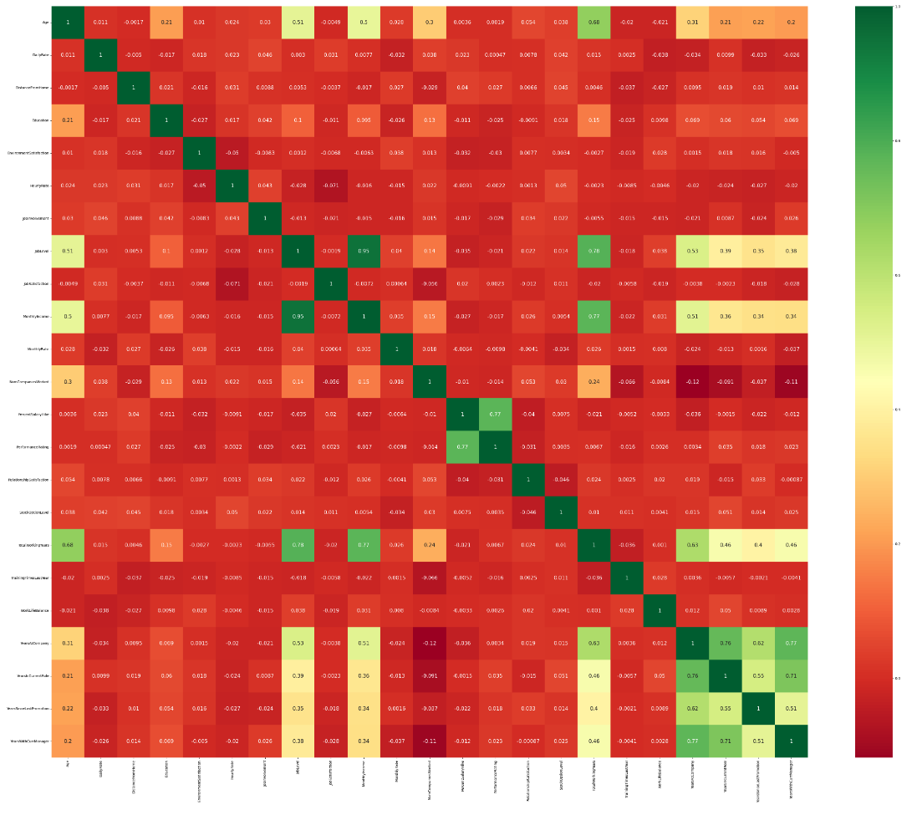
Correlation Heatmap
Most of the features were poorly correlated with each other.
The few relatively strong positive correlation between:
‘JobLevel’ & ‘MonthlyIncome’
‘YearsAtCompany’ & ‘YearsWithCurrManager’
‘YearsInCurrentRole’ & ‘YearsWithCurrManager’
Notes:
However, there are a few highly correlated features.
Specifically, there is a relatively strong positive correlation between: ‘JobLevel’ & ‘MonthlyIncome’, ‘YearsAtCompany’ & ‘YearsWithCurrManager’, and ‘YearsInCurrentRole’ & ‘YearsWithCurrManager’.
Furthermore, there is a negative correlation between ‘YearsAtCompany’ & ‘NumCompaniesWorked’, and ‘JobSatisfaction’ & ‘HourlyRate’.

Slide 12
03
Modeling

Slide 13
Modeling Overview
Type: Supervised Learning
Binary Classification
Models
0 – Employee stayed with company
1 – Employee attrition from company
Logistic Regression
Random Forest Classifier
XGBoost Classifier
Notes:
70/30 train test split, StandardScaler
Consider class imbalance problem
stratifying during train_test_split to preserves the proportion of how data is distributed in the attrition class after split(16/84).
Logistic regression works by estimating the probability of an instance belonging to a particular class using a logistic function, which maps any real-valued input to a value between 0 and 1.
GridSearchCV for hyperparameter tuning, scoring=roc_auc
Solver, penalty (regularization), penalty strength C
Random forests involve training decision trees on random subsets of the features as well as the training. The predictions of these trees are then combined using a simple voting scheme.
RandomizedSearchCV, scoring=roc_auc
N_estimators, max_depth, min sample split/leaf
XGBoost uses a gradient boosting algorithm that trains each tree in sequence to correct the mistakes of the previous tree.
RandomizedSearchCV, scoring=roc_auc
N_estimators, learning_rate, max_depth, min sample split/leaf

Slide 14
Model Comparison
Model | ROC-AUC | Accuracy | Weighted-Average Precision | Weighted-Average Recall | Weighted-Average F1-Score
Logistic Regression | 0.8232 | 0.8776 | 0.86 | 0.88 | 0.86
Random Forest Classifier | 0.8177 | 0.8571 | 0.86 | 0.86 | 0.81
XGBoost Classifier | 0.8403 | 0.8798 | 0.88 | 0.88 | 0.85
Notes:
ROC AUC - provides a measure of how well the model can distinguish between employees who will leave and employees who will stay based on their predicted probabilities.
Accuracy score - which measures the proportion of correct predictions made by the model. But not ideal
Weighted average scores take into account the class imbalance in target variable
High precision score (few FP) - good at identifying which employees will potentially attrition.
High recall score (high TP) - good at minimizing instances of employees who will attrition, but are misclassified as staying.

Slide 15
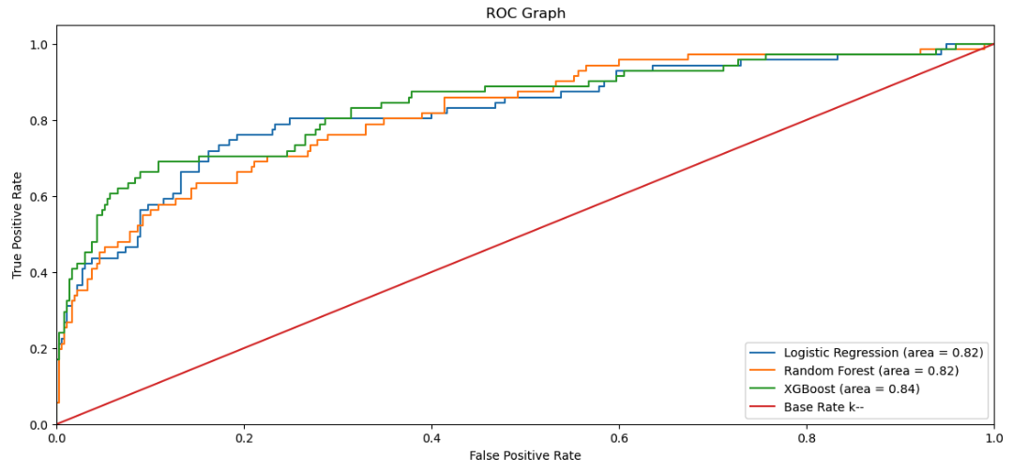
Model Comparison
Graph visualizing ROC Curve of the different models.

Slide 16
Final Model Selection
XGBoost Classifier Model
Highest AUC score: 84.03%
Highest accuracy score: 87.98%
Feature importance → feature selection for further analysis
How model handled misclassifications:
13% false positive
12% false negatives
Notes:
When predicting employee attrition, about 13% of the time it predicted an employee will attrition, when in fact they are staying, while 12% of the time it predicted an employee will stay, when they are actually leaving.
Logistic Regression
Pros: simple and fast, robust to small amounts of multicollinearity/non-normality, interpretability of coefficients
Cons: may not capture complex relationships, cannot handle non-linear relationships, sensitive to outliers
Random Forest
Pros: high accuracy, feature importance, robust to outliers, scalability to large datasets with high dimensionality
Cons: computationally expensive/memory usage, bias towards majority class when class are imbalanced, overfitting,
XGBoost
Pros: high accuracy, fast execution, feature importance, handle missing values
Cons: interpretability of output, many tuning parameters, computationally expensive, overfitting, can have bias towards majority class when class imbalanced

Slide 17
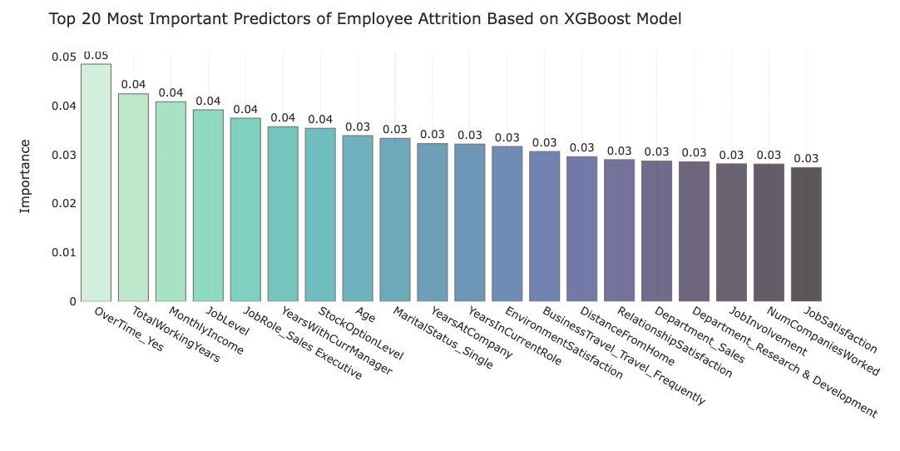
Analysis Results
OverTime_Yes
TotalWorkingYears
MonthlyIncome
JobLevel
JobRole_Sales Executive
Notes:
Based on the final model, the top 5 most important predictors/features of employee attrition are:
OverTime_Yes: employees who work overtime are most likely to leave the company.
TotalWorkingYears: employees with more total working years or work experience are less likely to attrition.
MonthlyIncome: employees with higher monthly income or high wages are less likely to leave the company.
JobLevel: employees with a higher job level are less likely to attrition from the company.
JobRole_Sales Executive: sales executive employees are most likely to attrition from company compared to employees with other job roles.

Slide 18
04
Recommendations

Slide 19
Strategic Retention Plan
• Address Overworking: Implement policies and procedures to reduce excessive overtime and promote a healthy work-life balance for employees.
• Evaluate Compensation: Review the compensation packages offered to employees, with a particular focus on those in sales executive roles. Ensure that the compensation is competitive and provides a sufficient financial incentive for employees to remain with the company.
• Foster Career Growth: Offer professional development opportunities, such as training and mentorship programs, to help employees progress in their careers, and increase their job level.
• Improve Job Satisfaction: Conduct regular surveys to understand employees' perceptions of the company, their job roles, and the work environment. Use this information to identify areas where improvements can be made and take steps to address any concerns.
• Offer Employee Benefits: Evaluate the employee benefits offered by the company, including health insurance, retirement plans, and paid time off, and ensure that they are competitive with those offered by other companies in the industry.
Notes:
Address Overworking: This could include setting clear limits on the number of hours employees are expected to work each week, providing paid time off and other incentives to encourage employees to take time off when needed, and promoting the use of flexible schedules to help employees manage their workloads.
Evaluate Compensation: Consider implementing a merit-based pay structure that rewards high-performing employees.
Foster Career Growth: Provide clear pathways for employees to advance within the company and communicate expectations for promotions.
Improve Job Satisfaction: Conduct regular surveys to understand employees' perceptions of the company, their job roles, and the work environment. Use this information to identify areas where improvements can be made and take steps to address any concerns.
Offer Employee Benefits: Evaluate the employee benefits offered by the company, including health insurance, retirement plans, and paid time off, and ensure that they are competitive with those offered by other companies in the industry.

Slide 20
Conclusions
Using the XGBoost Classifier Model, we were able to build a attrition prediction model that was able to predict which employees will become attrition with almost 88% accuracy.
Through this model, the HR department will be able to identify what types of employees are choosing to leave and determine which employees are at risk to leave next.

Slide 21
Future Work
Deploying model in production environment in order to learn from live data.
Running A/B testing using Strategic Retention Plan recommendations to see impact on employee attrition.
Obtain data on other factors that can contribute to employee attrition such as management style of supervisors/managers, or level of competition in the job market.
Resampling methods such as SMOTE (Synthetic Minority Over-sampling Technique) or ADASYN (Adaptive Synthetic Sampling) can be used to handle the class imbalance issue and improve model performance.
More features engineering can be implemented to improve model performance by selecting only the most relevant features so that the model can learn more efficiently and make better predictions.

Slide 22
Thanks!
Do you have any questions?
lecm130@gmail.com
https://github.com/chrismle/Employee_Attrition

