Slide 1
Defining NBA Player Archetypes using Clustering
By: Christopher Le

Slide 2
UNDERSTANDING THE PROBLEM
Fantasy NBA Basketball
13+ million players in 2022¹
$3.8 billion industry in 2022²
Fantasy teams dependent on NBA player statistical production
Traditional NBA Positions:
Point Guard, Shooting Guard, Small Forward, Power Forward, Center
NBA players no longer can be defined by the positions they play in.
Not representative of player’s on-the-court statistical production
Need new way to group players into different archetypes beyond positioning
Goal: use unsupervised learning models to define NBA player archetypes that better represents how they contribute to the team on the court.
Notes:
References:
https://thefsga.org/industry-demographics/
https://dataintelo.com/report/global-fantasy-basketball-market/
Traditionally, NBA players are classified into 5 positions based on the general strategic roles they play on the court.
However, players have begun to expand their basic skill set to assert dominance all over the court. These players no longer can be defined by the positions they play in.
With that in mind, I hope to provide a new way to group players into certain classifications beyond positioning so that NBA teams can form rosters with players that can further complement each other.
Furthermore, each year many play NBA fantasy leagues with aspirations of winning the championship. However, many fall short of completing their goals because they are unable to pick players who contribute to their needed statistical categories.
The goal of this project is to use unsupervised learning models to define new clusters to group NBA players into.

Slide 3
DATASET
The NBA player stats dataset was retrieved from Kaggle. This dataset contains 2021-2022 regular season NBA player stats per game.
Notes:
https://www.kaggle.com/datasets/vivovinco/nba-player-stats

Slide 4
Data Wrangling
01

Slide 5
DATA WRANGLING
Initial Shape: 812 rows x 30 columns
Issue 1 - Duplicate Player Entries
Dropped 207 rows contained names for players who changed teams
Issue 2 – Columns Unrelated to Game Statistics
Dropped 4 columns: rank (RK), age (AGE), team (Tm), & games started (GS)
Issue 3 – Inconsequential NBA Players
Filtered out players playing < 10 games.
Dropped 105 entries
Final shape: 500 rows x 26 columns
Notes:
The raw NBA Player Game Statistic dataset contained 812 rows with 30 columns
Issue 1: Duplicate Player Entries
The first problem encountered when exploring the raw dataset was that it contained duplicate player names. This was because the dataset accounted for players who played on multiple teams during the NBA season by having an entry with a player’s total statistics as well as separate entries with statistics based on each team a player was on.
For example, Aaron Holiday played 63 total games (TOT) during the NBA regular season, but 41 games were with the Washington Wizards (WAS) and 22 games were with the Phoenix Suns (PHO). So, there would be three separate Aaron Holiday entries: Aaron Holiday (TOT), Aaron Holiday (WAS), and Aaron Holiday (PHO). Since we are only focusing on a player’s comprehensive season statistics, the additional 207 rows containing multiple team player’s statistics spit into different teams were dropped.
Issue 2: Columns Unrelated to Game Statistics
There were 30 features, but not all of them were relevant to our analysis of a player’s individual game statistics.
Thus, the rank (RK), age (Age), team (Tm), and games started (GS) columns were dropped.
Issue 3: Inconsequential NBA Players
Lastly, a baseline check of the distribution of feature values was done to spot any potential outliers that may skew player statistics. There is potential for a player to skew the data if their statistics were based only on a handful of games. A more in-depth look at the distribution of games played revealed that there was a consider portion of players skewing the data to the right.
Since we want to analyze NBA players who have realistically opportunities to play and impact the game, we filtered the dataset to only contain players who played at least 10 games.
This filtered out 105 players from the dataset.

Slide 6
Exploratory Data Analysis
02

Slide 7
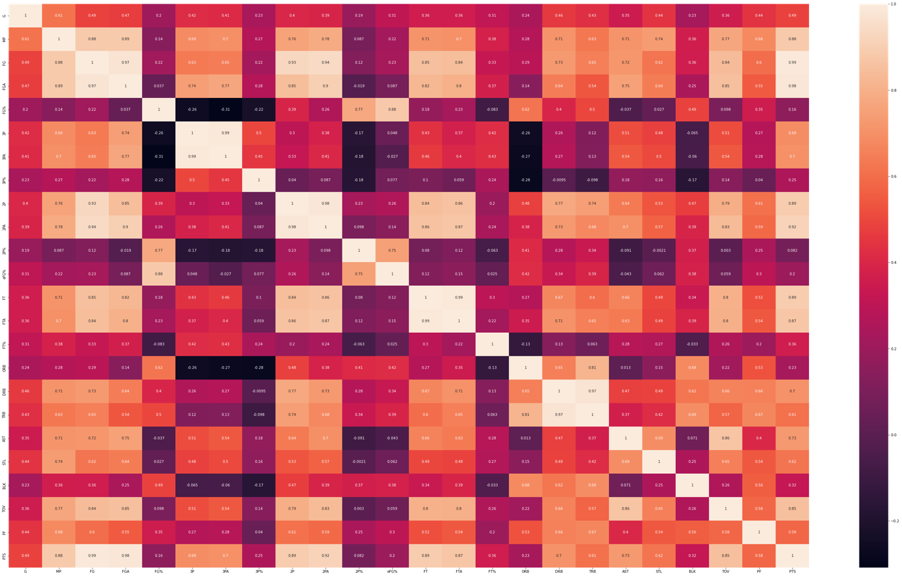
A heatmap representing the correlations between different features. Many features were highly correlated including: "FG"/"FGA", "3P"/"3PA", "2P"/"2PA", "FT"/"FTA", and "DRB"/"TRB".
Notes:
These correlations were expected because those stats are inherently dependent on each other.
Some features that were surprisingly highly correlated were: "AST"/"TOV", "FT"/"2P", "FG"/"2P".
Assists (AST) may be associated with more Turnovers (TOV) because players who pass the ball often have the ball in their hand more frequently and thus have more chances to turn the ball over.

Slide 8
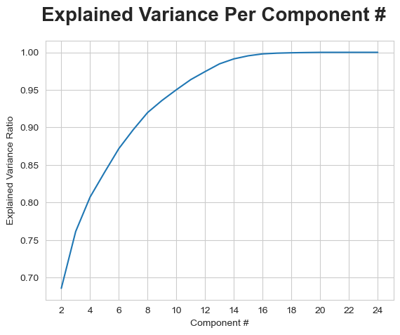
The first 5 components account for 84% of the variance and the first 10 components for 95% of the variance
Notes:
This figure depicts that the first 5 components account for ~84% of the variance and the first 10 components for ~95% of the variance.
I applied a Principal Component Analysis on the data as a means for dimensionality reduction for more efficient analysis. I narrowed it down to the first 10 PCA components because they account for about 95 of the variances of the data.

Slide 9
Modeling
03

Slide 10
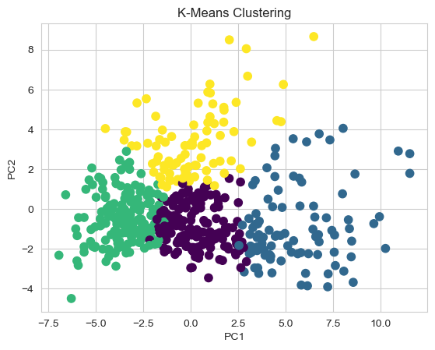
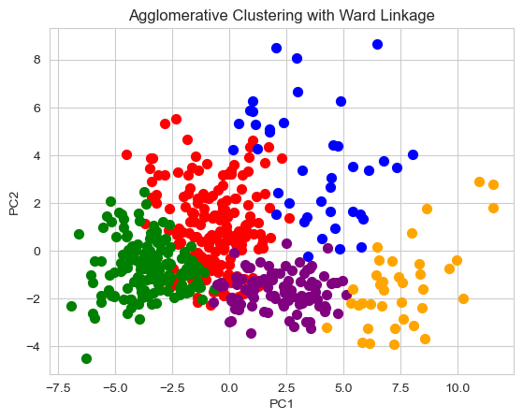
CLUSTERING MODELS
K-Means Clustering (k=4)
Optimal K based on: Silhouette Method
Average silhouette scores: 0.222
Agglomerative Hierarchal Clustering with Ward linkage (k=5).
Optimal K based on: Dendrogram
Average silhouette scores: 0.184
Notes:
Comparison of the scatterplots visualizing the clusters
Figure on the right displays a scatterplot of the K-Means Clustering Model with K=4.
To identify the optimal number of K to choose for my model, I used the Silhouette Method.
Based on the Silhouette Method, the optimal number of K was K=4, with an average silhouette score of 0.222.
Figure on the left shows scatterplot with Agglomerative Clustering method applied.
The optimal number of clusters was 5, which I determined using a dendrogram which allowed me to identify the area on the chart with the highest vertical distance that does not intersect with any clusters.
Average silhouette score: 0.184

Slide 11
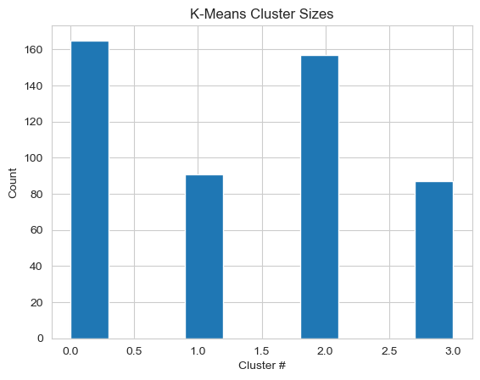
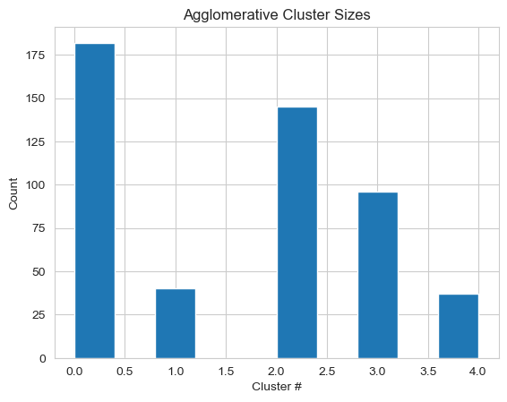
CLUSTER SIZES
Comparison of the cluster size distributions.
Final Model Selection: Agglomerative Clustering
Notes:
For the final model selection, I decided to use the Agglomerative Clustering with Ward Linkage.
While the K-Means Clustering had a higher Silhouette Coefficient score of 0.222 (n_clusters = 4) compared to 0.184 for Agglomerative Clustering (n_clusters = 5), I chose to use the Agglomerative Clustering because it offered a clear selection for the optimal number of clusters at K=5 and I also felt that 4 clusters were not enough to differentiate a pool of 500 players.
KC cluster sizes: 0 (165), 1 (91), 2 (157), 3 (87)
AC cluster sizes: 0 (182), 1 (40), 2 (145), 3 (96), 4 (37)

Slide 12
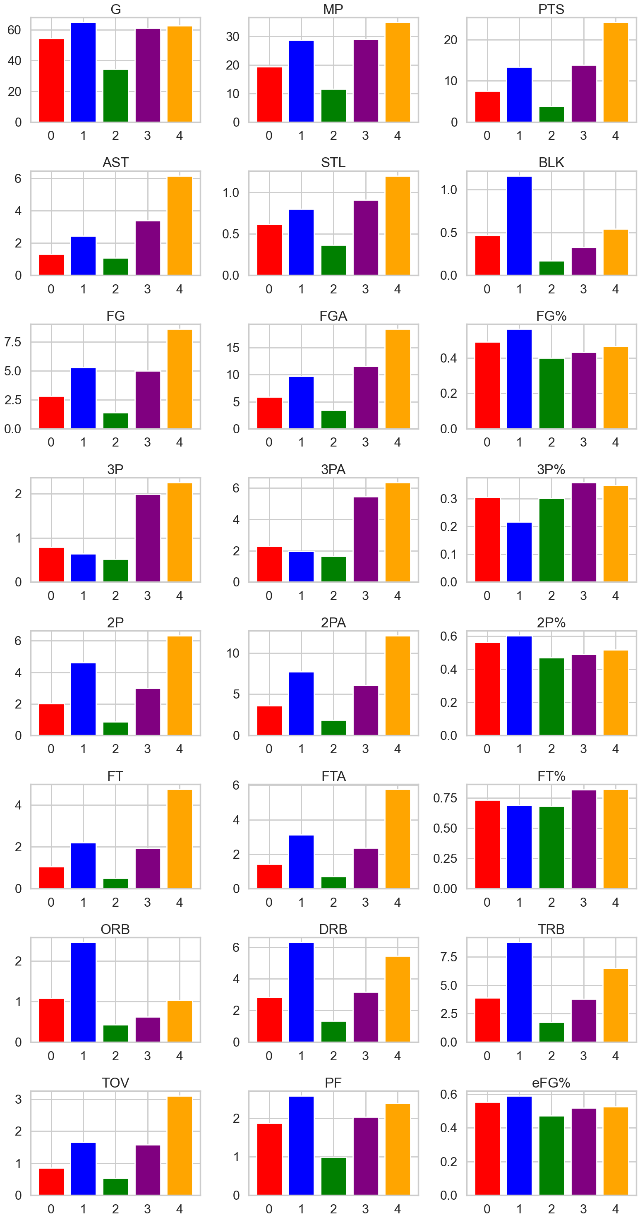
CLUSTERING ANALYSIS: ARCHETYPES
Cluster 0 (Red): Role Players
Cluster 1 (Blue): Traditional Big Men
Cluster 2 (Green): Bench Players
Cluster 3 (Purple): 3-and D- Players
Cluster 4 (Orange): Versatile All-Around Players
Notes:
Cluster 0 (Red): Role Players
Averaged > 54 games played at 19.4 minutes
Low- to Mid- tiered in most categories: PTS, AST, STL, BLK, TRB
Notable Players: LaMarcus Aldridge, Danny Green, Danilo Gallinari
Cluster 0 had the highest count of players in the pool with 182. I would interpret this group as the role players because while they do not excel in any particular area, but they play quality minutes and contribute to a wide range of statistical categories.
Cluster 1 (Blue): Traditional Big Men
Highest-tiered in TRB, BLK, FG%, 2P%
Low-tiered in 3PA, 3P%, FT%
Notable Players: Jarret Allen, Rudy Gobert, Clint Capela
Cluster 1 had players that I would consider as traditional big men– meaning they play close to the basket and have high rebounding numbers, blocks, and field goal percentage. However, they are unable to stretch the floor and shoot, thus they have low 3-point and free throw percentage.
Cluster 2 (Green): Bench Players
Averaged only 34 games at 11.5 minutes
Lowest-tiered in every category besides 3P%
Notable Players: Jose Alvarado, Kent Bazemore, Troy Brown Jr.
Cluster 2 was the cluster with the second highest number of players at 145. I consider them bench players due to their low number of games and minutes played– indicating their inability to consistently get on the floor. As a result, these players have the lowest averages across the board.
Cluster 3 (Purple): 3- and D- Players
2nd highest-tiered in 3P, FT%, PTS
High in defensive statistics: STL, BLK
Notable Players: Desmond Bane, Mikal Bridges, Malcom Brogdon
Cluster 3 had players I would categorize as 3-and-D players. These players specialize mainly in 3-point shooting and are key defensive assets to the team. Accordingly, this cluster had high steals, blocks as well as 3-point makes.
Cluster 4 (Orange): All-Stars
Highest-tiered in most categories including MP, PTS, AST, STL, FTA, TOV
Notable Players: Giannis Antetokounmpo, Stephen Curry, Lebron James
Cluster 4 had versatile players that contributed across the board and had the highest averages in most categories. They are rare in the NBA, and so, this cluster had the lowest number of players with only 37.

Slide 13
TAKEAWAYS
Through Agglomerative Hierarchal Clustering, I was able to group players into five different archetypes that had a blend of players from traditional positions.
Using these redefined clusters, teams can now assemble rosters with NBA players based on their on-the-court statistical contributions rather than what positions they played.
Archetypes provide an efficient way for NBA fantasy team managers to shore up their teams by picking players based on their statistical category needs.

Slide 14
FUTURE RESEARCH
The dataset used for these models only contained data for the 2021-2022 NBA season. The clustering models can be improved by incorporating data from multiple NBA seasons.
This clustering model provide 5 clusters. In the future I want to group players into even more clusters to see if there is a way to further differentiate players.
I would like to expand the dataset to incorporate advanced gameplay statistics that may illustrate playstyles such as spot-up shots, screen assists, isolated field goal attempts, transition shots made, deflections, charges drawn, or loose balls recovered. How do individual playstyle characteristics influence statistical contributions?

Slide 15
THANKS
Do you have any questions?
Christopher Le
Email: lecm130@gmail.com
https://github.com/chrismle/NBA-Clustering

