Slide 1

Who Helps you WIN?!

Slide 2

Introduction
What are we doing?
  We are going to show you who on your fantasy football team contributes most to your point total. Where do they come from? What team are they on now? What position do they play? How old are these guys anyway? How much does position contribute to your point total?
proc import datafile="M:\My_Private_Files\stat356\final\test.xlsx"
out=final356.test replace
dbms=xlsx;
run;
proc import datafile="M:\My_Private_Files\stat356\final\2022 Fantasy Points.xlsx"
out=final356.fantasy replace
dbms=xlsx;
run;

Slide 3
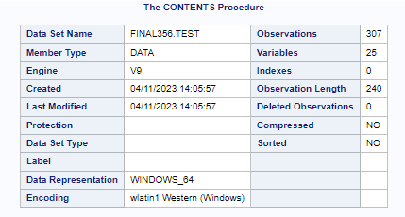
Contents Procedure
We are working with 307 players in this data set
We have 25 variables with a combination of categorical as well as numerical values
The data used was manually pulled from pro-football-reference.com, a reference website for everything to do with professional American Football
proc contents data=final356.test;
run;

Slide 4
Variables: Pt.1
Player: First and Last name of player
State: The state the player was born in
College: The last college the player went to
Team: The team the player was on for a majority of the 2022 season
Position: The position the player plays
Age: How old the player was at the start of the 2022 season
Games: How many games the player played in in the 2022 season

Slide 5

Variables: Pt.2
Player Variables
Pass_Yards: Total Passing Yards by the player for the 2022 season
Pass_TDs: Total Passing TDs
Ints: Total Interceptions
Rush_Yards: Total Rushing Yards
Rush_TDs: Total Rushing TDs
Receptions: Total Receptions
Rec_Yards: Total Receiving Yards
Rec_TDs: Total Receiving TDs
Fumbles: Total Fumbles
Two_Pt: Total Two-Point Conversions

Slide 6

Variables: Pt.3
Kicker Variables
XP: Total Extra Points
FG_30: Total Field Goals (0-39 yards)
FG_40: Total Field Goals (40-49 yards)
FG_50: Total Field Goals (50-59 yards)
FG_60: Total Field Goals (60+ yards)
FG_Miss: Total Field Goal Misses

Slide 7

Variables: Pt.4
Total: Total number of fantasy points in the 2022 season, calculated with the formula detailed on the next couple slides
Per_Game: Total/Games

Slide 8

Formula:
Player Stats
Total =
Pass_Yards * .04 + Pass_TDs * 4 + Ints * -2
+ Rush_Yards * .1 + Rush_TDs * 6
+ Receptions + Rec_Yards * .1 + Rec_TDs * 6
+ Fumbles * -2 + Two_Pt * 2

Slide 9

Formula:
Kicking Stats
Total =
XP + FG_30 * 3 + FG_40 * 4
+ FG_50 * 5 + FG_60 * 6 + FG_Miss * -1

Slide 10
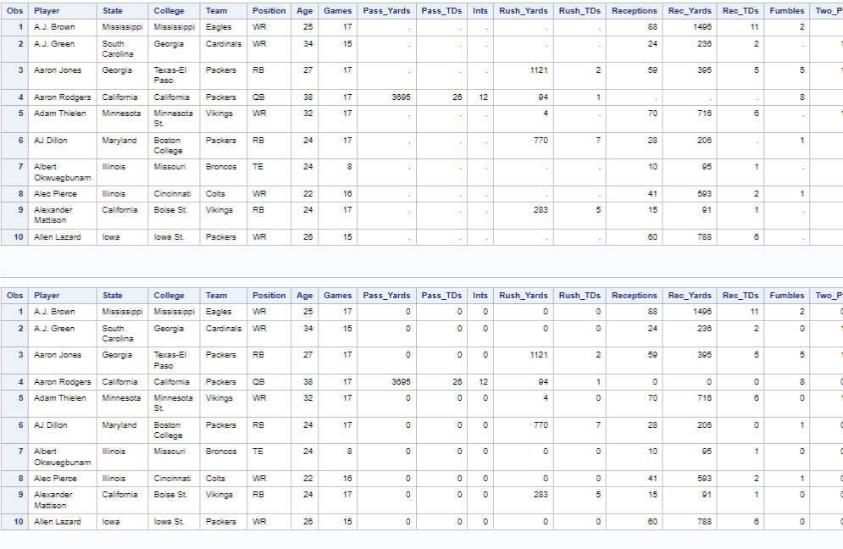
Data Tables
The first data table shows our data set when all ZERO values are removed.
The second data table shows our data set when all ZERO values are included.
proc print data=final356.test (obs=10);
run;
proc print data=final356.fantasy (obs=10);
run;

Slide 11
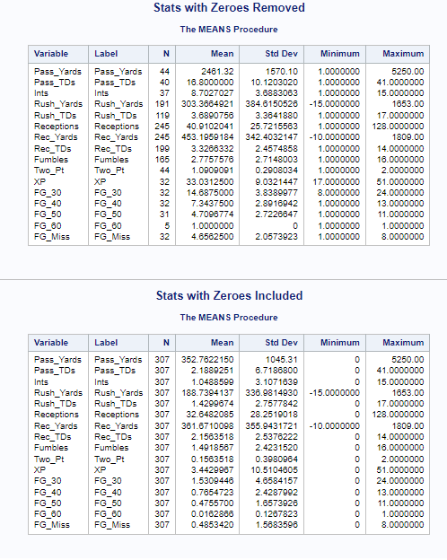
Means Procedure
Many discernable differences between the data sets depending on whether the zeros are included or not.
proc means data=final356.test;
title "Stats with Zeroes Removed";
vars Pass_Yards Pass_TDs Ints Rush_Yards Rush_TDs Receptions Rec_Yards Rec_TDs Fumbles Two_Pt XP FG_30 FG_40 FG_50 FG_60 FG_Miss;
run;
proc means data=final356.fantasy;
title "Stats with Zeroes Included";
vars Pass_Yards Pass_TDs Ints Rush_Yards Rush_TDs Receptions Rec_Yards Rec_TDs Fumbles Two_Pt XP FG_30 FG_40 FG_50 FG_60 FG_Miss;
run;
title;

Slide 12
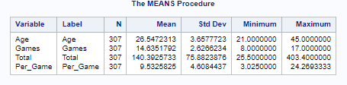
Means Procedure Continued
The means procedure also gave us some interesting statistics on the players themselves. The players in our data set had a mean age of 26 or 27 years old with an average games played of 14 or 15.
proc means data=final356.fantasy;
vars Age Games Total Per_Game;
run;

Slide 13
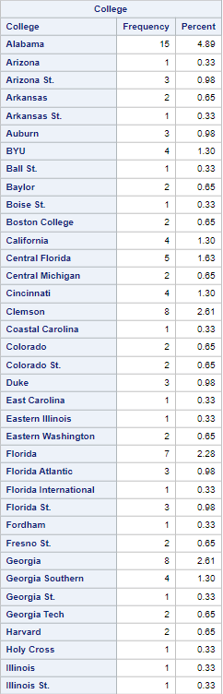
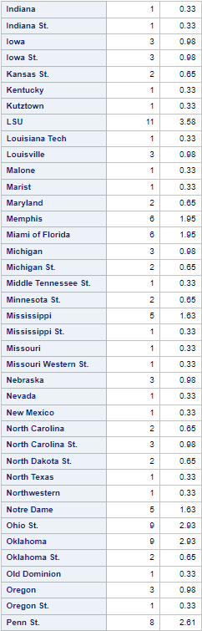
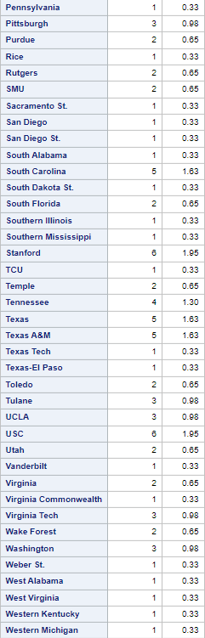
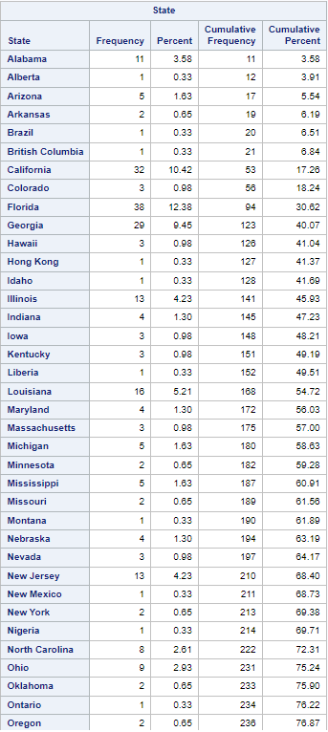
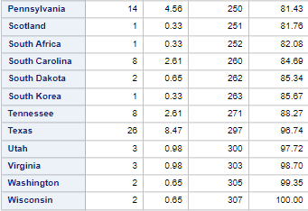

Frequency Fananza
Players per College
Players per State
Most players come from the state of Florida and the college Alabama.

Slide 14
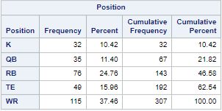
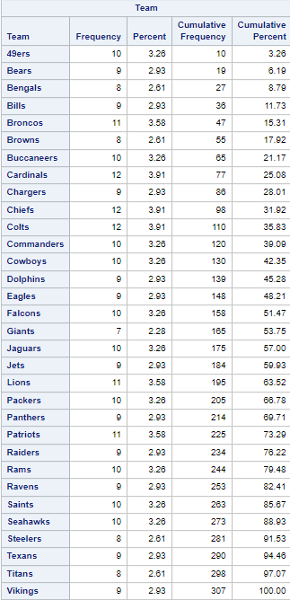
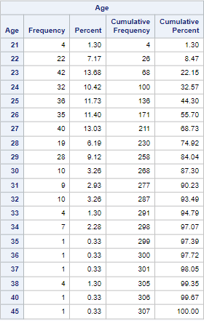
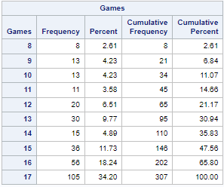
We Said Fananza
proc freq data=final356.fantasy;
tables State Team Position Age Games;
run;
proc freq data=final356.fantasy;
table College / nocum;
run;
Most available players come from the Chiefs, Cardinals, and Colts. Most players are 23 years old. There are more WR than other positions. Most players do play all 17 games.

Slide 15
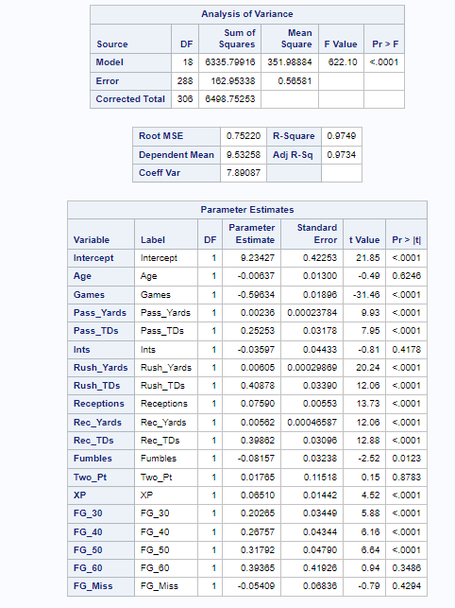
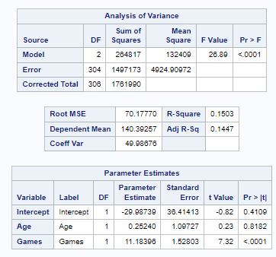
Regression Analysis Test
Per_Game vs All Other Stats
Total vs Age and Games
proc reg data=final356.fantasy;
model Total = Age Games;
run;
Age has a smaller impact than we expected

Slide 16
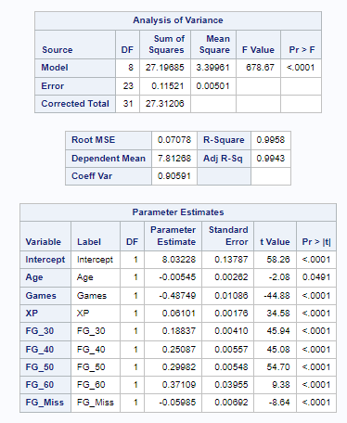
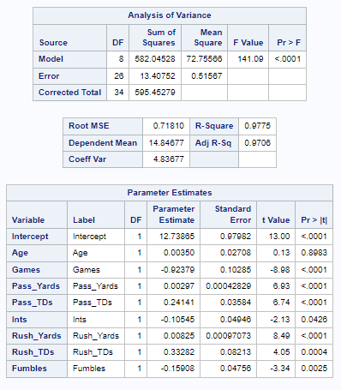
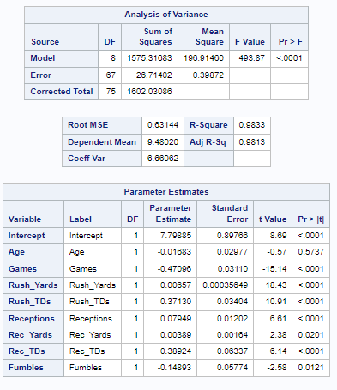
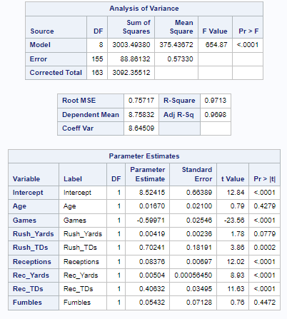
ANOVA Tables by Position vs Per-game Score
Wide Receivers
And
Tight ends
Kickers
Quarterbacks
Running backs

Slide 17
Regression Code
proc reg data=final356.fantasy;
model Per_Game = Age Games Pass_Yards Pass_TDs Ints Rush_Yards Rush_TDs Receptions Rec_Yards Rec_TDs Fumbles Two_Pt XP FG_30 FG_40 FG_50 FG_60 FG_Miss;
run;
proc reg data=final356.ks;
model Per_Game = Age Games XP FG_30 FG_40 FG_50 FG_60 FG_Miss;
run;
proc reg data=final356.qbs;
model Per_Game = Age Games Pass_Yards Pass_TDs Ints Rush_Yards Rush_TDs Fumbles;
run;
proc reg data=final356.rbs;
model Per_Game = Age Games Rush_Yards Rush_TDs Receptions Rec_Yards Rec_TDs Fumbles;
run;
proc reg data=final356.recs;
model Per_Game = Age Games Rush_Yards Rush_TDs Receptions Rec_Yards Rec_TDs Fumbles;
run;
data final356.qbs final356.rbs final356.recs final356.ks;
set final356.fantasy;
if Position = "QB" then output final356.qbs;
if Position = "RB" then output final356.rbs;
if Position in ("WR", "TE") then output final356.recs;
if Position = "K" then output final356.ks;
run;

Slide 18










Total Points and Per Game for each Age
Top 5
Bottom 5
proc sort data=final356.fantasy out=final356.agesort;
by Age;
run;
proc means data=final356.agesort;
by Age;
var Per_Game Total;
run;

Slide 19










Total Points and Per Game for each Team
Top 5
Bottom 5
proc sort data=final356.fantasy out=final356.teamsort;
by Team;
run;
proc means data=final356.teamsort;
by team;
var Per_Game Total;
run;

Slide 20










Total Points and Per Game for each State
Top 5
Bottom 5
proc sort data=final356.fantasy out=final356.statesort;
by State;
run;
proc means data=final356.statesort;
by State;
var Per_Game Total;
run;

Slide 21










Total Points and Per Game for each College
Top 5
Bottom 5
proc sort data=final356.fantasy out=final356.collegesort;
by College;
run;
proc means data=final356.collegesort;
by College;
var Per_Game Total;
run;

Slide 22
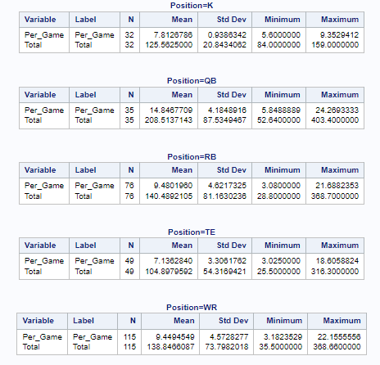
Total points and Per_Game points for Position
proc sort data=final356.fantasy out=final356.positionsort; ​
by Position; ​
run; ​
​
proc means data=final356.positionsort; ​
by Position; ​
var Per_Game Total; ​
run;

Slide 23
Conclusions
We believe that these are the biggest take aways from this data
Age matters a lot in real life football, but in regards to fantasy football, it really doesn't have a large impact on how many points will be scored.
Even if a player is amazing in real life, the more games that they miss in the season, the more it affects their per game score in the ones that they do play.
Most points from each position: QB > RB > WR > K > TE
When the sample size is large, it is important to know the state a player was born in, the college they played for, and the team they currently play for in the NFL. It seems that these give a real nice insight to how many points a player will score whether it be high or low

Slide 24
Source
Pro Football Stats, history, scores, standings, playoffs, Schedule & Records. Pro. (n.d.). Retrieved April 18, 2023, from https://www.pro-football-reference.com/

