Slide 1
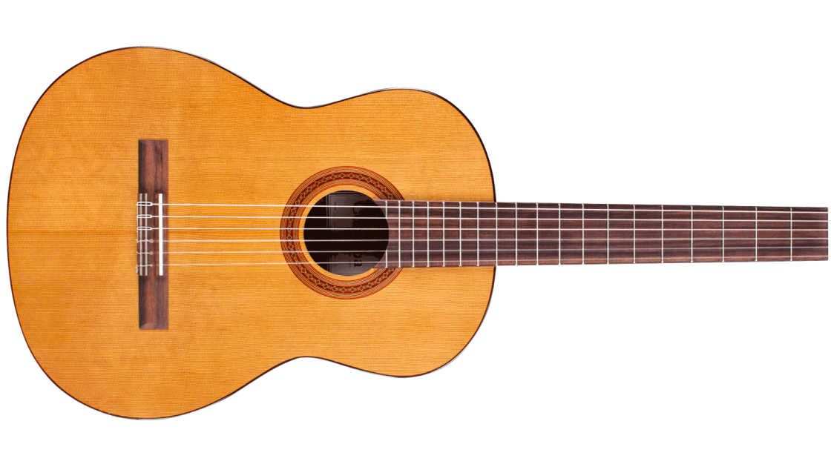
Musical Regression

Slide 2
What are we Doing?
We will create, run, and analyze multiple linear regression models to determine what goes into making a good and popular song.
This could be important for any up-and-coming artist or even if you yourself are trying to compose a masterpiece for a family event or gathering.
The Problem is Simple:
What makes a song a good song?
What really matters into making a song that lots of people listen to?

Slide 3
Objectives
We will create, run, and analyze multiple linear regression models to determine what goes into making a good and popular song.
This could be important for any up-and-coming artist or even if you yourself are trying to compose a masterpiece for a family event or gathering.
The Problem is Simple:
What makes a song a good song?
What really matters into making a song that lots of people listen to?

Slide 4

Our Data Set
We found the data we used in this project on kaggle.com, it was put together by Salvatore Rastelli and 2 others, and was last updated February 7th, 2023. This dataset has Spotify and YouTube data for over 20,700 songs and has 26 variables both numerical and categorical.
We removed a few of those variables as they wouldn't be that useful to us, we removed observations that had empty cells, and then cut the observations down to 4500, so that SAS would work well enough and we'd still have a considerable amount of observations.

Slide 5
Variables: Pt.1
Track: Name of song on Spotify
Artist: Artist who created the song
Album: Album the song is on, on Spotify
Title: Title of the "official" version of the song on YouTube
Channel: Channel this "official" version of the song is on

Slide 6
Variables: Pt.2
Streams: Number of plays the song has on Spotify
Views: Number of views the "official" version has on YouTube
Comments: Number of comments the "official" version has
Likes: Number of likes the "official" version has
Total_Listens: Streams + Views (Our response variable)

Slide 7
Variables: Pt.3
Duration_ms: Length of song in milliseconds
Seconds: Duration_ms/1000, Length of song in seconds
Minutes: Seconds/60, Length of song in minutes
Key: The key the track is in. Integers map to pitches using standard Pitch Class notation. E.g., 0 = C, 1 = C♯/D♭, 2 = D, and so on. If no key was detected, the value is -1.
Loudness: the overall loudness of a track in decibels (dB). Loudness values are averaged across the entire track and are useful for comparing relative loudness of tracks. Loudness is the quality of a sound that is the primary psychological correlate of physical strength (amplitude). Values typically range between -60 and 0 db.

Slide 8
Variables: Pt.4
Tempo: the overall estimated tempo of a track in beats per minute (BPM). In musical terminology, tempo is the speed or pace of a given piece and derives directly from the average beat duration.
Danceability: describes how suitable a track is for dancing based on a combination of musical elements including tempo, rhythm stability, beat strength, and overall regularity. A value of 0.0 is least danceable and 1.0 is most danceable.
Energy: is a measure from 0.0 to 1.0 and represents a perceptual measure of intensity and activity. Typically, energetic tracks feel fast, loud, and noisy. For example, death metal has high energy, while a Bach prelude scores low on the scale. Perceptual features contributing to this attribute include dynamic range, perceived loudness, timbre, onset rate, and general entropy.

Slide 9
Variables: Pt.5
Speechiness: detects the presence of spoken words in a track. The more exclusively speech-like the recording (e.g. talk show, audio book, poetry), the closer to 1.0 the attribute value. Values above 0.66 describe tracks that are probably made entirely of spoken words. Values between 0.33 and 0.66 describe tracks that may contain both music and speech, either in sections or layered, including such cases as rap music. Values below 0.33 most likely represent music and other non-speech-like tracks.
Acousticness: a confidence measure from 0.0 to 1.0 of whether the track is acoustic. 1.0 represents high confidence the track is acoustic.

Slide 10
Variables: Pt.6
Instrumentalness: predicts whether a track contains no vocals. "Ooh" and "aah" sounds are treated as instrumental in this context. Rap or spoken word tracks are clearly "vocal". The closer the instrumentalness value is to 1.0, the greater likelihood the track contains no vocal content. Values above 0.5 are intended to represent instrumental tracks, but confidence is higher as the value approaches 1.0.
Liveness: detects the presence of an audience in the recording. Higher liveness values represent an increased probability that the track was performed live. A value above 0.8 provides strong likelihood that the track is live.
Valence: a measure from 0.0 to 1.0 describing the musical positiveness conveyed by a track. Tracks with high valence sound more positive (e.g. happy, cheerful, euphoric), while tracks with low valence sound more negative (e.g., sad, depressed, angry).

Slide 11
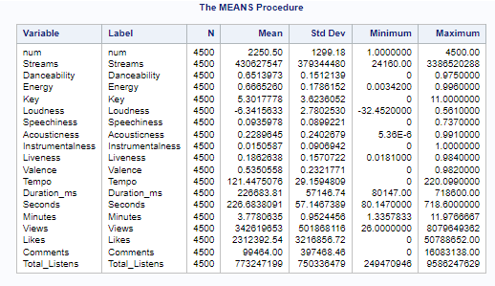
Means Procedure
What's important?
We are working with popular songs as we can see by number of streams and views
The average song is in the middle in terms of dancability, valence, and energy
The average song is low in terms of acousticness, instrumentalness, liveness, and speechiness
The average song is 3 min 45 sec
Average BPM of 121.45

Slide 12
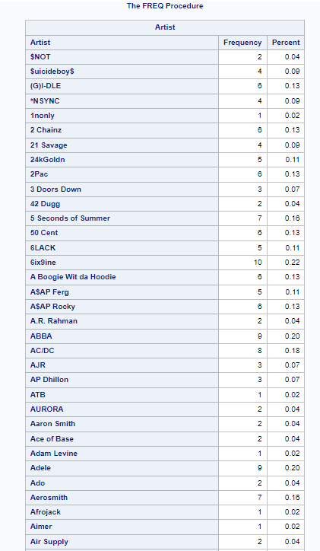
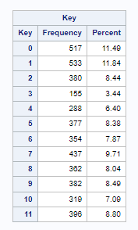
Frequency Procedure
We are working with so many different artists from so many different genres
This stuff is just interesting :)
More songs are in keys C and D than other keys

Slide 13
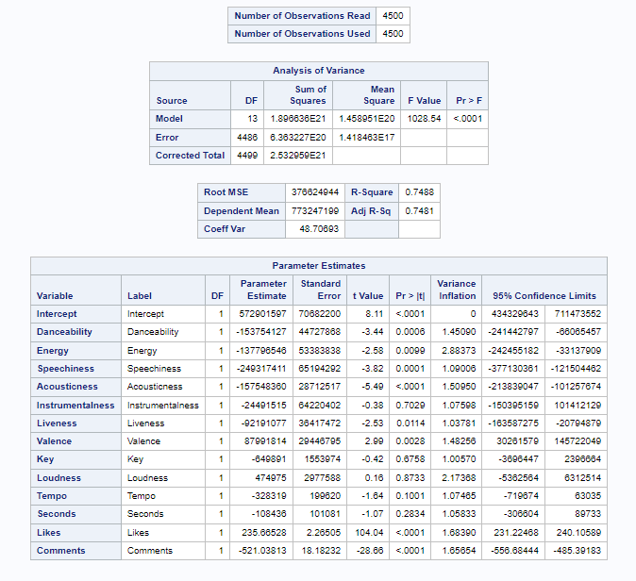
Multiple Linear Regression Test Original Model
What do we see at first glance?
Our R2 value is pretty good, 74.88% of our data can be explained by the model
We see some regressors that are not significant such as: Instrumentalness, key, loudness, tempo, and seconds at a 0.05 significance level
Our VIF values are acceptable as they are all less than 10
H₀: β₀ = β₁ = … = β₁₃ = 0 H₁: One β_{k} ≠ 0
We would conclude our model is significant at a 0.05 significance level as,
F0 = 1028.54 is large where we can say that our model is significant since we reject the null hypothesis

Slide 14
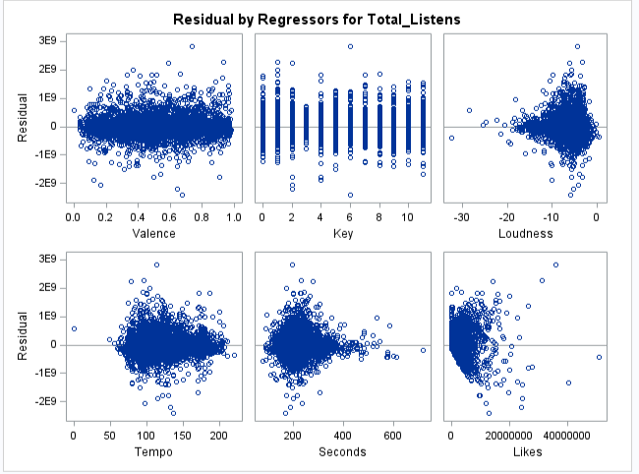
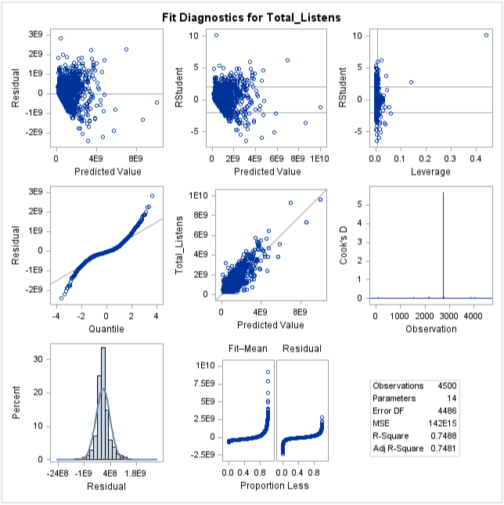
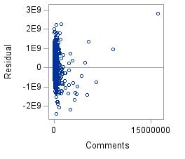
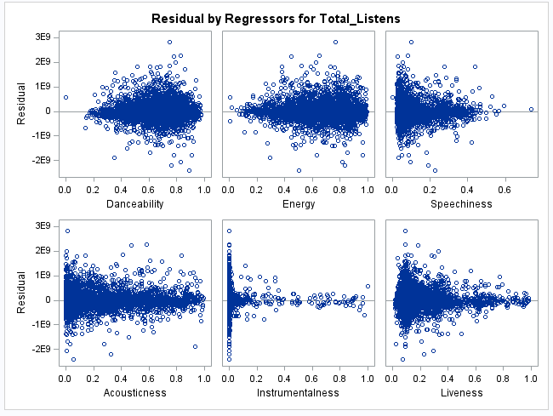
Fit Diagnostics

Slide 15
Different Model Approaches

Slide 16
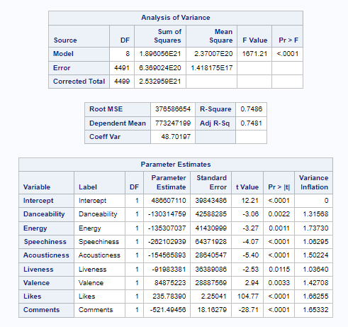

Model 1
Original Model with non-significant regressors removed
Variables Removed: Instrumentalness, Key, Loudness, Tempo, Seconds
0.02 smaller R² value
Larger F value

Slide 17
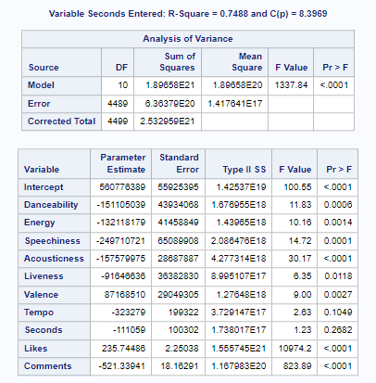

Forward Selection Technique
Variables Removed: Instrumentalness, Key, Loudness

Slide 18
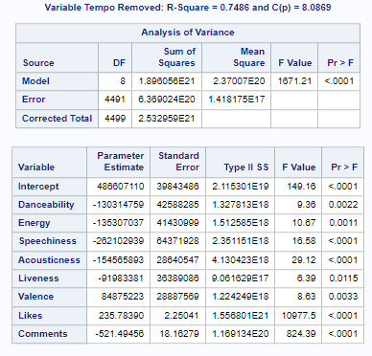
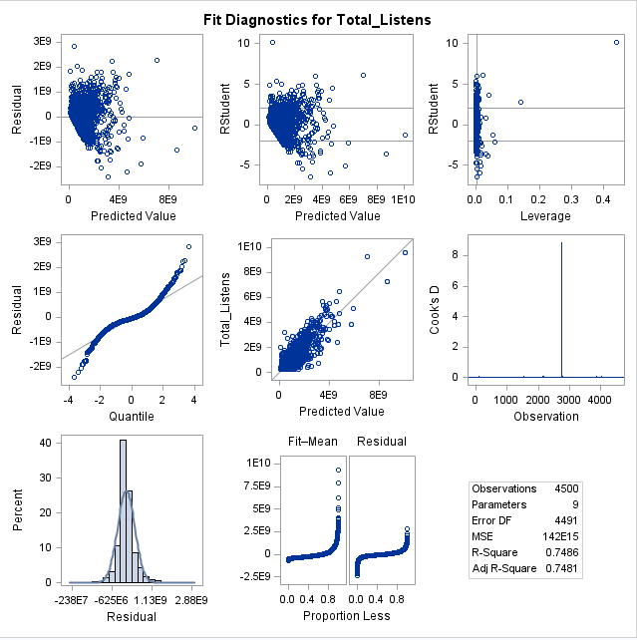
Backward Elimination Technique
Variables Removed: Same as our first test

Slide 19
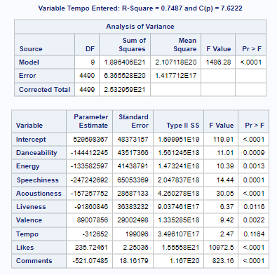

Stepwise Selection Technique
Variables Removed: Instrumentalness, Key, Loudness, Seconds

Slide 20
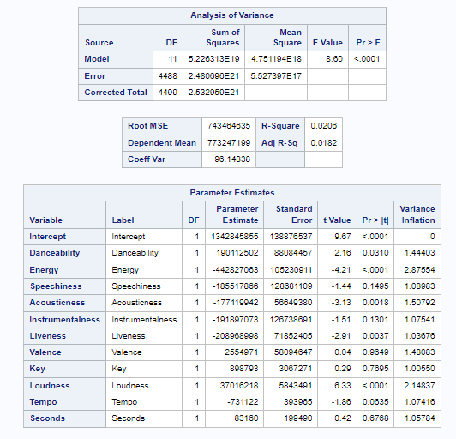
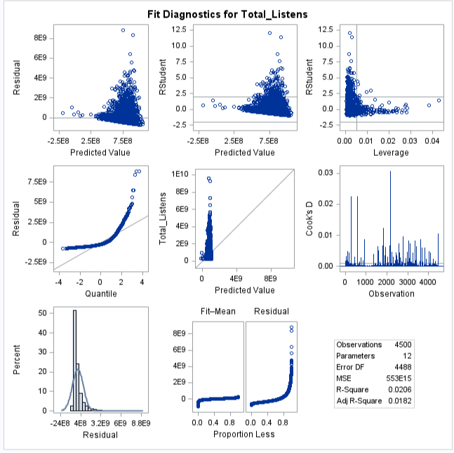
Oh my... Do Not Remove Likes and Comments

Slide 21
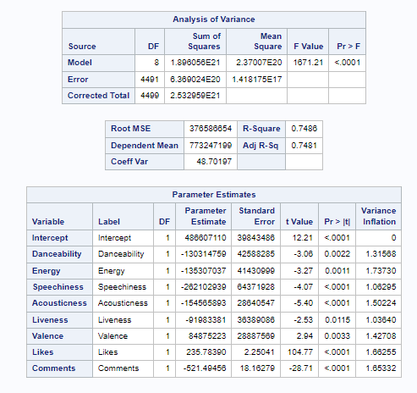
Selected Model
We decided to go with our original model with insignificant variables removed, which was also the same model that our backward elimination technique gave us. I.E., the one where our variables:
  Loudness, Key, Instrumentalness, Seconds, and Tempo were removed
Total_Listens = 486,607,110 – 130,314,759 * Danceability – 135,307,037 * Energy – 262,102,939 * Speechiness – 154,565,893 * Acousticness – 91,983,381 * Liveness + 84,875,223 * Valence + 235.7839 * Likes – 521.49456 * Comments
Again, we have no issues with multicollinearity as all our VIF values are very small

Slide 22

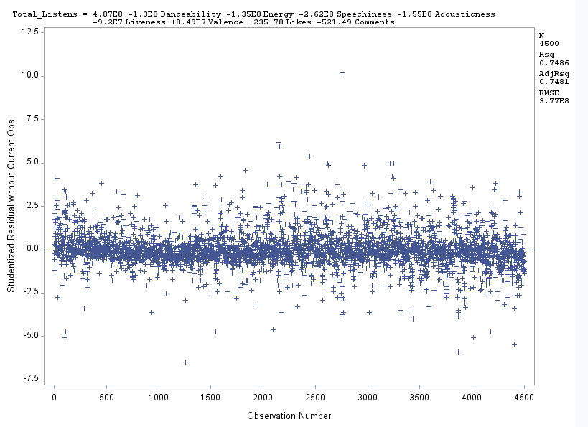
Fit Diagnostics for our Model
Much like our original model. As well as our R2 values.
There is one clear influential point when it comes to Cook's D and our R-student vs leverage plots... do you know what song that is?
Although our data is not in a time order, there does not seem to be any issue with correlation between our variables, as these points have a great range of values, and we can't see any clear pattern.

Slide 23
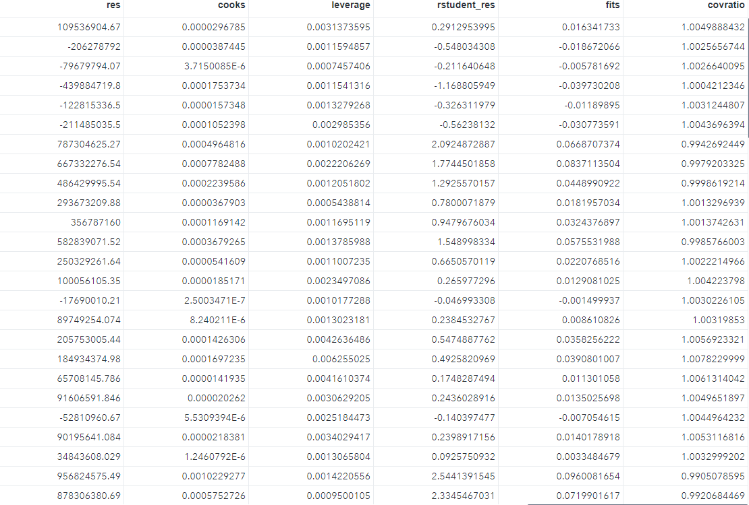
Leverage and Influential Points
Sorted data by their leverage on the data set
246 points with a value over
2*(9/4500) = .004.
One observation clearly stands out... that being "Dynamite" by BTS, which also has a Cook's D of almost 9! (observation 2753)

Slide 24
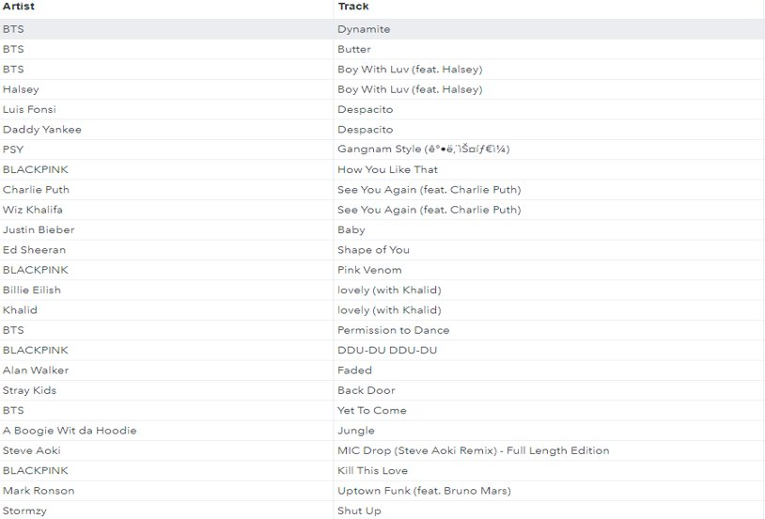
Leverage and Influential Points Cont.
"Dynamite" by BTS also has by far the highest Residual and RStudent values, with an RStudent value of 10.2, it is easily an influential point.
Also, if we consider any point with an RStudent value over 3 as too high, observations:
1548, 1594, 1797, 1829, 2154, 2156, 2244, 2315, 2620, 2622, 2771, 3045, 3361, 3631, 3697, 4452, and 4453 (17 songs) Can also be considered influential points

Slide 25
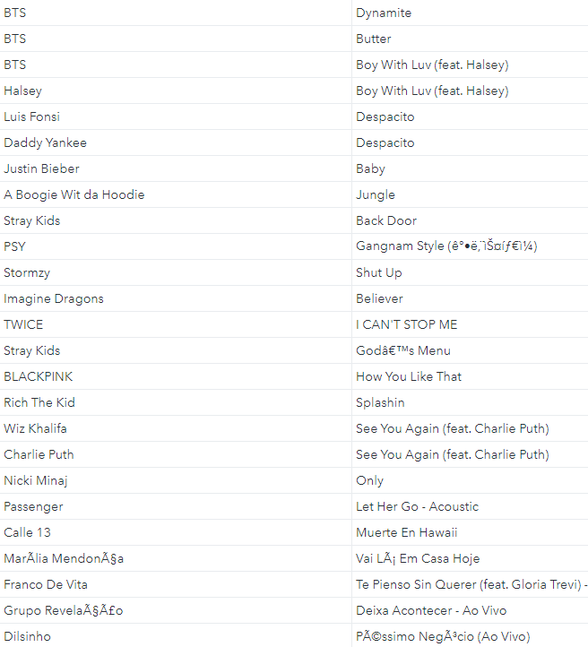
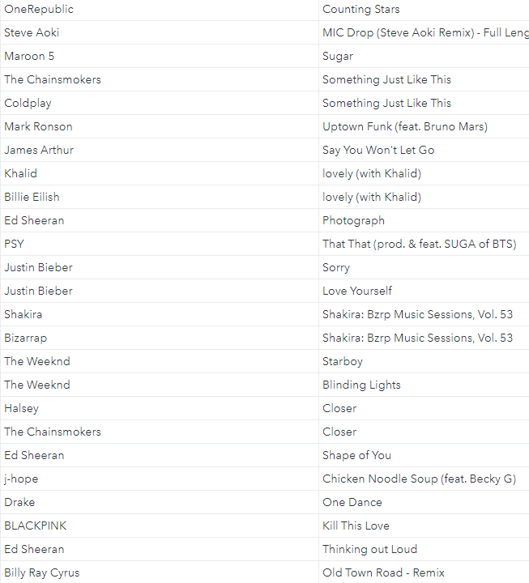
Leverage and Influential Points Cont.
Sorting by COVRATIO, we see that we have exactly 3,900 values of our 4,500 over 1, improving precision of the model, with the lowest being .926, which isn’t that far off from 1, but is still low enough that with 1-3*(9/4500) = .994, it and many others are considered influential. The highest COVRATIO by a good bit is, you guessed it, held by Dynamite by BTS.
Highest
Lowest

Slide 26
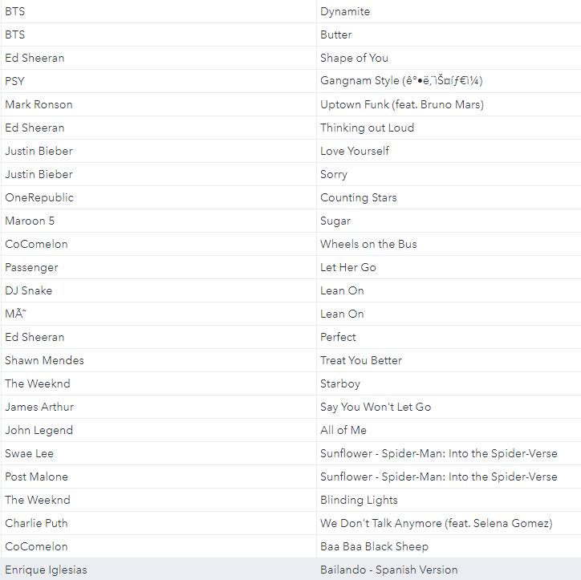
Leverage and Influential Points Cont.
Finally, looking at DFFITS values, using a cutoff of 2*sqrt(9/4500) = .0894, we have 155 observations that are influential on the fitted values, with the highest by far being Dynamite by BTS again.

Slide 27
Predictive Capability of our Model
For the purpose of this model, if we wanted to make a popular song, we would look at our
PRESS statistic of: 659,179,770,000,000,000,000
And our SS_{t} value of: 2,532,959,000,000,000,000,000
We can obtain a R²_{prediction} value of: 1 - ( PRESS / SS_{T} ) = .7398
This means that our model accounts for around 73.98% of the variability in predicting new observations, which is not too shabby.

Slide 28
Conclusions:
It is safe to say that likes and comments account for the most listens for a song.
The more people who hear it and like it, the more it will snowball. If you want to make a smash hit, just imitate BTS.
In general, you probably want your song to have more music than vocals.
Through our elimination techniques we found that we got rid of seconds or how long a song is. The fact that this variable was deemed insignificant is interesting since songs range from 30 seconds to 9 minutes or some crazy range like that.
Make your song energetic and danceable with high positivity, and you, my friend, have a song that people will listen to.

Slide 29
Code:
proc print data=final450.mainresiduals;
run;
proc sort data=final450.mainresiduals;
by descending rstudent_res;
run;
proc print data=final450.mainresiduals;
run;
proc sort data=final450.mainresiduals;
by descending cooks;
run;
proc print data=final450.mainresiduals;
run;
proc sort data=final450.mainresiduals;
by descending covratio;
run;
proc print data=final450.mainresiduals;
run;
proc sort data=final450.mainresiduals;
by descending fits;
run;
proc print data=final450.mainresiduals;
run;
proc reg data=final450.songs;
model Total_Listens = Danceability Energy Speechiness Acousticness Instrumentalness Liveness Valence Key Loudness Tempo Seconds Likes Comments/vif clb;
run;
proc reg data=final450.songs;
model Total_Listens = Danceability Energy Speechiness Acousticness Liveness Valence Likes Comments / vif;
run;
proc reg data=final450.songs;
model Total_Listens = Danceability Energy Speechiness Acousticness Instrumentalness Liveness Valence Key Loudness Tempo Seconds Likes Comments/selection=forward;
run;
proc reg data=final450.songs;
model Total_Listens = Danceability Energy Speechiness Acousticness Instrumentalness Liveness Valence Key Loudness Tempo Seconds Likes Comments/selection=backward;
run;
proc reg data=final450.songs;
model Total_Listens = Danceability Energy Speechiness Acousticness Instrumentalness Liveness Valence Key Loudness Tempo Seconds Likes Comments/selection=stepwise;
run;
proc reg data=final450.songs;
model Total_Listens = Danceability Energy Speechiness Acousticness Instrumentalness Liveness Valence Key Loudness Tempo Seconds/vif;
run;
libname final450 "M:\My_Private_Files\stat450\final";
options validvarname=v7;
proc import datafile="M:\My_Private_Files\stat450\final\Spotify_Youtube.xlsx"
out=final450.songs replace
dbms=xlsx;
run;
proc print data=final450.songs (obs=10);
run;
proc contents data=final450.songs;
run;
proc means data=final450.songs;
run;
proc freq data=final450.songs;
tables Artist Key / nocum;
run;
proc reg data=final450.songs outest=final450.press press;
model Total_Listens = Danceability Energy Speechiness Acousticness Liveness Valence Likes Comments / vif;
plot rstudent.*(obs.);
run;
proc reg data=final450.songs noprint;
model Total_Listens = Danceability Energy Speechiness Acousticness Liveness Valence Likes Comments / influence press;
output out=final450.mainresiduals h=leverage residual=res rstudent=rstudent_res cookd=cooks covratio=covratio dffits=fits;
run;
proc reg data=final450.songs;
model Total_Listens = Danceability Energy Speechiness Acousticness Liveness Valence Likes Comments / influence;
run;
proc sort data=final450.mainresiduals;
by descending leverage;
run;

Slide 30
Reference Page
Rastelli, S. (2023, March 20). Spotify and YouTube. Kaggle. Retrieved April 20, 2023, from https://www.kaggle.com/datasets/salvatorerastelli/spotify-and-youtube
Wikimedia Foundation. (2023, February 28). Pitch class. Wikipedia. Retrieved April 20, 2023, from https://en.wikipedia.org/wiki/Pitch_class

