Slide 1
DAPIDL — Cell-type prediction from DAPI nuclear staining
First clean cross-source numbers + annotation baseline
Lab meeting · 2026-05-04 · A pair (Janesick rep1+rep2 → STHELAR breast s0/s1/s3/s6)

Slide 2
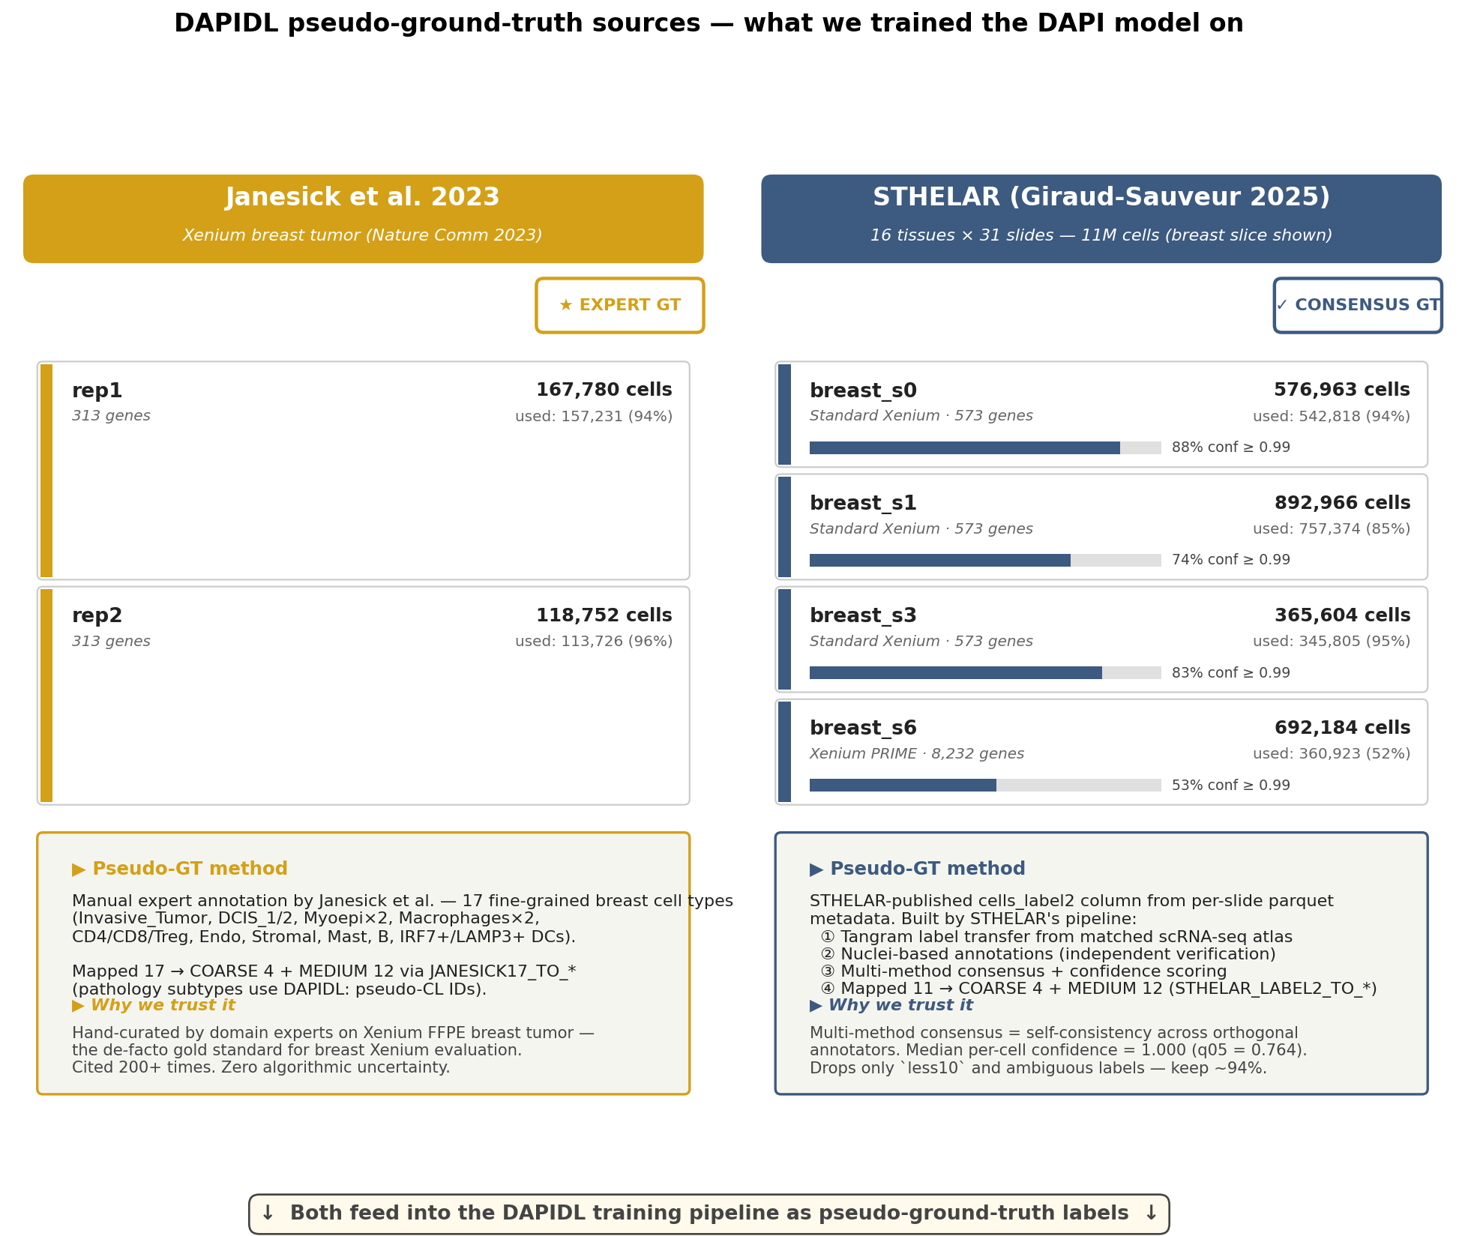
Pseudo-ground-truth sources
▶ Janesick provides expert 17-class GT (gold). STHELAR provides cells_label2 — a multi-method consensus with median per-cell confidence 1.0.

Slide 3
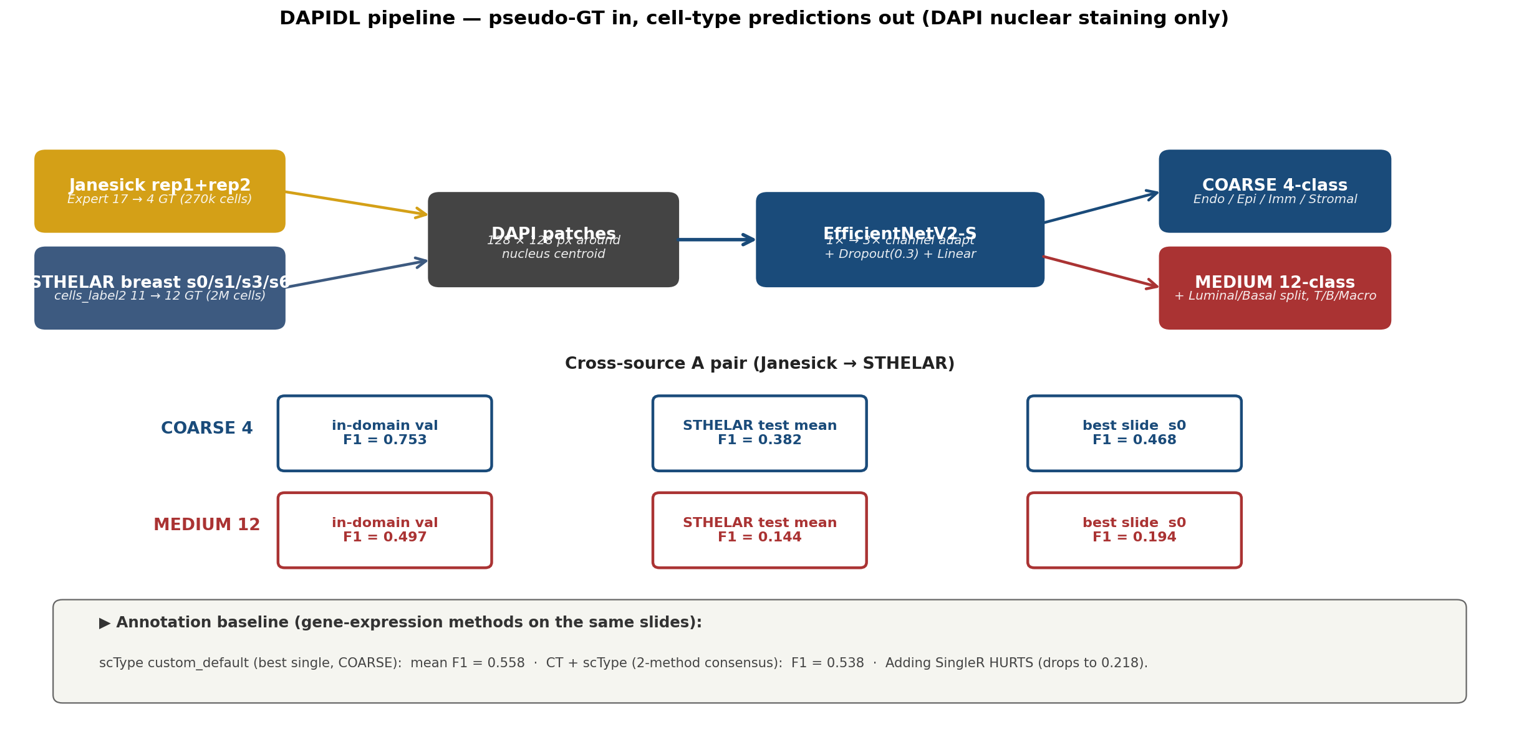
Pipeline overview
▶ Both label sources feed 128px DAPI patches into EfficientNetV2-S → COARSE-4 / MEDIUM-12 prediction.

Slide 4
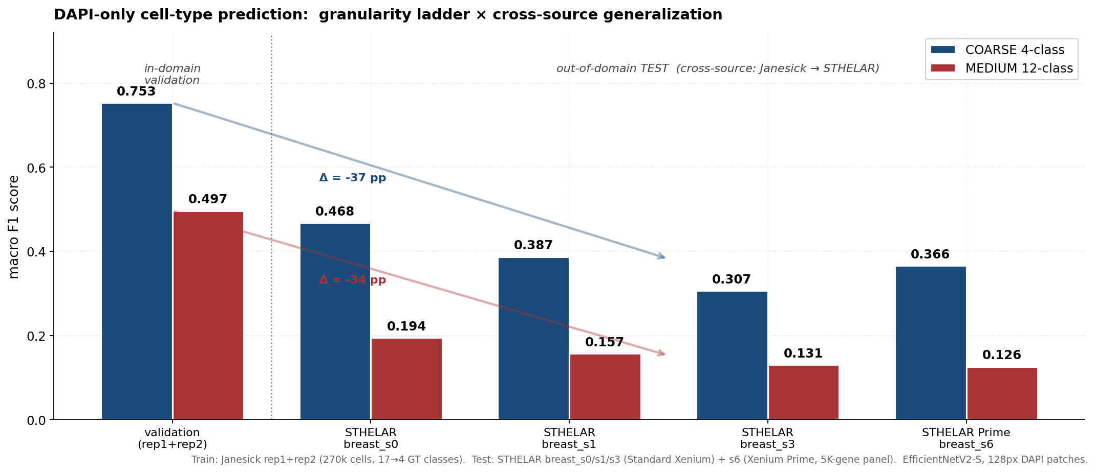
Granularity × cross-source generalization
▶ DAPI predicts COARSE-4 well in-domain (0.753); cross-source domain shift costs ~37 pp. MEDIUM-12 collapses to 0.13-0.19 on STHELAR.

Slide 5
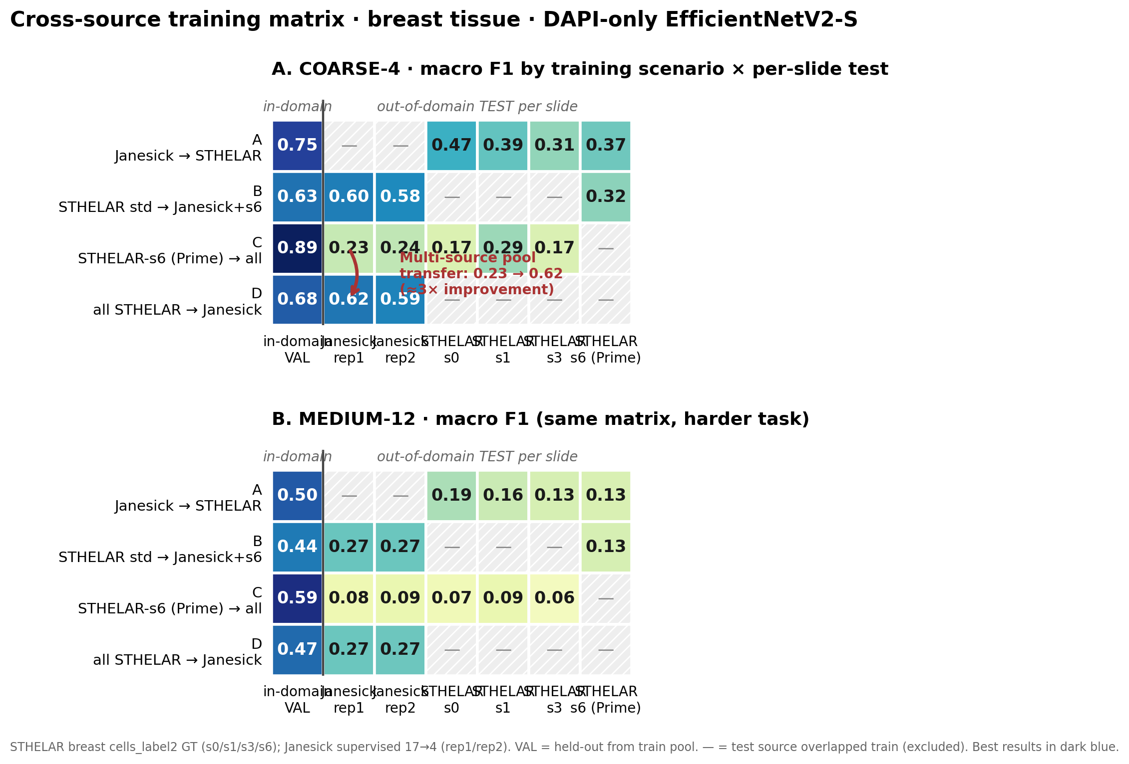
Cross-source matrix — A/B/C/D × per-slide test
▶ Pooling heterogeneous training data (D) turns Prime-only's 0.23 → 0.62 transfer on Janesick rep1 — a ~3× improvement at COARSE-4.

Slide 6
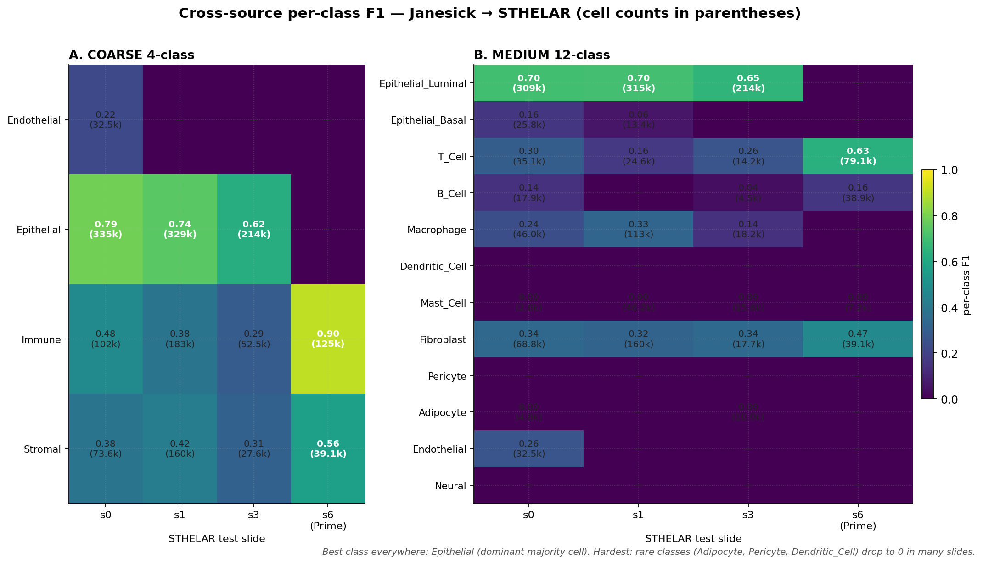
Per-class breakdown — what transfers and what doesn't
▶ Mammary Luminal transfers cleanly (F1 0.65-0.70). Rare types (Adipocyte, Pericyte, Dendritic_Cell) collapse to 0 — class imbalance + inherent difficulty.

Slide 7
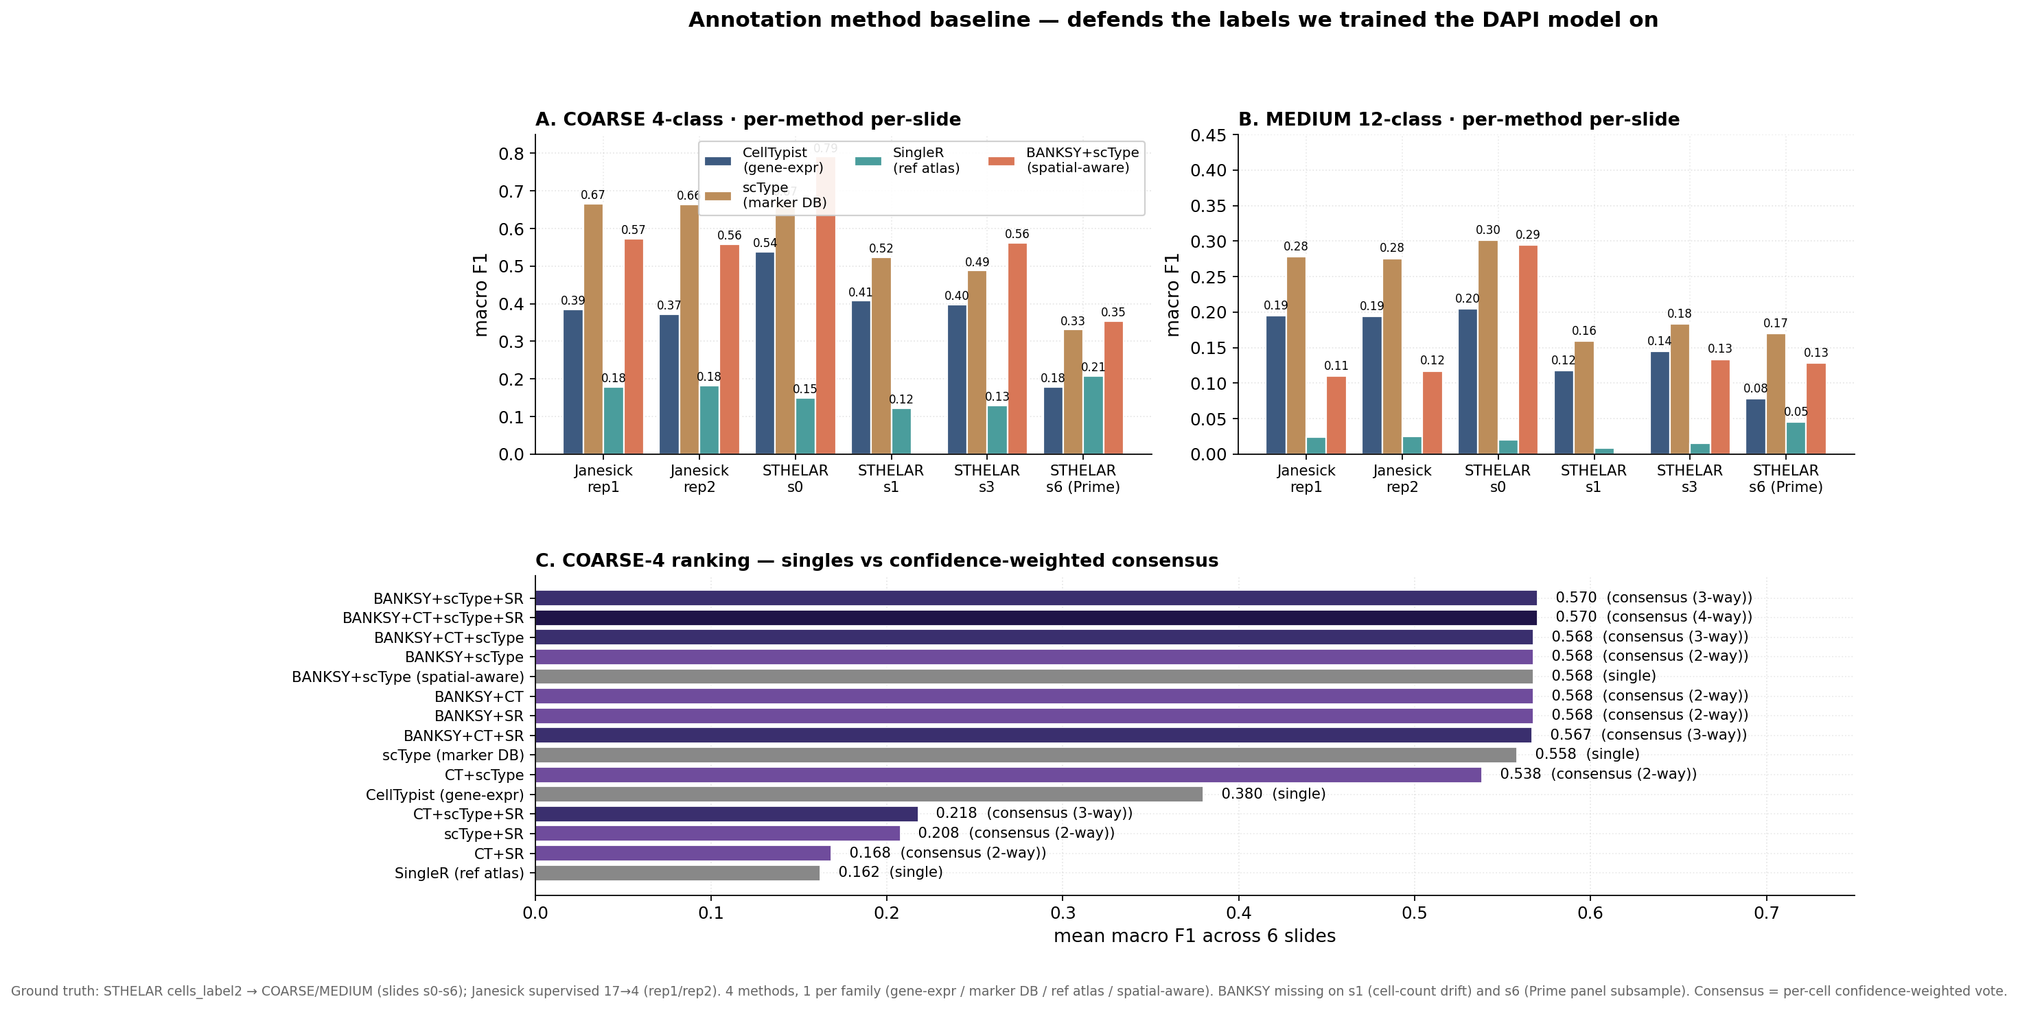
Annotation method baseline (validates our labels)
▶ scType custom_default beats CellTypist + SingleR on every slide. CT+scType consensus is best 2-method (0.538); adding SingleR HURTS the ensemble.

Slide 8
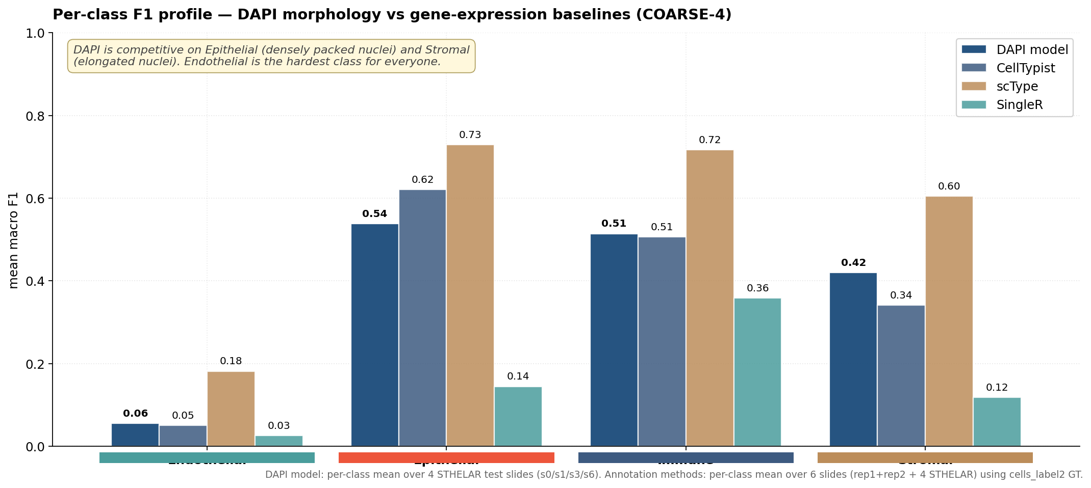
Per-class DAPI vs gene-expression baselines
▶ DAPI is competitive on the dominant classes (Epithelial, Immune, Stromal). Endothelial is the hardest class for every method — biological signal is too sparse.

Slide 9
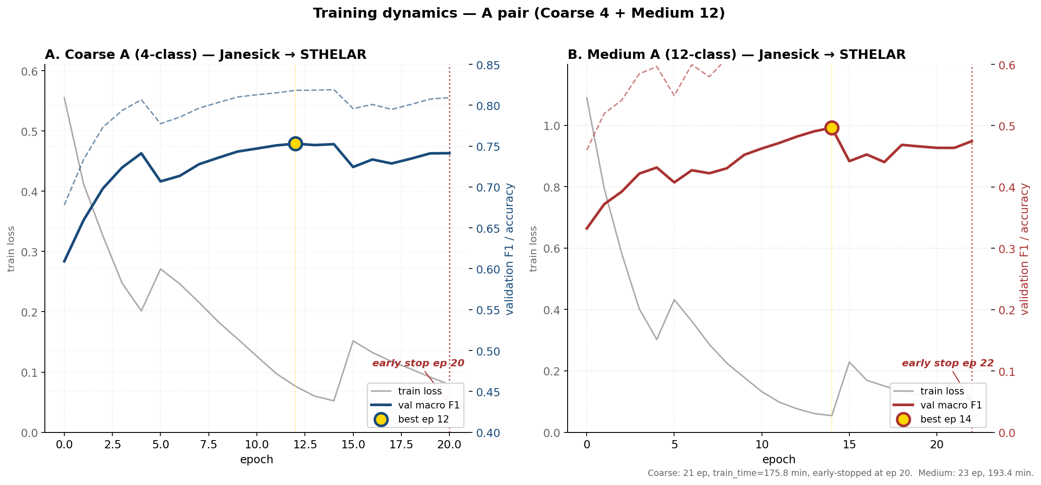
Training dynamics — how the model converged
▶ Coarse: best ep 12 (val F1 0.753), early-stopped ep 20. Medium: best ep 14 (val F1 0.497), early-stopped ep 22. Both converge cleanly.

Slide 10
Take-aways
● Granularity matters
COARSE 4-class works (val F1 0.753); MEDIUM 12-class drops sharply (0.497).
● Cross-source gap is real
Janesick → STHELAR drops F1 by ~37 pp at COARSE, ~34 pp at MEDIUM.
● Epithelial transfers; rare classes don't
Mammary luminal F1 0.65-0.70 across all slides. Adipocyte/Pericyte → 0.
● DAPI is competitive on common compartments
Per-class DAPI ≈ scType on Epi/Imm/Stromal. Endothelial hard for everyone.
● BANKSY+scType is the best annotation baseline
Mean F1 0.568 on COARSE-4 (beats scType 0.558). Spatial-aware clustering helps; SingleR still drags ensembles.
● Multi-source pooling beats single-source training
STHELAR-Prime alone transfers 0.23 to Janesick rep1. Pooling all STHELAR sources lifts this to 0.62 (~3×).
● Confidence: STHELAR cells_label2 is solid
Median per-cell confidence = 1.000 (q05 0.764). Equivalent to cells_final_label at COARSE.
● What's next
Skin tissue (Coarse F1 0.765, Medium 0.582) ready to fold in. CelloType instance-seg + breast_s1 BANKSY workaround deferred.

