Slide 1
DAPIDL
Predicting Cell Types from DAPI Nuclear Staining
Using Deep Learning & Spatial Transcriptomics
March 2026

Slide 2
Goal
Automatic cell type annotation using Deep Learning on DAPI-stained tissue sections
Train a CNN to predict cell types from nuclear morphology alone
Use spatial transcriptomics (Xenium, MERSCOPE) as automatic training data generator
Eliminate the need for expensive gene expression assays at inference time
Enable retrospective analysis of existing DAPI-stained tissue archives

Slide 3
Current Gold Standard vs. DAPIDL
Manual Pathology
DAPIDL
Subjective assessment
Fully automated & objective
Slow (hours per slide)
Fast (<1s / 1000 cells)
High cost per annotation
Low marginal cost
Expert-dependent
Reproducible & scalable

Slide 4
Spatial Transcriptomics
Technologies that measure gene expression at single-cell resolution while preserving spatial context
Platforms: Xenium (10x Genomics), MERSCOPE (Vizgen), CosMx (NanoString)
Output per cell: transcript counts for 300-5000 genes + spatial coordinates
All platforms include DAPI nuclear staining as morphology channel
Enable understanding of intra-tumor heterogeneity and the tumor microenvironment
Key insight: DAPI staining is universal across all spatial transcriptomics platforms. A model that learns from one dataset can predict on any DAPI image.

Slide 5
How Spatial Transcriptomics Works
Tissue section placed on slides with prepared probe spots
Probes bind complementary mRNA molecules in situ (FISH-based)
Fluorescent readout identifies which transcripts are present in each cell
Cell segmentation assigns transcripts to individual cells
Result: gene expression matrix + spatial coordinates + DAPI image
Limitation: Works for 300-5000 pre-selected genes (panel-based). Not whole-genome.

Slide 6
The Challenge: Training Data Quality
Training the CNN is straightforward once labels exist
Creating sufficient high-quality training labels is the real challenge
No pathologist-annotated ground truth available for most datasets
Automated annotation methods each have biases and error rates
Label noise directly degrades model convergence and accuracy
Our solution: Democratic consensus of 11 independent annotation algorithms. Only high-confidence cells enter the training set.

Slide 7
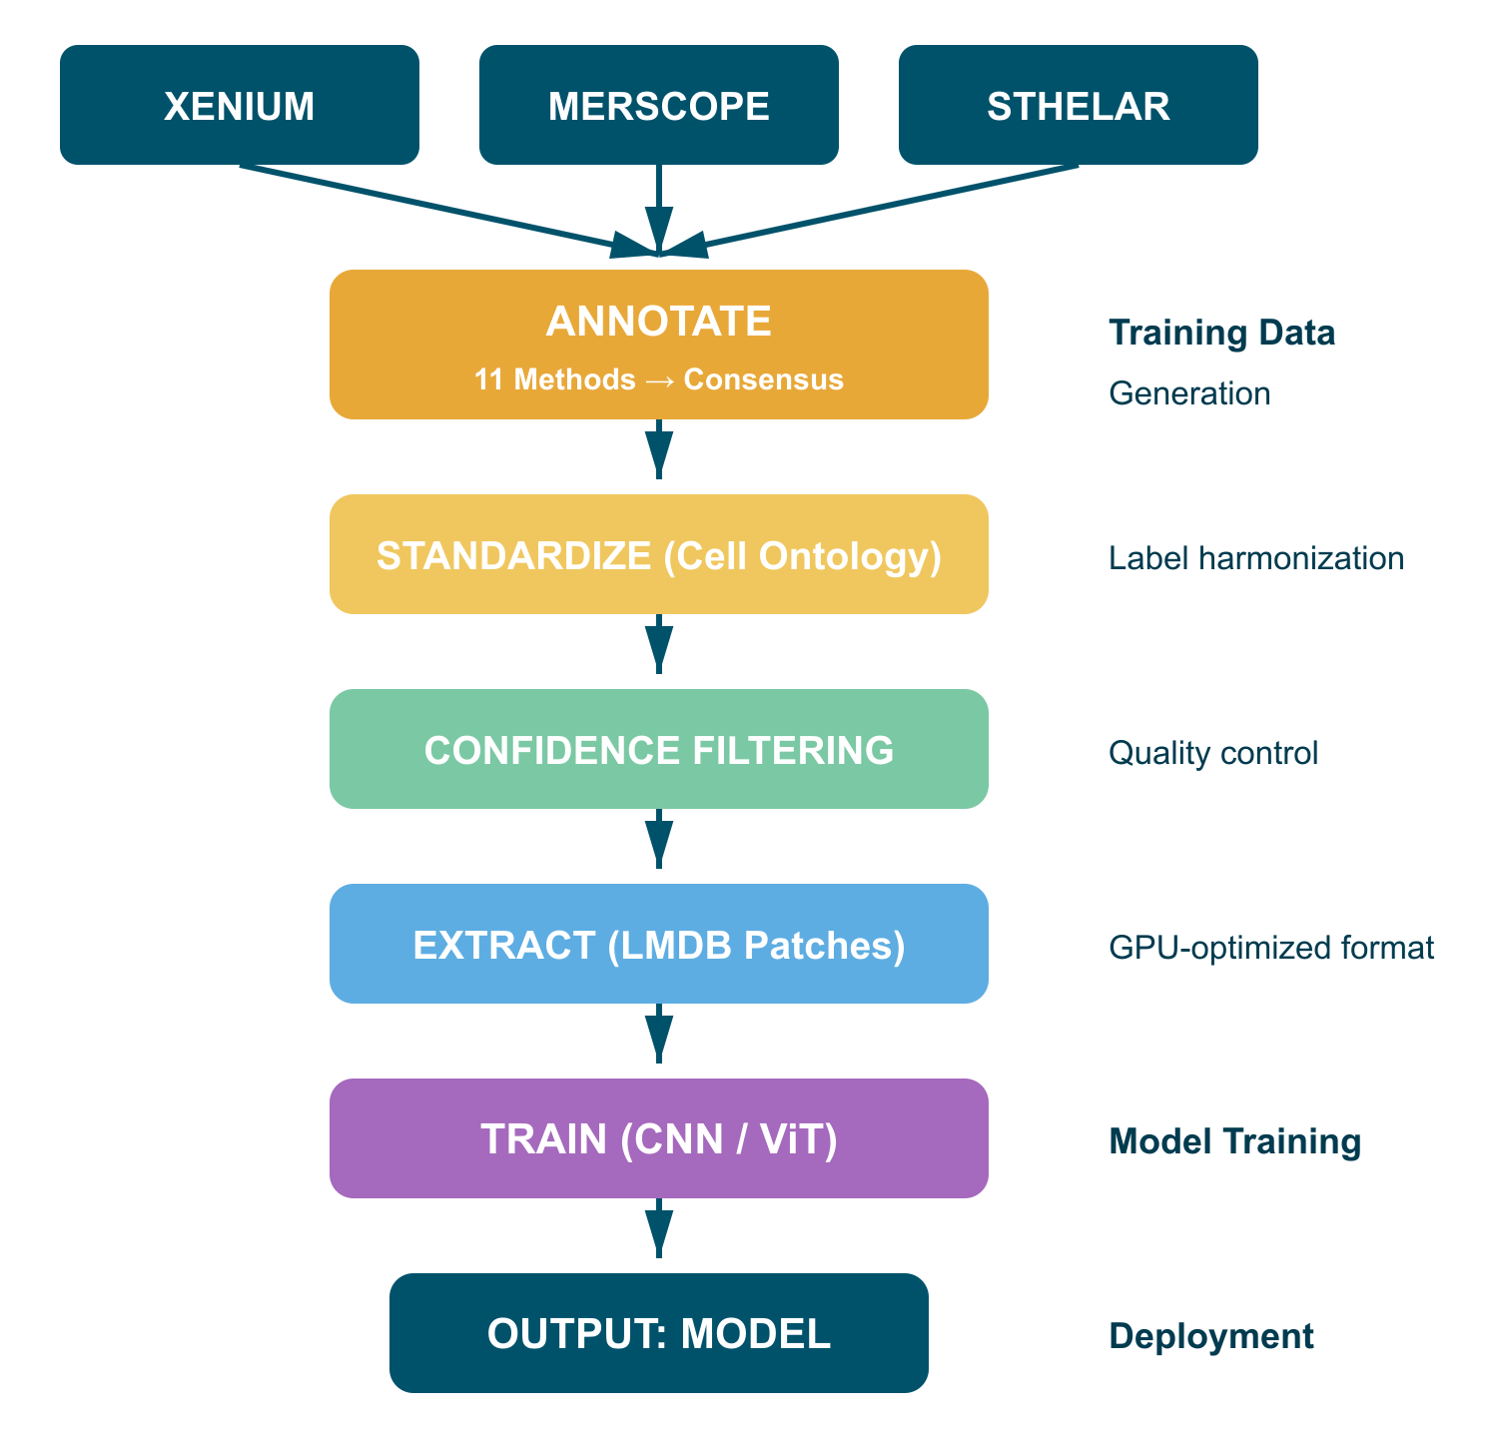
DAPIDL Pipeline
1. Input: Raw spatial transcriptomics data (Xenium, MERSCOPE, STHELAR)
2. Annotate: 11 methods vote on each cell's type using gene expression
3. Standardize: Map labels to Cell Ontology for cross-dataset consistency
4. Filter: Remove low-confidence cells (marker enrichment + spatial coherence)
5. Extract: Cut nucleus-centered DAPI patches, save as LMDB
6. Train: CNN/ViT learns to predict cell type from DAPI morphology
7. Output: Deployable model predicts on any DAPI image
Fully modular, configurable, and orchestrated via ClearML pipelines.

Slide 8
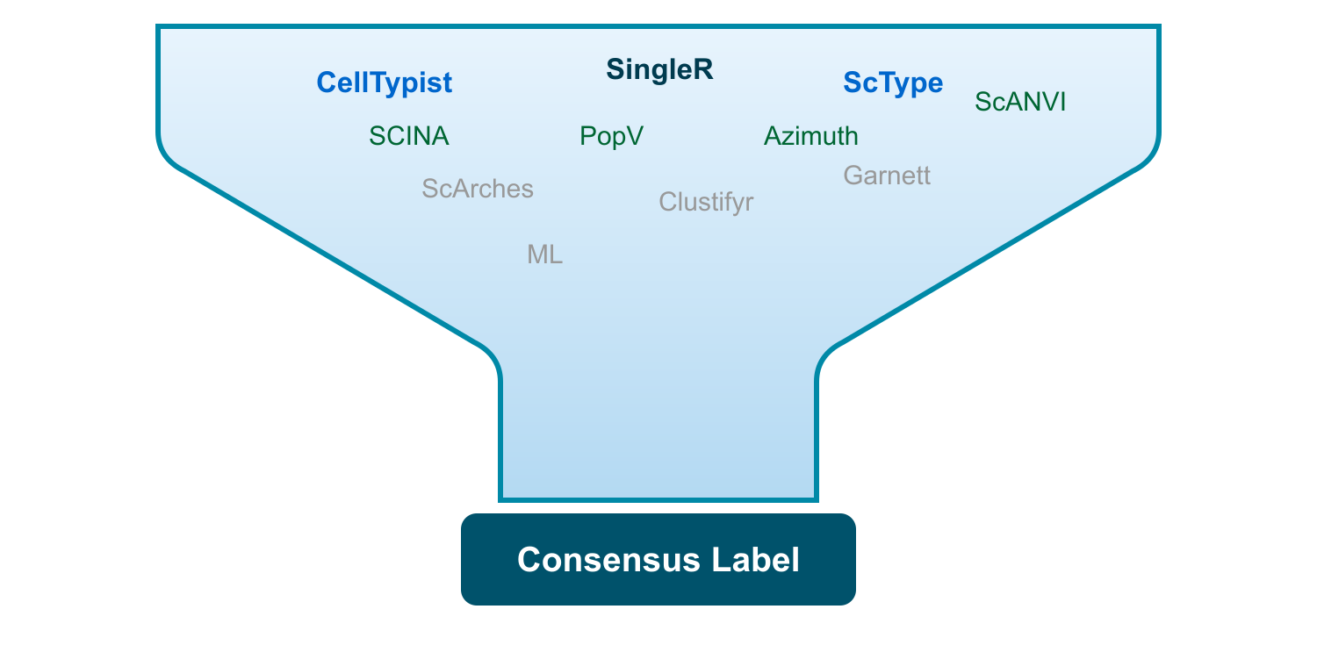
Automatic Annotation via Algorithmic Consensus
What they use:
Gene expression transcripts
Cell marker databases (CellMarker 2.0, PanglaoDB)
Reference atlases (Tabula Sapiens, Human Cell Atlas)
Democratized ground truth: We rely on majority vote of 11 distinct algorithms to generate training labels without manual annotation.
Methods: CellTypist, SingleR, ScType, SCINA, PopV, Azimuth, ScANVI, ScArches, Clustifyr, Garnett, ML classifiers

Slide 9
Ensemble Voting System
How It Works
Why This Works
Each method independently labels every cell
Per-cell majority vote determines final label
Unweighted voting outperforms confidence-weighted by 15-22%
Agreement rate determines confidence tier
Different methods use different algorithms and references
Errors are uncorrelated across methods
Consensus eliminates individual method biases
Achieves ~88% accuracy, 0.84 macro F1 on breast cancer (vs. ground truth)

Slide 10
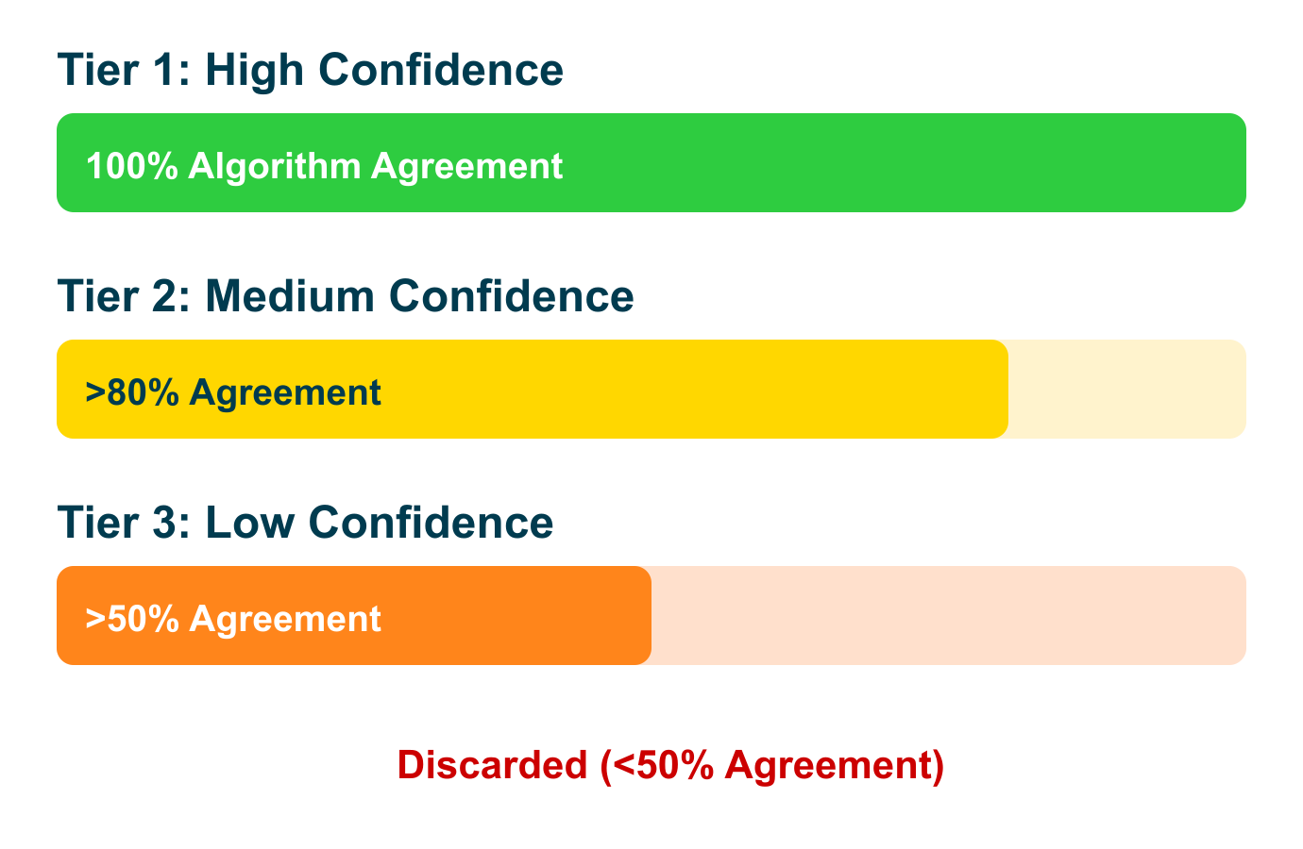
Quality Control via Confidence Tiers
Three-pass hierarchical filtering:
Tier 1: All methods agree (100%). Highest training priority.
Tier 2: >80% agreement. Good quality, included with lower weight.
Tier 3: >50% agreement. Used cautiously for rare cell types.
Discarded: <50% agreement. Ambiguous cells excluded to prevent confusing the model.
Additional quality signals: marker gene enrichment, spatial coherence (KNN), tissue-specific proportion plausibility.

Slide 11
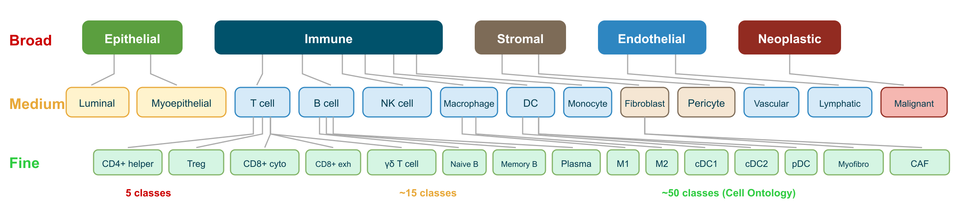
Standardized Language: Cell Ontology (CL)
Problem: Each annotation method uses different names for the same cell type.
"T_CD8", "Cytotoxic T", "CD8+ T-Cell", "T-Lymphocyte (CD8)" all mean the same thing
Solution: CL Mapper standardizes all labels to the Cell Ontology (OBO).
Exact match → Fuzzy match (>0.85) → Alias lookup
Hierarchical: Broad (3) → Medium (~15) → Fine (~50 classes)
Fine-grained labels only when confidence is high

Slide 12
How Backbones Work
Input: Single-nucleus DAPI image (128x128 px, 1 channel)
Channel Adaptation: Replicate to 3 channels for pretrained RGB networks
Backbone: EfficientNetV2-S extracts a 1792-dim feature vector
Classification heads: Three heads for Broad (3), Medium (~15), Fine (~50) classes
Transfer learning: Networks pretrained on ImageNet already recognize edges, textures, and shapes. These low-level features transfer directly to nuclear morphology.
Available backbones: EfficientNetV2-S (default, 20M params), ResNet-18/34, ConvNeXt-Tiny/Small, ViT-Base/Large, Phikon-v2 (pathology), UNI (pathology). LoRA fine-tuning supported via PEFT.

Slide 13
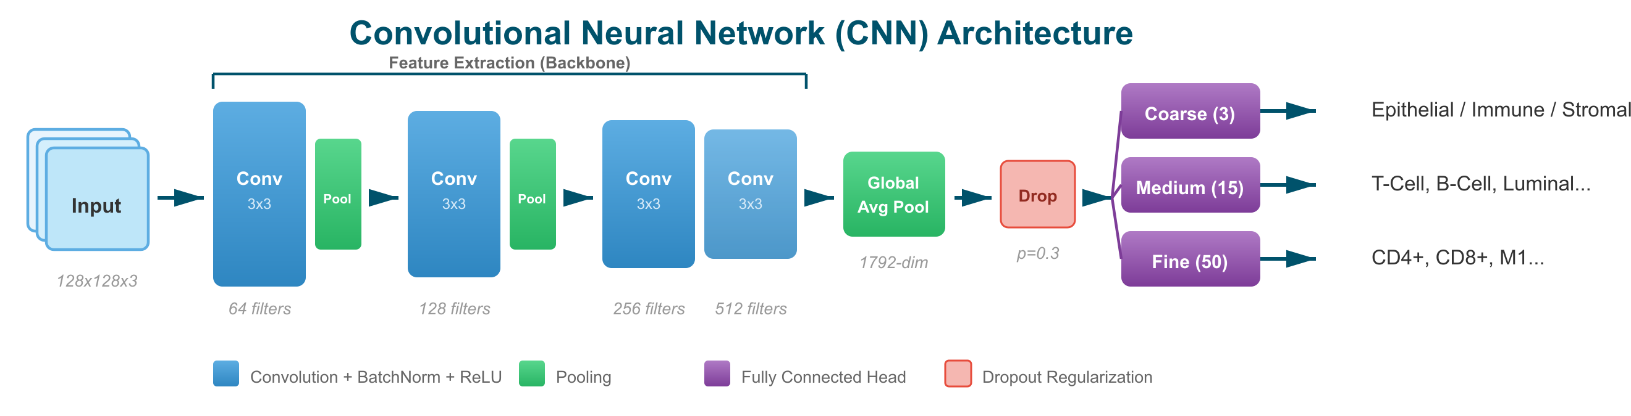
CNN Architecture (EfficientNetV2-S)
Stacked convolutional blocks progressively reduce spatial dimensions while increasing feature depth. Global average pooling produces a fixed-size feature vector for the classification heads.

Slide 14
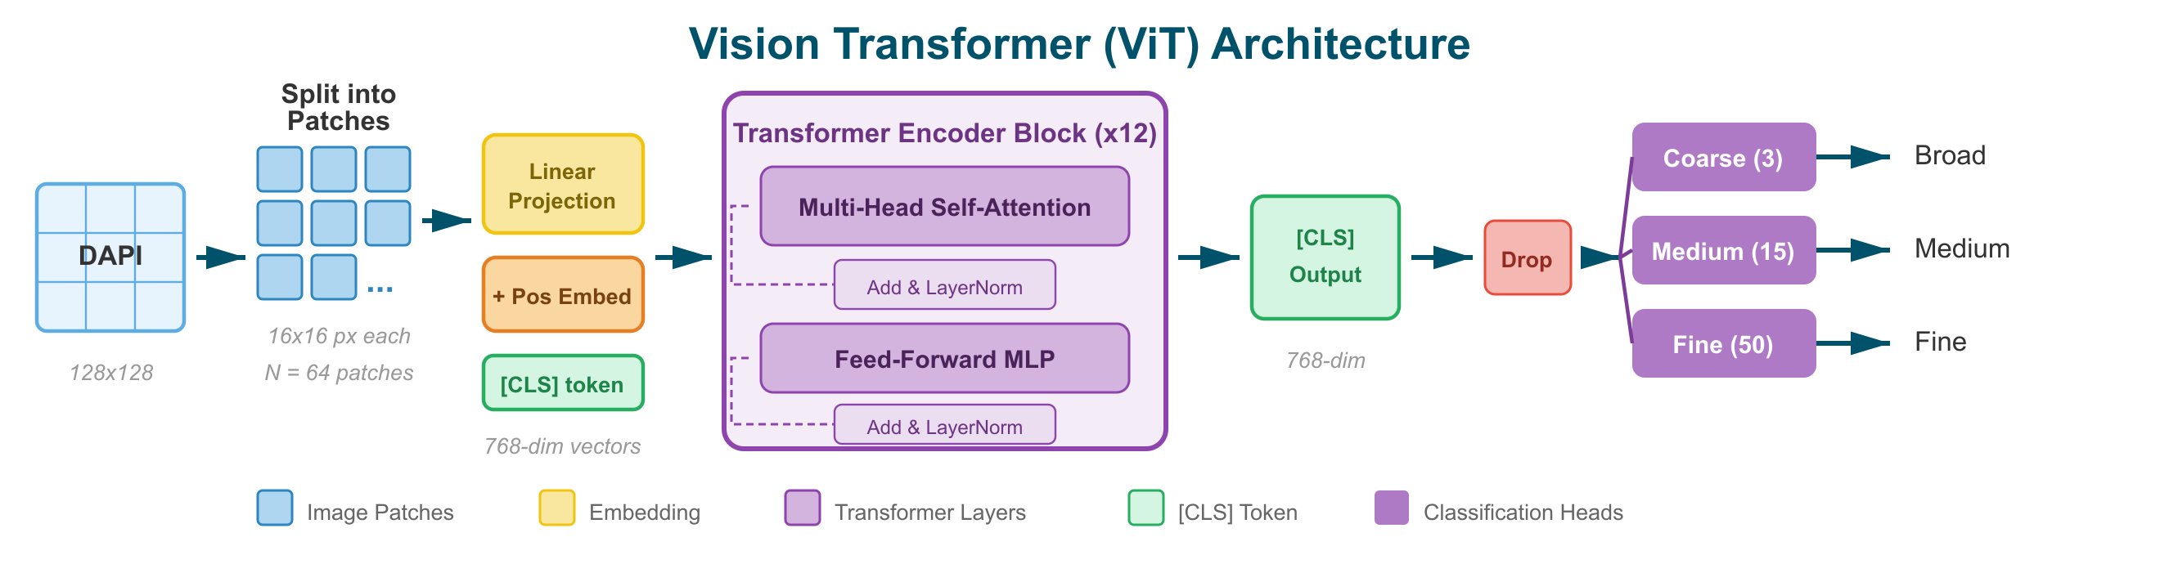
Vision Transformer (ViT) Architecture
The image is split into fixed-size patches, linearly projected into embeddings, and processed by a stack of Transformer encoder blocks using multi-head self-attention. The [CLS] token aggregates global information for classification.

Slide 15
Transfer Learning: Why It Works
Pre-training (ImageNet)
Fine-tuning (DAPI)
Trained on 14M+ labeled images
Learns universal visual features: edges, curves, gradients, textures
These features are domain-agnostic
The same edges and textures appear in nuclei
Only needs to learn domain-specific patterns
Faster convergence, better generalization
A model that can recognize edges of a wolf already knows how to recognize edges of a cell. We skip expensive base training and only fine-tune the classification head.

Slide 16
Curriculum Learning: Coarse to Fine
Hierarchical Training Strategy
Confidence-Based Fallback
Phase 1 (Broad): Epithelial vs. Immune vs. Stromal
Phase 2 (Medium): T-Cell, B-Cell, Macrophage, Luminal, Fibroblast...
Phase 3 (Fine): CD4+ T, CD8+ T, M1 Macrophage...
At inference: try fine prediction first
If confidence < threshold, fall back to medium
If still uncertain, report at broad level
Result: every cell gets a reliable label
Each phase progressively activates finer classification heads while maintaining coarse accuracy.

Slide 17
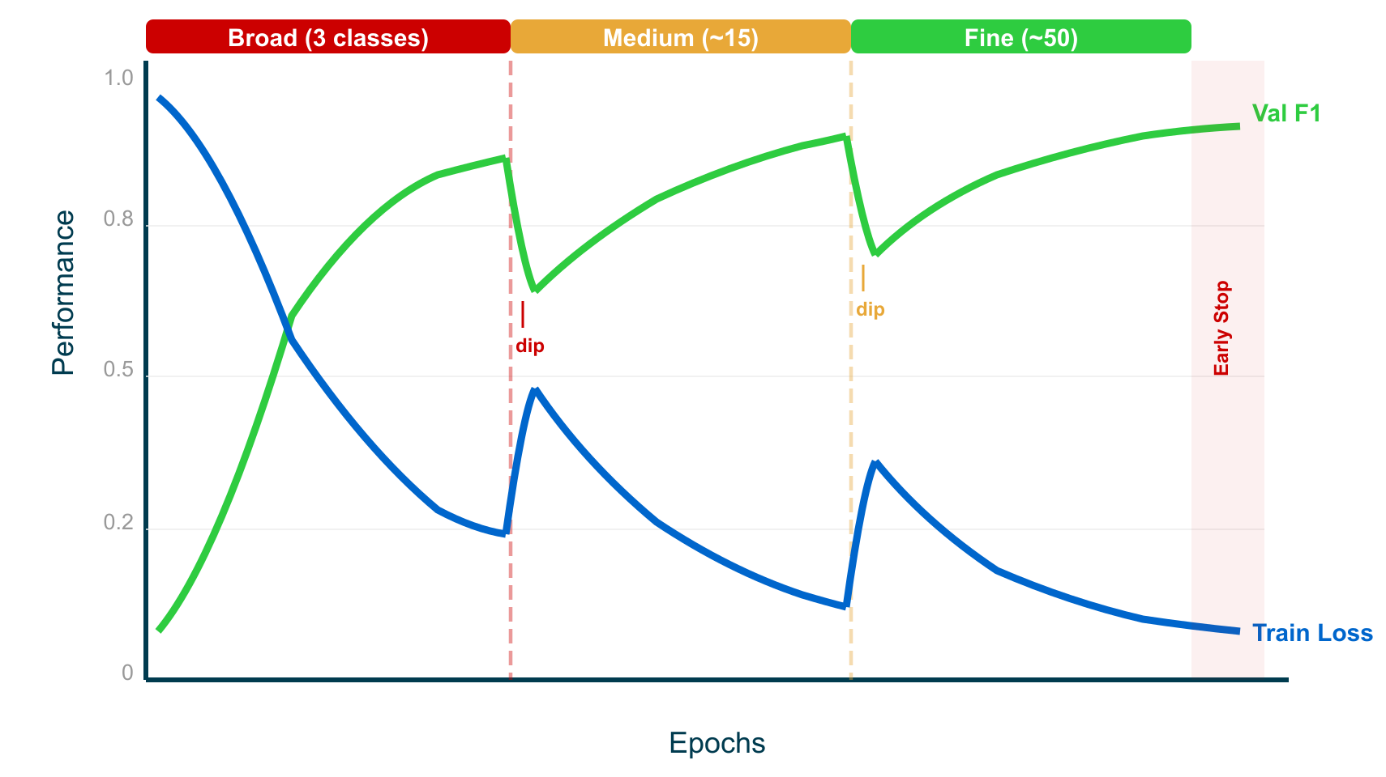
Training Loop & Validation Strategy
Curriculum Phase Transitions:
When switching from broad to medium, the new classification head unfreezes. This causes a temporary accuracy dip and loss spike as the model adapts to finer categories.
The same dip recurs at the medium→fine transition. Each time, the model recovers and surpasses its prior level.
Why the final plateau is lower:
Fine-grained cell subtypes (CD4+ vs CD8+) are harder to distinguish from DAPI morphology alone. The model converges at a lower ceiling — this is a biological, not a technical, limit.
Early stopping (patience=15), AdamW, cosine annealing, MixUp (0.2), DALI GPU loading.

Slide 18
Patch Size Comparison
Nucleus-Centered Patches
Key Finding
32x32: Only nucleus interior. Misses surrounding context.
64x64: Nucleus + immediate neighborhood.
128x128: Good balance of nucleus detail + local tissue context.
256x256: Includes multiple neighbors. Best F1 (+15% over 128)
Larger patches = better performance.
Local tissue context (neighboring cells, tissue architecture) provides critical classification cues beyond nuclear morphology.
Trade-off: larger patches need more GPU memory and slower training.
Physical-space normalization ensures consistent scale across platforms (target: 0.2125 um/px).

Slide 19
Results: Performance Metrics
Broad Classification (3 classes)
Fine-Grained (17 classes)
0.90
0.41
Macro F1 (Consensus Labels)
Macro F1 (best EfficientNetV2-S)
89%
67%
Overall Accuracy
Overall Accuracy
0.82
Per-class highlights: Epithelial Luminal 0.92, T-Cell 0.80, B-Cell 0.77. Stromal subtypes remain challenging (Fibroblast 0.36).
Macro F1 (Ground Truth Labels)
Xenium breast cancer dataset, 167,780 cells. EfficientNetV2-S backbone, 128px patches, consensus annotation.

Slide 20
Cross-Platform Compatibility
Why DAPIDL is Platform-Agnostic
Supported Platforms
Xenium (10x Genomics): 341 genes, 0.2125 um/px
MERSCOPE (Vizgen): 500 genes, 0.108 um/px
STHELAR: 31 sections, 16 tissue types, co-registered DAPI+H&E
Any DAPI image at inference (no transcriptomics needed)
DAPI staining chemistry is identical across Xenium, MERSCOPE, CosMx
Gene expression only used for training labels (not at inference)
Adaptive normalization handles intensity differences (~16x between platforms)

Slide 21
Foundation Models & LoRA Fine-Tuning
Pathology Foundation Models
LoRA Fine-Tuning (PEFT)
Phikon-v2 (Owkin): ViT-L/16, trained on 100M+ pathology patches
UNI (Mahmood Lab): ViT-L/16, pan-cancer histopathology
Native 3-channel input (H&E staining)
Low-Rank Adaptation: freeze backbone, train small adapter matrices
Reduces trainable parameters by ~95%
Faster training, lower GPU memory
Enables efficient adaptation to new tissue types
Finding: ImageNet-pretrained EfficientNetV2-S matches Phikon-v2 on DAPI (F1=0.41 vs 0.41). DAPI differs enough from H&E that pathology pretraining provides no advantage.

Slide 22
Validation Without Ground Truth
Challenge: Most spatial transcriptomics datasets lack pathologist-annotated ground truth.
Cross-Modal Validation
Marker Gene Validation
Leiden clustering: Compare unsupervised clusters with supervised labels (ARI, NMI)
DAPI morphology: Use trained CNN as independent validation (agreement rate)
Multi-method consensus: Agreement between annotation methods
Unified marker database (Cell Marker Accordion + CellMarker 2.0)
Verify that predicted cell types express expected markers
Spatial coherence: cells of same type should cluster spatially
Proportion plausibility: tissue-specific expected ratios

Slide 23
popV: Popular Vote Annotation
Framework combining multiple cell-type transfer tools for consensus classification (Ergen et al., Nature Genetics 2024)
Uses Tabula Sapiens as reference atlas with organ-specific subsets
Consensus voting reduces bias of individual tools
Predicts cell types with stated confidence per cell
Generates labels that are highly likely to match reference atlas cell types
popV achieves 0.90 F1 on Xenium breast cancer when combined with our confidence filtering, matching the best single-method performance while being more robust.

Slide 24
CellTypist: Machine Learning Annotation
Logistic regression-based classifier trained on the Human Cell Atlas
Model zoo: 100+ pretrained models for different tissues and cell types
Input: normalized gene expression vector per cell
Output: cell type label + probability score
Key models for DAPIDL: Cells_Adult_Breast.pkl, Immune_All_High.pkl, Immune_All_Low.pkl
Multi-model strategy: Running 3-5 CellTypist models in parallel and combining predictions achieves better coverage than any single model.
Dominguez Conde et al., Science 2022.

Slide 25
Configurable Parameters
Data Parameters
Training Parameters
Patch size: 32, 64, 128, 256 px
Normalization: adaptive, percentile, minmax
Confidence tier: 1, 2, or 3
Annotation methods: any subset of 11
Granularity: broad / coarse / fine
Segmentation: Xenium native or Cellpose
Backbone: EfficientNet, ResNet, ConvNeXt, ViT, Phikon-v2
Learning rate: 1e-4 (cosine annealing)
Batch size: 64-256
Augmentation: MixUp, rotation, flip, noise
Class weighting: inverse frequency with cap (10x)
HPO: Optuna-based Bayesian optimization via ClearML

Slide 26
Advantages & Clinical Impact
DAPI staining is already performed routinely in most histology labs
Cell types can be determined years after tissue collection from archived slides
No expensive spatial transcriptomics equipment needed at inference
Platform-agnostic: train on Xenium, predict on any DAPI image
Fully reproducible and scalable (no human subjectivity)
Modular pipeline: easily add new tissues, methods, or backbones
Vision: A universal DAPI classifier that works across tissue types, enabling rapid cell type mapping in any pathology lab with just standard nuclear staining.

Slide 27
Key References
Ergen et al. (2024) "Consensus prediction of cell type labels with popV" Nat Genetics
Aran et al. (2019) "SingleR: Reference-based single-cell annotation" Nat Immunology
Biancalani et al. (2021) "Tangram: Spatial alignment of single-cell transcriptomes" Nat Methods
Osumi-Sutherland et al. (2021) "Cell type ontologies of the Human Cell Atlas" Nat Cell Bio
Hua et al. (2026) "NuSPIRe: Self-supervised pretraining for nuclear morphology" Genome Biology
Diehl et al. (2016) "The Cell Ontology 2016: Enhanced content and interoperability" J Biomed Semantics
Wang et al. (2021) "Leveraging Cell Ontology to classify unseen cell types" Nat Comms
Full bibliography in Zotero collection "dapiDL".

Slide 28
Summary & Outlook
DAPIDL demonstrates that cell type prediction from DAPI nuclear staining alone is feasible, achieving 0.90 F1 at broad level and 0.41 F1 for 17 fine-grained classes.
The modular ClearML pipeline supports 3 platforms, 11 annotation methods, and multiple backbone architectures.
Next: Scale to 16+ tissue types via STHELAR. Universal DAPI classifier.

