Slide 1
v2 · 2026-05-02
DAPIDL
Predicting cell types from DAPI nuclei
Deep learning + spatial transcriptomics
Christian Muke · v2 deck rebuilt around measurements

Slide 2
Goal
Automatic cell-type annotation from DAPI-stained nuclei alone — trained on labels from spatial transcriptomics.
• Train a neural network to predict cell types from nuclear morphology
• Use spatial transcriptomics (Xenium, MERSCOPE, STHELAR) to generate labels at scale
• Deploy on any DAPI image — no expensive transcriptomics needed at analysis time
• Enable retrospective analysis of archived histology slides
Vision: a universal DAPI classifier that works across tissues with one stain.

Slide 3
DAPIDL pipeline
From raw spatial transcriptomics → deployable DAPI model in 6 steps.
INPUT
Xenium · MERSCOPE · STHELAR
ANNOTATE
11 methods → consensus
STANDARDIZE
Cell Ontology mapping
FILTER
Confidence tiers (T1/T2/T3)
EXTRACT
DAPI patches → LMDB
TRAIN
EfficientNetV2-S → 3 heads
DEPLOY
DAPI image in → cell types out
• Steps 1–4 produce high-confidence training labels from gene expression.
• Steps 5–7 turn those labels into a DAPI-only classifier.
• Modular: swap any step (e.g. add new annotators, swap backbones, fuse modalities).

Slide 4
Three numbers to remember
Everything else in the deck unpacks one of these.
0.84
0.60
+0.05
macro F1
DAPI ceiling
from H&E fusion
popV ensemble vs expert pathologist (Janesick et al.) on Xenium breast
test macro F1 from DAPI-only model at coarse 4-class breast
F1 gain when DAPI is fused with H&E via cross-attention

Slide 5
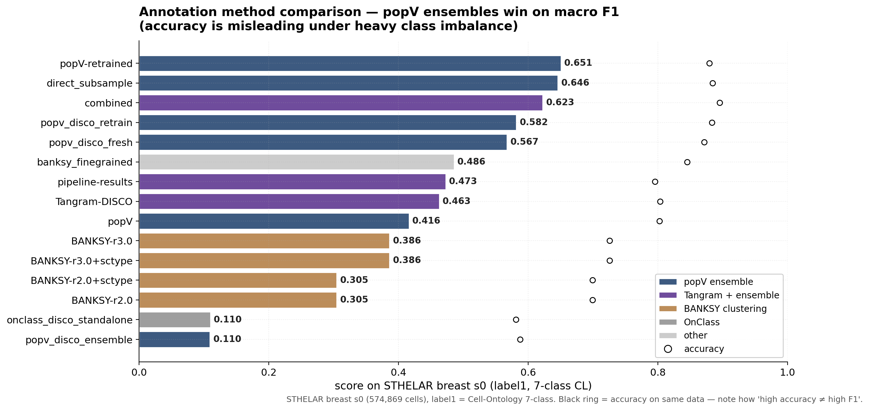
Which annotation method should you trust?
popV ensembles win on macro F1; BANKSY wins on accuracy. Choose by metric, not method.
STHELAR breast s0 (574,869 cells), Cell-Ontology 7-class label. Open circles = accuracy on same data — note the F1/acc gap.

Slide 6
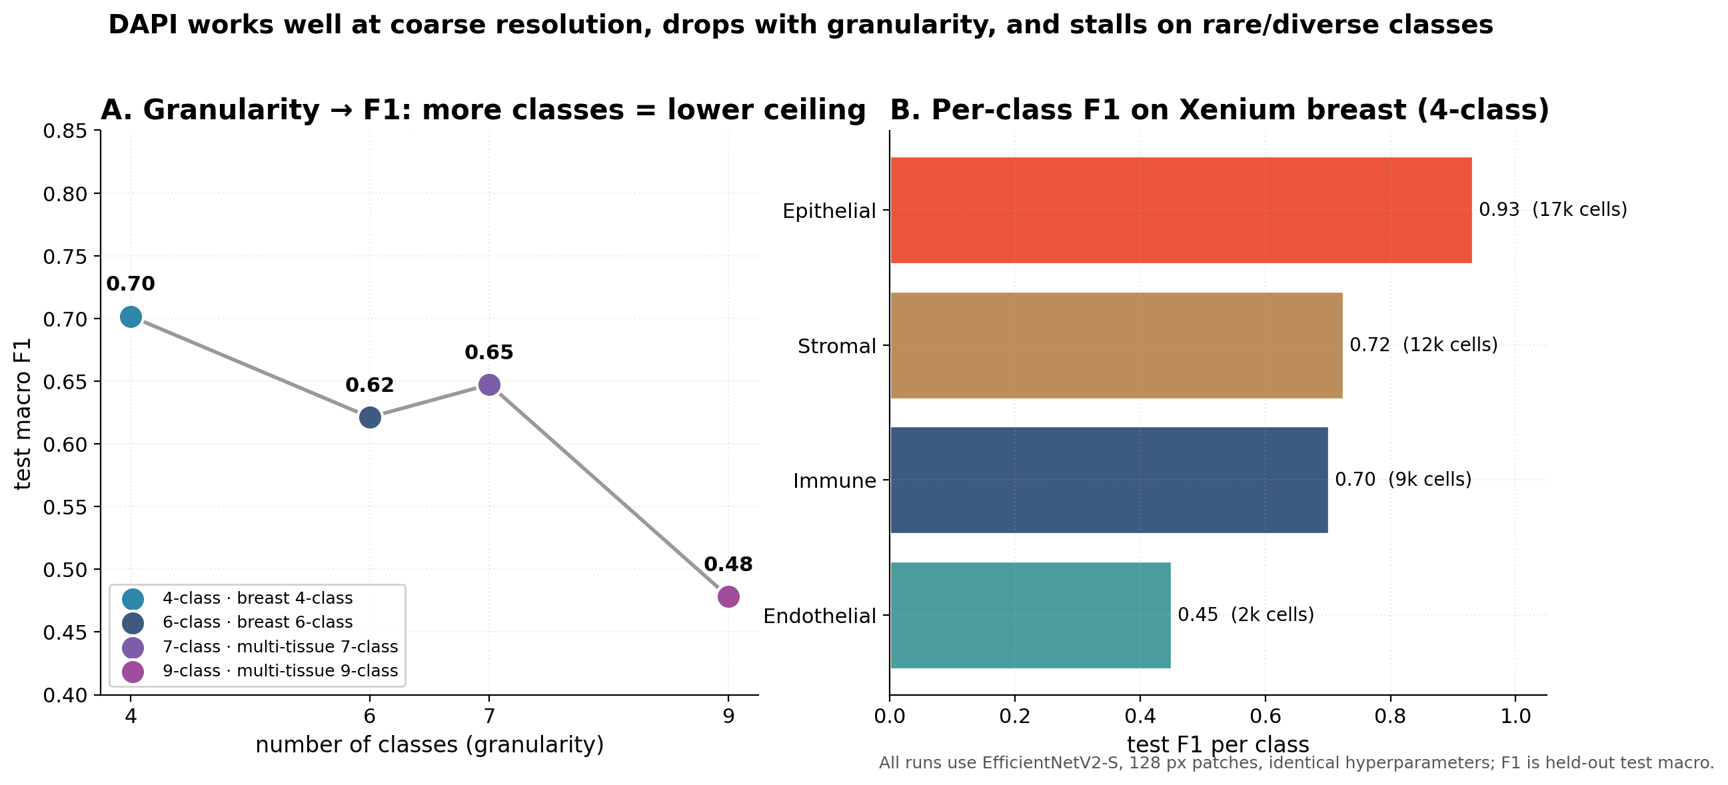
What can DAPI predict, at what granularity?
F1 drops from 0.70 (4-class) to 0.48 (9-class). Per-class panel: epithelial easy, endothelial hardest.
All runs use EfficientNetV2-S, 128 px patches, identical hyperparameters.

Slide 7
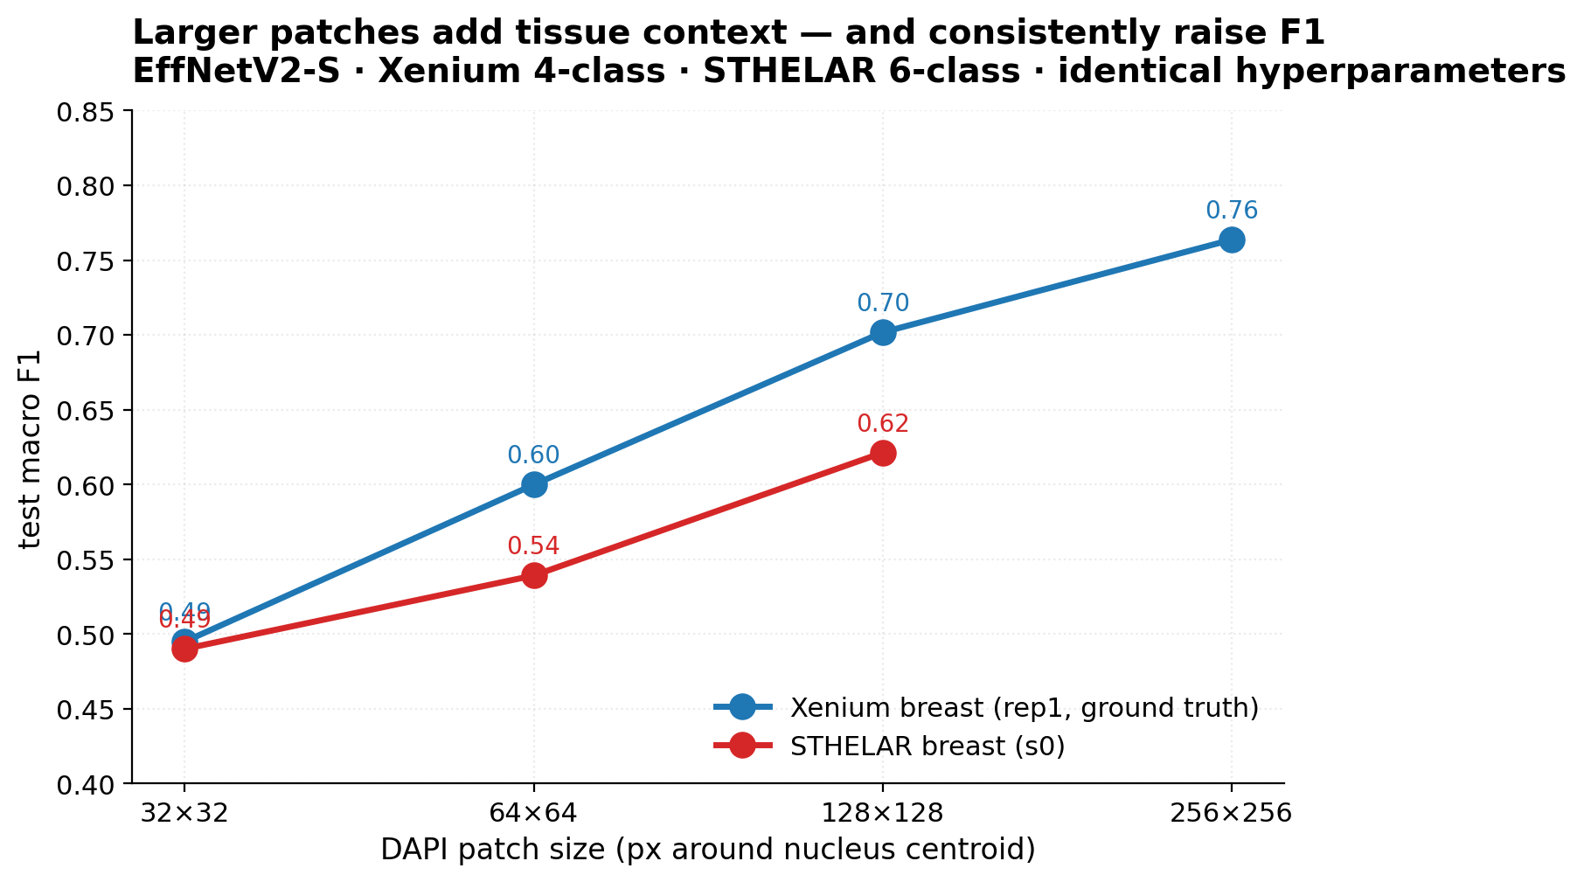
Patch size — local context matters
Larger patches consistently raise F1 across both Xenium and STHELAR.
EffNetV2-S · Xenium 4-class · STHELAR 6-class · identical hyperparameters.

Slide 8
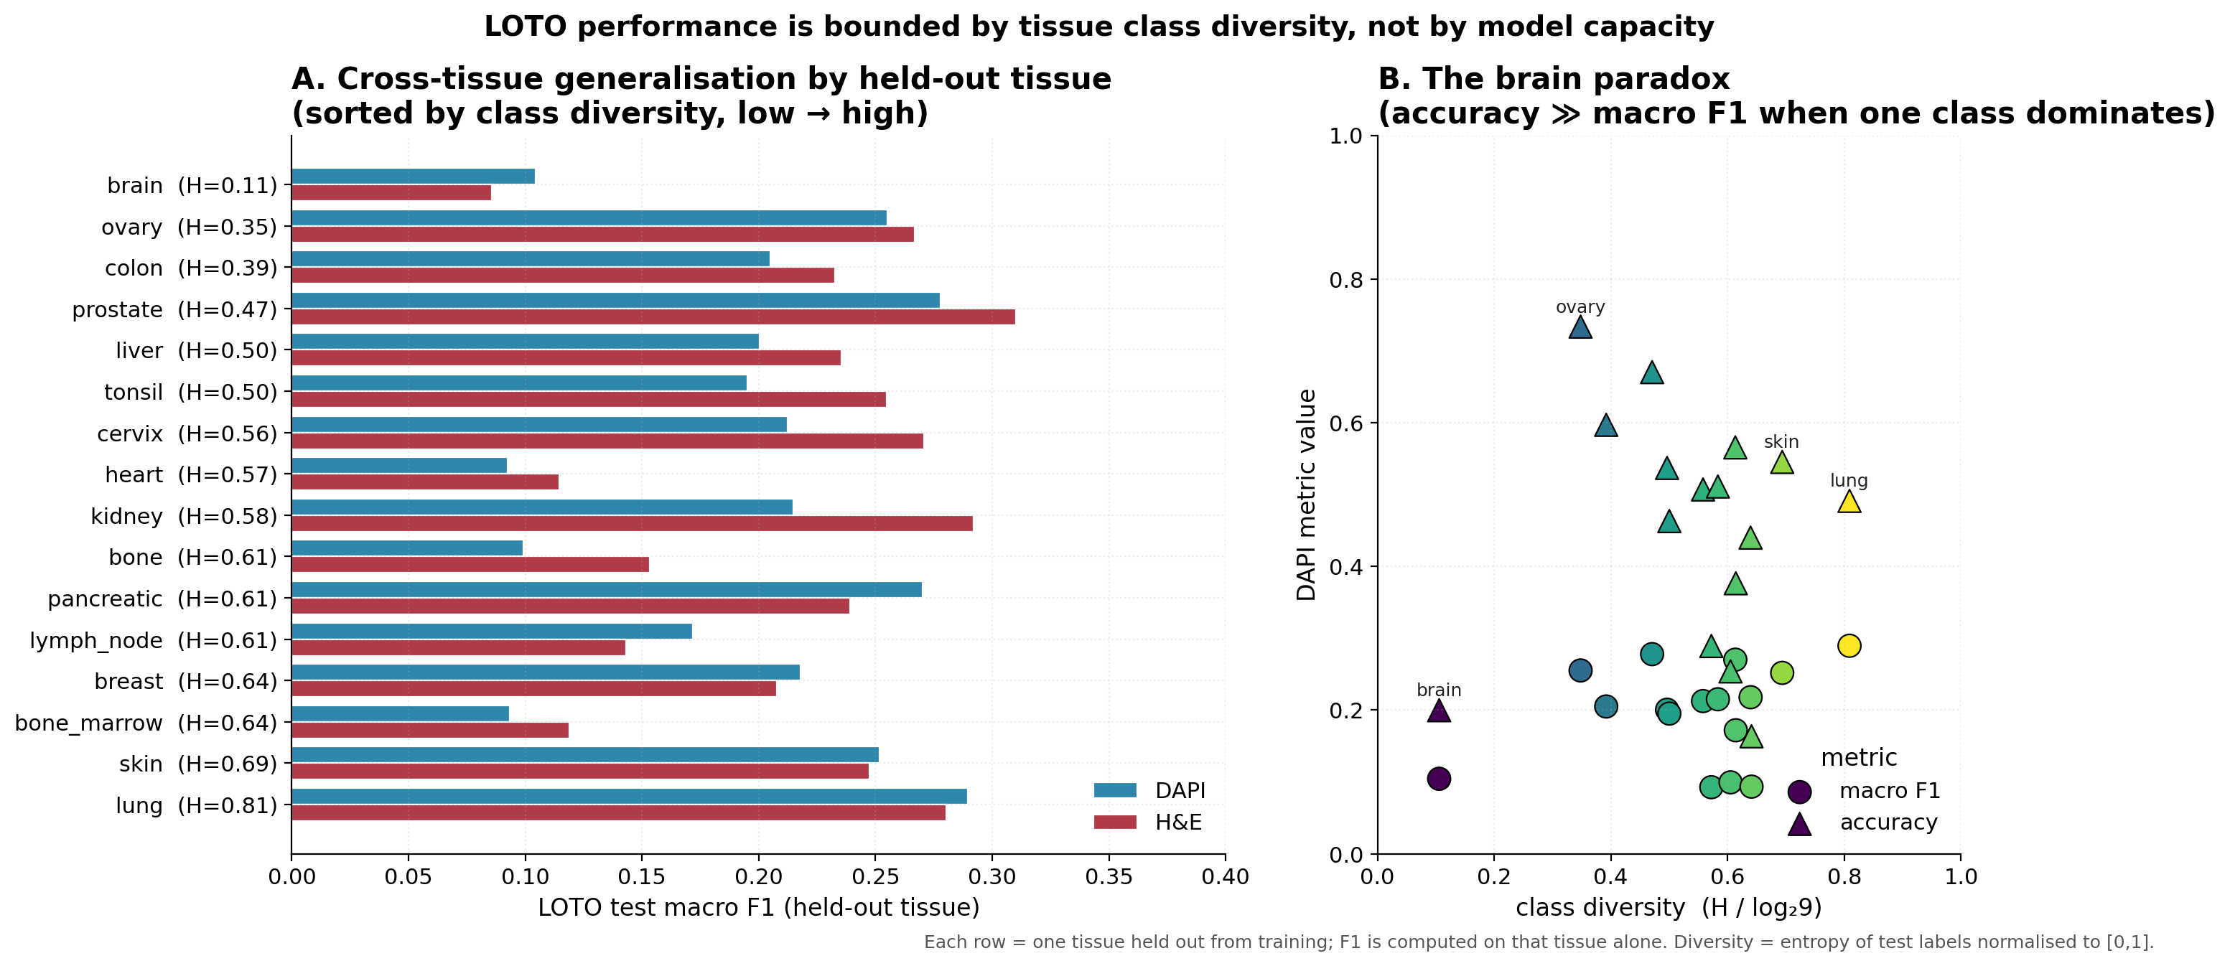
Cross-tissue generalisation — bounded by class diversity
The brain paradox: when one class dominates, accuracy ≫ macro F1.
Each row = one tissue held out from training; F1 computed on that tissue alone.

Slide 9
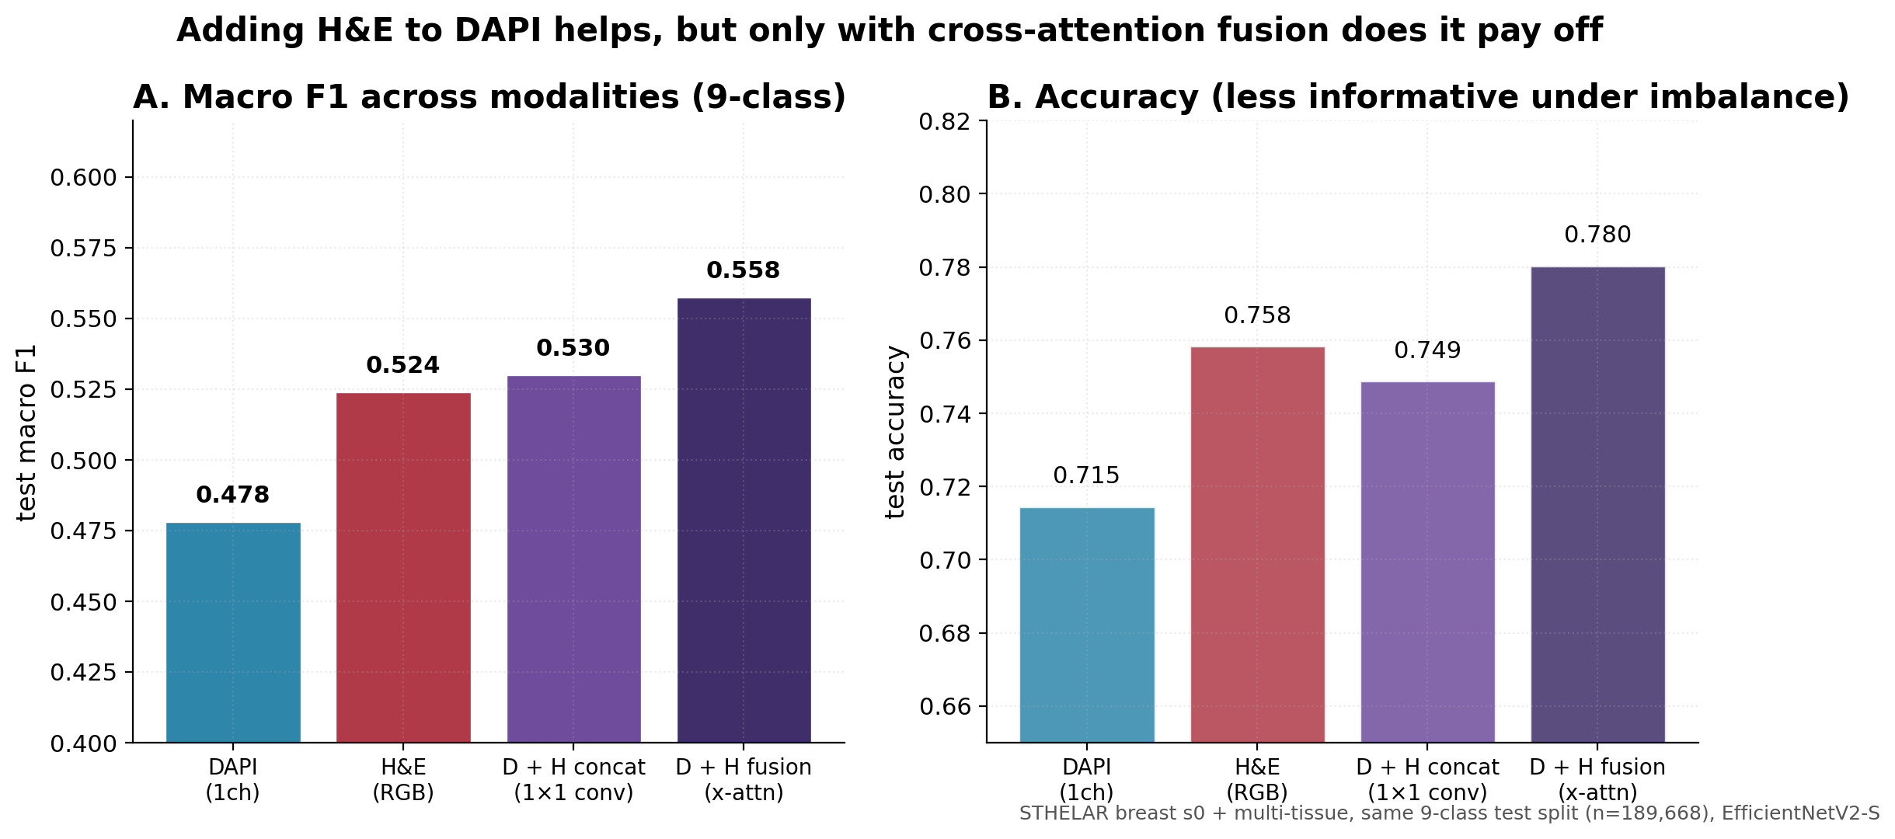
DAPI · H&E · multimodal fusion
H&E alone slightly beats DAPI; cross-attention fusion adds +5 pp F1 over DAPI.
STHELAR same 9-class test split (n=189,668), EfficientNetV2-S, identical training.

Slide 10
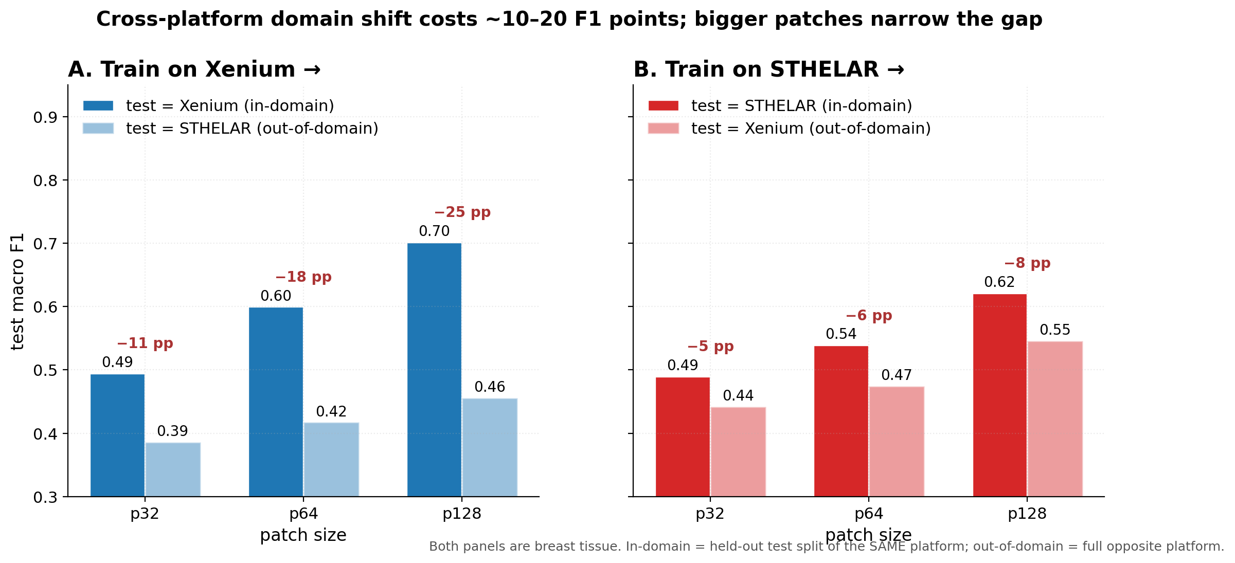
Cross-platform: STHELAR ↔ Xenium
Domain shift costs 10–25 F1 points; STHELAR-trained models transfer better than Xenium-trained.
Both panels are breast tissue. In-domain = held-out test of the SAME platform.

Slide 11
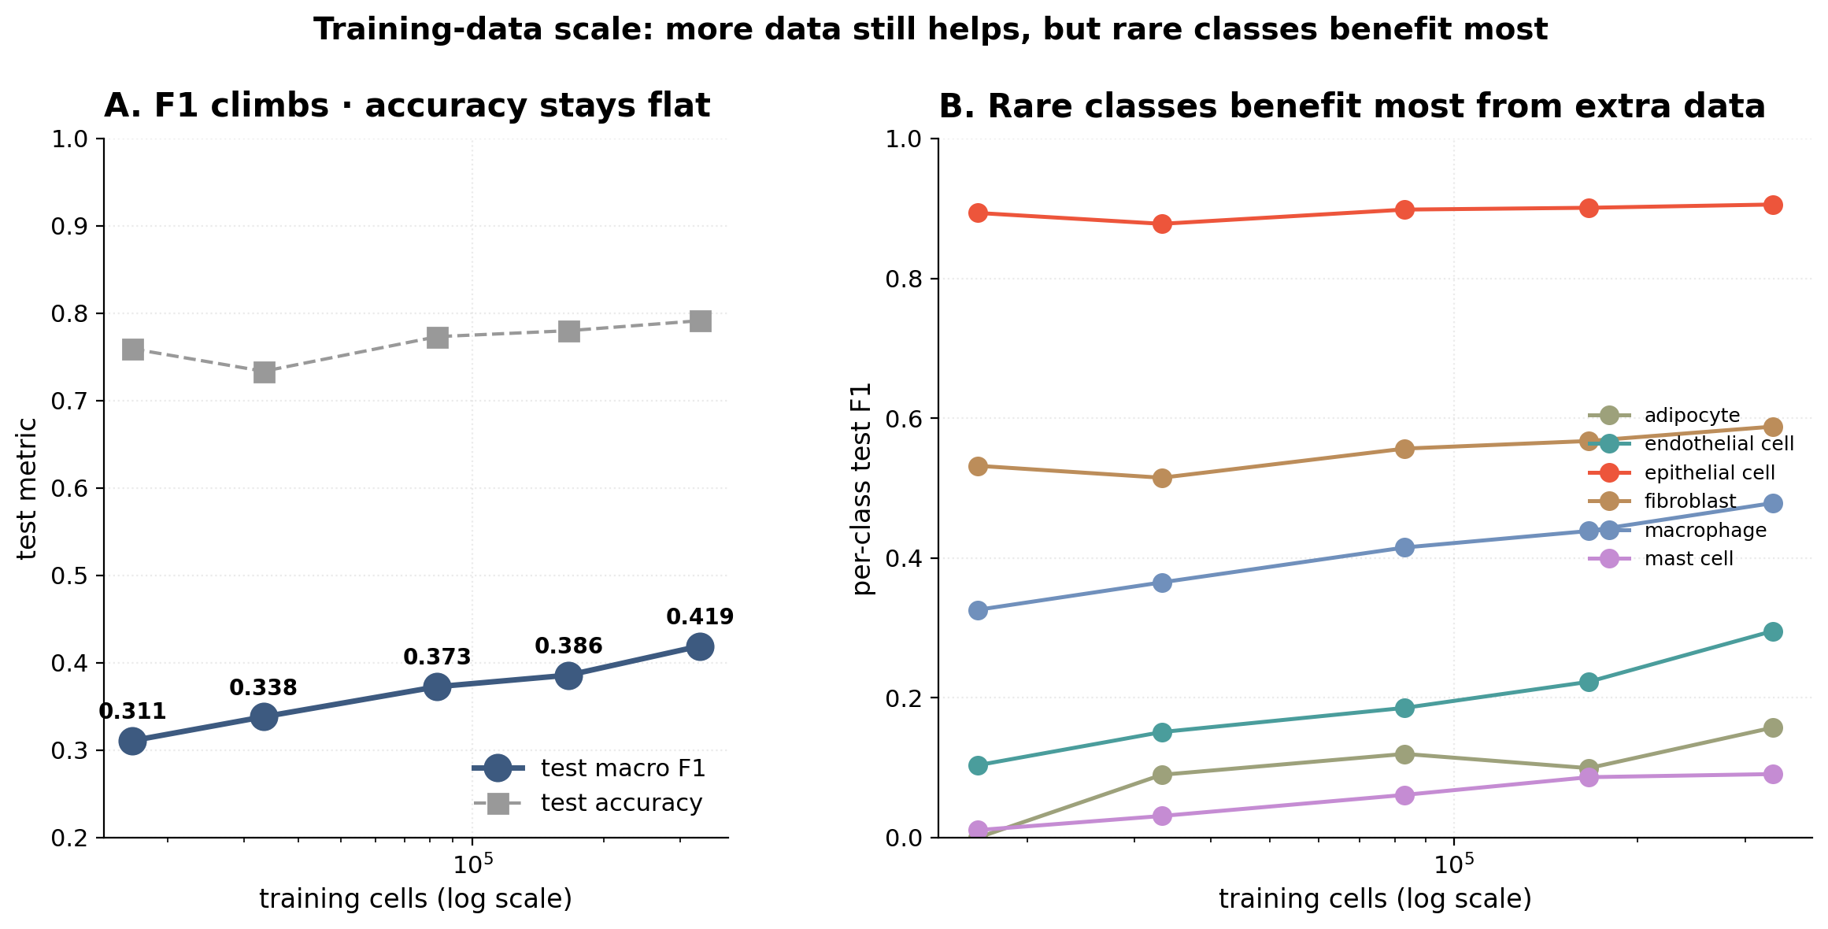
How much training data do you need?
F1 climbs from 0.31 (5 %) to 0.42 (100 %); rare classes — endothelial, mast — benefit most.
STHELAR breast s0 · fixed val/test (n=71,228 each) · 5 fractions of the train pool · EfficientNetV2-S, identical hyperparameters.

Slide 12
Limitations & honest caveats
What this work does not (yet) deliver — listed up-front so reviewers don't have to dig.
DAPI ceiling
Macro F1 plateaus around 0.55–0.65 for coarse classes. Nuclear morphology alone does not fully resolve cell identity.
Stromal & rare classes
Endothelial F1 ≈ 0.45, Mast/Adipocyte F1 ≈ 0–0.20. Class imbalance and morphological similarity to neighbours are the bottleneck.
Cross-platform domain shift
Models trained on one platform lose ~10–25 F1 points on another. STHELAR → Xenium transfers better than Xenium → STHELAR.
Training-label noise
Spatial-transcriptomics-derived labels have ~10–15 % error rate (see Fig 4 vs Janesick GT). The model inherits this floor.
Single tissue dominance
The cleanest results are on breast. Brain LOTO drops to F1 ≈ 0.10 because its class composition (93 % endothelial) differs sharply.

Slide 13
Impact & outlook
If we accept the F1 ceiling, what does this enable?
• DAPI staining is already routine in most pathology / histology labs
• Cell types can be inferred years after tissue collection — retrospective analysis
• No expensive spatial transcriptomics needed at inference time
• Platform-agnostic: train on any spatial platform, predict on any DAPI image
• Modular pipeline: easy to extend with new tissues, methods, modalities
Vision
A universal DAPI classifier that maps any nuclear-stained slide to cell types — at the F1 ceiling biology allows.

