Slide 1
Kubernetes Monitoring
Setting up a Kubernetes monitoring stack

Slide 2
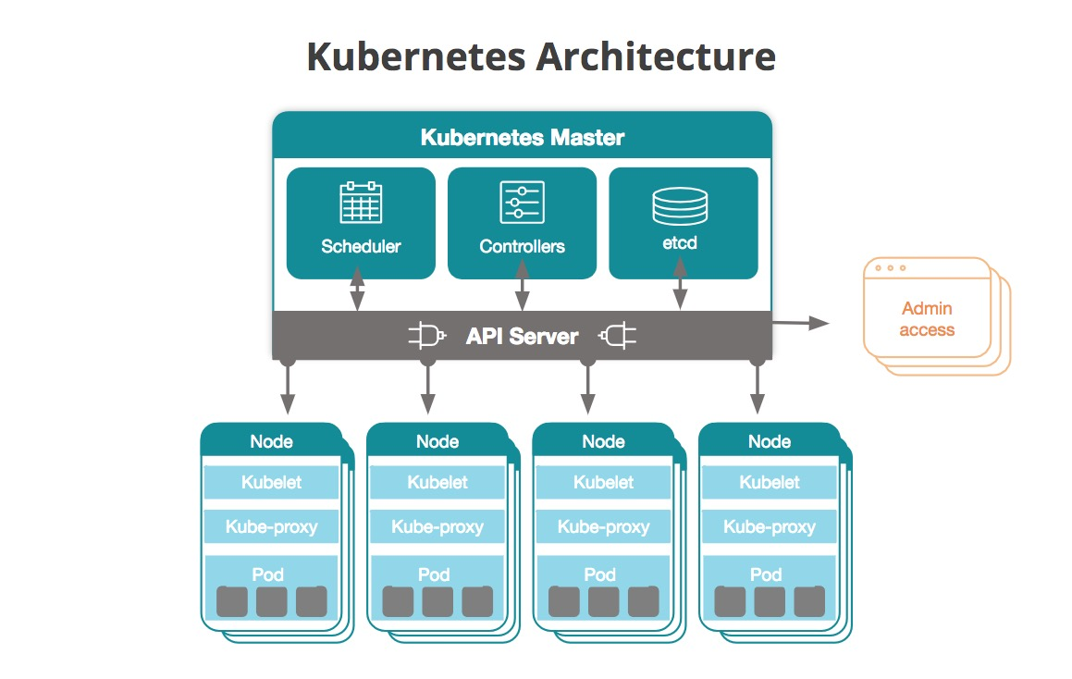
Setting up a Kubernetes monitoring stack
Key Concepts
Kubernetes (also referred to as “k8s” or “k-eights”) is an open-source software that allows to manage (orchestrate) containers at scale. Architecturally, Kubernetes are deployed as clusters. Generally speaking, a cluster has one master and one or more worker nodes
Key Components
Master | Kube-apiserver Etcd Kube-scheduler Kube-controller-manager Cloud-controller-manager
Worker | Kubelet Kube-proxy Container runtime Pod
Notes:
Kubernetes Components
When you deploy Kubernetes, you get a cluster.
A Kubernetes cluster consists of a set of worker machines, called nodes, that run containerized applications. Every cluster has at least one worker node.
The worker node(s) host the Pods that are the components of the application workload. The control plane manages the worker nodes and the Pods in the cluster. In production environments, the control plane usually runs across multiple computers and a cluster usually runs multiple nodes, providing fault-tolerance and high availability.
Master Components
The control plane’s components make global decisions about the cluster (for example, scheduling), as well as detecting and responding to cluster events (for example, starting up a new pod). Control plane components can be run on any machine in the cluster. However, for simplicity, set up scripts typically start all control plane components on the same machine, and do not run user containers on this machine.
kube-apiserver
The API server is a component of the Kubernetes control plane that exposes the Kubernetes API. The API server is the front end for the Kubernetes control plane. The main implementation of a Kubernetes API server is kube-apiserver. kube-apiserver is designed to scale horizontally—that is, it scales by deploying more instances. You can run several instances of kube-apiserver and balance traffic between those instances.
etcd
Consistent and highly-available key value store used as Kubernetes’ backing store for all cluster data. If your Kubernetes cluster uses etcd as its backing store, make sure you have a back up plan for those data.
kube-scheduler
Control plane component that watches for newly created Pods with no assigned node, and selects a node for them to run on. Factors taken into account for scheduling decisions include: individual and collective resource requirements, hardware/software/policy constraints, affinity and anti-affinity specifications, data locality, inter-workload interference, and deadlines.
kube-controller-manager
Control Plane component that runs controller processes. Logically, each controller is a separate process, but to reduce complexity, they are all compiled into a single binary and run in a single process.
These controllers include:
Node controller: Responsible for noticing and responding when nodes go down.
Replication controller: Responsible for maintaining the correct number of pods for every replication controller object in the system.
Endpoints controller: Populates the Endpoints object (that is, joins Services & Pods).
Service Account & Token controllers: Create default accounts and API access tokens for new namespaces.
cloud-controller-manager
A Kubernetes control plane component that embeds cloud-specific control logic. The cloud controller manager lets you link your cluster into your cloud provider’s API, and separates out the components that interact with that cloud platform from components that just interact with your cluster. The cloud-controller-manager only runs controllers that are specific to your cloud provider. If you are running Kubernetes on your own premises, or in a learning environment inside your own PC, the cluster does not have a cloud controller manager. As with the kube-controller-manager, the cloud-controller-manager combines several logically independent control loops into a single binary that you run as a single process. You can scale horizontally (run more than one copy) to improve performance or to help tolerate failures.
The following controllers can have cloud provider dependencies:
Node controller: For checking the cloud provider to determine if a node has been deleted in the cloud after it stops responding
Route controller: For setting up routes in the underlying cloud infrastructure
Service controller: For creating, updating and deleting cloud provider load balancers
Node Components
Node components run on every node, maintaining running pods and providing the Kubernetes runtime environment.
kubelet
An agent that runs on each node in the cluster. It makes sure that containers are running in a Pod. The kubelet takes a set of PodSpecs that are provided through various mechanisms and ensures that the containers described in those PodSpecs are running and healthy. The kubelet doesn’t manage containers which were not created by Kubernetes.
kube-proxy
kube-proxy is a network proxy that runs on each node in your cluster, implementing part of the Kubernetes Service concept. kube-proxy maintains network rules on nodes. These network rules allow network communication to your Pods from network sessions inside or outside of your cluster. kube-proxy uses the operating system packet filtering layer if there is one and it’s available. Otherwise, kube-proxy forwards the traffic itself.
Container Runtime
The container runtime is the software that is responsible for running containers. Kubernetes supports several container runtimes: Docker, containerd, CRI-O, and any implementation of the Kubernetes CRI (Container Runtime Interface).

Slide 3
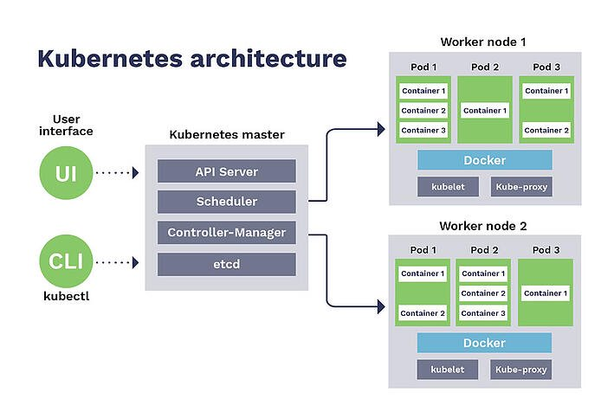
Setting up a Kubernetes monitoring stack
Key Concepts - continue
With Kubernetes, applications are developed to run in containers, which represent the technology used to pack together applications with their configurations and dependencies to decouple them from any underlying host infrastructure
Containers are grouped into pods, the basic operational unit for Kubernetes. Pods contain one or more containers which are administered as a single entity
Pods are logically grouped into namespaces, whose scope is to isolate applications from one another. Namespaces can be seen as virtual machines, in that they can be independently set, administered and run

Slide 4
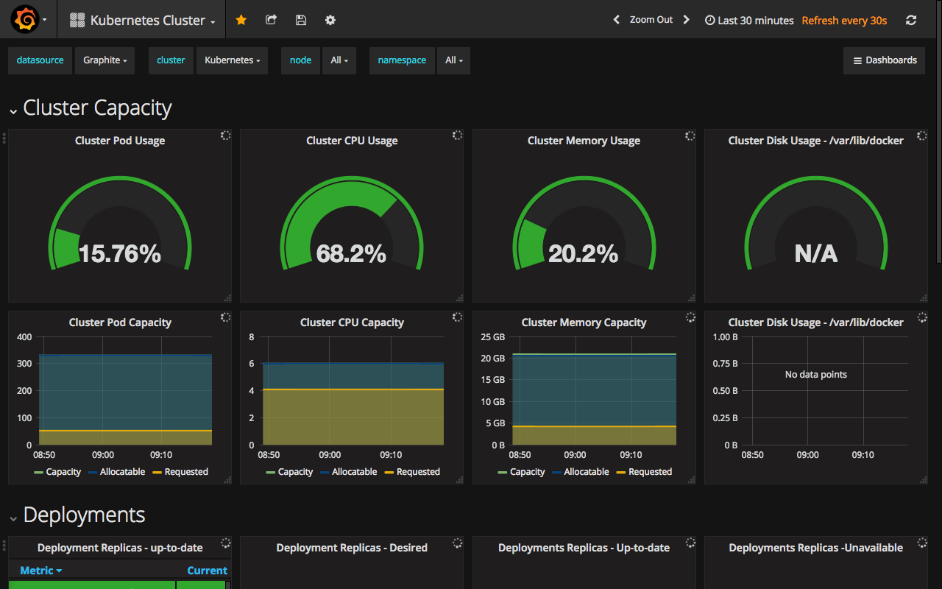
Setting up a Kubernetes monitoring stack
Monitoring
Two levels of monitoring:
Kubernetes cluster
Nodes
Applications
Resource utilization
Pods
Kubernetes metrics
Pod container metrics
Application metrics

Slide 5


Setting up a Kubernetes monitoring stack
Monitoring - continue
Cluster monitoring
General objective is to monitor the health of the entire cluster through metrics such as:
Node resource utilization, as in network bandwidth, disk utilization, CPU, and memory utilization. Using these metrics, one can find out whether or not to increase or decrease the number and size of nodes in the cluster
Number of nodes, to help figure out what you are paying for (if you are using cloud providers), and to discover what the cluster is being used for
Running pods, to help determine if the number of nodes available is sufficient to handle the current workload, and any unexpected failures

Slide 6

Setting up a Kubernetes monitoring stack
Monitoring – even more
Pod monitoring
Three major categories
Kubernetes metrics, to monitor how a specific pod and its deployment are being handled by the orchestrator
Pod container metrics, such as CPU, network, and memory usage compared with the maximum allowed
Application metrics, developed by the application itself and generally related to the business rules it addresses

Slide 7

Setting up a Kubernetes monitoring stack
Monitoring Options
Two main approaches:
Via Kubernetes DeamonSets, or
Through a monitoring tool
Prometheus
ELK Stack
Fluentd
cAdvisor
Kubewatch
Jaeger
Weave Scope, etc…
Notes:
DeamonSets
One approach to monitoring all cluster nodes is to create a special kind of Kubernetes pod called DaemonSets. Kubernetes ensures that every node created has a copy of the DaemonSet pod, which virtually enables one deployment to watch each machine in the cluster. As nodes are destroyed, the pod is also terminated. Many monitoring solutions use the Kubernetes DaemonSet structure to deploy an agent on every cluster node. In this case, there is not a general solution as each tool will have its own software for cluster monitoring.

Slide 8
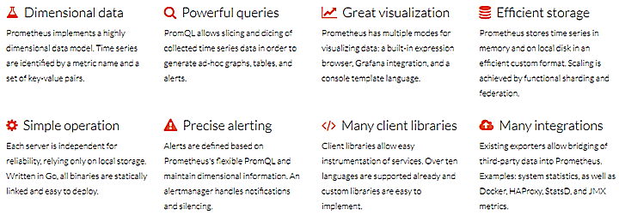
Setting up a Kubernetes monitoring stack
Prometheus
Prometheus has emerged as the de-facto open source standard for monitoring Kubernetes
Real-time metrics are collected in a time-series database
SQL-based language to query metrics (PromQL)
Additional plug-ins such as alert management and data exporters available
Runs on top of kubernetes via the Prometheus Operator
Integrated with Grafana
Notes:
Grafana is open source visualization and analytics software. It allows you to query, visualize, alert on, and explore your metrics no matter where they are stored. In plain English, it provides you with tools to turn your time-series database (TSDB) data into beautiful graphs and visualizations.

Slide 9
Setting up a Kubernetes monitoring stack
Prometheus Operator Installation
Prometheus Operator installed with Helm
Helm is a package manager for Kubernetes
Helm allows to install and manage applications on Kubernetes clusters through a simple command-line interface
No separate installation needed for Grafana as it is already integrated in the Prometheus Operator
Notes:
What is a Kubernetes Operator?
Operators are Kubernetes-specific applications (pods) that configure, manage and optimize other Kubernetes deployments automatically. They are implemented as a custom controller. A Kubernetes operator encapsulates the know-how of deploying and scaling an application and directly executes algorithm decisions communicating with the API. A Kubernetes Operator might be able to:
Install and provide sane initial configuration and sizing for your deployment, according to the specs of your Kubernetes cluster.
Perform live reloading of deployments and pods to accommodate for any user-requested parameter modification (hot config reloading).
Automatically scale up or down according to performance metrics.
Perform backups, integrity checks or any other maintenance task.
Basically, anything that can be expressed as code by a human admin can be automated inside a Kubernetes Operator.
Kubernetes Operators make extensive use of Custom Resource Definitions (or CRDs) to create context-specific entities and objects that will be accessed like any other Kubernetes API resource. Operators read, write and update CRDs to persist service configuration inside the cluster.
Prometheus Operator
The Prometheus Operator for Kubernetes provides easy monitoring definitions for Kubernetes services and deployment and management of Prometheus instances. We are going to use the Prometheus Operator to:
Perform the initial installation and configuration of the full Kubernetes-Prometheus stack
Prometheus servers
Alertmanager
Grafana
Host node_exporter
kube-state-metrics
Define metric endpoint autoconfiguration using the ServiceMonitor entities
Customize and scale the services using the Operator CRDs and ConfigMaps, making our configuration fully portable and declarative
The Operator acts on the following custom resource definitions (CRDs):
Prometheus, which defines the desired Prometheus deployment. The Operator ensures at all times that a deployment matching the resource definition is running.
ServiceMonitor, which declaratively specifies how groups of services should be monitored. The Operator automatically generates Prometheus scrape configuration based on the definition.
PrometheusRule, which defines a desired Prometheus rule file, which can be loaded by a Prometheus instance containing Prometheus alerting and recording rules.
Alertmanager, which defines a desired Alertmanager deployment. The Operator ensures at all times that a deployment matching the resource definition is running.
The kube-prometheus directory inside the Operator repository contains default services and configurations, so you get not only the Prometheus Operator itself, but a complete setup that you can start using and customizing from the get-go.
Helm is a a package manager that provides an easy way to find, share, and use software built for Kubernetes. The project uses a packaging format called charts, which are a collection of files that describe a related set of Kubernetes resources. It is used in production by a variety of organizations, including AT&T, Bitnami, CERN, Conde Nast, Microsoft, VMWare, and many others. Since its inception, there have been more than 13,000 contributions representing over 1,500 companies to the Helm project. Helm was created in 2015 at Deis, which was later acquired by Microsoft. What is now known as Helm classic was introduced at the inaugural KubeCon that November. In 2016, the Helm team joined forces with Google, Skippbox, and Bitnami to produce Helm 2, which defined a workflow for creating, installing, and managing Helm charts. In June 2018, Helm joined the Cloud Native Computing Foundation or CNCF as an incubating project. The Helm Hub was launched in late 2018 as a centralized home for Helm charts and today sees more than hundreds of millions of downloads a month. Late last year, the Helm team released Helm 3, which builds upon the Helm 2 workflow, changing the underlying infrastructure to reflect the needs of the community as they change and evolve. Very recently, CNCF announced that Helm is the tenth project to graduate. To move from the maturity level of incubation to graduation, projects must demonstrate thriving adoption, an open governance process, and a strong commitment to community, sustainability, and inclusivity.

Slide 10
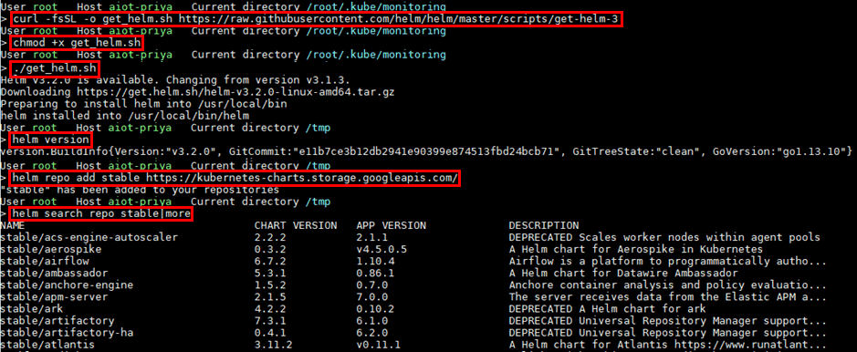
Setting up a Kubernetes monitoring stack
Helm Installation
Download, install, and add a repository to Helm

Slide 11
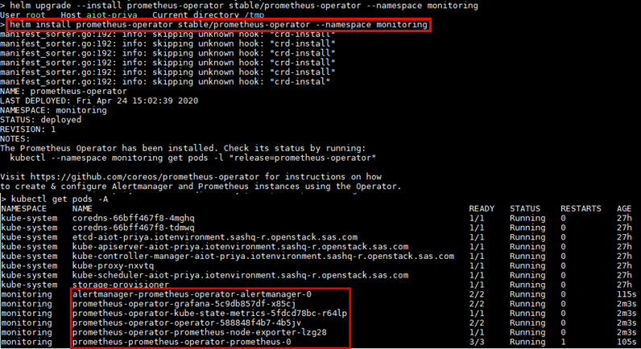
Setting up a Kubernetes monitoring stack
Prometheus Operator Installation
Install Prometheus using Helm
Notes:
The output of the kubectl command shows that the Grafana and alertmanager integration was also installed – no need for extra install steps.

Slide 12
Setting up a Kubernetes monitoring stack
Prometheus Operator Installation (continue)
To access the Prometheus web interface as well as Grafana, they both need to be “exposed” as services:
PROMETHEUS_LOG="/tmp/prometheus.log"
PROMETHEUS_PORT="9090"
kubectl port-forward -n $(kubectl get pod -A -l 'app=prometheus' -o jsonpath='{.items[0].metadata.namespace}') $(kubectl get pod -A -l 'app=prometheus' -o jsonpath='{.items[0].metadata.name}') --address $(hostname -i) $PROMETHEUS_PORT:$PROMETHEUS_PORT >>$PROMETHEUS_LOG &
GRAFANA_LOG="/tmp/grafana.log"
GRAFANA_PORT=“3000"
kubectl port-forward -n $(kubectl get pod -A -l 'app.kubernetes.io/name=grafana' -o jsonpath='{.items[0].metadata.namespace}') $(kubectl get pod -A -l 'app.kubernetes.io/name=grafana' -o jsonpath='{.items[0].metadata.name}') --address $(hostname -i) $GRAFANA_PORT:$GRAFANA_PORT >>$GRAFANA_LOG &
Notes:
By default, pods are only accessible through their internal IP addresses within the Kubernetes cluster. To make them accessible from outside the Kubernetes virtual network, pods need to be “exposed” as Kubernetes services. There are several ways to do that. For instance, the kubectl patch command can be used to update the Service in-place to a public-facing type like LoadBalancer, or the kubectl port-forward command can be used to forward a local port to a Grafana Pod port.
To use kubectl patch, enter the following command:
kubectl patch svc “<Grafana service name>" --namespace <Grafana namespace> -p '{"spec": {"type": "LoadBalancer"}}’
The above command will cause an external IP address to be generated for outside access. It might take a few minutes for the process to complete. To monitor it, the following command can be used:
kubectl get svc –namespace <Grafana namespace> -w
To expose the service via port-forwarding, a command similar to the following can be used:
kubectl port-forward -n $(kubectl get pod -A -l 'app.kubernetes.io/name=grafana' -o jsonpath='{.items[0].metadata.namespace}') $(kubectl get pod -A -l 'app.kubernetes.io/name=grafana' -o jsonpath='{.items[0].metadata.name}') --address $(hostname -i) 3000

Slide 13
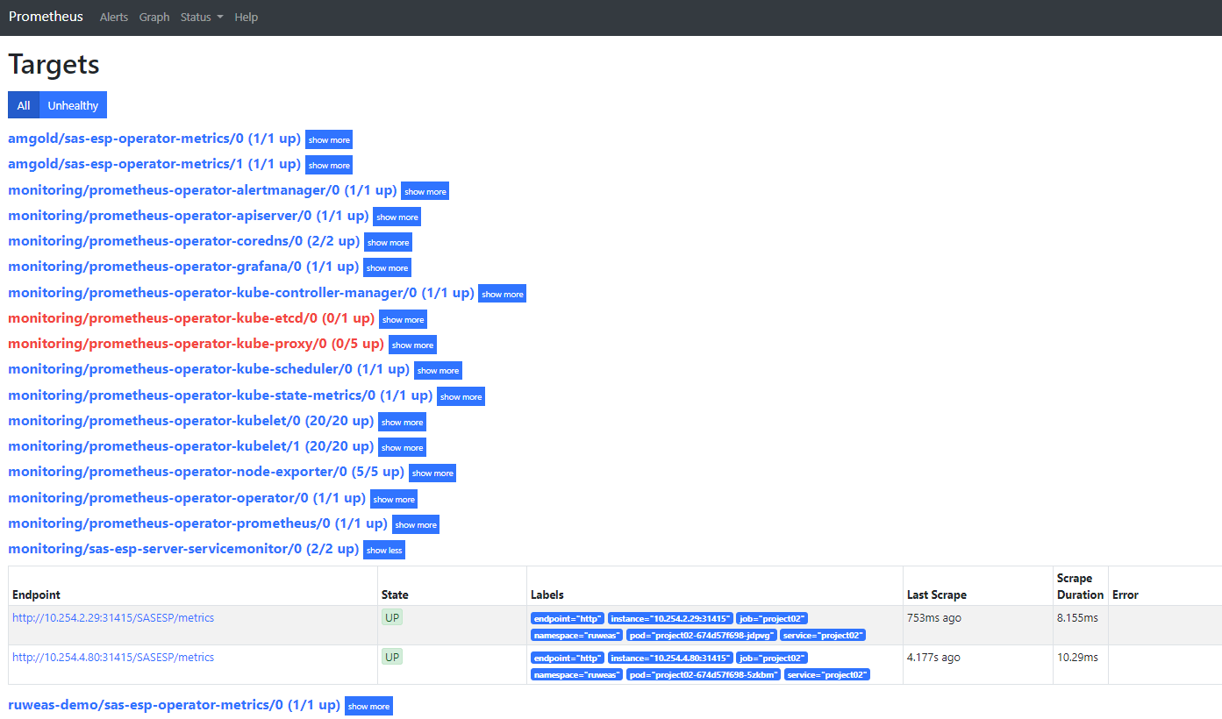
Setting up a Kubernetes monitoring stack
Prometheus access
Once Prometheus has been exposed, it can be accessed from a browser as in the following example:
http(s)://<Prometheus host>:9090

Slide 14

Setting up a Kubernetes monitoring stack
Grafana access
Once Grafana has been exposed, it can be accessed from a browser as in the following example:
http(s)://<Grafana host>:3000 (Initial credentials are admin/prom-operator)

Slide 15

Setting up a Kubernetes monitoring stack
Our monitoring stack is up, now what?

Slide 16

Setting up a Kubernetes monitoring stack
Prometheus
To know what to monitor, Prometheus relies on targets
Targets are “scraped” at regular intervals to collect metrics (or scrapes) which are then stored in the Prometheus time-series database
Service Monitors are used to identify and scrape targets
Applications that don’t expose metrics in a time-series format, can have them scraped through exporters
Alerts can be configured to automatically send out notifications via the Alertmanager following the triggering of events
Notes:
Behind the cover, Prometheus uses levelDB, an in-grown time-series database developed by Google. LevelDB is supposed to be used as a short-term storage mean. For long-term purposes, it is recommended that Prometheus be configured to read and write from/to external storage to minimize performance impact on the Kubernetes cluster. Following is a list of remote endpoints and storage currently supported (keep in mind the list is a work in progress):
AppOptics: write
Azure Data Explorer: read and write
Azure Event Hubs: write
Chronix: write
Cortex: read and write
CrateDB: read and write
Elasticsearch: write
Gnocchi: write
Google Cloud Spanner: read and write
Graphite: write
InfluxDB: read and write
IRONdb: read and write
Kafka: write
M3DB: read and write
OpenTSDB: write
PostgreSQL/TimescaleDB: read and write
QuasarDB: read and write
SignalFx: write
Splunk: read and write
TiKV: read and write
Thanos: write
VictoriaMetrics: write
Wavefront: write
Prometheus exporters
Many popular server applications like Nginx or PostgreSQL are much older than the Prometheus metrics / OpenMetrics popularization. They usually have their own metrics formats and
exposition methods. If you are trying to unify your metric pipeline across many microservices and hosts using Prometheus metrics, this may be a problem. To work around this hurdle,
the Prometheus community is creating and maintaining a vast collection of Prometheus exporters. An exporter is a “translator” or “adapter” program able to collect the server native
metrics (or generate its own data observing the server behaviour) and re-publishing these metrics using the Prometheus metrics format and HTTP protocol transports. These small
binaries can be co-located in the same container or pod executing the main server that is being monitored, or isolated in their own sidecar container and then you can collect the
service metrics scraping the exporter that exposes and transforms them into Prometheus metrics.

Slide 17

Setting up a Kubernetes monitoring stack
Grafana
Grafana can process data in a time series format from different providers
Providers are defined to Grafana as data sources
One can develop their own data source plug-ins or use pre-defined ones
Luckily for us, the Prometheus Operator comes with its own, which means Grafana can ingest data from Prometheus directly without any required configuration
Dashboards are used to visualize metrics for one or more data sources

Slide 18

Setting up a Kubernetes monitoring stack
SAS Event Stream Processing & Prometheus
The SAS ESP server exposes metrics by default
Two families of metrics are currently available:
window_cpu_usage
- CPU usage at the window level
esp_mem_usage
- ESP Server memory usage by memory type (total, virtual, and RSS)
“By default, Prometheus scrapes the ESP server’s /metrics endpoint for server metrics”
Notes:
The SAS ESP server exposes metrics automatically via the prometheus section of esp-properties.yml file. Two “families” of metrics are surfaced.
ESP_CPU_USAGE reports on CPU consumption at the ESP window level, whereas ESP_MEM_USAGE shows memory info based on type (total, vm, and RSS).
A few other counters are available that reports on the total number of metrics sent to Prometheus as well as the total number of bytes transferred to the
Prometheus server.
As a side note, our documentation indicates that ESP uses the /metrics endpoint to dump its metrics. In reality, that endpoint is used to gather metrics for the metering
server. The ESP server metrics are instead collected using the /SASESP/metrics endpoint.

Slide 19
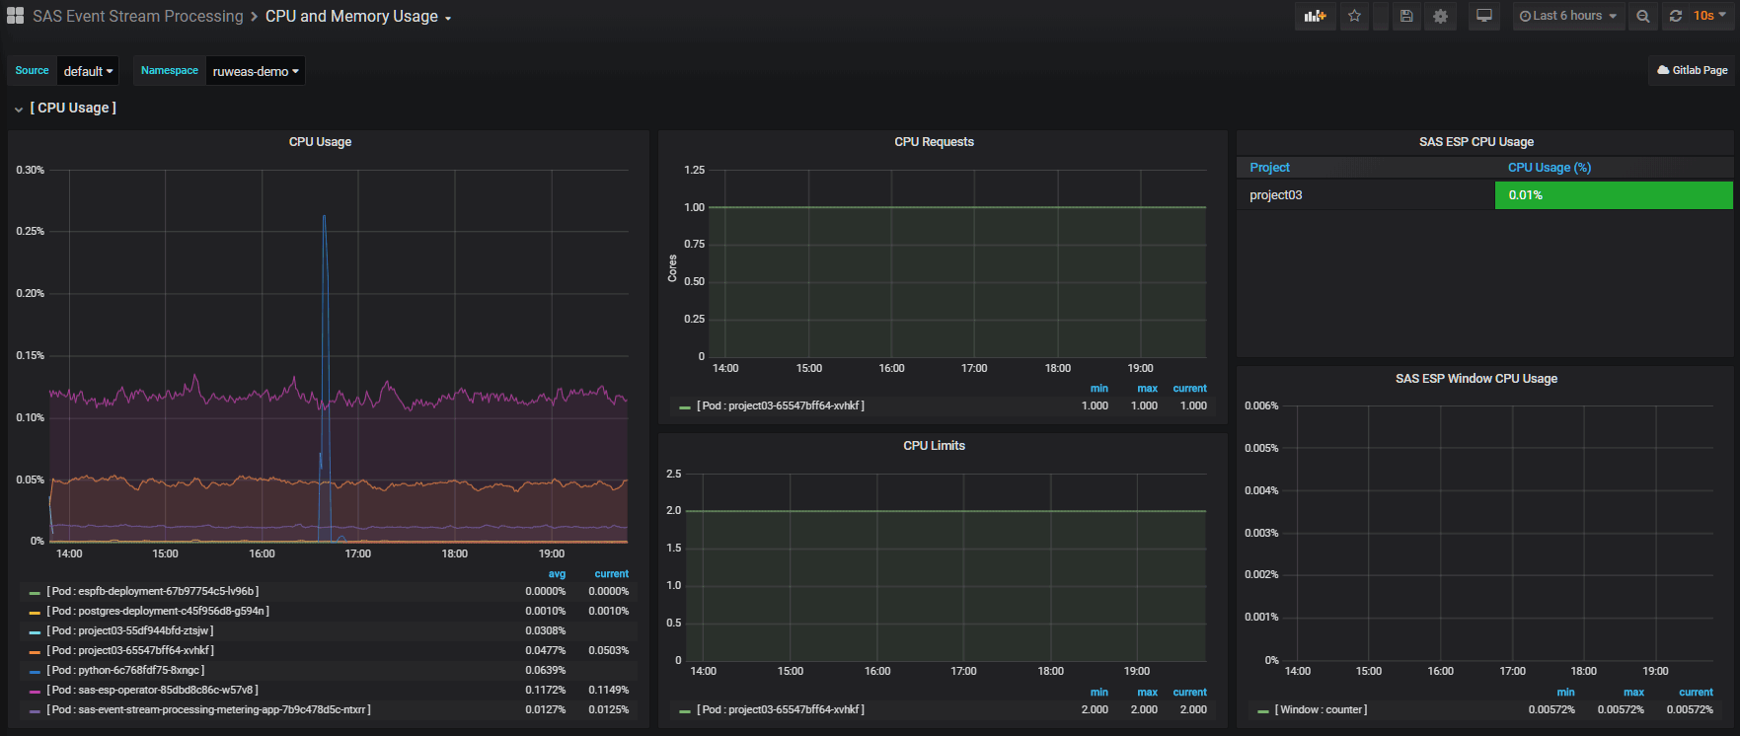
Setting up a Kubernetes monitoring stack
Grafana dashboard sample for ESP - CPU

Slide 20
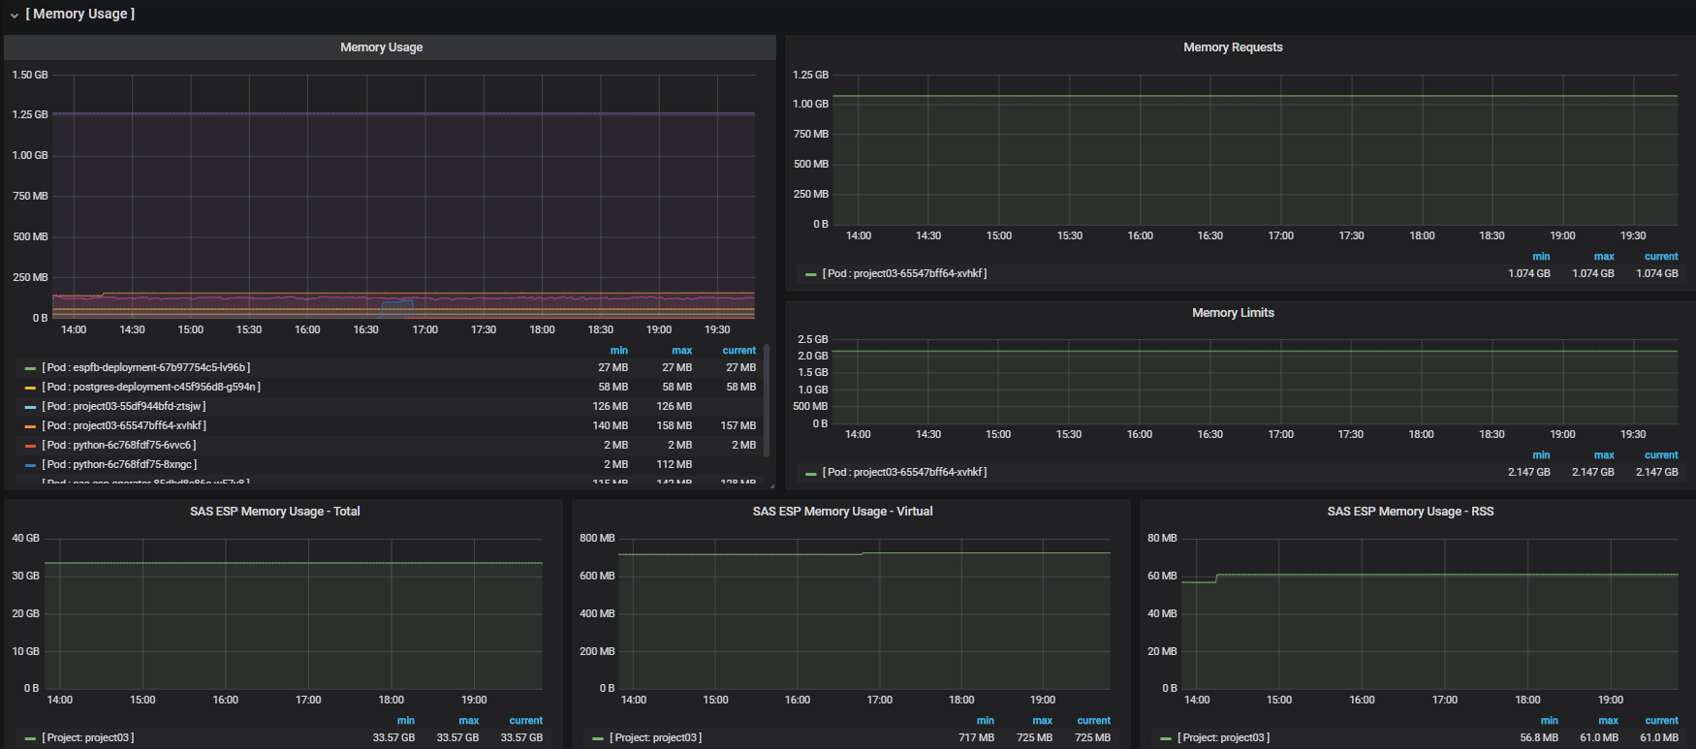
Setting up a Kubernetes monitoring stack
Grafana dashboard sample for ESP - Memory

Slide 21

Questions?

