Slide 1








A multicontact problem: the virtual testing of joints for the prediction of damping
[ 8th World Congress on Computational Mechanics - Venice 2008 ]
D. Néron, P. Ladevèze, A. Caignot • LMT-Cachan
J.-F. Durand • EADS/ASTRIUM-ST
R&T “damping prediction in launchers”
astrium

Slide 2

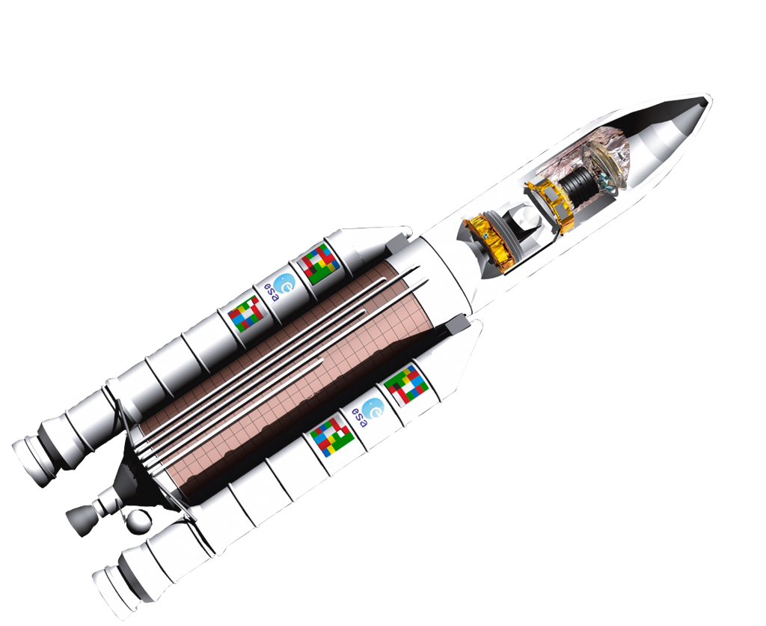


Industrial context
Damping in space launch vehicles
  highly influences the response of the launcher
  near its fundamental modes of vibration
  one of the major issues of dimensioning
Today: no prediction
  damping modeled globally
  damping coefficients identified using validation
  tests on prototypes or on final structures
  local dissipative phenomena not taken
  into account
Aim: to be able to predict damping
  during the dimensioning phase of the launcher
Ariane 5 launcher

Slide 3
Scientific context
Aim: to propose a dedicated approach
  to predict damping coefficients
As easy as elastic coefficients
  without testing the entire final structure
  but only using some representative specimens
  main difficulty: damping in joints
  (already known results for damping in materials)
Introduction of a new tool
  for the virtual testing of the joints
Ariane 5 launcher

Slide 4
Outline
Description of the problem and experimental results
A virtual testing tool for the prediction of damping
Comparison between experimental and virtual results
Conclusions

Slide 5
Outline
Description of the problem and experimental results
A virtual testing tool for the prediction of damping
Comparison between experimental and virtual results
Conclusions

Slide 6
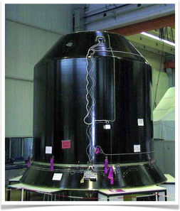
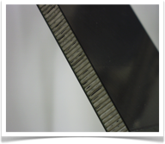
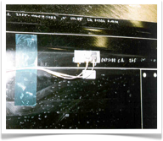
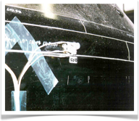
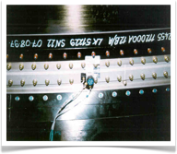
Damping in the launcher
3
2
1
Sylda
satellite double launch system
of Ariane 5
4
1
2
3
4
sandwich composite
carbon/epoxy skin +
aluminum honeycomb
stuck joint
stuck joint
with stiffening piece
bolted joint

Slide 7

Classical procedure
Modal approach
  proportional damping: damping matrix is a linear combination of
  stiffness and mass matrices
Main drawbacks
  damping modeled globally and not predicted
  damping identified on the global structure
  influence of loading level and frequency often not taken into account

Slide 8
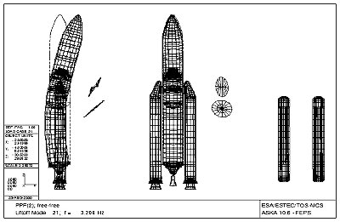
New procedure
Database of damping coefficients
  for each mode and each type of solicitation
  dissipation due to the material and to the joints
Main advantages
  more accurate prediction of the behavior of the launcher
  more efficient phase of dimensioning
Generalized loadings
(traction forces, shear forces,
bending moments)
Damping database
Initial calculation without
damping on an assembly of
shell-type elements
New calculation using
the predicted
modal damping
Modal damping

Slide 9
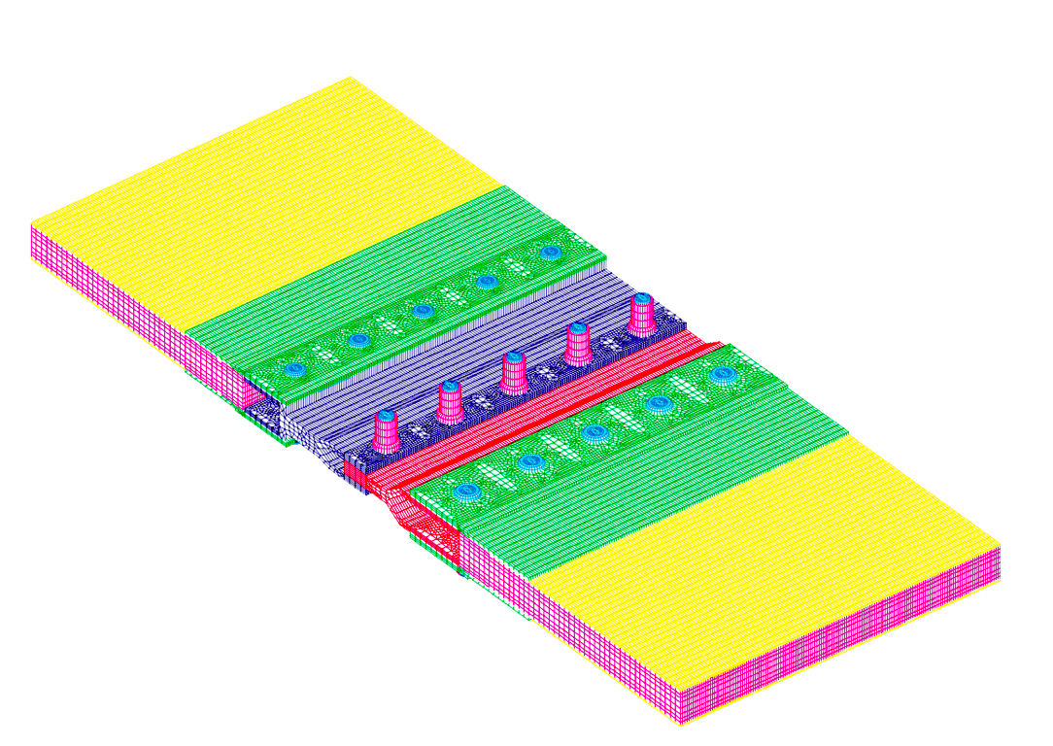
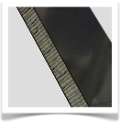
Database of damping coefficients
Generalized loadings
(traction forces, shear forces,
bending moments)
Damping database
Initial calculation without
damping on an assembly of
shell-type elements
New calculation using
the predicted
modal damping
Modal damping
η = η(solicitation type, loading level, frequency, geometry)
In material
In joints
homogenization
virtual
testing
R&T LMT-Cachan/
ASTRIUM-ST/CNES 04-08
[Adams et al. 93, 94 ...]

Slide 10
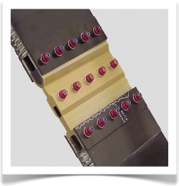
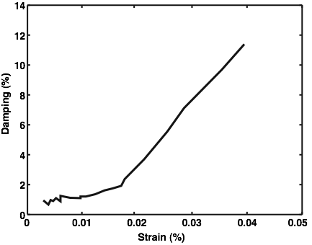
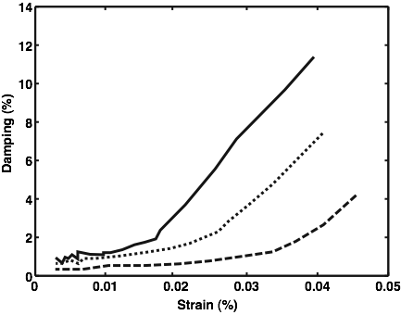
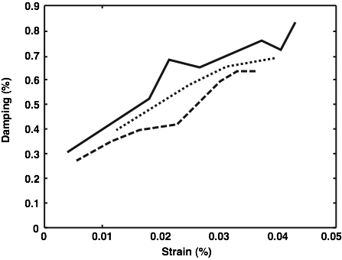
Experimental results for bolted joints
Damping test [R&T LMT-Cachan/ASTRIUM-ST/CNES 01-04]
Damping highly nonlinear with the level of strain
Damping nearly independent on the excitation frequency
Grinding process with the number of cycles
η = 12%
η = 0.5%
13 Hz
1 cycle: η = 12%
17 Hz
15 cycles: η = 8%
40,000 cycles: η = 4%
25 Hz

Slide 11
Blabla...

Slide 12
Outline
Description of the problem and experimental results
A virtual testing tool for the prediction of damping
Comparison between experimental and virtual results
Conclusions

Slide 13
Conclusions
Prediction of damping due to the joints in space launchers
  aim: to build a database of damping coefficients
A virtual testing computational strategy
  dedicated to the treatment of contact problems with a large number of DOFs and (eventually stochastic) parameters
  computations impossible with industrial codes (CPU time prohibitive, computation fails, to sufficiently accurate)
  promising accuracy of the virtual results compared to the tests
Work in progress
  to improve the computing times further to get results faster

Slide 14
The end thank you.
[ 8th World Congress on Computational Mechanics - Venice 2008 ]

