Slide 1
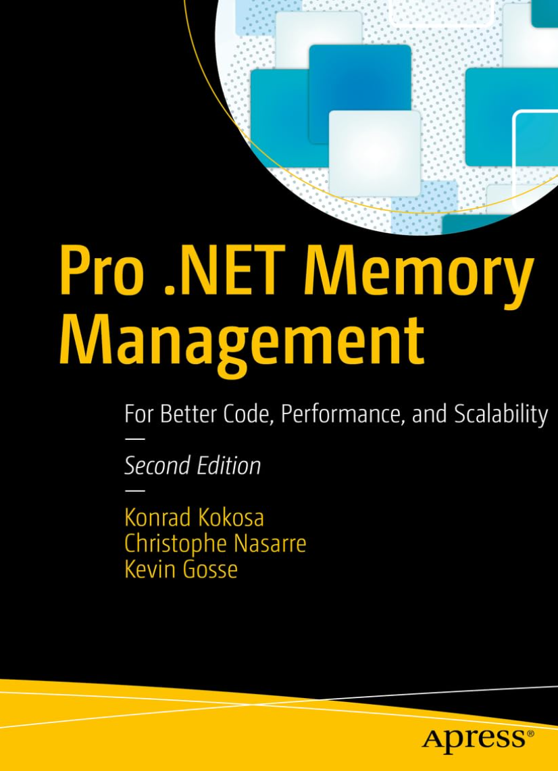

Spying + Changing Agents
Christophe Nasarre
Developer at Datadog
Twitter @chnasarre
@chrisnas.bsky.social
Notes:
POLL: raise your hand if you are using agents to generate code
Copilot ?
Cursor ?
Claude ?
Codex ?
ChatGPT :^)
Session Setup
-----------------------
Open Explorer on
Cursor
C:\Users\Christophe Nasarre\.cursor\projects
C:\Users\Christophe Nasarre\.cursor\projects\C-dev-dd-win-prof\agent-transcripts\90f37e83-0aa8-4d76-8e3a-094322899a3e
C:\Users\Christophe Nasarre\AppData\Roaming\Cursor\User\workspaceStorage\2f4a4dd9b247ee19ce12fb78b89e3710
C:\Users\Christophe Nasarre\AppData\Roaming\Cursor\User\globalStorage
C:\Users\Christophe Nasarre\.cursor\plans
Claude
C:\Users\Christophe Nasarre\.claude\projects\
C:\Users\Christophe Nasarre\.claude\projects\C--github-chrisnas-UpdateConferencePrague2026
C:\Users\Christophe Nasarre\.claude\plans
Copilot
C:\Users\Christophe Nasarre\.copilot\session-state\835cd582-56e3-4791-bf53-59d906c4bef3
C:\Users\Christophe Nasarre\.copilot\session-state\70110422-2ee2-406a-a916-a44cb3a38d33
1. Ensure that C:\github\chrisnas\UpdateConferencePrague2026\.github\hooks contains harness-spy.json + open C:\github\chrisnas\UpdateConferencePrague2026\.cursor and .claude to access the hook configuration
2. open a prompt in C:\github\chrisnas\UpdateConferencePrague2026\CLI Tools\dump and prepare to start Copilot.exe
3. start CopilotSpy
4. start process explorer and select copilot.exe to see the Copilot.Hook.exe being spawned
5. open C:\Users\Christophe Nasarre\AppData\Local\HarnessSpy\Copilot\Payloads and sort by date to look at the last session
6. C:\Users\Christophe Nasarre\AppData\Local\HarnessSpy\Claude\Payloads and sort by date to look at the last session
7. open C:\Users\Christophe Nasarre\AppData\Local\HarnessSpy\Copilot\Payloads and look at the last session
8. open file:///C:/github/chrisnas/UpdateConferencePrague2026/Harness%20Spy/Docs/agent-harness-tool-reference.html for the list of tools
9. open file:///C:/github/chrisnas/UpdateConferencePrague2026/Harness%20Spy/Docs/hook-response-control-reference.html for hook control side of the story
10. start SessionViewer and find the last copilot session
11. open C:\Users\Christophe Nasarre\.copilot\session-state and look for the last session
12. open C:\Users\Christophe Nasarre\.cursor\projects
13. open C:\Users\Christophe Nasarre\AppData\Roaming\Cursor\User\workspaceStorage\2f4a4dd9b247ee19ce12fb78b89e3710 and look for workspace.json
14. start CursorDBNavigator and open UpdateConferencePrague2026\Memory leak analysis session
15. start 2 instances of DB Browser SQLite
one for C:\Users\Christophe Nasarre\AppData\Roaming\Cursor\User\globalStorage\state.vscdb
one for C:\Users\Christophe Nasarre\AppData\Roaming\Cursor\User\workspaceStorage\2f4a4dd9b247ee19ce12fb78b89e3710\state.vscdb
-----------------------
16. Open a Terminal for the CatBoss demo (i.e. using hooks to change Cursor behavior)
Type $env:HARNESS_SPY_CURSOR_DEMO = 'cat-boss’ to set the env var that changes the behavior of the hook console app
Type $env:HARNESS_SPY_CURSOR_DEMO_TRANSLATION_LANGUAGE = 'Czech’ to have the final translation in Czech
The detail of the demo is available in github\chrisnas\HarnessSpy\docs\demo_cat_boss_cursor.md

Slide 2


Copilot, Cursor and Claude
Hooks
Transcript
Session + plans
undocumented
undocumented
Notes:
I don’t know for you, but my usage of AI drastically changed in November last year.
Before that, I was using chat bots to brainstorm, trying to get generated code that was full of hallucinated API calls 50% of the time and, if I was lucky, I had to manually copy text in my Visual Studio to realize that it was not compiling.
Things suddenly changed for me with Opus 4.6 and Cursor: the chat was integrated inside my IDE to help me prepare de detailed plan, generate the corresponding code, with no more hallucinations, no more errors (or self fixed!), but more important, no more copy and paste: seamless direct access to my machine (except for permissions)!
Next, step, I look at the documentation and free training (I know… I know… but I’m old :^) to understand MCP servers and skills (attend my other talk if you are interested in these subjects).
But how to ensure that these non-deterministic tools are doing what I’m expecting them to do?
Because I need to understand how things work, I started to look inside these agent harnesses by asking them to help me writing tools to dig into their own workflow: for an old developer like me, this was so meta :^)
In this session, I will try to make these magical black boxes less magical and more transparent. In addition, you might get some ideas to improve your own agentic workflows
The major source of understanding came from the documented hooks provided by these harnesses and you will quickly get a fine grained view of what is happening because it is happening « live » while your are using your agents. I will show you other usages of hooks more related to securing your work.
Then, I will spend some time on undocumented stuff:
Transcripts are the agents logs for offline history and analysis
Sessions and plans also provide structure to your work

Slide 3
LLM != agent
User
prompt
“
Œ
final response
A model predicts. A harness acts.
Ž
enriched message
Agent Harness
Models (LLM)
Context Assembler
Skills
tool calls

…

P
‘
tool results
Tool Dispatcher
MCP
servers
model response
’

tools call
DEMO: Copilot CLI with CopilotSpy
tools response
Environment
HOOKS
TRANSCRIPTS
SESSIONS
PLANS
4
Notes:
NEXT: but first, let start by a demo of a memory leak investigation with Copilot CLI and CopilotSpy
Let’s summarize what we have seen

Slide 4
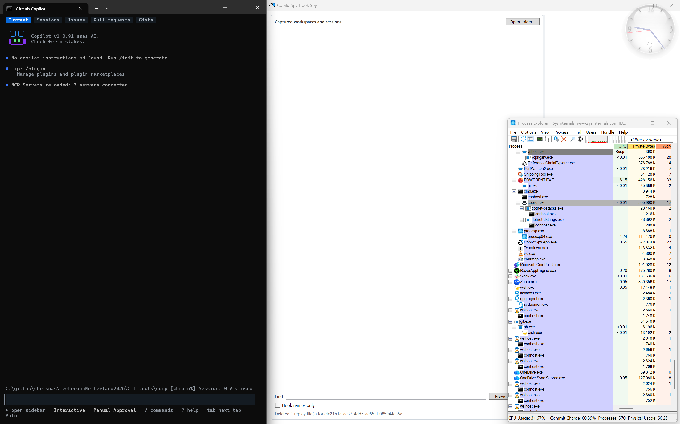
Notes:
DEMO: show worspace, session, turn and MCP/Skills
Start CopilotSpy on the right
Open a command prompt and go to C:\github\chrisnas\UpdateConferencePrague2026\CLI tools\dump
start Github Copilot CLI in that prompt → the current folder will be the harness workspace
Start process explorer small on the right and select copilot.exe
/MCP list and show the corresponding processes in process explorer under copilot.exe
/skill list and show my 2 dotnet-*-analysis skills
Type Look for memory leaks based on the files available in current folder to start the first turn of a session
→ look at the processes that will be spawn → you might see ClaudeSpy.Hook.exe because copilot is also generating Claude hooks; don’t ask me why…
Accept all prompts
Look at:
the skill info in purple
Permissions in green
preToolUse for the tools that are executed including Powershell
At the end:
show the summary
Open C:\Users\Christophe Nasarre\AppData\Local\HarnessSpy\Copilot\Payloads to list the payloads by Date

Slide 5
Hooks have to work on every OS
stdout is used as a control channel (not as the usual log stream)
AGENT HARNESS
Spawns one short-lived process
HOOK PROCESS
stdin: JSON
stdout: no-op
HARNESS SPY
User-only named pipe
HOOKS
TRANSCRIPTS
SESSIONS
PLANS
7

Slide 6
Did I say payload?
Cursor and Claude
Cursor DEMO
  hook_event_name
  conversation_id, generation_id
Claude DEMO
  hook_event_name
  session_id, prompt_id
HOOKS
TRANSCRIPTS
SESSIONS
PLANS
7
Notes:
DEMO:
Show a payload for Cursor from C:\Users\Christophe Nasarre\AppData\Local\HarnessSpy\Cursor\Payloads
Hook_event_name for the event
Conversation_id for the session
Generation_id for the turn
Show the configuration for Claude from C:\Users\Christophe Nasarre\AppData\Local\HarnessSpy\Claude\Payloads
Hook_event_name for the event
session_id for the session
prompt_id for the turn

Slide 7
Did I say payload?
Copilot special case
Copilot in VS Code is… well… not to be used
Copilot DEMO
  No event name!
  session_id
  No turn id!
Is the CopilotSpy tool a magician?
HOOKS
TRANSCRIPTS
SESSIONS
PLANS
7
Notes:
DEMO:
Show the configuration for Copilot from C:\Users\Christophe Nasarre\AppData\Local\HarnessSpy\Copilot\Payloads
No event name
Session_id for the session
No turn id
So… how could the spy even work?

Slide 8
How to register hooks?... in json
Copilot, Claude and Cursor all share a timeout to respond
Copilot DEMO
  .github/hooks/xyz.json
Cursor DEMO
  .cursor/hooks.json, ~/.cursor/hooks.json, C:\Users\<current user>\.cursor\hooks.json
Claude DEMO
  .claude/settings.json
  !! This configuration file is also used by Copilot and Cursor !!
HOOKS
TRANSCRIPTS
SESSIONS
PLANS
7
Notes:
DEMO:
Show the configuration for Copilot
type:command → powershell & syntax
--event : required because… not event name in the payload
-- source : required to make the difference between Copilot in VS Code and Copilot CLI (note that there is no hook in Copilot in Visual Studio)
--runtime : shared model between VS Code and CLI
Show the configuration for Cursor
Very simple
--hook was only added for debugging purpose when some hooks where not received by CursorSpy (but fixed by increased timeout)
Show the configuration for Claude
type:command → powershell & syntax

Slide 9
Are hooks read-only?
Yes in my spy tools
stdout is the way
  return code matters (0 = read json from stdout and 2 = block)
Copilot
  “{}” and return 0
Cursor
  “{}” and return 0
Claude
  Empty and return 0
…But could also be used for validation or modification
HOOKS
TRANSCRIPTS
SESSIONS
PLANS
7

Slide 10
Take control!
DEMO: Cursor under cat control
You could “control” how the harness is behaving and what is sent to the LLM
sessionStart
  Possible to inject additional rules to all prompts
beforeSubmitPrompt
  Could stop and display a message
preToolUse
  Deny tool execution (including subagent task) or change the command
postToolUse
  Trigger action based on tool result
stop
  Add quality gates BEFORE accepting model response
HOOKS
TRANSCRIPTS
SESSIONS
PLANS
7
Notes:
Show
agent-harness-tool-reference.html for tool references
hook-response-control-reference.html for control by hooks
DEMO: details in github\chrisnas\HarnessSpy\docs\demo_cat_boss_cursor.md
Start CursorSpy
Open a Terminal in C:\Demos\CatBossGuid
Set the env vars for the demo
$env:HARNESS_SPY_CURSOR_DEMO = 'cat-boss’
$env:HARNESS_SPY_CURSOR_DEMO_TRANSLATION_LANGUAGE = 'Czech'
Start cursor --new-window .
Enter the following prompt: Build me a GUID generator.
Enter a more complete prompt: Build a minimal .NET console app named GuidGenerator that prints one GUID using the default GUID formatting. Before coding, ask a subagent to review the architecture. Create it with dotnet new, then run dotnet add package UUIDNext, build it, and run it.

Slide 11
Hooks = control points, not only logs
The same hook can observe or control.
OBSERVE
Audit · OpenTelemetry
Failures · timings
HOOK
CONTROL
Policy · quality gates
Retry · context
BLIND SPOTS
system prompt · full results · raw reasoning · token consumption/billing
transcript_path
HOOKS
TRANSCRIPTS
SESSIONS
PLANS
11
Notes:
Hooks allow you to monitor and validate harness actions but still blindspots like system prompt, reasoning or token consumption

Slide 12
Transcript ~= harness log
+ TRANSCRIPT
Transcript content is undocumented
JSONL = line by line JSON
Transcript != chat history
No new session step: complement hooks payload
HOOKS
TRANSCRIPTS
SESSIONS
PLANS
7
Notes:
Transition: the first challenge is to figure out when such a transcript if available

Slide 13
Harnesses do not help…
+ TRANSCRIPT
Transcript paths appear at different moments…or never
CLAUDE
main path at start
CURSOR
path after 2–7 events
CLAUDE
subagent path at stop
COPILOT
path at agentStop
VS CODE LOCAL
No transcript pointer · hooks-only
HOOKS
TRANSCRIPTS
SESSIONS
PLANS
12
Notes:
Here are the times when to expect a transcript path
And these files might not even still be here at that time

Slide 14
Reading a moving target
+ TRANSCRIPT
Copy first. Parse later.
PATH
accepted hook
TAILER
complete lines
SIDECAR
durable raw row
PARSER
version-pinned
RECONCILER
hook-first
HOOKS
TRANSCRIPTS
SESSIONS
PLANS
13
Notes:
Once we know the path, it is time to read its content, row by row.
!! We don’t look at ALL files in a given directory !!
Once a end-of-line is found, copy the resulting line into a sidecar file storageThen, parse and reconcile with the structure built from the hooks

Slide 15
Sidecar == Flight recorder
+ TRANSCRIPT
The harness can clean up; the investigation can continue.
REPLAY
deleted sessions
SEARCH
past sessions
DURABLE
SIDECAR
EVALUATE
regression corpus
INVESTIGATION
security + incidents
PLAINTEXT · SENSITIVE · RETAIN CAREFULLY
HOOKS
TRANSCRIPTS
SESSIONS
PLANS
16
Notes:
These sidecar files could be used to:
Replay deleted sessions
Evaluate how good were our skills/MCP tools
Search (files, tools,…) into previous sessions
Troubleshoot incidents or security validations

Slide 16
Sure !... But for what?
+ TRANSCRIPT
Copilot, Cursor, Claude
Reasoning + final response
MCP server + tool identity
Execution + permission outcomes
Tokens (input · output · cache) + reasoning
Nano-AIU + premium requests “billing”
System prompts!!!
HOOKS
TRANSCRIPTS
SESSIONS
PLANS
7

Slide 17
Sure !... But for what?
+ TRANSCRIPT
Copilot, Cursor, Claude
Attached skills + paths
Internal tool requests
MCP enrichment
No explicit thinking
No usage accounting
HOOKS
TRANSCRIPTS
SESSIONS
PLANS
7

Slide 18
Sure !... But for what?
+ TRANSCRIPT
Copilot, Cursor, Claude
Readable · opaque · redacted thinking
Exact tool/result IDs
MCP + subagent identity
Skills
Tokens + cost
Durations + line changes
System prompts!!!
HOOKS
TRANSCRIPTS
SESSIONS
PLANS
7

Slide 19
From a live spy to an history viewer
+ SESSION
DEMO: SessionViewer
Two applications · two different evidence boundaries
LIVE SPY APPS
Accepted hooks
Named pipe
Hook-first reconciliation
Transcript sidecars
SESSION VIEWER
Harness-owned files
SQLite + JSONL + indexes
Process probes
No hooks · no pipe
HOOKS
TRANSCRIPTS
SESSIONS
PLANS
17
Notes:
DEMO:
Find the session we’ve just demoed with CopilotSpy
What is missing?
TODO

Slide 20
One session, many artifacts
+ SESSION
A session is reconstructed from fragments.
CURSOR
agent JSONL
state.vscdb
workspace manifest
CLAUDE
sessions index
main + recovery JSONL
subagent files
SESSION
COPILOT CLI
events.jsonl · workspace.yaml
HOOKS
TRANSCRIPTS
SESSIONS
PLANS
18
Notes:
NEXT: let’s see in more details where you can find what

Slide 21
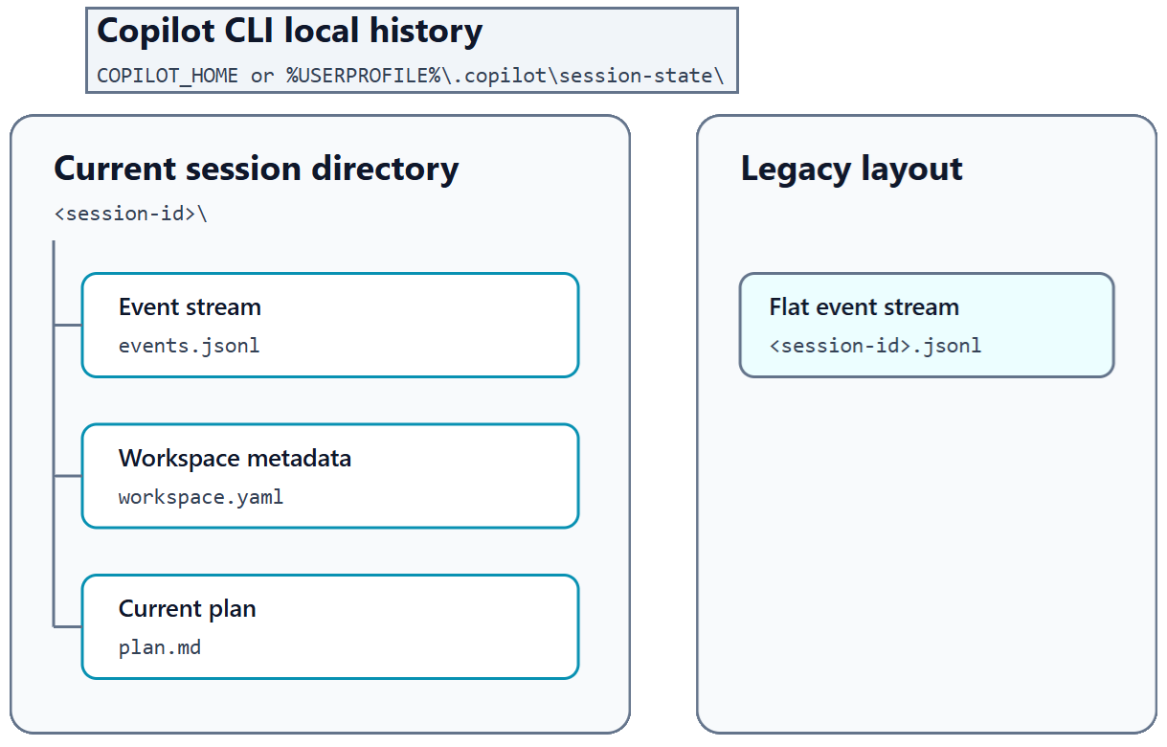
DEMO: Look into workspace.yaml & events.jsonl
Many sources
+ SESSION
Copilot, Cursor, Claude
HOOKS
TRANSCRIPTS
SESSIONS
PLANS
7
Notes:
Go to a session folder:
Ex: C:\Users\Christophe Nasarre\.copilot\session-state\06958e8a-9425-4880-8692-94e9a4c48c66
Look at workspace.yaml for the corresponding workspace folder + creation/update times
id: c8579dae-bcff-456c-8fdf-3af5d88e476e
--> this id is the session ID.
Look for events.jsonl for the list of steps during this session
each line has a "type" value and a JSON sub-object under "data" : {…} for the details
Here is the usual order of lines:
session.start
...
session.shutdown final snapshot A
session.resume clear stale final aggregate
...
session.shutdown final snapshot B
A call sequence with permissions: (corresponding to the toolCallId = call_Y3MKiUvJn4URICaOnAsG3Vqf)
{"type":"assistant.message","data":{"toolRequests":[{"toolCallId":"call_Y3MKiUvJn4URICaOnAsG3Vqf","name":"powershell","arguments":{"command":"
{"type":"tool.execution_start","data":{"toolCallId":"call_Y3MKiUvJn4URICaOnAsG3Vqf","toolName":"powershell","arguments":{"command":"
{"type":"permission.requested","data":{"requestId":"616591b6-3844-43ab-b7c5-aa0c3b0c9645","permissionRequest":{"kind":"shell","toolCallId":"call_Y3MKiUvJn4URICaOnAsG3Vqf",
{"type":"permission.completed","data":{"requestId":"616591b6-3844-43ab-b7c5-aa0c3b0c9645","toolCallId":"call_Y3MKiUvJn4URICaOnAsG3Vqf","result":{"kind":"approved"},"decisionSource":"human_response"}
{"type":"tool.execution_complete","data":{"toolCallId":"call_Y3MKiUvJn4URICaOnAsG3Vqf","turnId":"4","shellExecution":{"exitCode":0},"success":true,"result":{"content":"Package Id Version Commands\n--
A sequence to show that a skill is used:
{"type":"assistant.message",
"data":{"toolRequests":[{"toolCallId":"call_AbDNNBhWUMPa84yC2Ut6s6e7","name":"skill","arguments":{"skill":"dotnet-memory-analysis"},"type":"function"}],
"interactionId":"8e5dd196-9135-491b-ae07-3efe5bb06400","turnId":"0","id":"134e4bda-8df1-44cf-9399-933b502161ee"}
{"type":"tool.execution_start",
"data":{"toolCallId":"call_AbDNNBhWUMPa84yC2Ut6s6e7","toolName":"skill","arguments":{"skill":"dotnet-memory-analysis"},
"id":"8c307930-6fc0-4a91-b5b1-17abd0e6c955","parentId":"134e4bda-8df1-44cf-9399-933b502161ee"}
{"type":"tool.execution_complete",
"data":{"toolCallId":"call_AbDNNBhWUMPa84yC2Ut6s6e7","success":true,"result":{"content":"Skill \"dotnet-memory-analysis\" loaded successfully..."},
"id":"882c5b44-7b59-4873-9416-46238e7e9f8e","parentId":"8c307930-6fc0-4a91-b5b1-17abd0e6c955"}
{"type":"skill.invoked",
"data":{"name":"dotnet-memory-analysis","path":"C:\\...\\.copilot\\skills\\dotnet-memory-analysis\\SKILL.md",
"content":"# .NET Memory Analysis\n","id":"a9e83062-5f56-419b-b84c-5569ab040958","parentId":"882c5b44-7b59-4873-9416-46238e7e9f8e"}
{"type":"skill.context_delivered_ref",
"data":{"interactionId":"8e5dd196-9135-491b-ae07-3efe5bb06400","source":"skill-dotnet-memory-analysis",
"id":"ceaa29c9-0b42-4fc8-8ca7-a2aba3d93ddc","parentId":"a9e83062-5f56-419b-b84c-5569ab040958"}
It is also possible to resume a session by right-clicking a session in SessionViewer and select Open Session
→ Just start a new process with the expected command line that you see in a console when you close a Copilot session
copilot --resume="<session-id>"

Slide 22
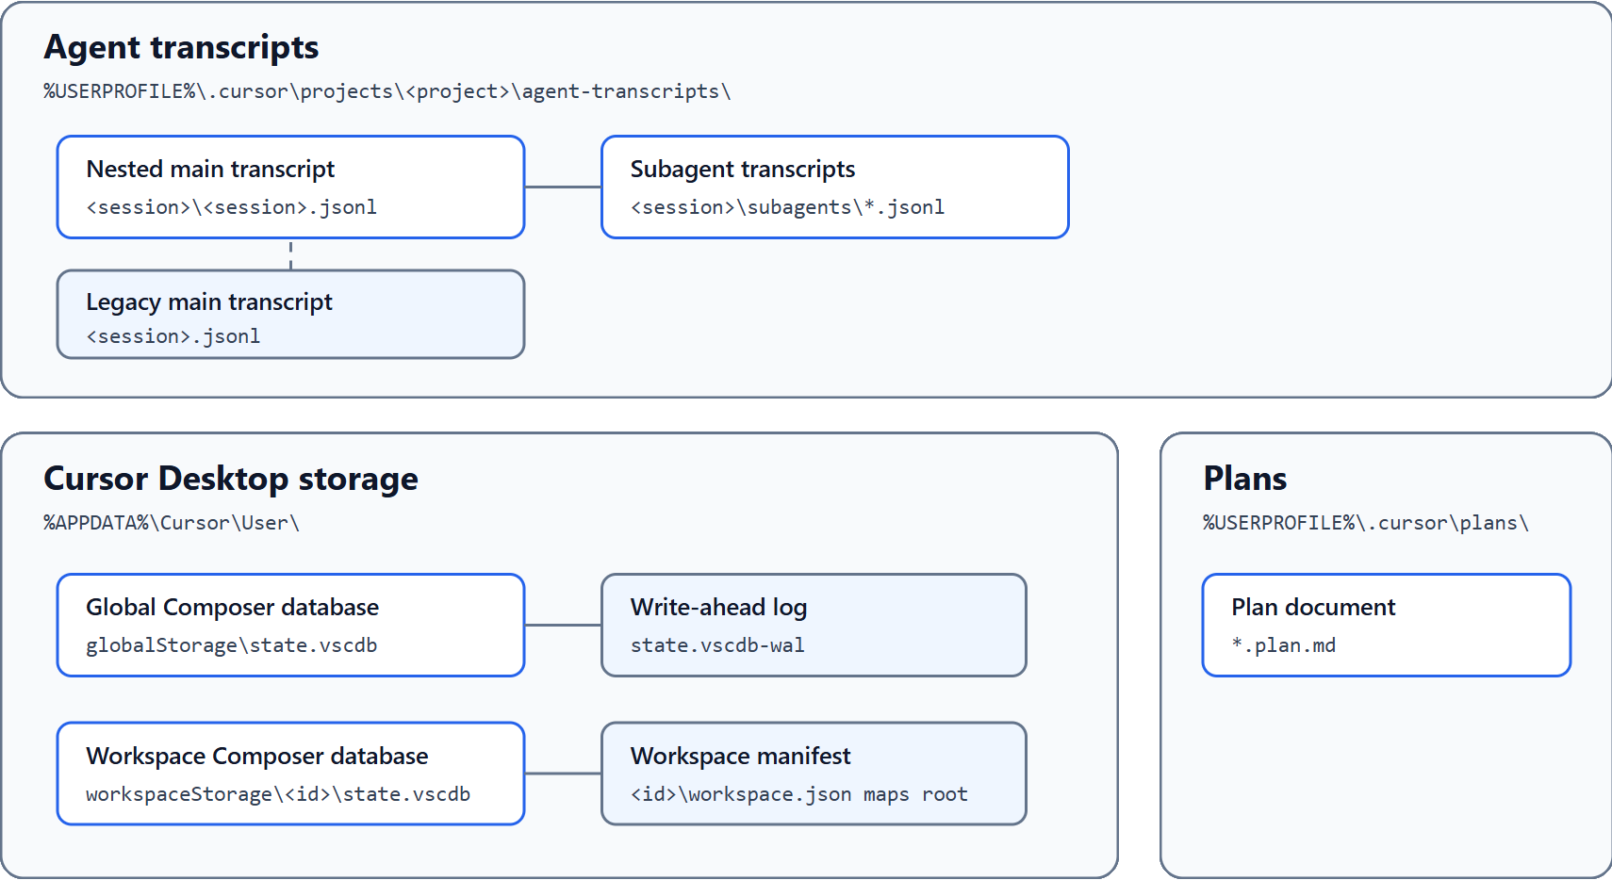
Many sources
+ SESSION
Copilot, Cursor, Claude
HOOKS
TRANSCRIPTS
SESSIONS
PLANS
7
Notes:
DEMO:
look into C:\Users\Christophe Nasarre\.cursor\projects
Transcripts files are read from well known folders under .cursor\projects\<project>\agent-transcripts
NOTE: <project> here means workspace
Typical folder contents
projects\<workspace-context>\
├── agent-transcripts\
│ └── <session-UUID>\
│ ├── <session-UUID>.jsonl
│ └── subagents\
├── terminals\
├── mcps\
├── assets\
└── canvases\
agent-transcripts: conversation events and tool activity. Each UUID beneath it is an actual session.
subagents: transcripts of agents delegated from the parent session.
terminals: captured terminal metadata and output available to the agent.
mcps: generated descriptions of available MCP tools, prompts, and resources. This is not the authoritative MCP configuration.
assets: images and attachments used by conversations.
canvases: Cursor Canvas artifacts.
The key relationship is:
projects
└── workspace/context folder
└── agent-transcripts
└── session UUID
└── transcript
--------------------------------------------------------
Look into C:\Users\Christophe Nasarre\AppData\Roaming\Cursor\User\globalStorage
→ state.vscdb for the global one where all sessions (=composers) are described
Look into C:\Users\Christophe Nasarre\AppData\Roaming\Cursor\User\workspaceStorage (\2f4a4dd9b247ee19ce12fb78b89e3710 → this id is the workspace ID for a dd-win-prof for example)
→ state.vscdb : contains the list of sessions (=composers) attached to this workspace under [ItemsTable].composer.composerData.”selectedComposerIds”
→ workspace.json: contains the folder
Let’s dig into more details in the next slide

Slide 23
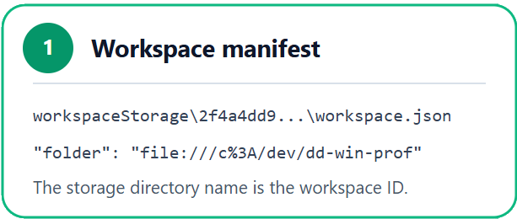
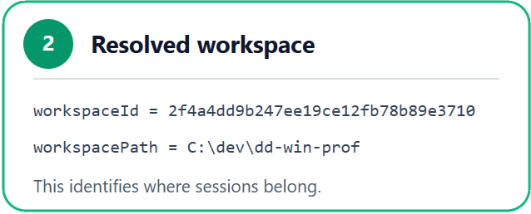
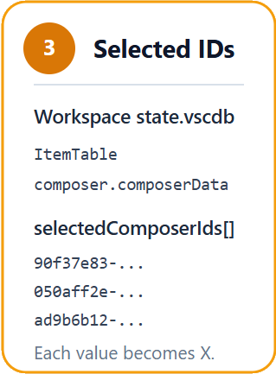
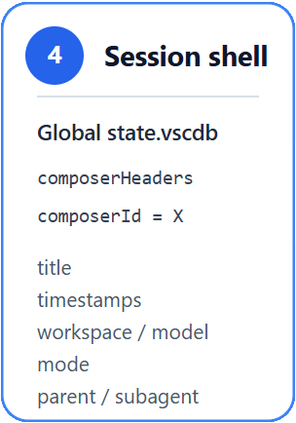
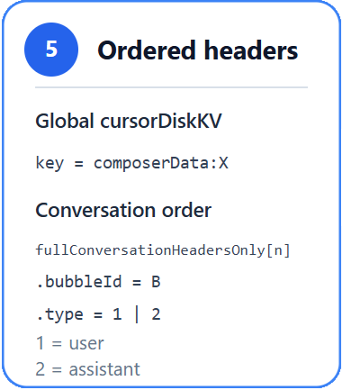
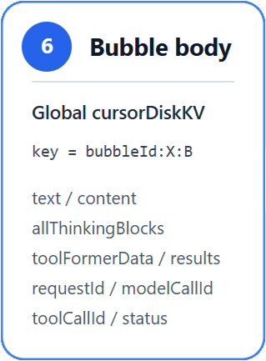
DEMO: CursorDBNavigator
Many sources
+ SESSION
Copilot, Cursor, Claude
HOOKS
TRANSCRIPTS
SESSIONS
PLANS
7
Notes:
DEMO:
Start from C:\Users\Christophe Nasarre\AppData\Roaming\Cursor\User\workspaceStorage\2f4a4dd9b247ee19ce12fb78b89e3710
and look at the workspace.json
{
"folder": "file:///c%3A/dev/dd-win-prof"
}
Start DBBrowser for SQLite on C:\Users\Christophe Nasarre\AppData\Roaming\Cursor\User\workspaceStorage\2f4a4dd9b247ee19ce12fb78b89e3710\state.vscdb
go to Browse Data Tab on ItemTable in combobox → look at composer.composerData field
"selectedComposerIds": [
"90f37e83-0aa8-4d76-8e3a-094322899a3e",
"050aff2e-6911-4c50-8886-6afb0c9b2323",
"ad9b6b12-6295-48f6-b2a9-6ac755e7a855"
]
Start DBBrowser for SQLite on C:\Users\Christophe Nasarre\AppData\Roaming\Cursor\User\globalStorage\state.vscdb to get more details about these composers
Find their workspace id + time info by running the following SQL:
SELECT composerId,
workspaceId,
isSubagent,
datetime(createdAt / 1000.0, 'unixepoch') AS createdUtc,
datetime(lastUpdatedAt / 1000.0, 'unixepoch') AS updatedUtc
FROM composerHeaders
WHERE composerId IN (
'90f37e83-0aa8-4d76-8e3a-094322899a3e',
'050aff2e-6911-4c50-8886-6afb0c9b2323',
'ad9b6b12-6295-48f6-b2a9-6ac755e7a855'
);
Look for “bubbles” for the first one by running the following SQL command:
SELECT json(CAST(value AS TEXT))
FROM cursorDiskKV
WHERE key =
'composerData:90f37e83-0aa8-4d76-8e3a-094322899a3e’;
And look for the "fullConversationHeadersOnly": […] array containing all bubbles (user/assistant) interactions
The following SQL command will list ALL bubbles for a given composer:
SELECT json(CAST(value AS TEXT))
FROM cursorDiskKV
WHERE key LIKE
'bubbleId:90f37e83-0aa8-4d76-8e3a-094322899a3e:%’;
Then look for one with “toolFormerData” : {…}
CursorDBNavigator helps to understand:
Start from c:\dev\dd-win-prof workspace
Click “Profile upload error handling”

Slide 24
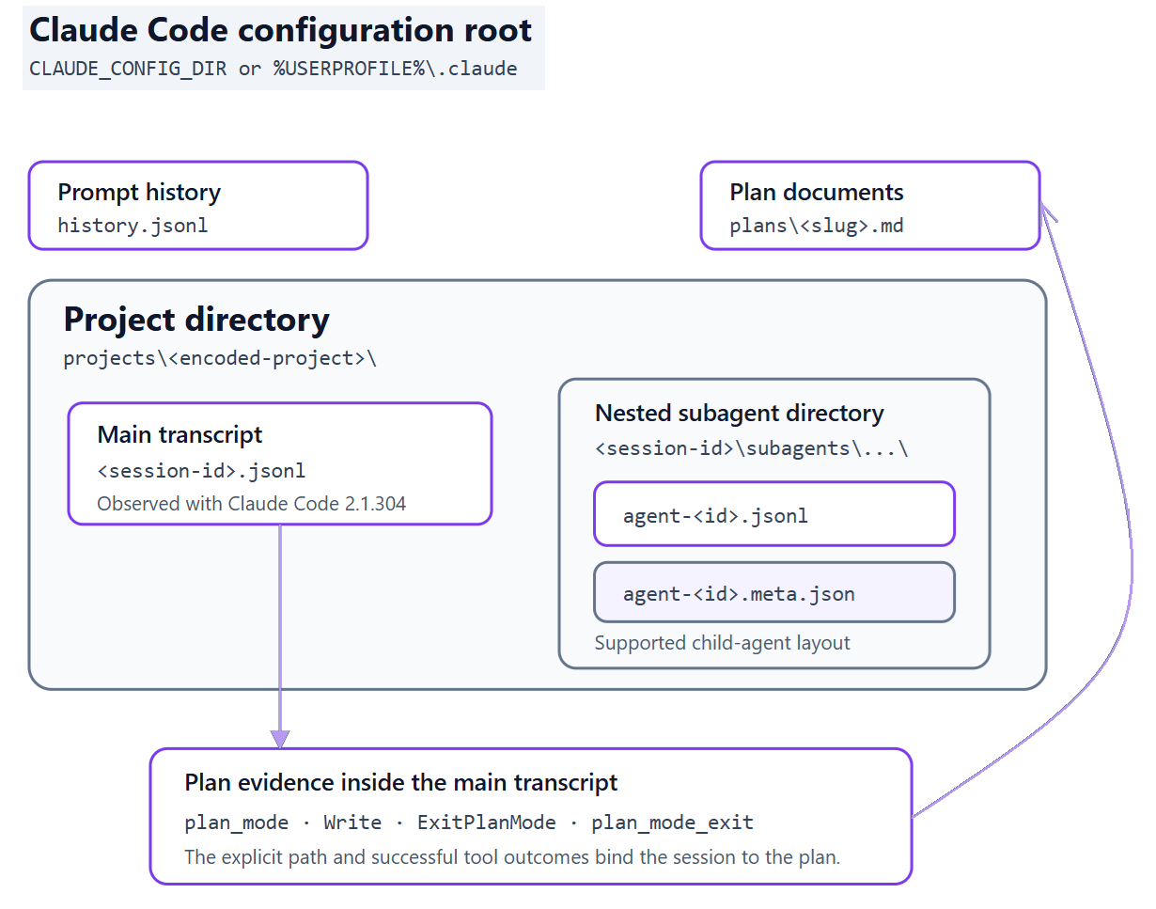
Many sources
+ SESSION
Copilot, Cursor, Claude
HOOKS
TRANSCRIPTS
SESSIONS
PLANS
7
Notes:
DEMO:
Goto C:\Users\Christophe Nasarre\.claude\projects
→ see all workspaces (i.e. projects)
Goto C:\Users\Christophe Nasarre\.claude\projects\C--github-chrisnas-UpdateConferencePrague2026
open the lastest changed jsonl file - 12db5393-5633-4aeb-a506-79baef38877c.jsonl
Look for "type":"prompt_snapshot","systemPrompt“
→ show the system prompt
Look for « slug » in order to find the UNIQUE plan when working in plan mode
→ open the file to see that each subplan appears in a dedicated section
Goto C:\Users\Christophe Nasarre\.claude\sessions
→ <pid>.json file corresponding to running instances of Claude Code
NOTE: the value of the name field could be used to find the corresponding console application because it is part of its title
Also, it seems to be possible to communicate to a live Claude Code session using a named pipe on Windows via "messagingSocketPath": "\\\\.\\pipe\\LOCAL\\cc-msg-046049c0bd00ad5740dd5589c8fd4a6e“. It is needed to know the security token available from the CLAUDE_CODE_MESSAGING_TOKEN env var of the Claude process (its pid is provided by the pid field – here 59300)
Note that the pipe is also available in the Claude process via CLAUDE_CODE_MESSAGING_SOCKET env var
Send these 2 JSON UTF-8 text lines (finish by \n) to start a new turn
{"type":"auth","token":"<stolen-or-inherited-token>"}
{"type":"user","message":{"role":"user","content":"Run dotnet test and summarize the failures"}}
{
"pid": 59300,
"sessionId": "12db5393-5633-4aeb-a506-79baef38877c",
"cwd": "C:\\github\\chrisnas\\UpdateConferencePrague2026",
"startedAt": 1792485864880,
"procStart": "134369594625880562",
"version": "2.1.304",
"peerProtocol": 1,
"peerFeatures": [
"notify_idle",
"artifact_yield"
],
"kind": "interactive",
"entrypoint": "cli",
"pidDomain": "win32:desktop-svkn926",
"messagingSocketPath": "\\\\.\\pipe\\LOCAL\\cc-msg-046049c0bd00ad5740dd5589c8fd4a6e",
"name": "dedupe-cache-entry-strings",
"nameSource": "auto",
"nameSince": 1792485865477,
"updatedAt": 1792488778069,
"status": "idle",
"statusUpdatedAt": 1792488778069
}
No need to spend more time here: json-based like Copilot
→ Read my blog post if you need to support Claude

Slide 25
I thought I had a plan
+ PLAN
Copilot, Cursor, Claude
Only one plan under session folder called… plan.md
Creation and updates can be found in events.jsonl records
HOOKS
TRANSCRIPTS
SESSIONS
PLANS
24

Slide 26
I thought I had a plan
+ PLAN
Copilot, Cursor, Claude
Many .plan.md files under %USERPROFILE%\.cursor\plans
TODO bullets appear as yaml at the top of the file
Look for tool_use with name = CreatePlan
Look for tool_use with name = Write/StrReplace
→ input.path pointing to .cursor\plan\*.plan.md
HOOKS
TRANSCRIPTS
SESSIONS
PLANS
24

Slide 27
I thought I had a plan
+ PLAN
Copilot, Cursor, Claude
Only one plan under session folder under %USERPROFILE%\plans
Weird “slug” names
In events.jsonl records, look for
→ plan_mode/plan_mode_reentry/plan_mode_exit with planFilePath
→ tools ExitPlanMode, Write with the plan folder as hint
HOOKS
TRANSCRIPTS
SESSIONS
PLANS
24

Slide 28
Post-mortem on sessions?
History becomes reusable engineering evidence.
SEARCH / KNOWLEDGE
reuse solved investigations
COMPARE / EVALUATE
models, prompts, attempts
RESUME / HANDOFF
continue with context
AUDIT / GOVERN
failures, files, retention
DEMO: Build your own tools!
HOOKS
TRANSCRIPTS
SESSIONS
PLANS
23
Notes:
Imagine:
a skill to analyze sessions
Custom tools
DEMO:
my cost helper SHIFT + CTRL + /
Cursor Navigator integrated as a VS Code extension to “jump” to another running Cursor instance in another Windows Virtual Desktop

Slide 29
Resources
  Reference documentation
  https://cursor.com/docs/hooks
  https://code.claude.com/docs/en/hooks
  https://docs.github.com/copilot/reference/hooks-reference
  My blog series about agentic AI for more details
  https://chrisnas.github.io
  This content
  https://github.com/chrisnas/UpdateConferencePrague2026

Slide 30

Thank you!
@chnasarre
chrisnas.bsky.social
chrisnas

