Slide 1
Semiconductor Industry Pricing Dependencies Micro-Project #2 https://github.com/chrisngem/ANA500
Christian Dela Rosa
October 02, 2022

Slide 2
Problem Statement
Problem Statement & Hypothesis Formulation
Background: The semiconductor industry has experienced a renaissance with the added demand for computation, cloud computing, and artificial intelligence. As a cyclical industry, demand can be thought of as time dependent – and based on supply abundance or constraints – pricing power or pressure, respectively, can result. Using a publicly available data set, the employee (resource) workforce size in the industry will be evaluated for its effect on semiconductor industry pricing power. Price of import and export will also be compensated for, as well as seasonal effects.
Objective(s): Which factors have the largest impact semiconductor supplier pricing power?
Current labor force size
Price of import/export goods and capital
Seasonal factors

Slide 3
Hypothesis Formulation
Problem Statement & Hypothesis Formulation
H₀: There is no relationship between semiconductor supplier pricing power and labor force size, input/output costs, and seasonality
H_{A}: An increase labor force size and decrease in input/output costs raises semiconductor supplier pricing power while seasonality has a cyclical effect
The null hypothesis (H₀) states that labor force size, input/output costs, and seasonality (independent variables) have no association on the pricing power (dependent variable) of a semiconductor company.
The alternative hypothesis (H_{A}) states that and increase in labor force size and a decrease in input/output costs will increase the pricing power (dependent variable) of a semiconductor company, while seasonality will have a cyclical effect.

Slide 4
Hierarchy Chart
Problem Statement & Hypothesis Formulation
Hierarchy Chart
Producer Price Index = Semi.dataset(employees, import/export costs, date [seasonality])
Main Program
(Output: PPI;
Input: Semi Dataset)

Slide 5
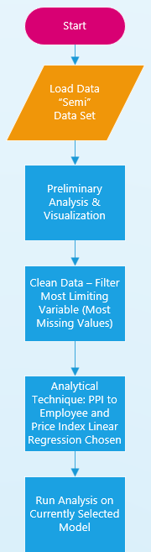
Flowchart (Found my Visio Key!)
Flowchart

Slide 6
Flowchart (2 of 3)
Flowchart
(Future)

Slide 7
Flowchart (3 of 3)
Flowchart
(Future)

Slide 8
Pseudocode
Pseudocode
# Import required libraries
import numpy as np
import pandas as pd
import matplotlib.pyplot as plt
# Read raw data file
semi_raw = pd.read_csv (r'C:\Users\Christian\OneDrive\Graduate School\ANA500\Semi.csv')
# Noticed several missing values; limiting variable (with most missing values) was Export_PI_Cap
# So filtered by recasting table using notnull() Boolean subtable:
semi = semi_raw[semi_raw.Export_PI_Cap.notnull()]
# Print the filtered (cleaned) dataframe
print (semi)

Slide 9
Pseudocode (continued)
Pseudocode
# Plot the generalized variables by DATE:
df_gen = pd.DataFrame(semi, columns=["DATE", "PPI", "Employees", "Weights", "Industrial_Production"])
df_gen.plot(x="DATE", y=["PPI", "Employees", "Weights", "Industrial_Production"], kind="line", figsize=(10,10))
plt.show()
# Plot the pricing variables by DATE:
# Note: could not figure out why some of the price index variables were not plotting
--- Figured this out… it was the datatype of the variables that were not plotting, converted from object to float64
df_ppi = pd.DataFrame(semi, columns=["DATE", "PPI", "Export_PI", "Import_PI", "Export_PI_Nosemi", "Import_PI_Cap", "Export_PI_Cap"])
df_ppi.plot(x="DATE", y=["PPI", "Export_PI", "Import_PI", "Export_PI_Nosemi", "Import_PI_Cap", "Export_PI_Cap"], kind="line", figsize=(10,10))
plt.show()

Slide 10
Pseudocode (continued)
Pseudocode
# Check to see that extracted data frame has all requested columns; still not sure why not plotting
print(df_ppi)
# Scatter plot - hints at the correlation between my two variables in the null hypothesis
df_scatter = pd.DataFrame(semi, columns=["PPI", "Employees"])
ax1 = df.plot.scatter(x="PPI", y="Employees", c="DarkBlue")
# Start of the linear regression models - first is PPI as a function of Employee [base]
Y = semi['PPI']
X = semi['Employees']
X = sm.add_constant(X)
model = sm.OLS(Y,X)
results = model.fit()

Slide 11
Pseudocode (continued)
Pseudocode
print('PPI vs Employees Parameters')
print(results.params)
print()
print('PPI vs Employees')
print(results.summary())
Y = semi['PPI']
X = semi[['Export_PI', 'Import_PI', 'Export_PI_Nosemi', 'Export_PI_Cap', 'Import_PI_Cap']]
X = sm.add_constant(X)
model = sm.OLS(Y,X)
results = model.fit()
# Second linear regression model is PPI as a function of price indices
print('PPI vs Price Index Parameters')
print(results.params)
print()
print('PPI vs Price')
print(results.summary())

Slide 12
Acquire
The Data Science Process (1/5)
Semiconductor pricing data was acquired through Kaggle.com, which is a popular place for data scientists, machine learning practitioners, engineers, (and students!) to post projects, participate in data science competitions and acquire open-source datasets.
Data source: https://www.kaggle.com/datasets/ramjasmaurya/semiconductor-shortages19852021

Slide 13
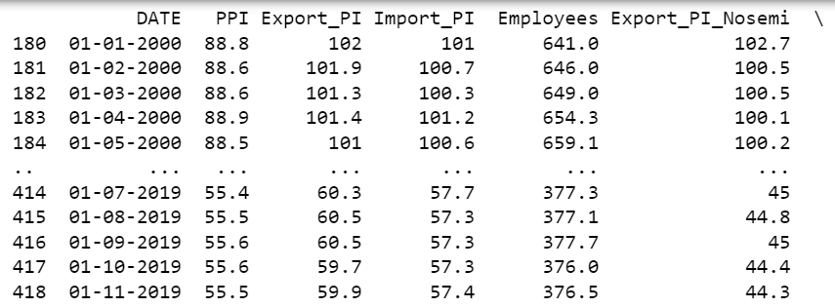
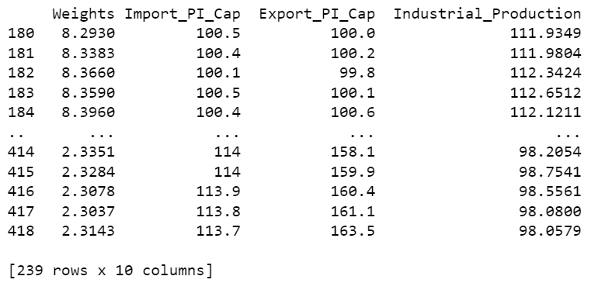
Prepare
The Data Science Process (2/5)
The Kaggle data set was imported into Python and cleaned via the following: one variable had the most missing values, Export_PI_Cap. When filtered to include only the observations that had an Export_PI_Cap value recorded, all other variables cleaned up nicely with respect to missing variables.

Slide 14
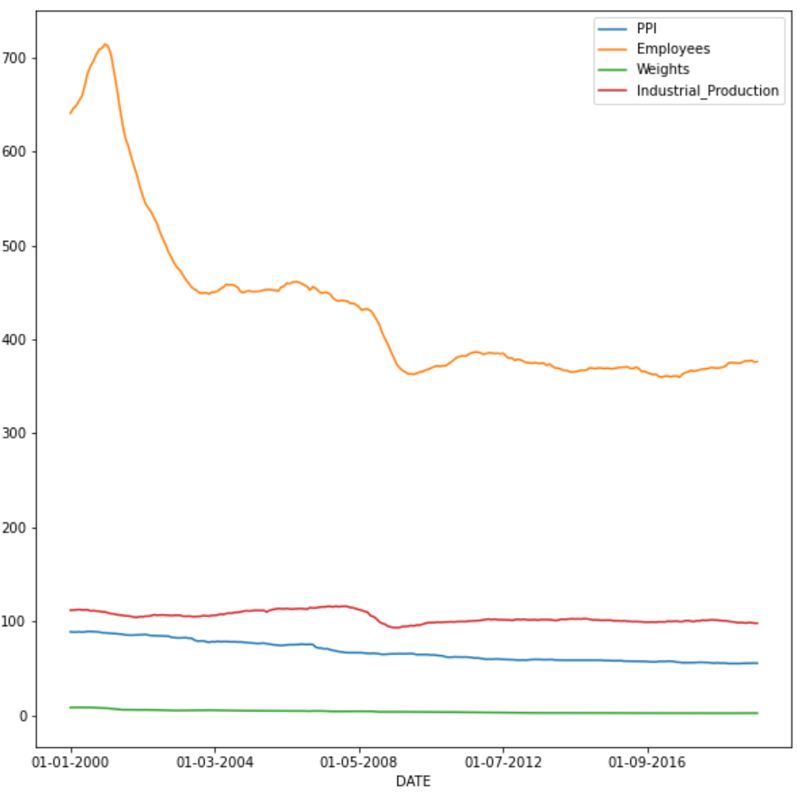
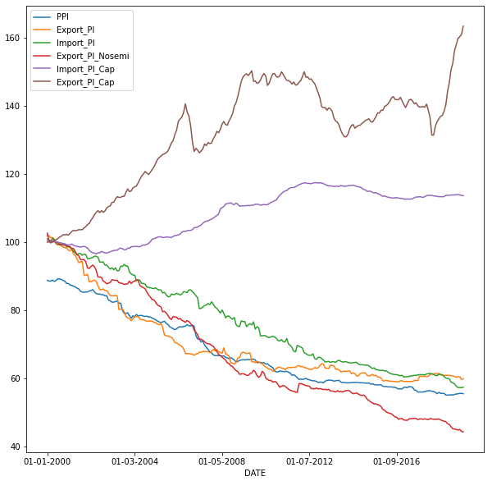
Prepare (continued)
The Data Science Process (2/5)
Visualizing by Date provided insight as to the correlations (or not) between variables:

Slide 15
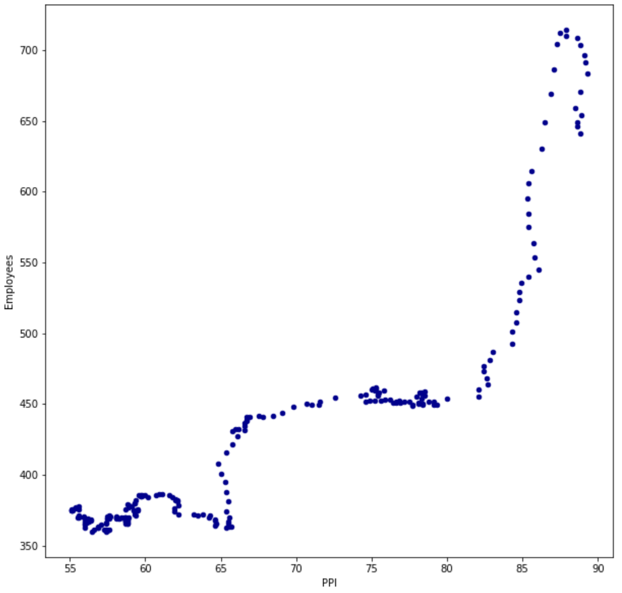
Prepare (continued)
The Data Science Process (2/5)
Plotting a Scatterplot in Python provided good indication of the relationship between the primary explanatory variable, labor force size (Employees), and supplier pricing power (PPI):

Slide 16
Analyze data
The Data Science Process (3/5)
Linear Regression was chosen to determine statistical relationships between each of the independent variables. The following models were chosen:
PPI = f(Employees)
PPI = f(Import_PI, Export_PI, Import_PI_Cap, Export_PI_Cap,
Export_PI_Nosemi)
PPI = f(DATE)*
*Note: DATE will be recast to seasons to determine seasonality

Slide 17
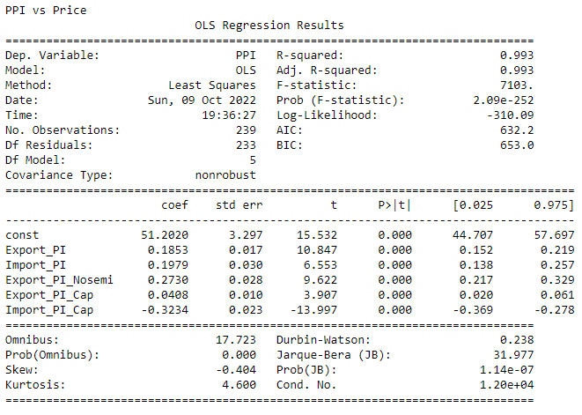
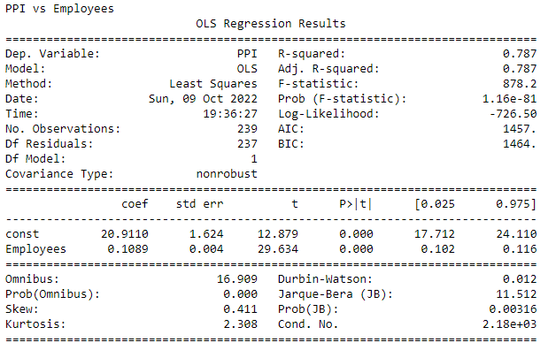
Analyze data
The Data Science Process (3/5)
Results of the linear regression provided very strong evidence of statistical relationships between the Employee and Price Index independent variables and the proposed models.
P values were < 0.05 across the board:

Slide 18
Report
The Data Science Process (4/5)
Based on the completed analysis of the “SEMI” dataset, the null hypothesis can be rejected:
H₀: There is no relationship between semiconductor supplier pricing power and labor force size, input/output costs, and seasonality
NOTE: there is still additional study to be done, from the sensitivities of the input price indices to overall PPI and if employee base interacts with those input price indices. Also, the machine learning element needs to be incorporated into this analysis. Finally, I still have to figure out how to convert the DATE variable into seasons.

Slide 19
Act
The Data Science Process (5/5)
<apply results, connect results with the chosen problem statement or business question>

