Slide 1
Semiconductor Industry Pricing Dependencies Micro-Project (Final) https://github.com/chrisngem/ANA500
Christian Dela Rosa
October 02, 2022
(Revised October 16, 2022, October 22, 2022)

Slide 2
Problem Statement
Problem Statement & Hypothesis Formulation
Background: The semiconductor industry has experienced a renaissance with the added demand for computation, cloud computing, and artificial intelligence. As a cyclical industry, demand can be thought of as time dependent – and based on supply abundance or constraints – pricing power or pressure, respectively, can result. Using a publicly available data set, the employee (resource) workforce size in the industry will be evaluated for its effect on semiconductor industry pricing power. Price of import and export will also be compensated for, as well as seasonal effects.
Objective(s): Which factors have the largest impact semiconductor supplier pricing power?
Current labor force size
Price of import/export goods and capital
Seasonal factors

Slide 3
Hypothesis Formulation
Problem Statement & Hypothesis Formulation
H₀: There is no relationship between semiconductor supplier pricing power and labor force size, input/output costs, and seasonality
H_{A}: An increase labor force size and decrease in input/output costs raises semiconductor supplier pricing power while seasonality has a cyclical effect
The null hypothesis (H₀) states that labor force size, input/output costs, and seasonality (independent variables) have no association on the pricing power (dependent variable) of a semiconductor company.
The alternative hypothesis (H_{A}) states that and increase in labor force size and a decrease in input/output costs will increase the pricing power (dependent variable) of a semiconductor company, while seasonality will have a cyclical effect.

Slide 4
Hierarchy Chart
Problem Statement & Hypothesis Formulation
Hierarchy Chart
Producer Price Index = Semi.dataset(employees, import/export costs, date [seasonality])
Main Program
(Output: PPI;
Input: Semi Dataset)

Slide 5
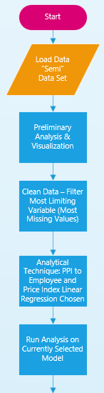
Flowchart
Flowchart

Slide 6
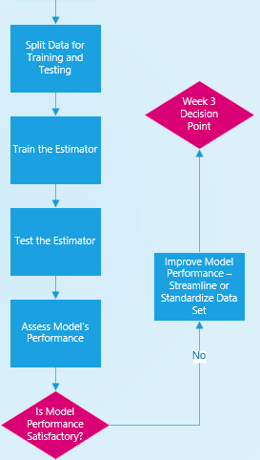
Flowchart (2 of 3)
Flowchart

Slide 7
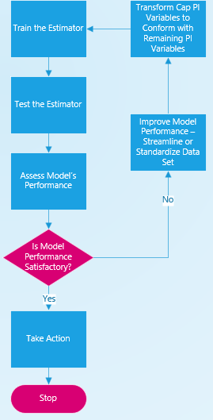
Flowchart (3 of 3)
Flowchart

Slide 8
Pseudocode
Pseudocode
# Import required libraries
import numpy as np
import pandas as pd
import matplotlib.pyplot as plt
# Read raw data file
semi_raw = pd.read_csv (r'C:\Users\Christian\OneDrive\Graduate School\ANA500\Semi.csv')
# Noticed several missing values; limiting variable (with most missing values) was Export_PI_Cap
# So filtered by recasting table using notnull() Boolean subtable:
semi = semi_raw[semi_raw.Export_PI_Cap.notnull()]
# Print the filtered (cleaned) dataframe
print (semi)

Slide 9
Pseudocode (continued)
Pseudocode
# Plot the generalized variables by DATE:
df_gen = pd.DataFrame(semi, columns=["DATE", "PPI", "Employees", "Weights", "Industrial_Production"])
df_gen.plot(x="DATE", y=["PPI", "Employees", "Weights", "Industrial_Production"], kind="line", figsize=(10,10))
plt.show()
# Plot the pricing variables by DATE:
# Note: could not figure out why some of the price index variables were not plotting
--- Figured this out… it was the datatype of the variables that were not plotting, converted from object to float64
df_ppi = pd.DataFrame(semi, columns=["DATE", "PPI", "Export_PI", "Import_PI", "Export_PI_Nosemi", "Import_PI_Cap", "Export_PI_Cap"])
df_ppi.plot(x="DATE", y=["PPI", "Export_PI", "Import_PI", "Export_PI_Nosemi", "Import_PI_Cap", "Export_PI_Cap"], kind="line", figsize=(10,10))
plt.show()

Slide 10
Pseudocode (continued)
Pseudocode
# Check to see that extracted data frame has all requested columns; still not sure why not plotting
print(df_ppi)
# Scatter plot - hints at the correlation between my two variables in the null hypothesis
df_scatter = pd.DataFrame(semi, columns=["PPI", "Employees"])
ax1 = df.plot.scatter(x="PPI", y="Employees", c="DarkBlue")
*** Week Three saw a lot of work in the subsequent sections; split the data frame into training and test sets and figured out
*** how to plot the data set via scatter pictorial and overlay the predicted values
# Split data set into training and test:
train, test = train_test_split(semi, test_size=0.3,random_state=109)
print(train, test)

Slide 11
Pseudocode (continued)
Pseudocode
# Slice the data into test/train x/y:
Y_emp_train = train['PPI']
X_emp_train = train['Employees']
X_emp_train_lr = sm.add_constant(X_emp_train)
Y_emp_test = test['PPI']
X_emp_test = test['Employees']
X_emp_test_lr = sm.add_constant(X_emp_test)
# Start of the linear regression models - first is PPI as a function of Employee [base]
model = LinearRegression(fit_intercept=True).fit(X_emp_train_lr, Y_emp_train)
print()
print('PPI versus Employees in the Industry Linear Regression')
print('------------------------------------------------------')
print('intercept:', model.intercept_)
print('slope:', model.coef_)

Slide 12
Pseudocode (continued)
Pseudocode
Y_emp_pred = model.predict(X_emp_test_lr)
# print('Predicted response:', Y_emp_pred, sep='\n')
plt.scatter(X_emp_train, Y_emp_train)
plt.plot(X_emp_test, Y_emp_pred, color = 'r');
plt.show()
model = sm.OLS(Y_emp_train,X_emp_train_lr)
results = model.fit()
print('PPI vs Employees Parameters')
print(results.params)
print()
print('PPI vs Employees')
print(results.summary())
svm_reg = LinearSVR(epsilon=1.5)
lsvr = svm_reg.fit(X_emp_train_lr, Y_emp_train)
print()
score = lsvr.score(X_emp_train_lr, Y_emp_train)
print("PPI vs Employees SVR R-squared:", score)
print("PPI vs Employees SVR Explained Variance Score:", metrics.explained_variance_score(Y_emp_test, Y_emp_pred))

Slide 13
Pseudocode (conclusion)
Pseudocode
For Week Four, the price index input (Import/Export) to PPI correlation was refined by transforming the capital price indices (Import & Export) across the 100-value centerline: Xform = 100 / Previous PI * 100:
semi['Import_PI_CapX'] = 100 / semi['Import_PI_Cap'] * 100
semi['Export_PI_CapX'] = 100 / semi['Export_PI_Cap'] * 100
After seeing the initial PI to PPI model inaccuracy, plotting using the above transformed values:
[..]
X_pi_trainX = train[['Export_PI', 'Import_PI', 'Export_PI_Nosemi', 'Export_PI_CapX', 'Import_PI_CapX’]]
[..]
X_pi_testX = test[['Export_PI', 'Import_PI', 'Export_PI_Nosemi', 'Export_PI_CapX', 'Import_PI_CapX’]]
modelX = LinearRegression(fit_intercept=True).fit(X_pi_train_lrX, Y_pi_trainX)
Y_pi_predX = modelX.predict(X_pi_test_lrX)
And plot:
plt.plot(df_x_pi_5['Export_PI'], df_y_pi, color='k');

Slide 14
Acquire
The Data Science Process (1/5)
Semiconductor pricing data was acquired through Kaggle.com, which is a popular place for data scientists, machine learning practitioners, engineers, (and students!) to post projects, participate in data science competitions and acquire open-source datasets.
Data source: https://www.kaggle.com/datasets/ramjasmaurya/semiconductor-shortages19852021

Slide 15
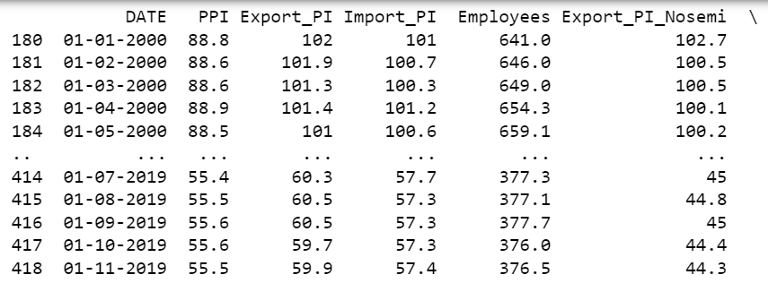
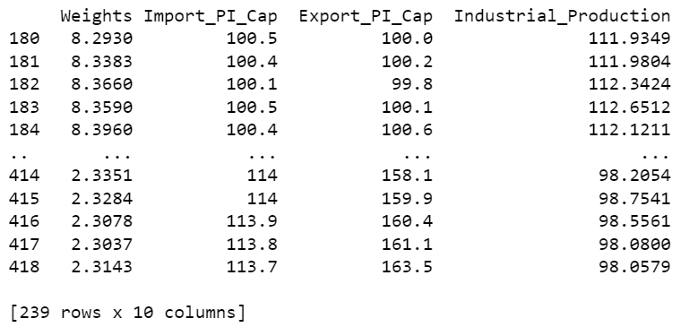
Prepare
The Data Science Process (2/5)
The Kaggle data set was imported into Python and cleaned via the following: one variable had the most missing values, Export_PI_Cap. When filtered to include only the observations that had an Export_PI_Cap value recorded, all other variables cleaned up nicely with respect to missing variables.

Slide 16
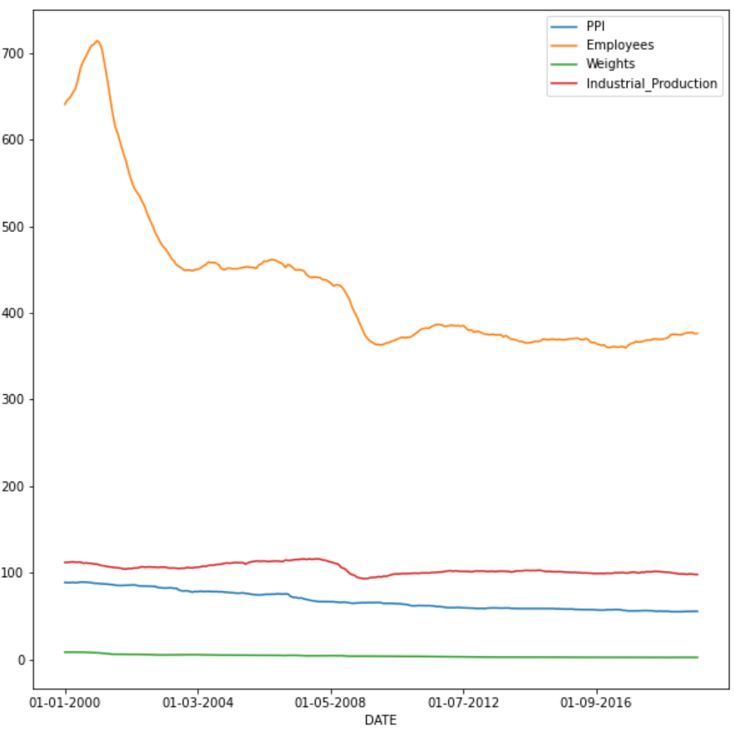
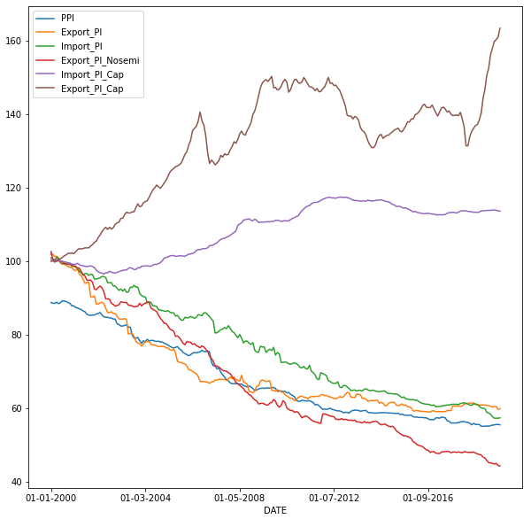
Prepare (continued)
The Data Science Process (2/5)
Visualizing by Date provided insight as to the correlations (or not) between variables:

Slide 17
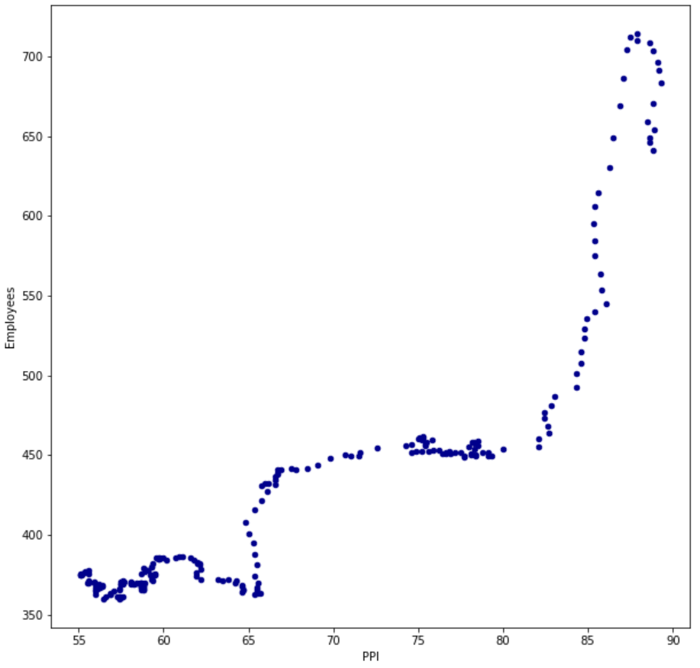
Prepare (continued)
The Data Science Process (2/5)
Plotting a Scatterplot in Python provided good indication of the relationship between the primary explanatory variable, labor force size (Employees), and supplier pricing power (PPI):

Slide 18
Prepare (converting date to season)
The Data Science Process (2/5)
As part of addressing the assumed hypotheses, each observation’s date in the dataframe had to be converted into a season, which was chosen to be categorical (1 = 1st QTR, 2 = 2nd QTR, etc.):
semi['DateTime'] = pd.to_datetime(semi['DATE'])
semi['Season'] = (semi['DateTime'].dt.day + 2)//3

Slide 19
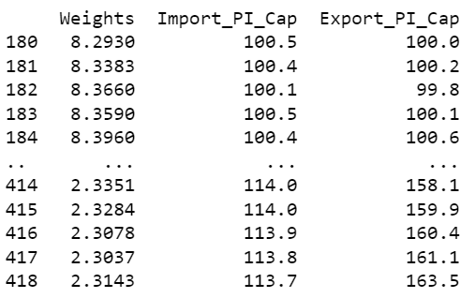
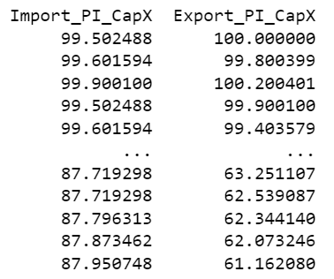
Prepare (continued)
The Data Science Process (2/5)
For Week Four, unsatisfied by the original predictive model with the diverging capital price indices; those two indices were transformed across the 100-value axis (i.e., original 120 price index => 80 price index):

Slide 20
Analyze data
The Data Science Process (3/5)
Linear Regression was chosen to determine statistical relationships between each of the independent variables. The following models were chosen:
PPI = f(Employees)
PPI = f(Import_PI, Export_PI, Import_PI_Cap, Export_PI_Cap,
Export_PI_Nosemi)
PPI = f(DATE)*
*Note: DATE was recast to seasons to determine seasonality

Slide 21
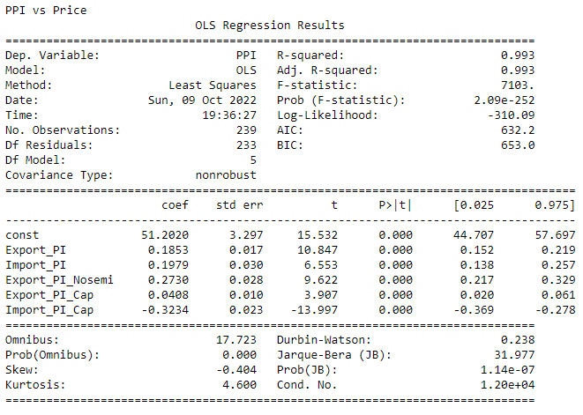
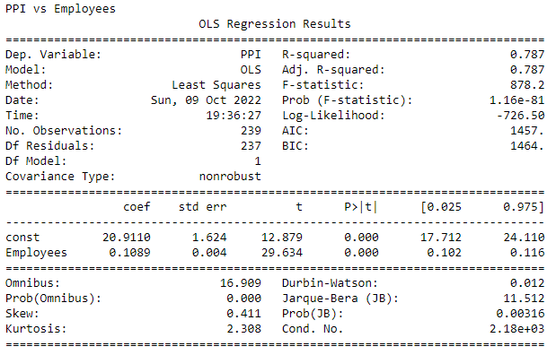
Analyze data
The Data Science Process (3/5)
Results of the linear regression provided very strong evidence of statistical relationships between the Employee and Price Index independent variables and the proposed models.
P values were < 0.05 across the board:

Slide 22
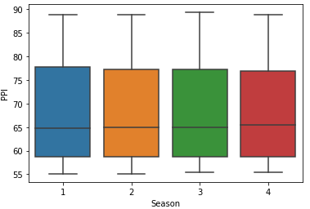
Analyze data (Seasonality)
The Data Science Process (3/5)
Analyzing the seasonality of the Producer’s Price Index (PPI) revealed insignificant statistical variation between the annual quarter slices chosen:

Slide 23
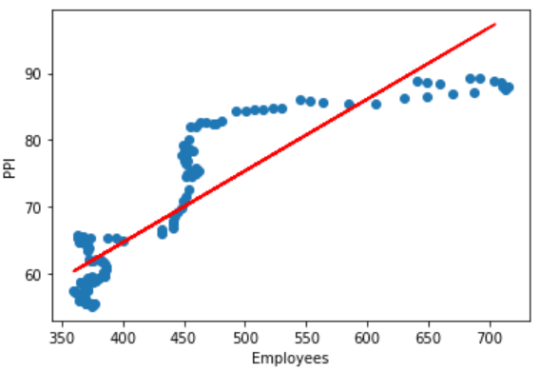
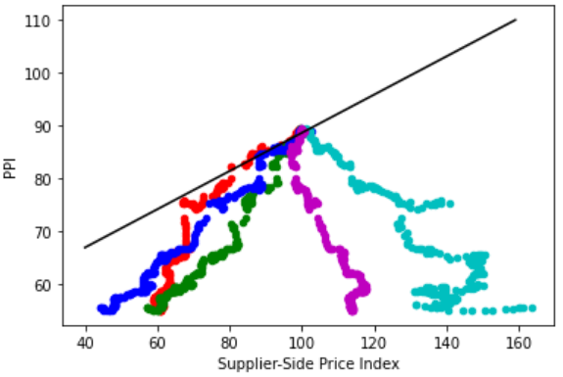
Analyze data (Model Performance)
The Data Science Process (3/5)
While the PPI/Employee model appeared to perform well, the PPI vs supplier price indices did not (about as well as the seasonality):

Slide 24
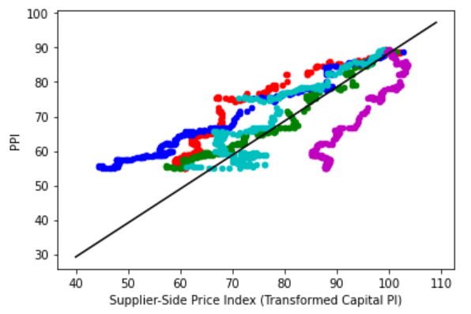
Analyze data (Model Performance)
The Data Science Process (3/5)
After transforming the capital price indices across the 100-value axis, the model converges more satisfactorily:

Slide 25
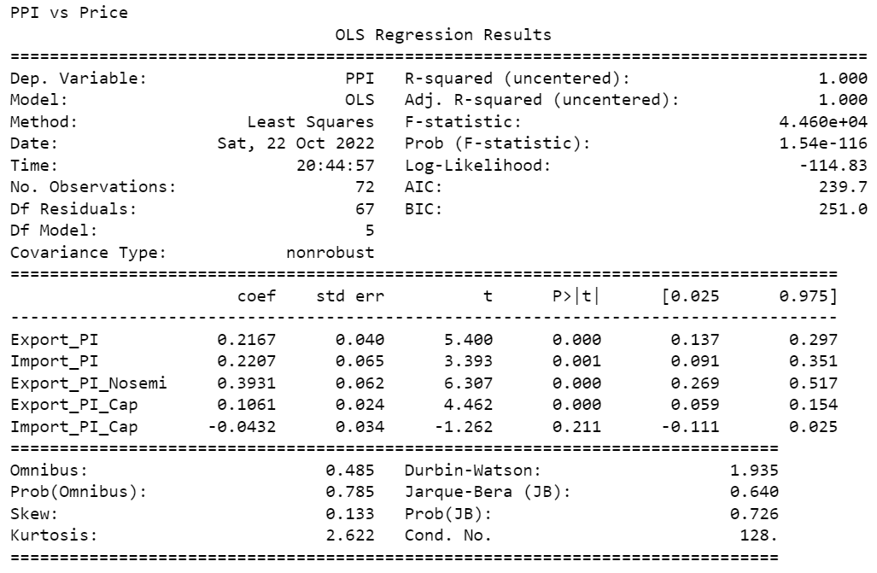
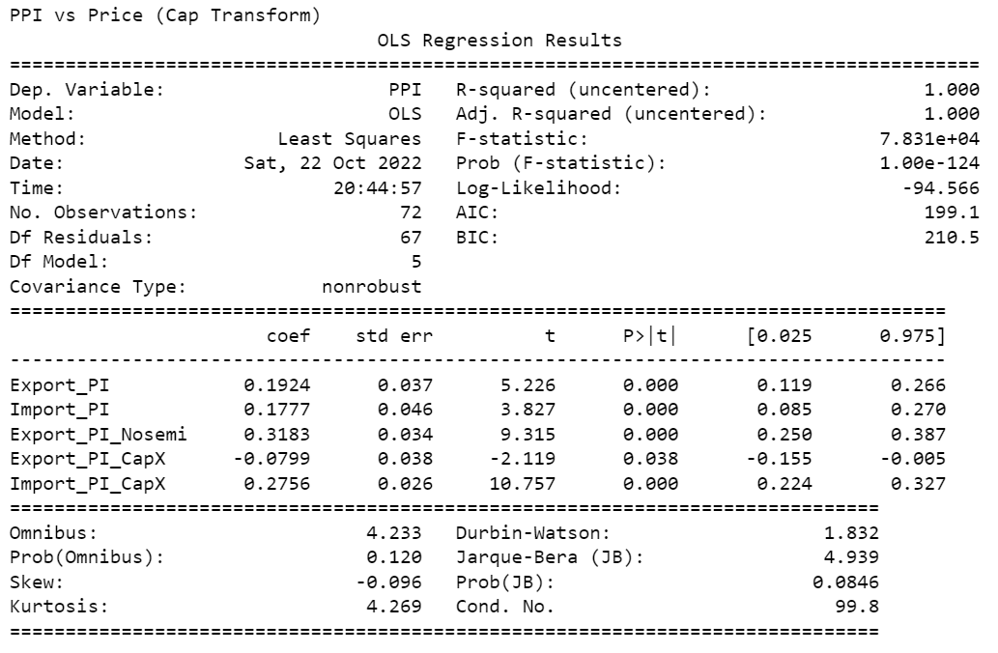
Analyze data (Model Performance)
The Data Science Process (3/5)
And is further confirmed by the sm.OLS subroutine for the underlying statistics:

Slide 26
Report
The Data Science Process (4/5)
Based on the completed analysis of the “SEMI” dataset, the null hypothesis can only be rejected if the expected relationship to seasonality is removed from the statement:
H₀: There is no relationship between semiconductor supplier pricing power and labor force size, as well as input/output costs, and seasonality
Removing seasonality also accepts the alternative hypothesis:
H_{A}: The alternative hypothesis (HA) states that and increase in labor force size and a decrease in input/output costs will increase the pricing power (dependent variable) of a semiconductor company, while seasonality will have a cyclical effect.
The planned check of price index sensitivity to the two other variables (PPI & Employee) was not performed. However, based on the differing correlations between the price indices and employee base to PPI – this sensitivity is expected to be insignificant.

Slide 27
Act
The Data Science Process (5/5)
The semiconductor industry is very well aware of how import/export costs and capital expenditures affect how much they can charge for finished goods
In general, the semiconductor Producer Price Index increases when:
More employees are added to the payroll (overhead costs go up)
Import and Export costs increase
Less capital expenditures are made (decreases efficiency and offsets other areas)
The data shows there are no seasonal effects to PPI, so companies should not factor in time of the year when planning industrial output
It is concluded (surprisingly) that efficiency gains are obvious given that as Employee Base and Industrial Output goes down, PPI follows suit – in essence, we get “more for less”
While the relationship is strong between input/output costs and PPI, how both of those factors play into the relative size of the industry-wide employee base is still under investigation

