Slide 1




Slide 2
TRAVEL SMART
GROUP 3
Student1513994 – Lê Thành Vinh(Leader)

Slide 3
Phí Văn Hiếu
Lê Thành Vinh
Trần Thế Hiếu
Nguyễn Tiến Đạt
Nguyễn Đức Dũng
TRAVEL SMART
GROUP 3
Instructor: Ngo Trung Kien

Slide 4
Chapter
I
Project Introduction
Chapter II
Technology
Chapter III
Image

Slide 5
Traveling offers benefits for health, mental well-being, and social interaction
Traveling has become one of the popular activities for adventure seekers
Chapter
I
Project Introduction
Chapter II
Technology
Chapter III
Image
A passion for adventure and a desire to challenge oneself through traveling

Slide 6
Traveling has become one of the popular activities for adventure seekers
Traveling offers benefits for health, mental well-being, and social interaction
Chapter
I
Project Introduction
Chapter II
Technology
Chapter III
Image
A passion for adventure and a desire to challenge oneself through traveling
Information about travel, providing guidelines for safe journeys

Slide 7
Traveling offers benefits for health, mental well-being, and social interaction
Traveling has become one of the popular activities for adventure seekers
Chapter
I
Project Introduction
Chapter II
Technology
Chapter III
Image
A passion for adventure and a desire to challenge oneself through traveling
Information about travel, providing guidelines for safe journeys

Slide 8
Traveling offers benefits for health, mental well-being, and social interaction
Traveling has become one of the popular activities for adventure seekers
Chapter
I
Project Introduction
Chapter II
Technology
Chapter III
Image
A passion for adventure and a desire to challenge oneself through traveling
Information about travel, providing guidelines for safe journeys

Slide 9
Traveling offers benefits for health, mental well-being, and social interaction
Traveling has become one of the popular activities for adventure seekers
Chapter
I
Project Introduction
Chapter II
Technology
Chapter III
Image
A passion for adventure and a desire to challenge oneself through traveling
Information about travel, providing guidelines for safe journeys

Slide 10




Chapter II
Technology
Chapter III
Image

Slide 11
Chapter II
Technology
Chapter III
Image
FrontEnd
CSS
CSS
Database

Slide 12
Chapter II
Technology
Chapter III
Image
FrontEnd
CSS
CSS
Database

Slide 13
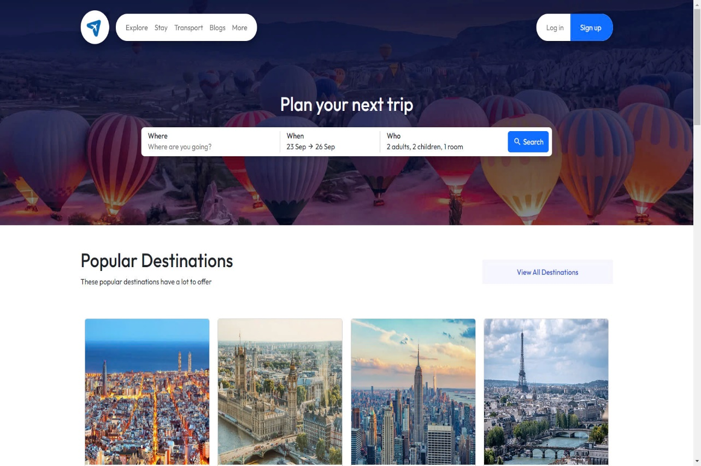
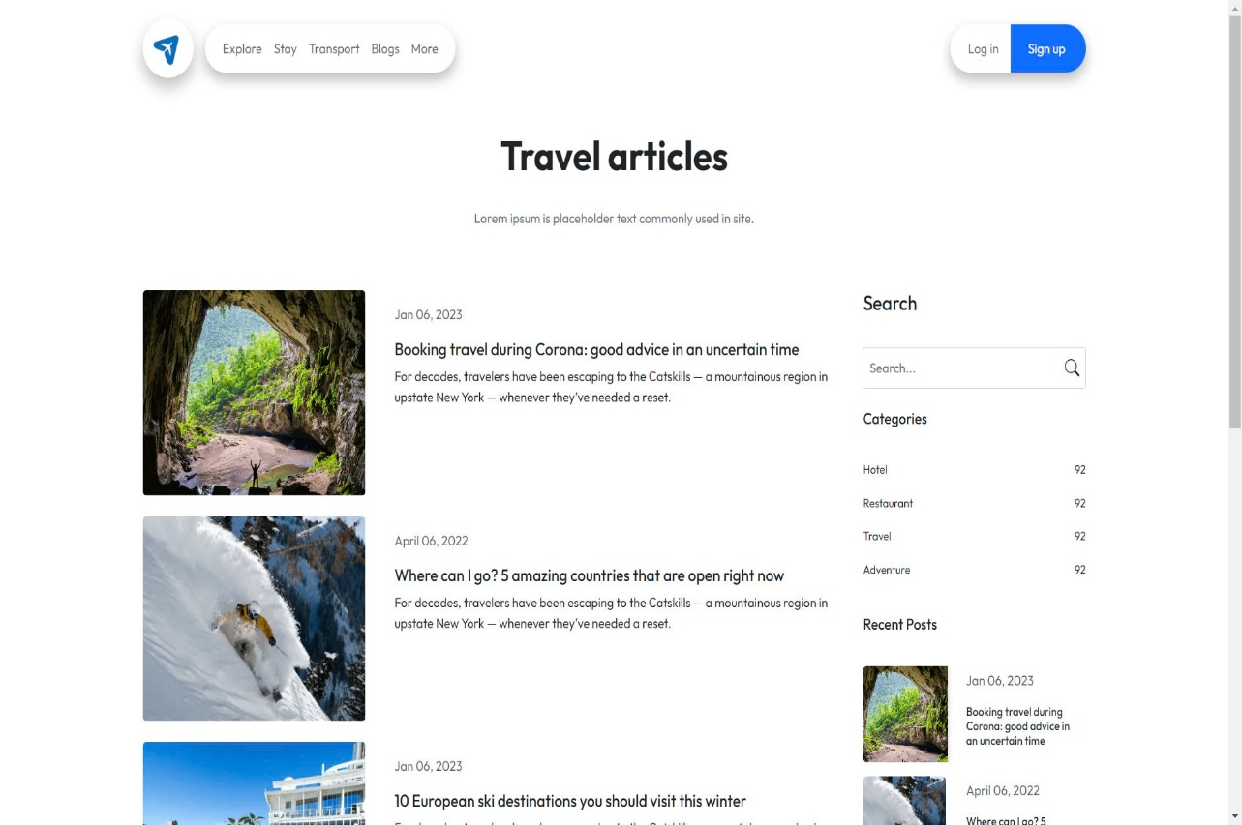
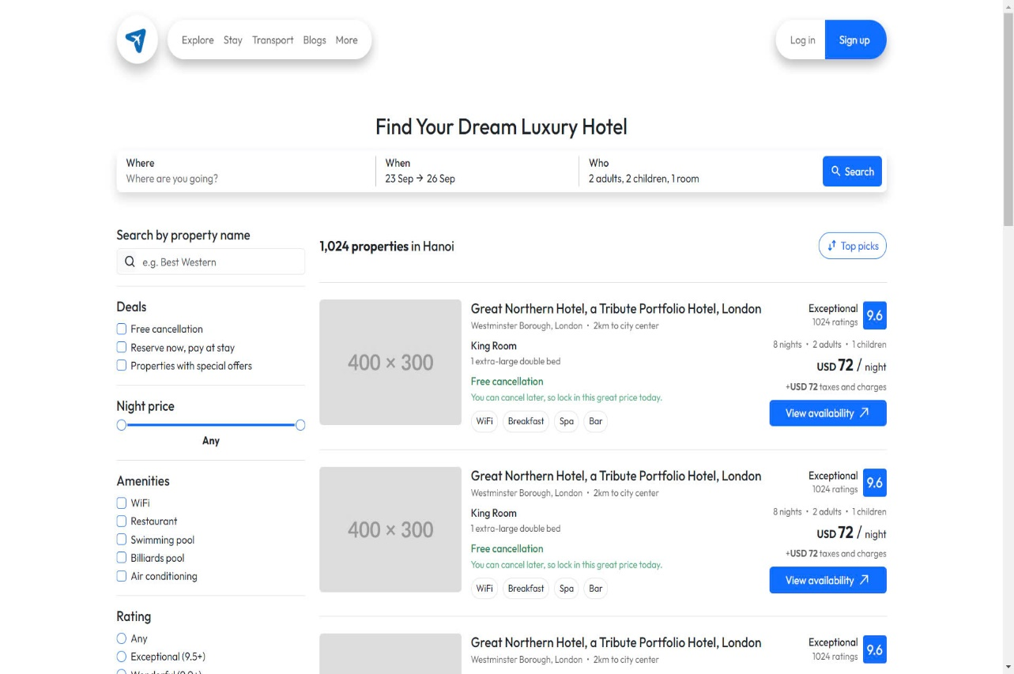
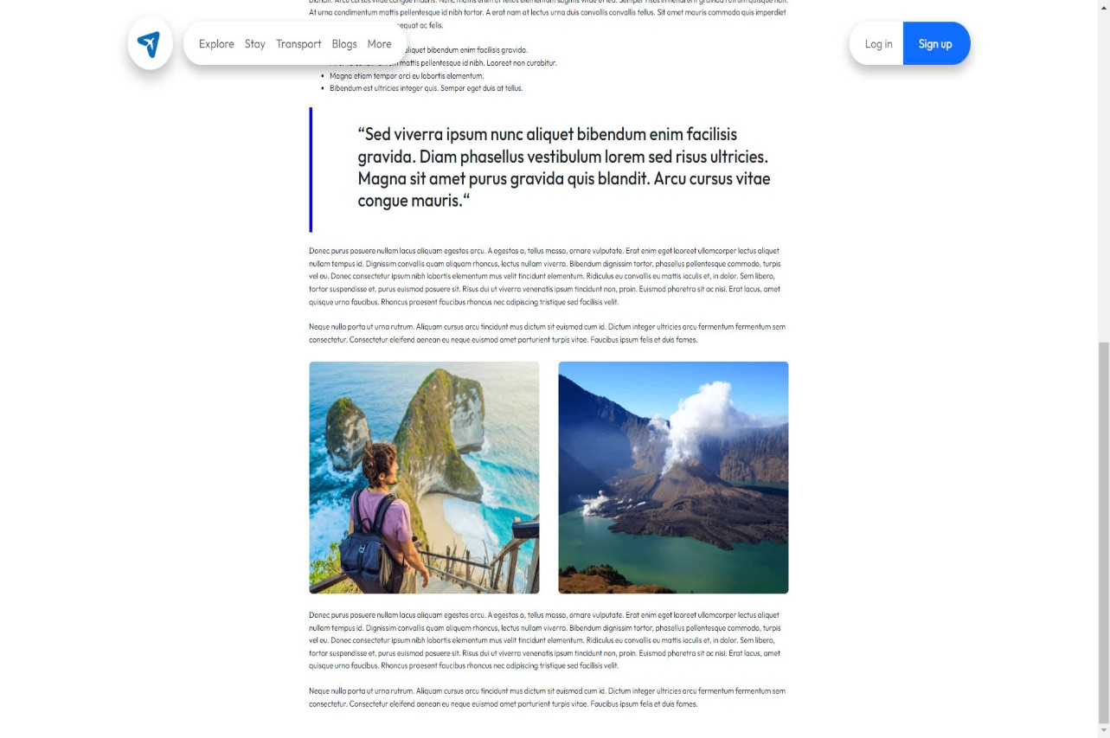
Chapter II
Technology
Chapter III
Image

Slide 14


