Slide 1

27
API Endpoints
Experimental *
G.722 · PCMU · PCMA
v1.1
Open SIP Endpoint built for
engineers and hobbyists
Containerized
No audio hardware required.
Fully headless-capable via REST API
Fully functional Web UI
Codecs
Docker / Podman
Deployment
Pcap , Adhoc Recording, Transcription
Capture
For Developers & Engineers

Slide 2
Problem & Use Cases
The Gap
Potential Use Cases
Traditional SIP softphones require audio hardware/virtualised hardware
TEST
SIP Testing
Automate call flows with REST API - no physical hardware needed
Difficult to automate — no headless / API-driven control
No built-in packet capture for SIP/RTP analysis
PCAP
Network Analysis
Capture SIP + RTP per call, open in Wireshark
Difficult to containerise and deploy to cloud
CLOUD
Cloud Deployment
Runs headless on any cloud VM, no audio hardware
CI/CD
CI/CD Integration
Trigger calls, play audio, verify via API in pipelines
PHONE
Softphone
Full-featured web UI for engineers/home lab hobbyists

Slide 3
Project Goals
No Hardware Dependencies
Runs anywhere — cloud VM, home server, or CI runner — without audio hardware, tcpdump, or kernel modules.
● No sound card or audio device
● No tcpdump or raw socket access
● Fully headless via REST API
Full Headless Automation
Every feature is reachable through the REST API. Script call flows, test IVR systems, and automate from pipelines.
● 27-endpoint REST API
● OpenAPI 3.1 spec included
● WebSocket real-time events
Reliability
Built to stay registered and recover automatically. Keepalive pings, IP change detection, and graceful reconnection.
● OPTIONS keepalive every 30s
● Auto re-register on IP change
● Call cleanup on disconnect
Engineer-First Experience
Full SIP dialog in every pcap, live stats in the UI, browser audio relay, dark mode, and mobile-responsive layout.
● Full SIP capture: INVITE to BYE
● Live RTP stats panel
● Dark mode + mobile responsive

Slide 4
What You Can Do
Full softphone capability (WiP) — all controllable via REST API or web UI
Call Control
■ Make and receive calls
■ Hold & resume mid-call
■ Send DTMF tones
■ Reject unwanted calls
Transfer & Conference
■ Blind transfer to any extension
■ Attended transfer — hear first, then bridge
■ 3-way conference calls
■ Drop conference leg independently
Audio Injection
■ Upload any WAV file
■ Play audio into a live call
■ Far end hears it as natural call audio
■ Perfect for hold music, IVR testing, announcements
Packet Capture , Record, Transcribe
■ Automatic per call packet capture (PCAP)
Full SIP + RTP in one file
■ Adhoc call recording (WAV)
Audio decoded to WAV
■ Post call recording transcription
Live Monitoring
■ See codec, jitter, packet loss live
■ RX and TX kbps in real time
■ Listen to the call in your browser
■ WebSocket events for every state change
Reliability
■ Keepalive pings detect PBX issues early
■ Auto re-register if connection drops
■ Missed and cancelled calls tracked
■ Remote hold shown in UI automatically

Slide 5
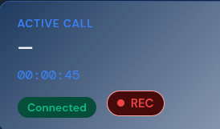
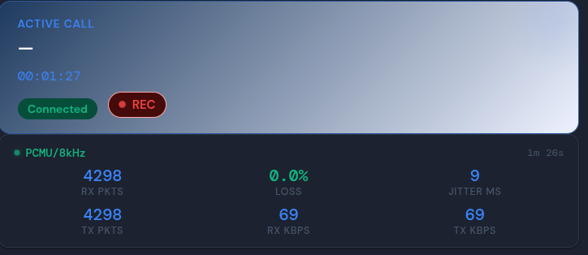
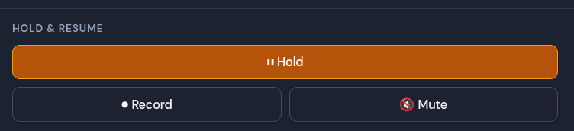
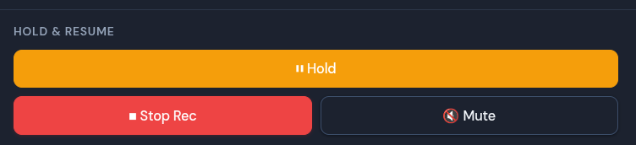
Live Audio & Monitoring
Hear the call in your browser and watch quality metrics in real time
Listen Live in the Browser
● Click Listen during any active call
● Inbound audio streams to your browser via WebSocket
● Uses the Web Audio API — no plugins or extensions
● Works for G.722 wideband and G.711 narrowband calls
On-Demand Recording
● Start and stop recording at any point mid-call
● WAV file saved instantly — download from the UI
● Separate from the automatic per-call pcap capture
Live RTP Stats Panel
● Appears automatically when a call connects
● Updates every 2 seconds via the REST API
What You Can See
● Codec — G.722, PCMU, or PCMA
● RX and TX packet counts
● Packet loss percentage
● Jitter in milliseconds
● RX and TX bitrate (kbps)
● Call duration

Slide 6
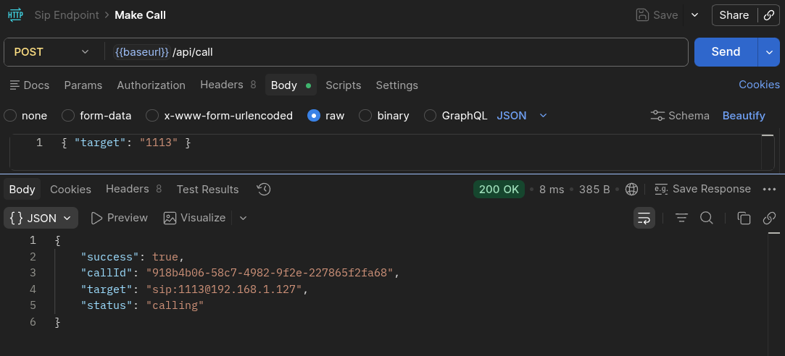
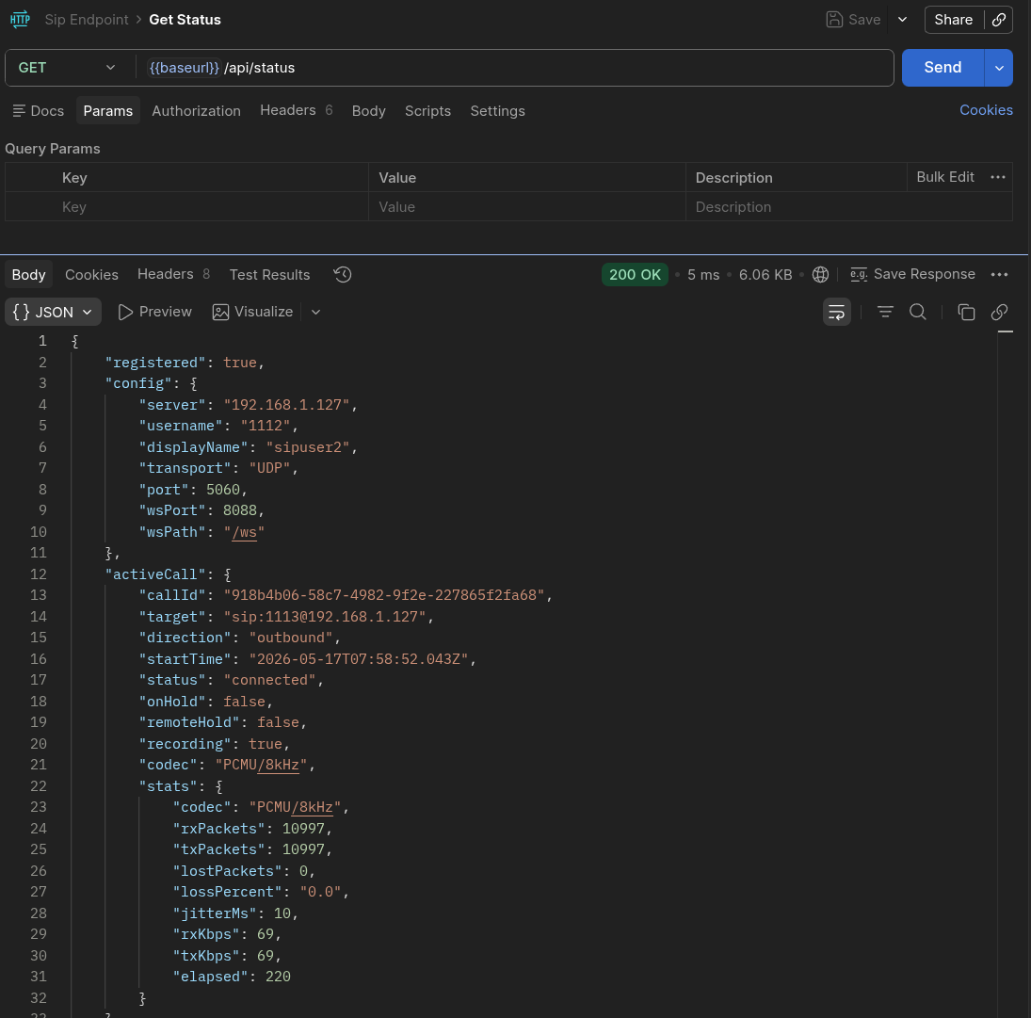
Headless & Automation
Run without a UI — call the REST API from scripts, pipelines, or any HTTP client
# Register
curl -X POST /api/register \
-d '{"server":"pbx","username":"1001",...}'
# Make a call
curl -X POST /api/call \
-d '{"target":"1002"}'
# Play audio into the call
curl -X POST /api/play \
-d '{"filename":"hold-music.g722"}'
# Hang up + download pcap
curl -X POST /api/hangup
curl -O /captures/call_*.pcap
Deployment
● Docker or Podman — single compose command
● network_mode: host keeps SIP/RTP routing simple
● Captures volume persists across restarts
● No audio hardware, no special kernel modules
Use Cases
● SIP testing — automate call flows in CI/CD
● IVR testing — play prompts, verify responses
● Network analysis — pcap every call automatically
● Cloud deployment — any Linux VM, any provider
Quick Start
podman-compose up -d --build

Slide 7
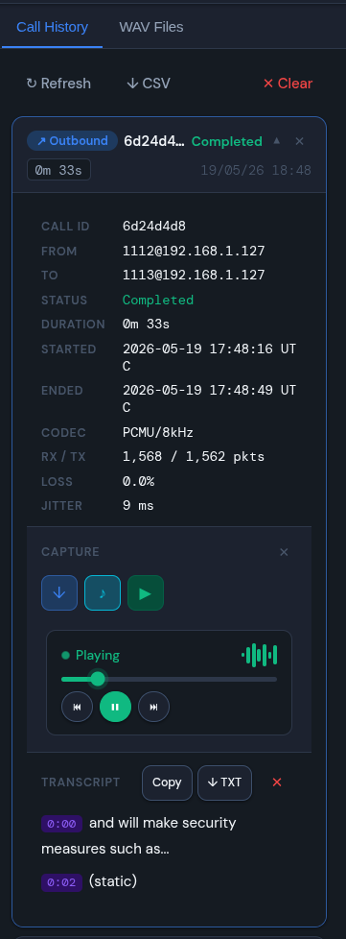
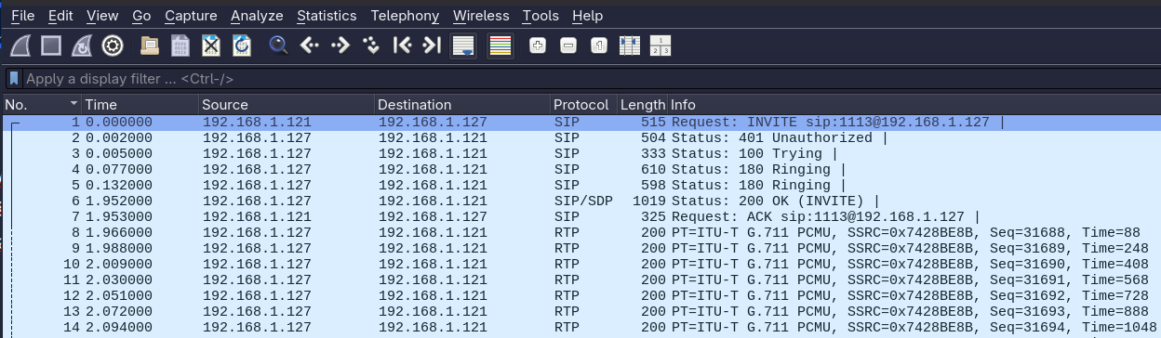
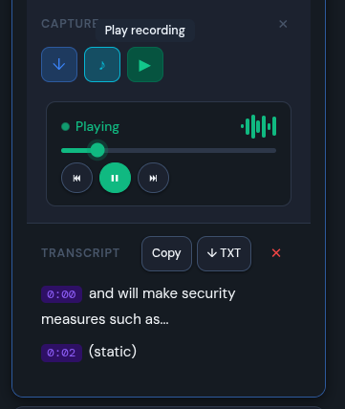
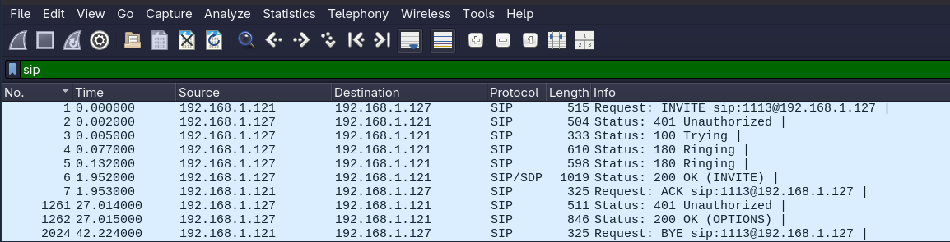
Packet Capture & Audio Recording
Every call automatically saved — no configuration needed
Per-Call .pcap Capture
■ Opens in Wireshark
■ Full SIP dialog: INVITE, 100, 180, 200, ACK, BYE
■ RTP media packets alongside signalling
■ Use Telephony → VoIP Calls in Wireshark
■ Filter by 'sip' to see just the dialog
■ Named with timestamp and call ID
■ Download via UI button or REST API
Audio Recording (.wav)
■ Automatically decoded from the call's RTP stream
■ Supports G.722 wideband and G.711 narrowband
■ Saved as a standard WAV file — plays in any player
■ On-demand recording: start and stop mid-call
■ Linked to matching call log/pcap in the UI
■ Download via UI or REST API

Slide 8
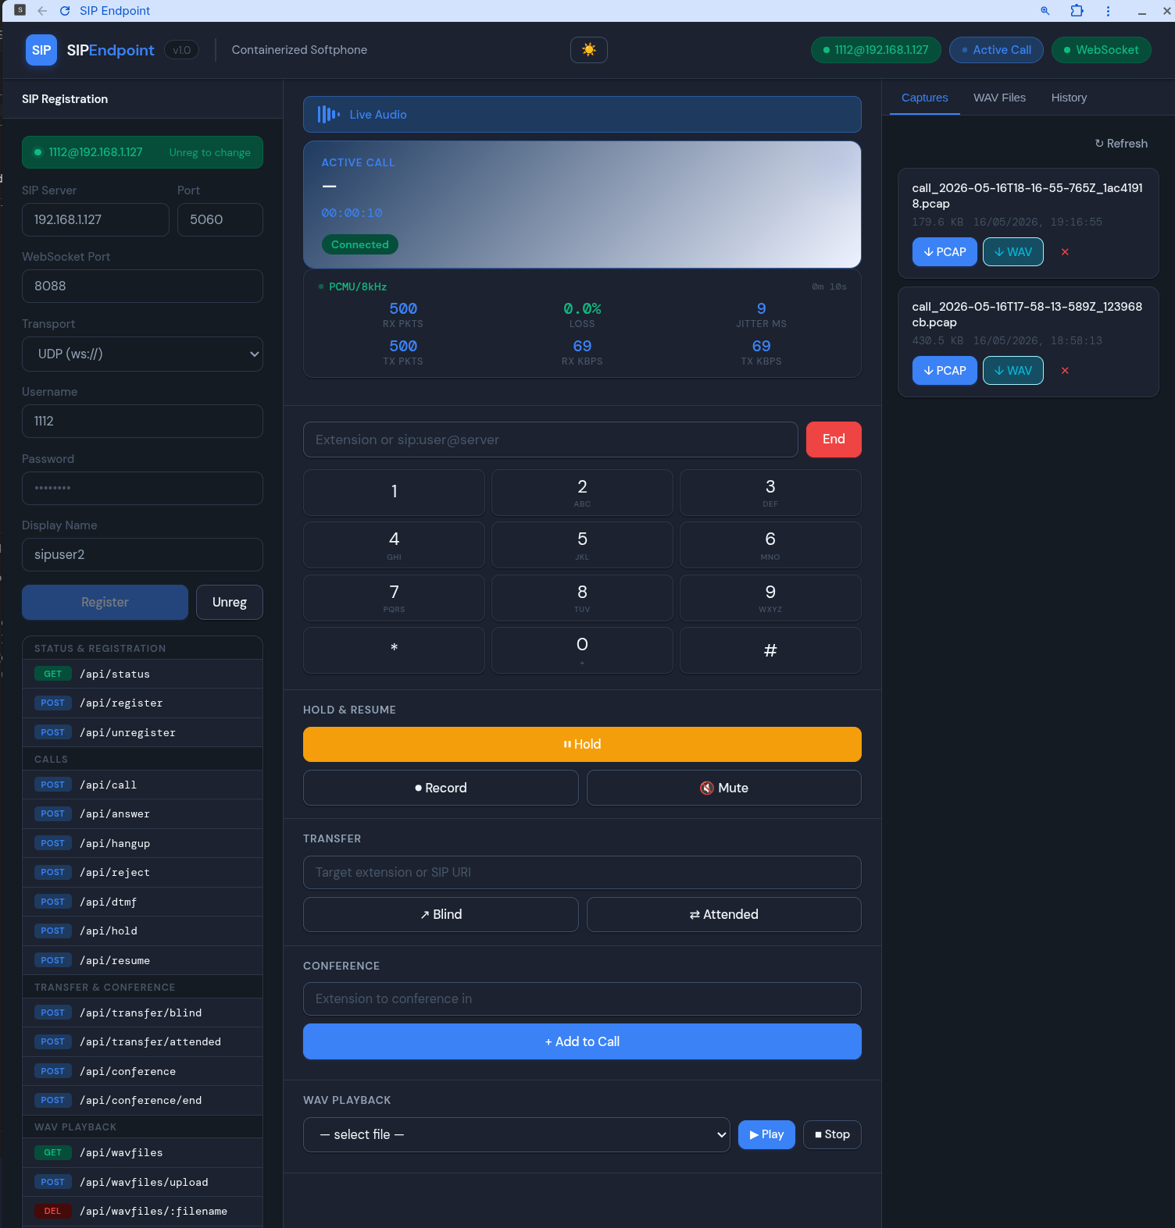
Web UI
Registration Panel
Softphone Panel
Right Panel (Tabs)
SIP server, port, WS port
Live call display card (blue gradient)
Captures: ↓ PCAP · ↓ WAV per call
Transport: UDP / TLS
WAV Files: upload · play · delete
DTMF dialpad (12 keys)
Username, password, display name
History: direction, target, duration
Hold / Resume controls
Locks form when registered
status, timestamp, ↓ pcap link
Blind + attended transfer
Populates from API state on reload
3-way conference with drop
CSV export · Clear history
Full API endpoint reference
WAV file selector + playback
Collapsible log panel + export
Theme: Clarity — DM Sans + DM Mono · White card surfaces · Blue/Green/Amber status system · Collapsible log with unread count

Slide 9
What's New in v1.1
v1.0 to v1.1 | 15 new features
Audio & Media
Call Handling
UI & Reliability
Live audio relay to browser
ws://host:3000/audio + Web Audio API
On-demand call recording
POST /api/record/start|stop
Live RTP stats panel
Codec, jitter, loss%, RX/TX kbps
Browser notifications + ringtone
On incoming call when tab unfocused
Missed call detection
History: missed / cancelled status
CANCEL support
Pre-answer hangup sends CANCEL
Remote hold detection
a=sendonly re-INVITE shown in UI
Full SIP capture in pcap
INVITE/100/180/200/ACK/BYE
Dark / light mode
Toggle persisted to localStorage
Mobile responsive layout
Breakpoints at 1100px and 768px
OPTIONS keepalive
30s ping, auto re-register on fail
Graceful WS reconnection
Call cleanup + auto-reconnect

Slide 10
Quick Reference
SIP
Endpoint
Web UI
http://localhost:3000
Containerized SIP Softphone
API Status
GET /api/status
What we built:
Full-featured SIP softphone — no audio HW
27-endpoint REST API + WebSocket events
G.722 wideband audio, WAV injection
Per-call pcap + decoded audio recording
Docker/Podman, cloud-ready, headless
OpenAPI 3.1 spec included
OpenAPI Spec
openapi.json
Captures
/captures/ volume
WAV Files
/wavfiles/ volume
History
/captures/call_history.json
github.com/chrisnock-personal/container-sip-endpoint

