Slide 1

Aggre/Gator
Aggre/Gator
event streams, swallowed whole
Intelligent Event Aggregation Platform
Source-agnostic · Configurable grouping · Cradle-to-grave lifecycle · Real-time insights

Slide 2
The Problem
Modern systems produce floods of related events - but they arrive fragmented, out of order, and from many sources.
⚡
Scattered Sources
🔍
No End-to-End View
Events arrive from APIs, queues, databases, webhooks - all in isolation with no shared context.
Individual events tell you something happened. You can't see the full story without manual correlation.
⏱
Lifecycle is Invisible
📊
Insights are Missing
When did this order actually complete? Did this trade settle? Is this session still active?
Without grouped data, reporting is limited to raw event counts - not meaningful business metrics.

Slide 3
What Aggre/Gator Does
One platform. Any source. Complete event lifecycle - automatically.
01
Ingest from Anywhere
02
Group by Configurable Key
A single HTTP endpoint accepts events from any producer - APIs, queues, webhooks, batch jobs. Full REST API available for headless integration of all core features.
Policies define which field in the event body acts as the aggregation key. All events sharing a key value are automatically linked into one group.
03
Cradle-to-Grave Lifecycle
04
Reports & Insights
Define exactly which event opens a group (cradle) and which closes it (grave) using per-policy field conditions. You control the lifecycle rules.
Real-time dashboards show throughput, completion rates, duration distributions, and per-policy breakdowns. Timed-out groups are surfaced automatically.

Slide 4
Source Agnostic
One endpoint. Any producer.
REST API
Batch Job
POST
/api/v1/events/ingest
Message Queue
Database CDC
Single HTTP Endpoint
Webhook
IoT Device
No source-specific connectors or adapters
Events are plain JSON - any schema accepted
Policy rules extract meaning from the body
Works with sync APIs and async queues alike
On-premise, cloud, or hybrid producers supported

Slide 5
Grouping by Configurable Key
Related events automatically linked - no code required.
Policy Configuration
Event Group: TRD-9001
name: Trade Lifecycle
key_field: body.tradeRef
cradle_field: body.eventType
cradle_value: "trade.initiated"
grave_field: body.status
grave_value: "settled"
trade.initiated
CRADLE
→
trade.confirmed
trade.cleared
status: "settled"
GRAVE
Any JSON field can be the aggregation key — tradeRef, orderId, sessionId, correlationId. No schema changes required. Policies are created and modified through the UI at runtime.

Slide 6
Cradle-to-Grave Lifecycle
User-defined open and close criteria. The platform handles the rest.
CRADLE
Matched
GRAVE
Matched
Field condition met group opens
Close condition met
group completes
Event
Received
Segments
Append
Insights
Available
Any source POSTs
a JSON event
Subsequent events
link to the group
Duration, segments,
status captured
⏱ Auto-Timeout: if no grave arrives within a configurable window, the group is automatically closed and marked Timed Out — no manual intervention needed.

Slide 7
Architecture
PRODUCERS
INGEST
POLICY PROCESSING
STORAGE
REST API
POST /ingest
HTTP API
Policy Matcher
in_progress_events
Hot store
Cradle/Grave eval
Key extraction
Message
Queue
completed_events
Partitioned WAL
Express.js / Node 20
Timeout Job
Webhook
event_segments
60s sweep · Retroactive
GIN-indexed JSON
PostgreSQL 16
Batch Job
React UI
REST API
Vite + nginx
GET /events · GET /stats
Core ingest & policy path
PostgreSQL storage
Background jobs

Slide 8
REST API — Headless Integration
Every core feature is available programmatically - no UI required.
POST
/api/v1/events/ingest
Ingest an event from any source
GET
/api/v1/events
List & filter event groups (status, policy, date, key, body)
GET
/api/v1/events/:id
Retrieve a single group with all segments
GET
/api/v1/events/stats
Aggregate metrics — completion rate, throughput, counts
GET
/api/v1/events/performance
Slowest groups, in-progress aging, duration histogram
GET
/api/v1/policies
List all aggregation policies
POST
/api/v1/policies
Create a new policy
PUT
/api/v1/policies/:id
Update policy including timeout configuration
PATCH
/api/v1/policies/:id/toggle
Activate or deactivate a policy
All endpoints accept and return JSON · Authentication can be layered via reverse proxy or API gateway

Slide 9
Reports & Insights
From raw event streams to actionable intelligence - in real time.
91%
3.2s
0.8%
16,060
Completion Rate
Avg Duration
Timeout Rate
Total Segments
📈
Throughput Charts
🥧
Policy Breakdown Pies
🗓
Hourly Activity Heatmap
Group opens vs closes over time. Spot ingestion spikes and quiet periods at a glance.
Event groups and segment counts by policy — understand which flows dominate.
7-day × 24-hour grid. Reveal peak windows and off-hours anomalies instantly.
📊
Duration Histogram
🏥
Policy Health Cards
⚡
Event Group Performance
See where groups cluster — sub-second vs multi-day. Identify slow outliers.
Completion rate, timeout rate, avg/p50/p95 duration per policy with health badges.
Slowest groups, aging in-progress, and inline segment timeline drill-down.

Slide 10
In Summary
🌐
Source agnostic
One HTTP endpoint accepts events from any producer, any format, any system.
Aggre/Gator
🔑
Configurable grouping
Policies define the key field that links related events - no code changes needed.
event streams,
swallowed whole
🧬
Cradle-to-grave lifecycle
User-defined open and close conditions give complete visibility into each group's journey.
📊
Rich reporting
Real-time dashboards, per-policy health, duration analysis, and stale group detection.
⏱
Auto-timeout
v1.0
Groups that never receive a grave are automatically aged out and surfaced in the UI.

Slide 11
Appendix
Screenshots from WiP Prototype

Slide 12


Current Status
A1
WiP - Functional Prototype
Fully Dockerized Container
Fully functional
encapsulates the entire application, including its code, runtime, system tools, libraries, database and configurations, into a single, portable, and reproducible unit
All features are working as designed, no smoke and mirrors or hard coded data

Slide 13
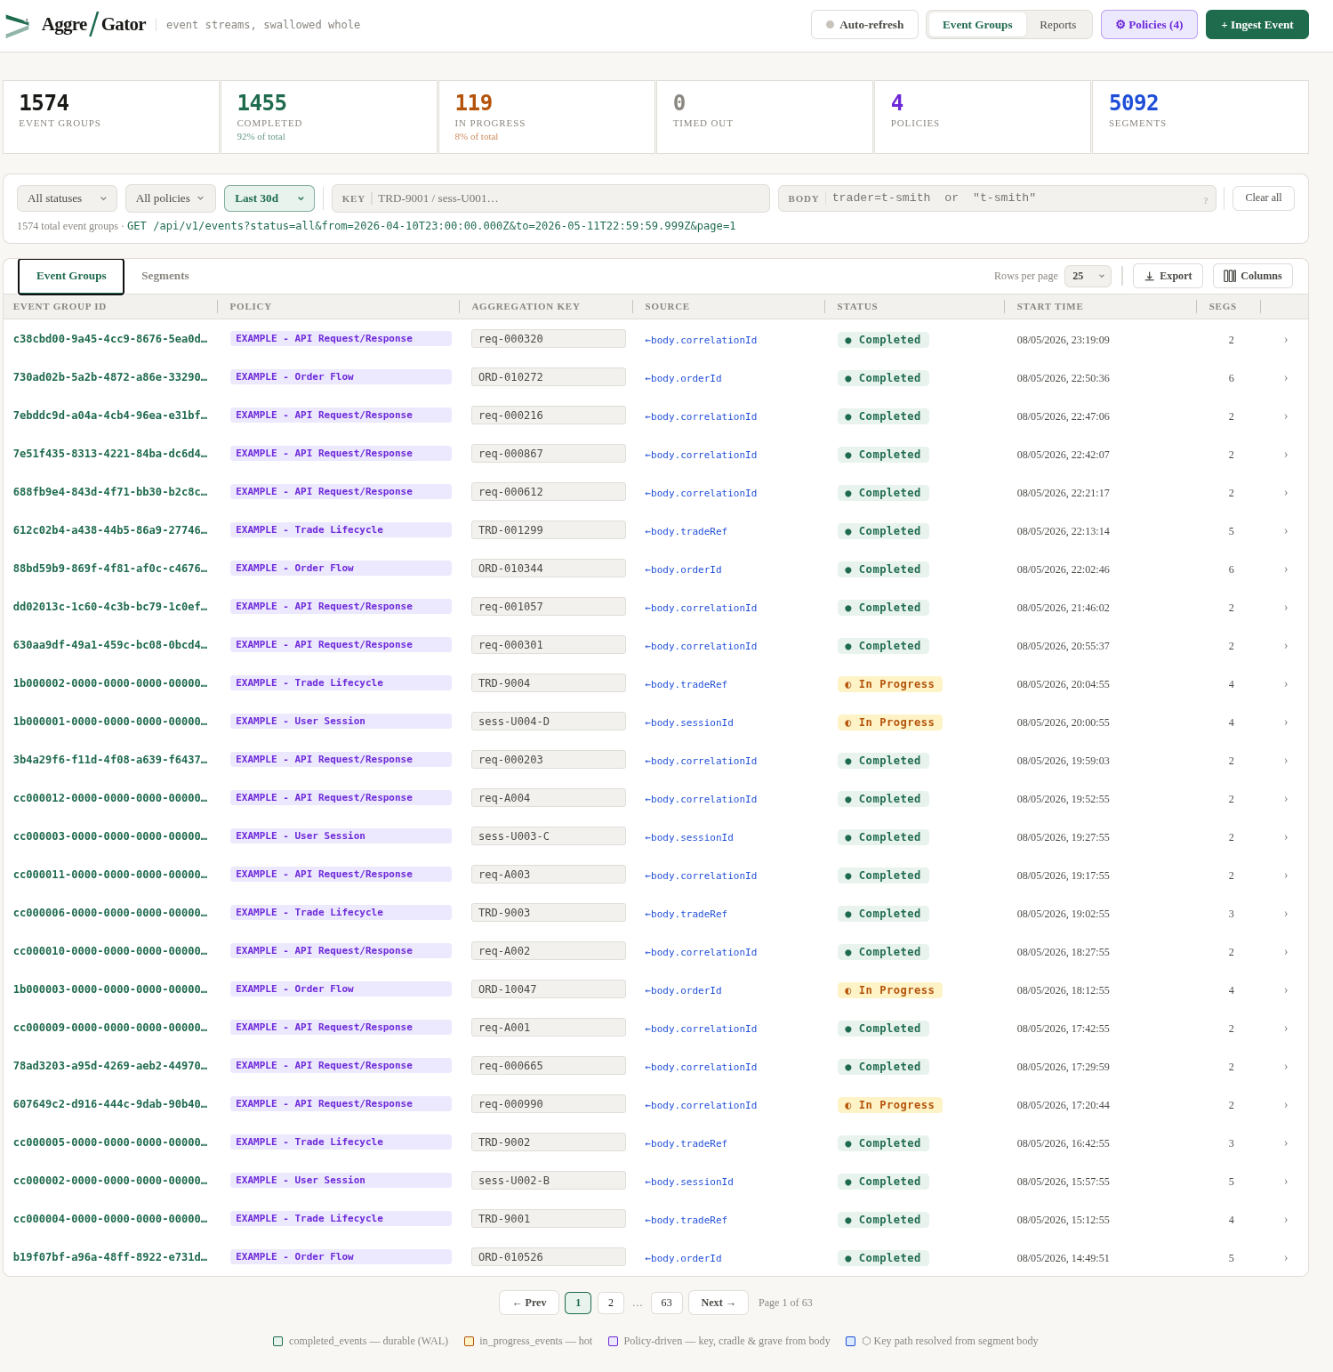
Event Groups — Overview
A1
Key Points
Filter by status (Completed / In Progress / Timed Out), policy, date range, aggregation key and body content
Stats bar shows live counts — total groups, completion rate, in-progress, timed-out, segments
Rows per page and column visibility are configurable; export to JSON or CSV from any row
Clicking a row opens the in-line detail panel without leaving the list
🖼
Fig. A1 — Event Groups — Overview

Slide 14
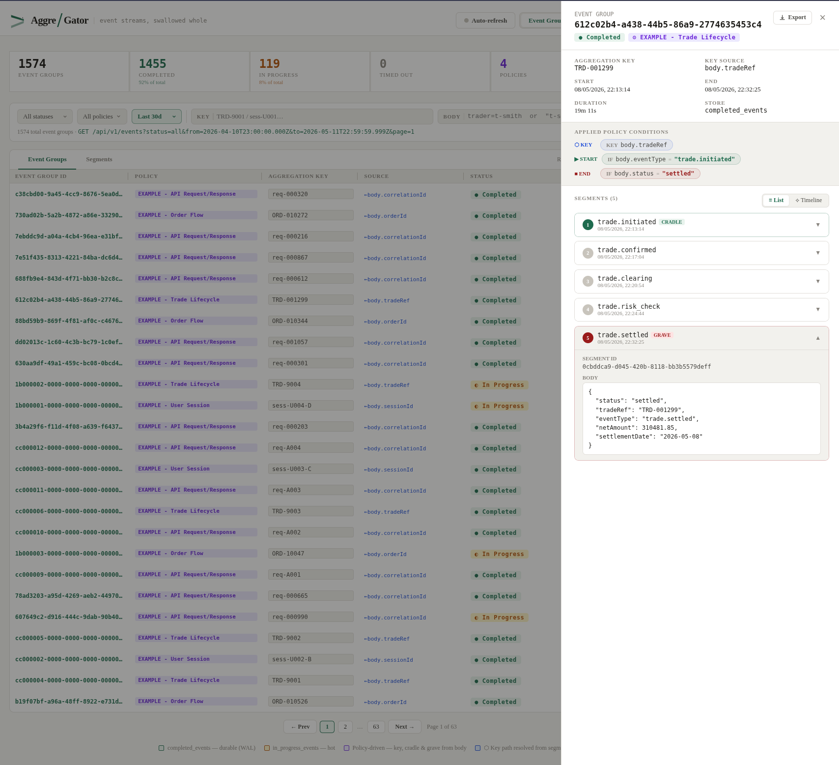
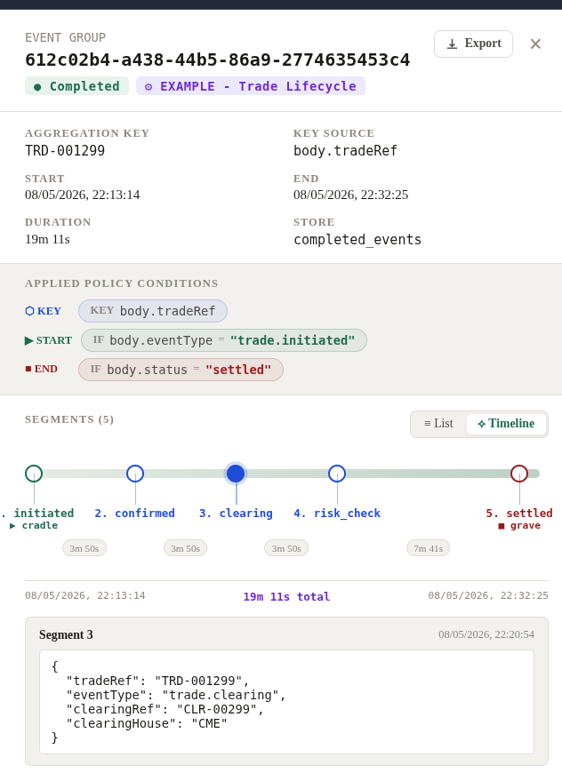
Event Group Detail & Timeline
A2
Key Points
Left panel shows the full event group — aggregation key, policy, start/end, duration and store
Each segment is listed in sequence; CRADLE and GRAVE are labelled; LAST BEFORE TIMEOUT marks auto-closed groups
Click any segment to expand the raw JSON body for inspection
Switch between List and Timeline views; export the full group as JSON or CSV
Fig. A2 — Event Group Detail & Timeline

Slide 15
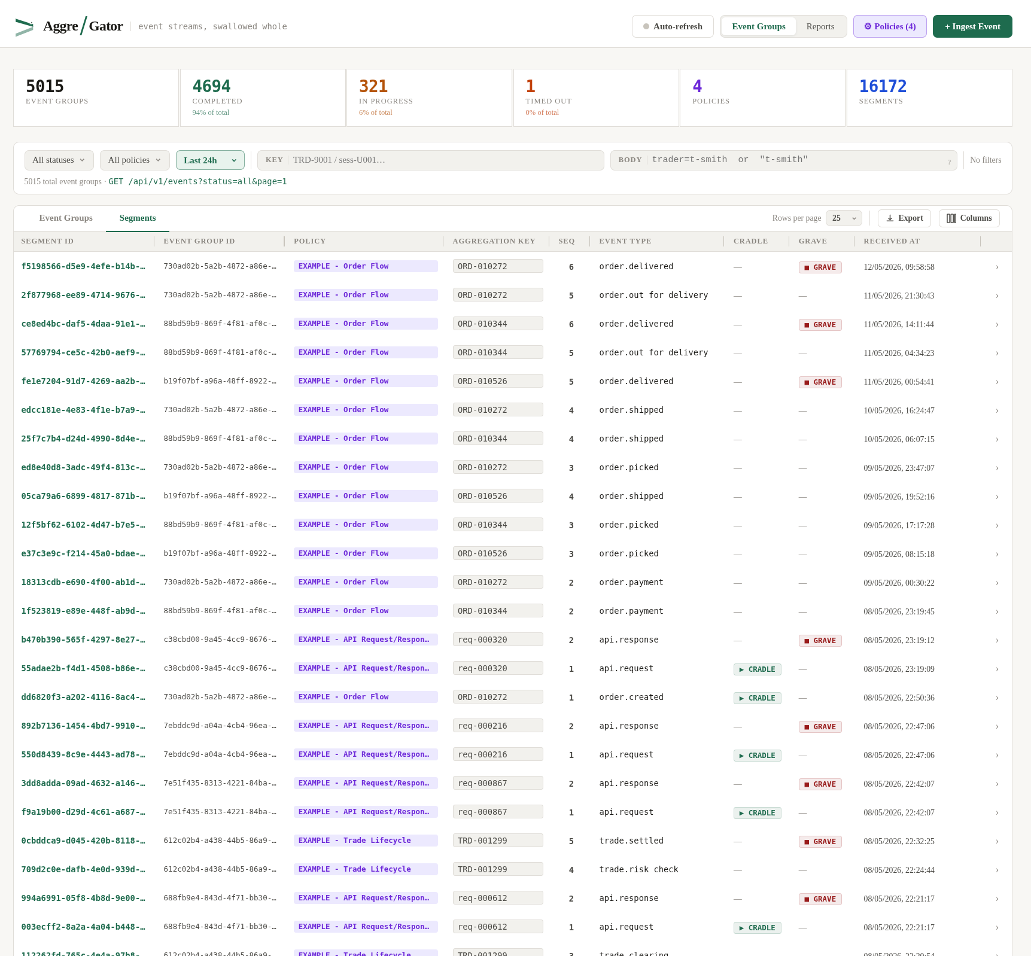
Raw Events
A3
Key Points
The Segments tab shows every individual event across all groups in a flat, sortable list
Filter segments by policy, date range, aggregation key or body search
Useful for finding a specific event ID and jumping directly to its parent group
Column visibility is configurable — show or hide event ID, timestamp, body fields as needed
Fig. A2 — Event Group Detail & Timeline

Slide 16
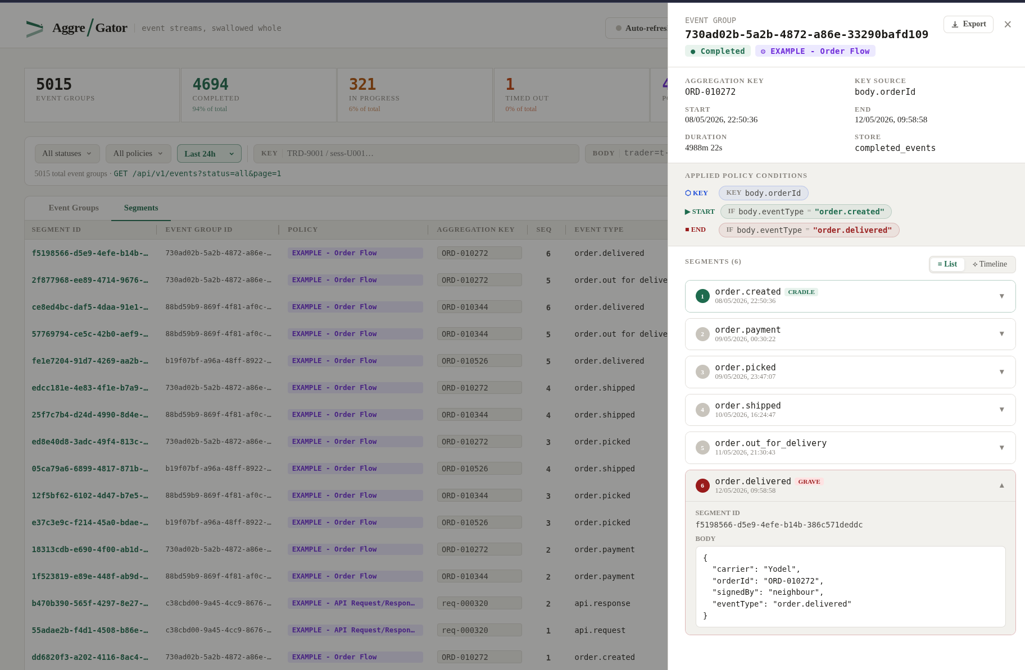
Raw Events – Drill into Event Group Detail
A4
Key Points
Clicking any segment row opens the parent event group detail panel on the right
The originating segment is highlighted so context is immediately clear
The full segment timeline is visible — navigate forward or back through related segments
Group metadata (policy, duration, status) is shown alongside the segment body
Fig. A2 — Event Group Detail & Timeline

Slide 17
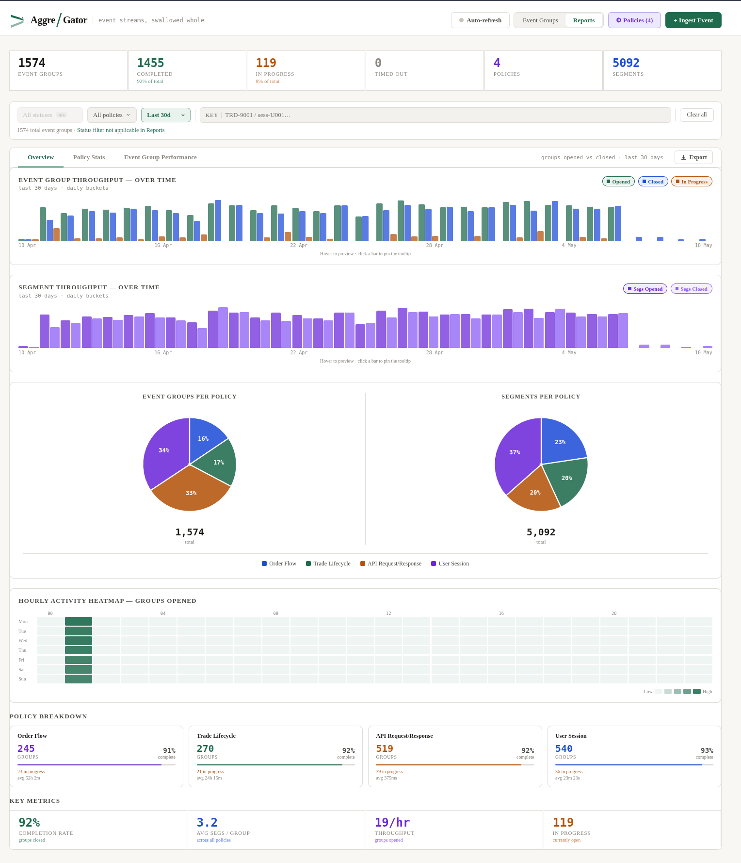
Reports — Overview
A5
Key Points
Throughput charts show group opens vs closes over time with configurable bucket granularity
Pie charts break down event groups and segment counts by policy for the selected time window
Hourly heat map reveals peak ingestion windows across a 7-day × 24-hour grid
KPI row below shows completion rate, avg segments per group, throughput and in-progress count
Fig. A3 — Reports — Overview

Slide 18
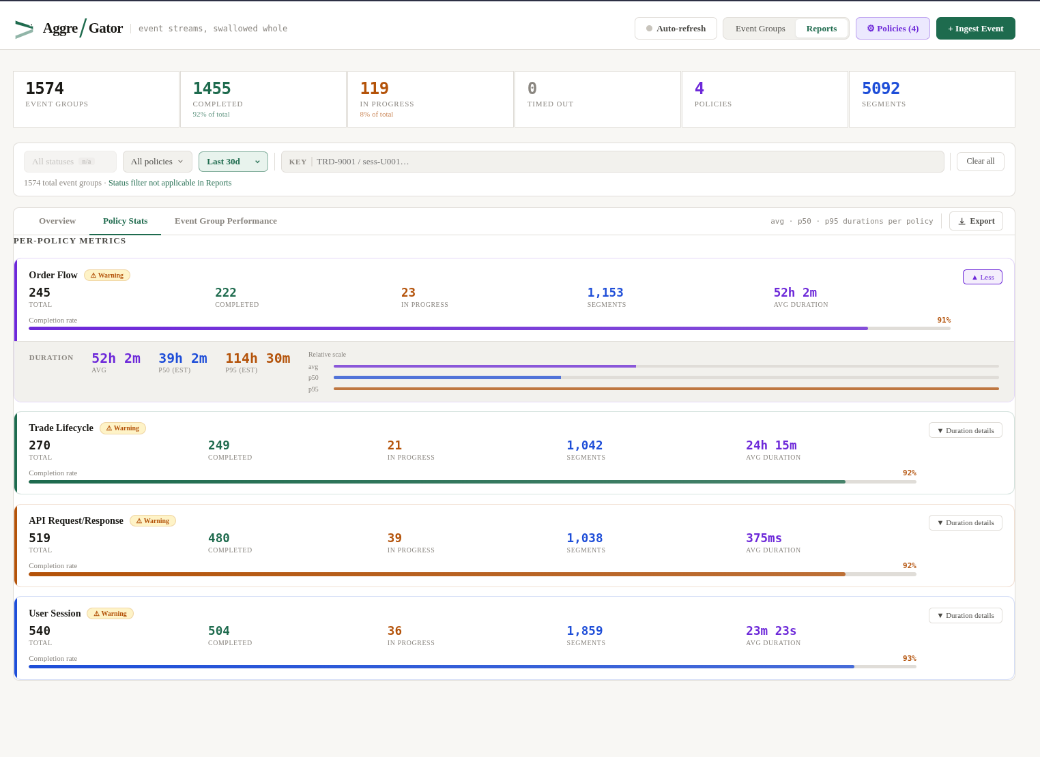
Reports — Policy Stats
A6
Key Points
Each policy gets a health card — Healthy / Warning / Critical based on completion rate
Stat grid shows total, completed, timed-out, in-progress, segments and avg duration per policy
Gradient completion bar shows natural completions vs timeouts in distinct colours
Expand any card to see avg / p50 / p95 duration estimates with a relative scale bar
Fig. A4 — Reports — Policy Stats

Slide 19
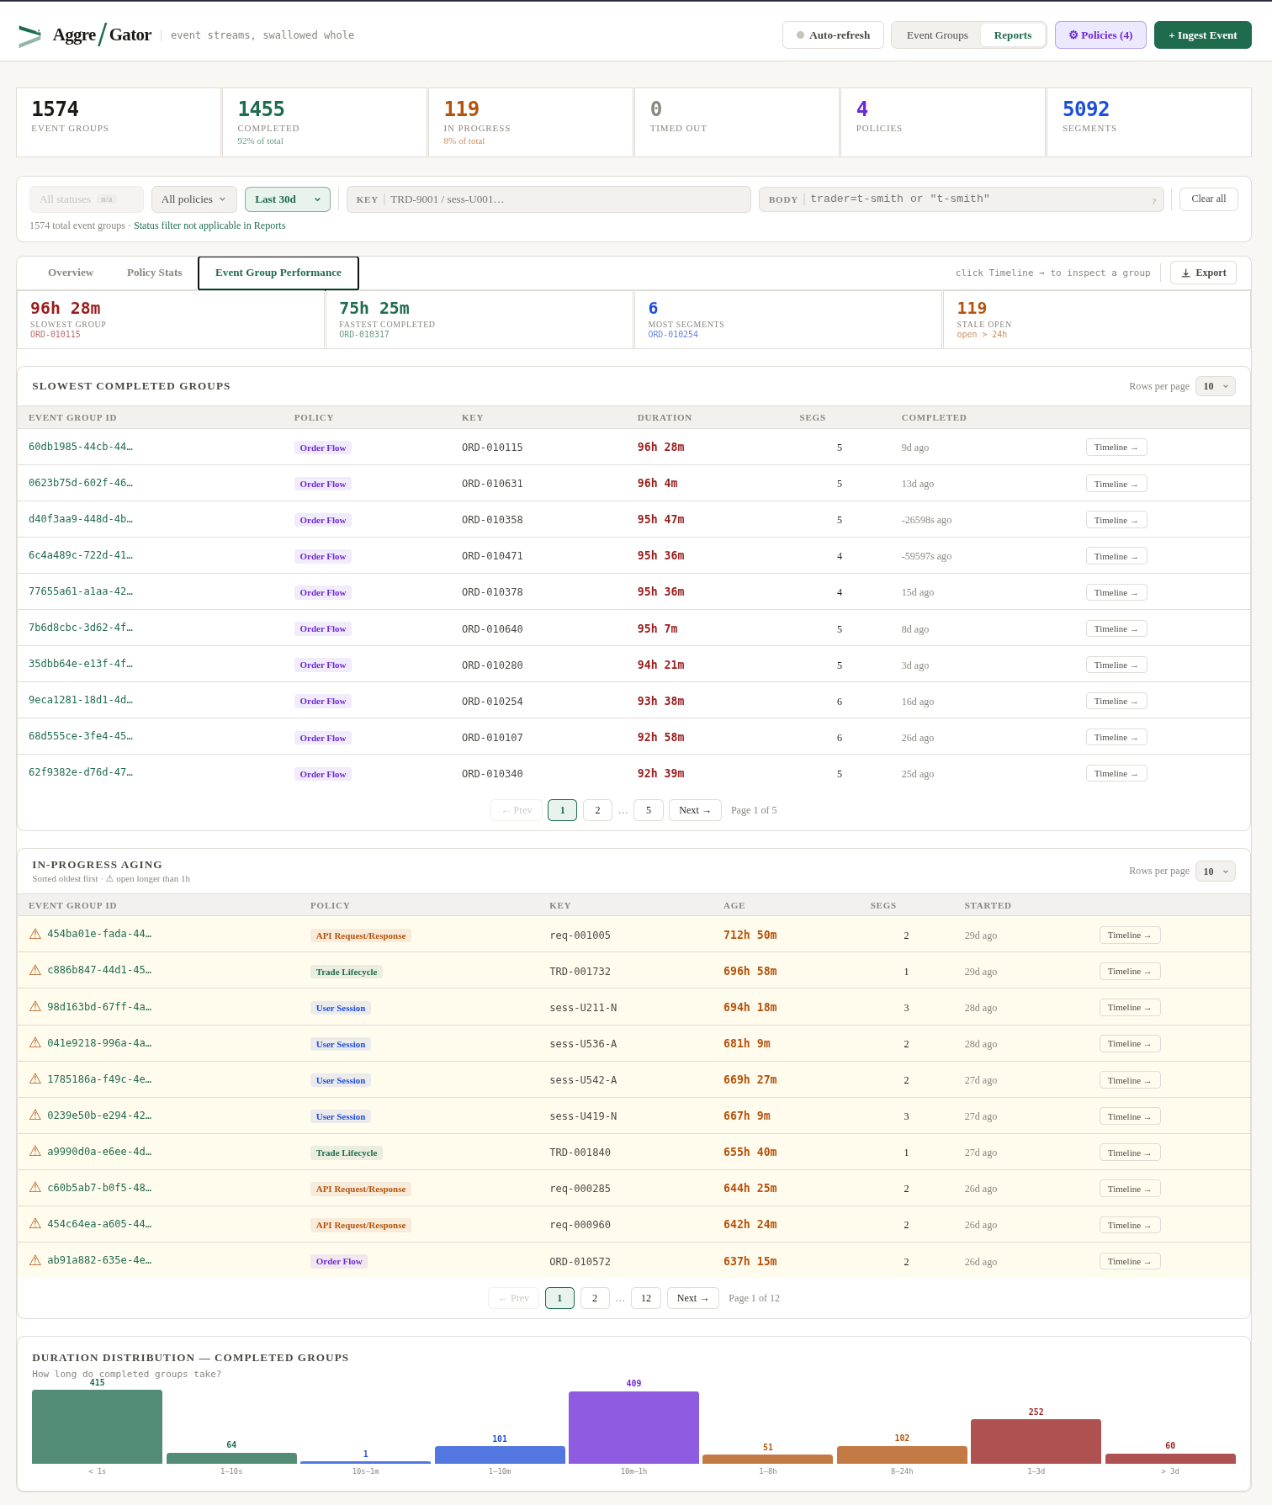
Event Group Performance
A7
Key Points
Summary stats bar shows slowest group, fastest completion, most segments, and stale-open count
Slowest Completed table is sorted by duration — click Timeline to drill into any group inline
In-Progress Aging table sorts oldest-first and flags groups open longer than 1 hour
Duration histogram buckets all completed groups from sub-second to multi-day at a glance
Fig. A5 — Event Group Performance

Slide 20
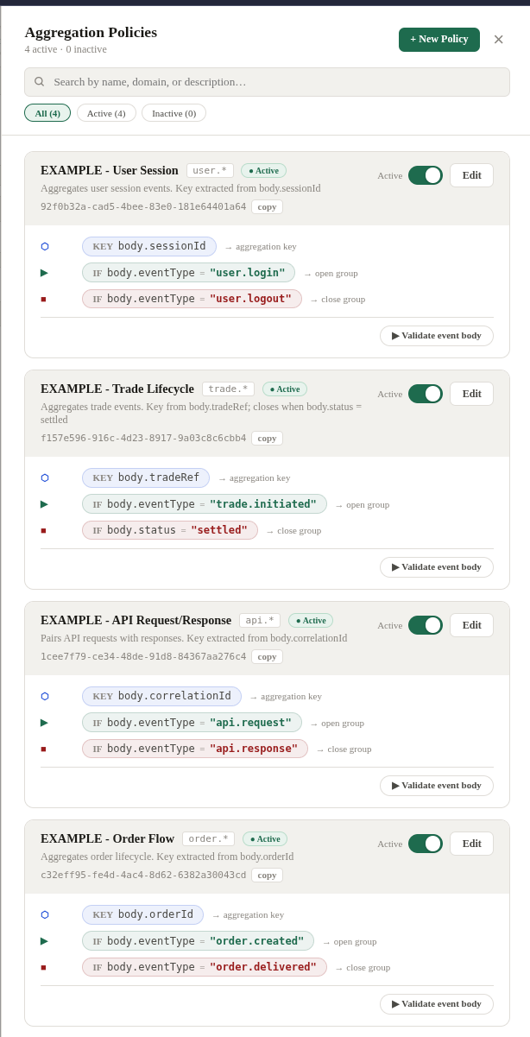
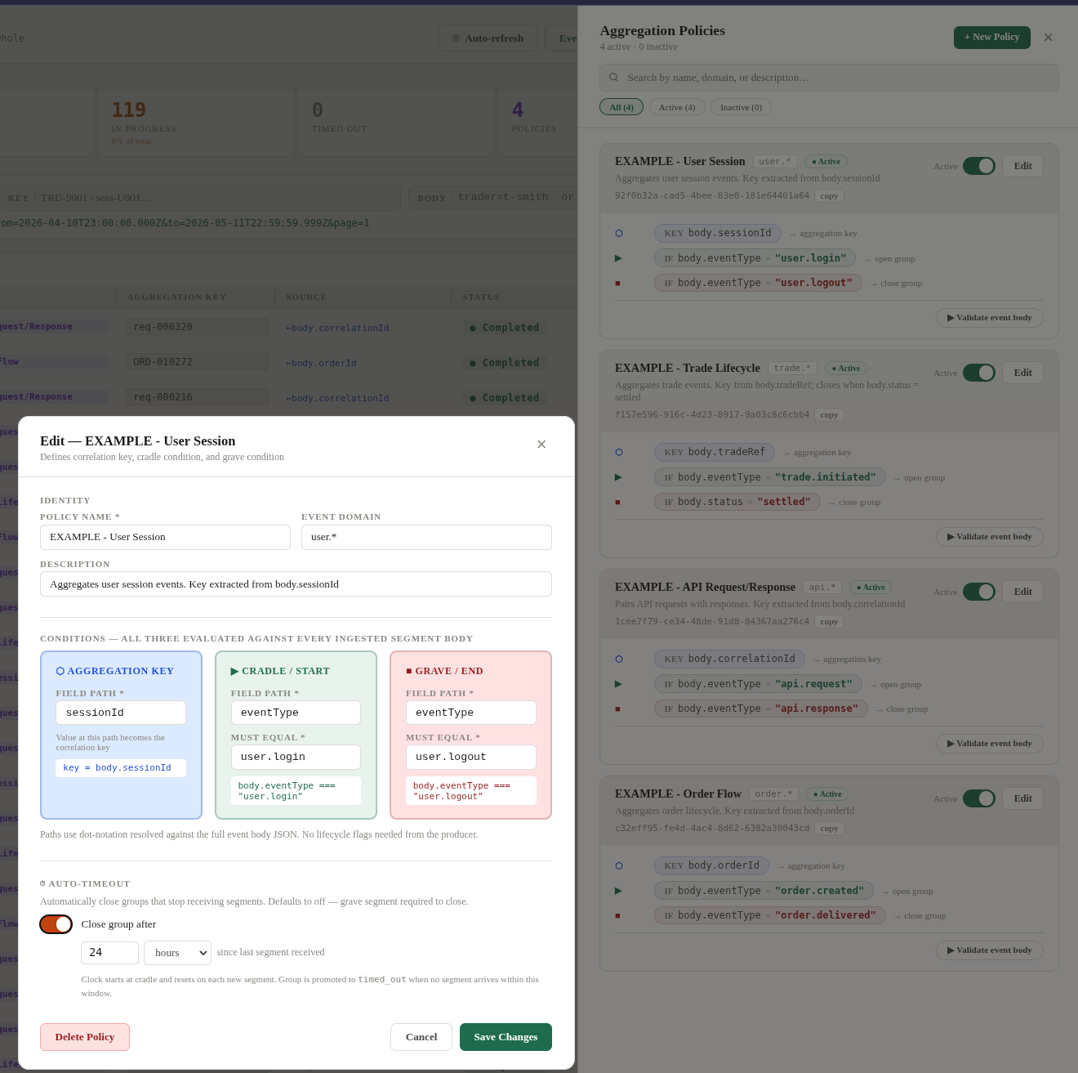
Policy Configuration
A8
Key Points
Each policy defines a key field (the grouping key), cradle condition (open) and grave condition (close)
Auto-Timeout toggle sets a per-policy window — groups with no grave after this period are auto-closed
Saving a timeout retroactively applies it: existing in-progress groups are swept and closed immediately
Policies can be activated/deactivated at runtime without restarting — changes take effect on the next ingest
Fig. A6 — Policy Configuration

Slide 21
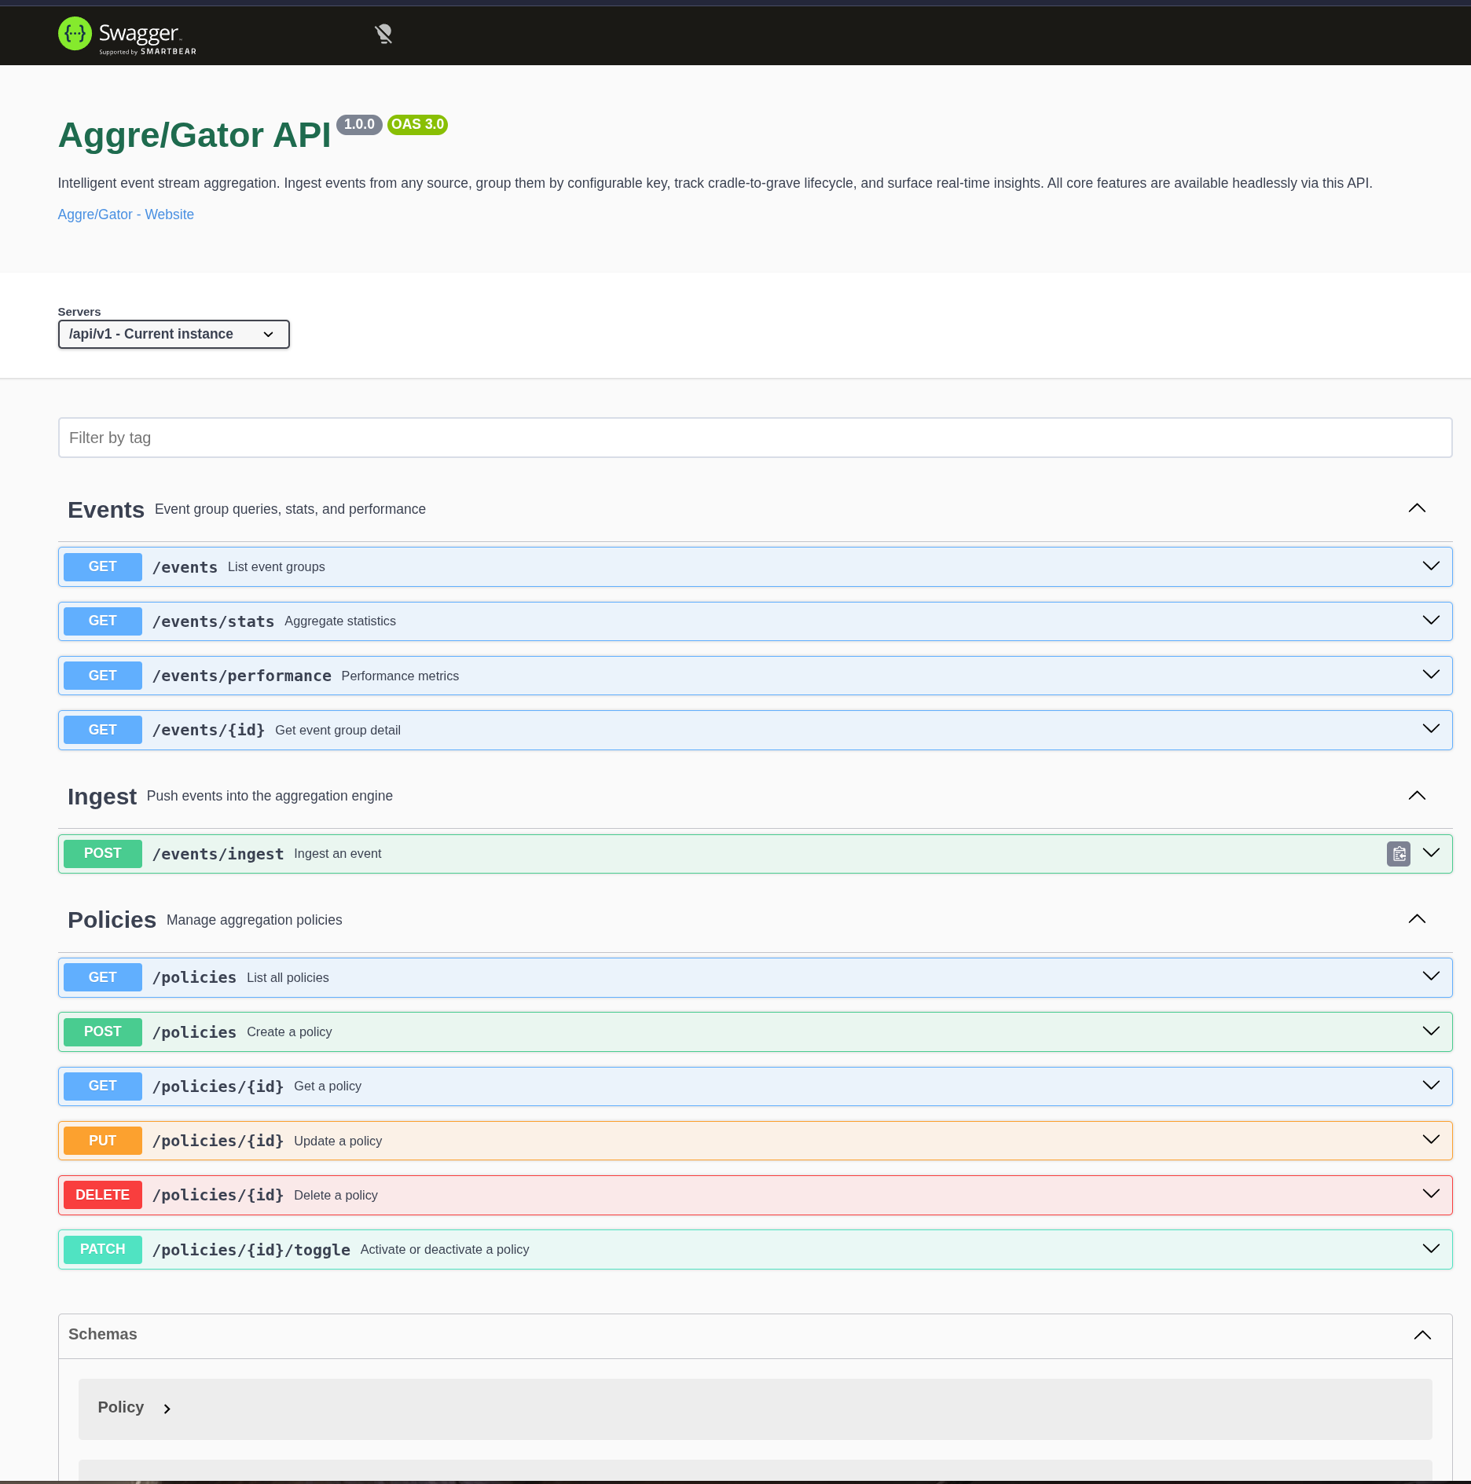
Self Hosted API Documentation
A8
Key Points
Self hosted swagger API documentation at <Sever>:<port>/api/v1/docs
Contains documentation and schema for all endpoints
Open API 3.0 compliant JSON exportable (works in postman etc)
Fig. A6 — Policy Configuration

Slide 22

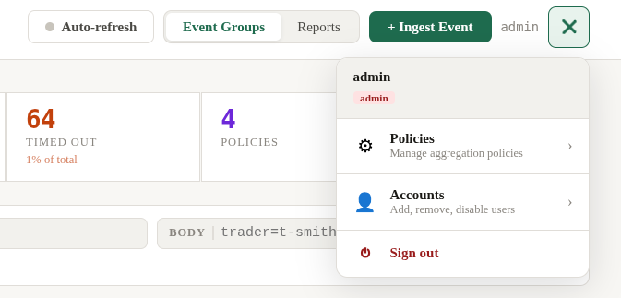
Wip Configuration Menus
A8
Key Points
“Burger” style menu item added for de-cluttering of UI / ease of configuration
Policies screen migrated to Menu
Accounts menu item and UI added
Fig. A6 — Policy Configuration

Slide 23
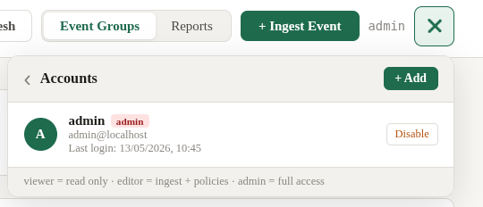
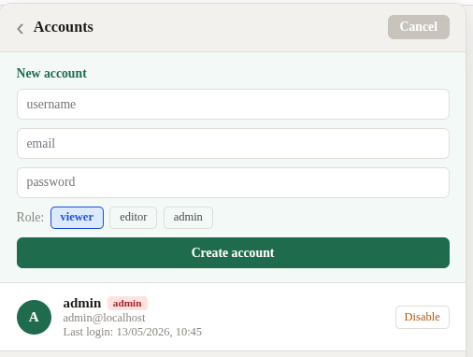
Wip Configuration Menus - Users
A8
Key Points
Manage UI accounts (Add,Disable,Remove)
Grant Roles (View,Edit,FullAdmin) – *API Read/API Write in Futures
Last Login host and datetime information
All accounts stored in database with password hashing
Fig. A6 — Policy Configuration

