Slide 1
THE FUTURE OF PRODUCT MARKETING
PART I · CHAPTER 1
The Old Playbook Is Dead
Pragmatic Remix: All 37 Boxes (Reframed)
Chris O'Hara & Dan Yu · futureofpmm.com · March 2026

Slide 2
THE STORY OF SARAH
Sometime in late 2024, a product marketer noticed something strange in her pipeline data...
1
2
3
Traffic Up, Forms Down
Prospects Knew Too Much
Deals Closed in 3 Weeks
More people visiting product pages, fewer downloading white papers
Showing up to calls knowing competitive pricing and technical limitations
Typical cycle was 11 weeks. Two enterprise deals closed in under 3.
What had changed: her buyers had started using AI agents to do the research, comparison shopping, and vendor pre-qualification that used to take human buying committees weeks.

Slide 3
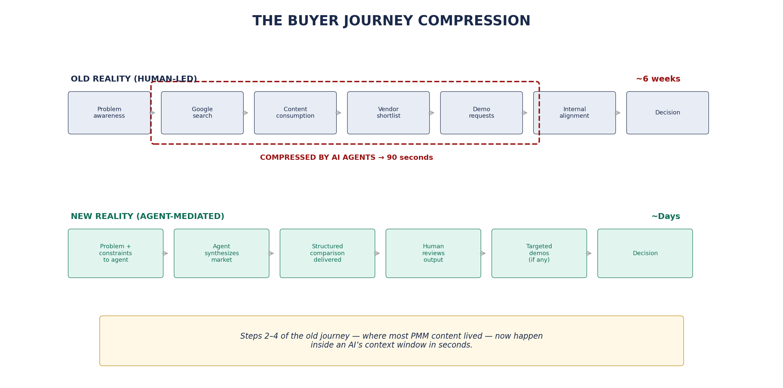
THE BUYER JOURNEY COMPRESSION
Figure 1: Steps 2–4 of the old journey — where most PMM content lived — now happen inside an AI's context window in seconds.

Slide 4
THE THREE ERAS OF ENTERPRISE DATA
ERA 1
ERA 2
ERA 3
Data Warehouse
Data Lake
Data Fabric
Age of Reports
Age of Unification
Age of Agents
ETL batch jobs. Static deliverables. Quarterly reviews. Slow data, slow marketing, slow buyers.
CDP era. Customer strategy. Journey mapping. Win/loss analysis. "A CDP knows your customer."
Agentic AI. Federated metadata. Agents that monitor, adjust, generate. "An AMP knows your business."
A DMP knew your audience. A CDP knew your customer. An AMP knows your business.

Slide 5
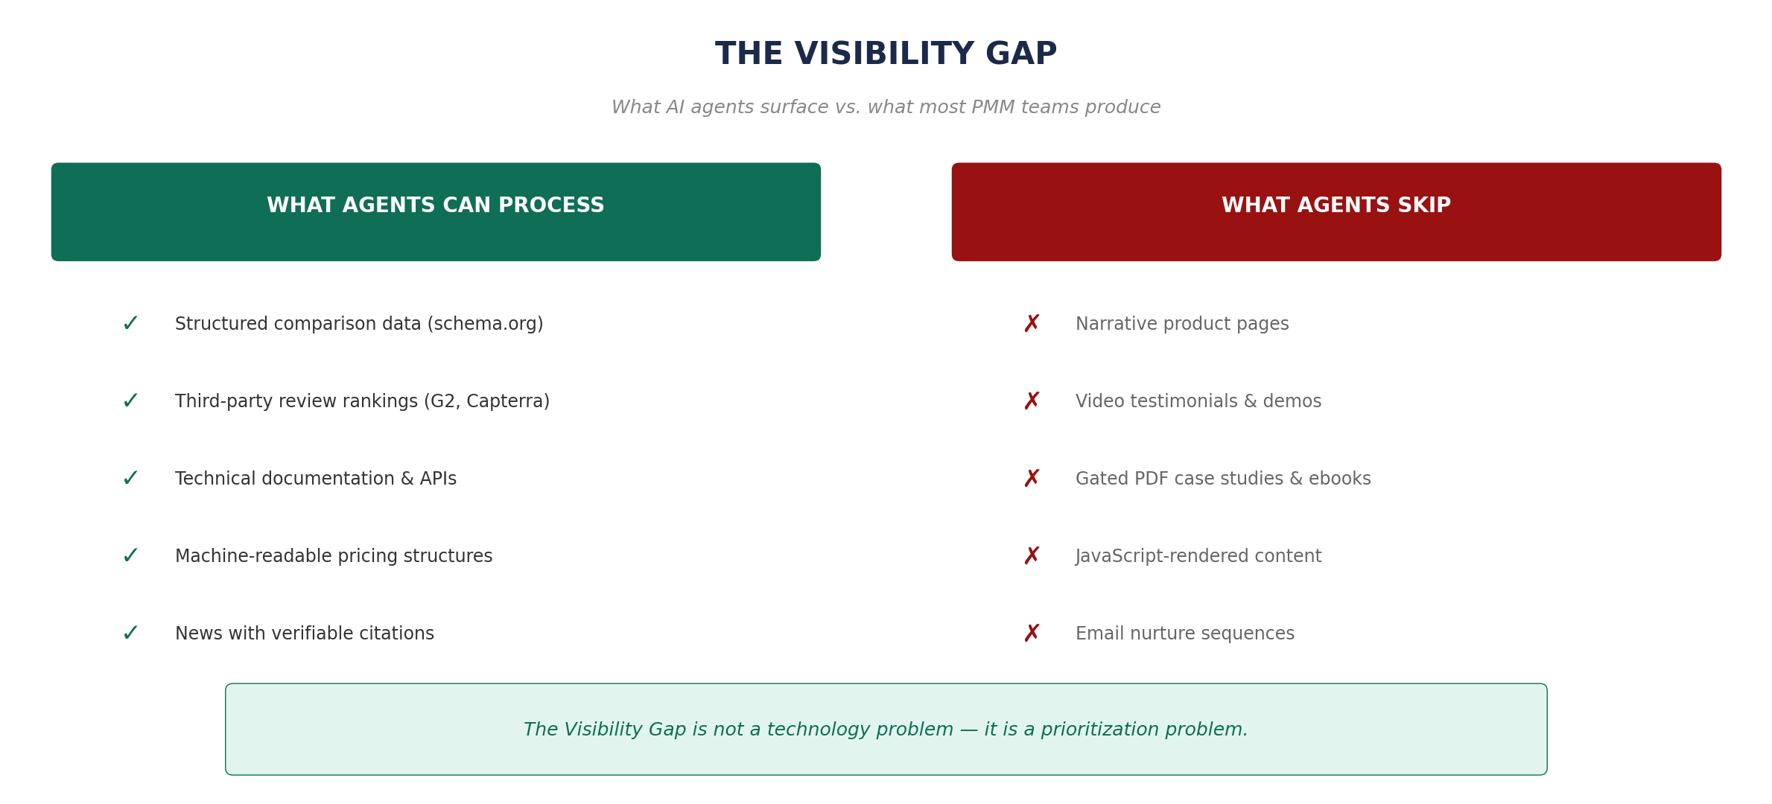
THE VISIBILITY GAP
Figure 2: The Visibility Gap is not a technology problem — it is a prioritization problem.

Slide 6
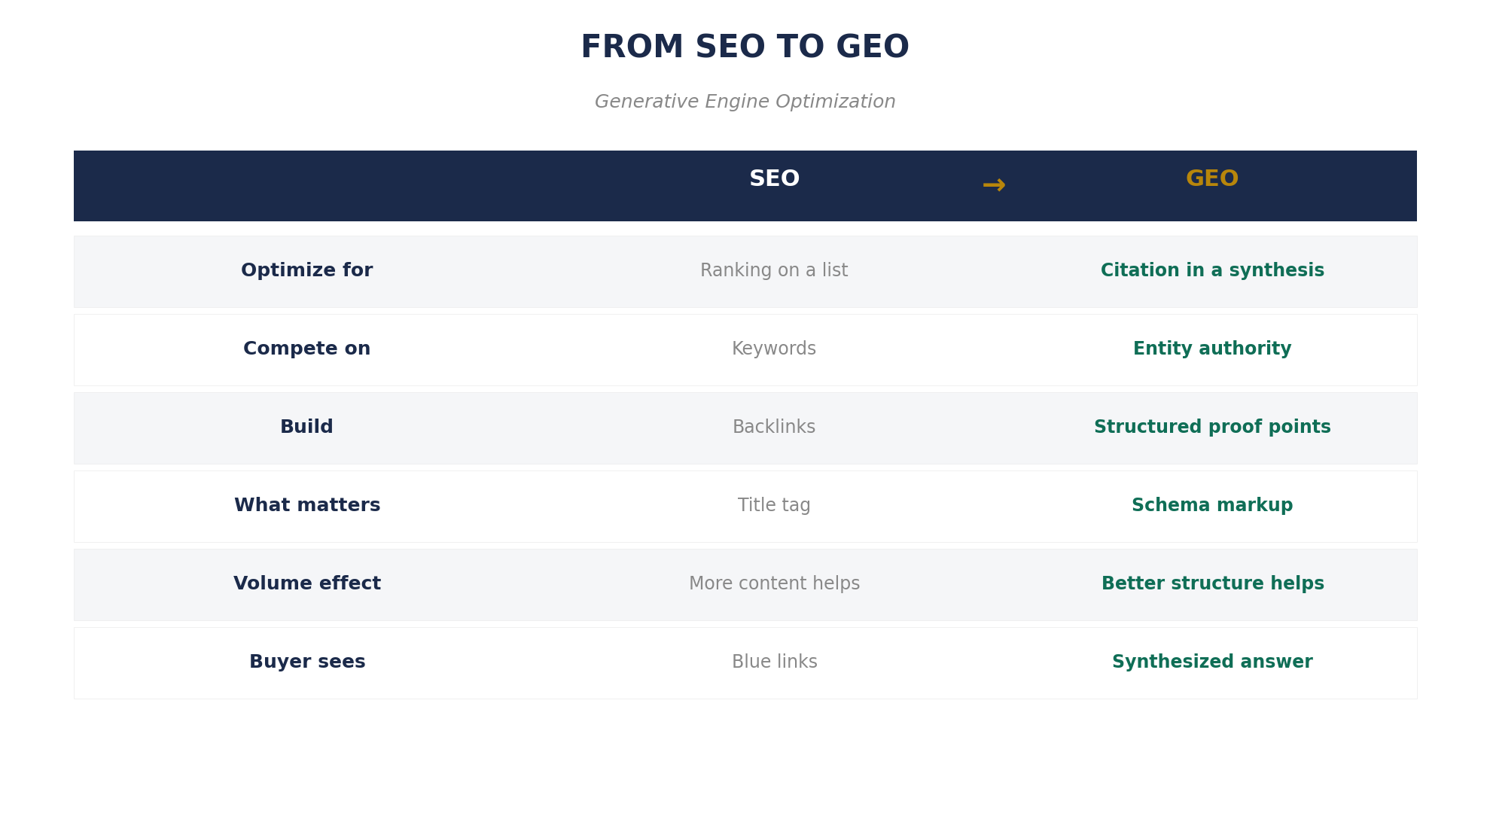
FROM SEO TO GEO
Generative Engine Optimization — the signals are fundamentally different.
The Audit (Do This Week)
Open Claude, ChatGPT, or Perplexity. Ask it to evaluate vendors in your category. See if your company appears. That 60-second exercise tells you more about your GEO readiness than any consultant's report.

Slide 7
THE PRAGMATIC FRAMEWORK MEETS THE MACHINE
37 boxes. Three clusters. One question: what happens when AI agents become part of the team?
CLUSTER 1
CLUSTER 2
CLUSTER 3
Automated
Augmented
Elevated
Market sizing, derivative content, event logistics, sales tools production. Agents do the majority today.
Positioning, win/loss analysis, buyer personas, pricing strategy. Human essential, agent accelerates.
Stakeholder management, customer empathy, thought leadership. Irreducibly human.
70% time savings on production. If your value is producing artifacts, the automation wave is not your friend.
Human-agent team is so much better that operating without agents becomes a competitive disadvantage.
These activities become MORE important precisely because machines can't do them. This is where careers are built.

Slide 8
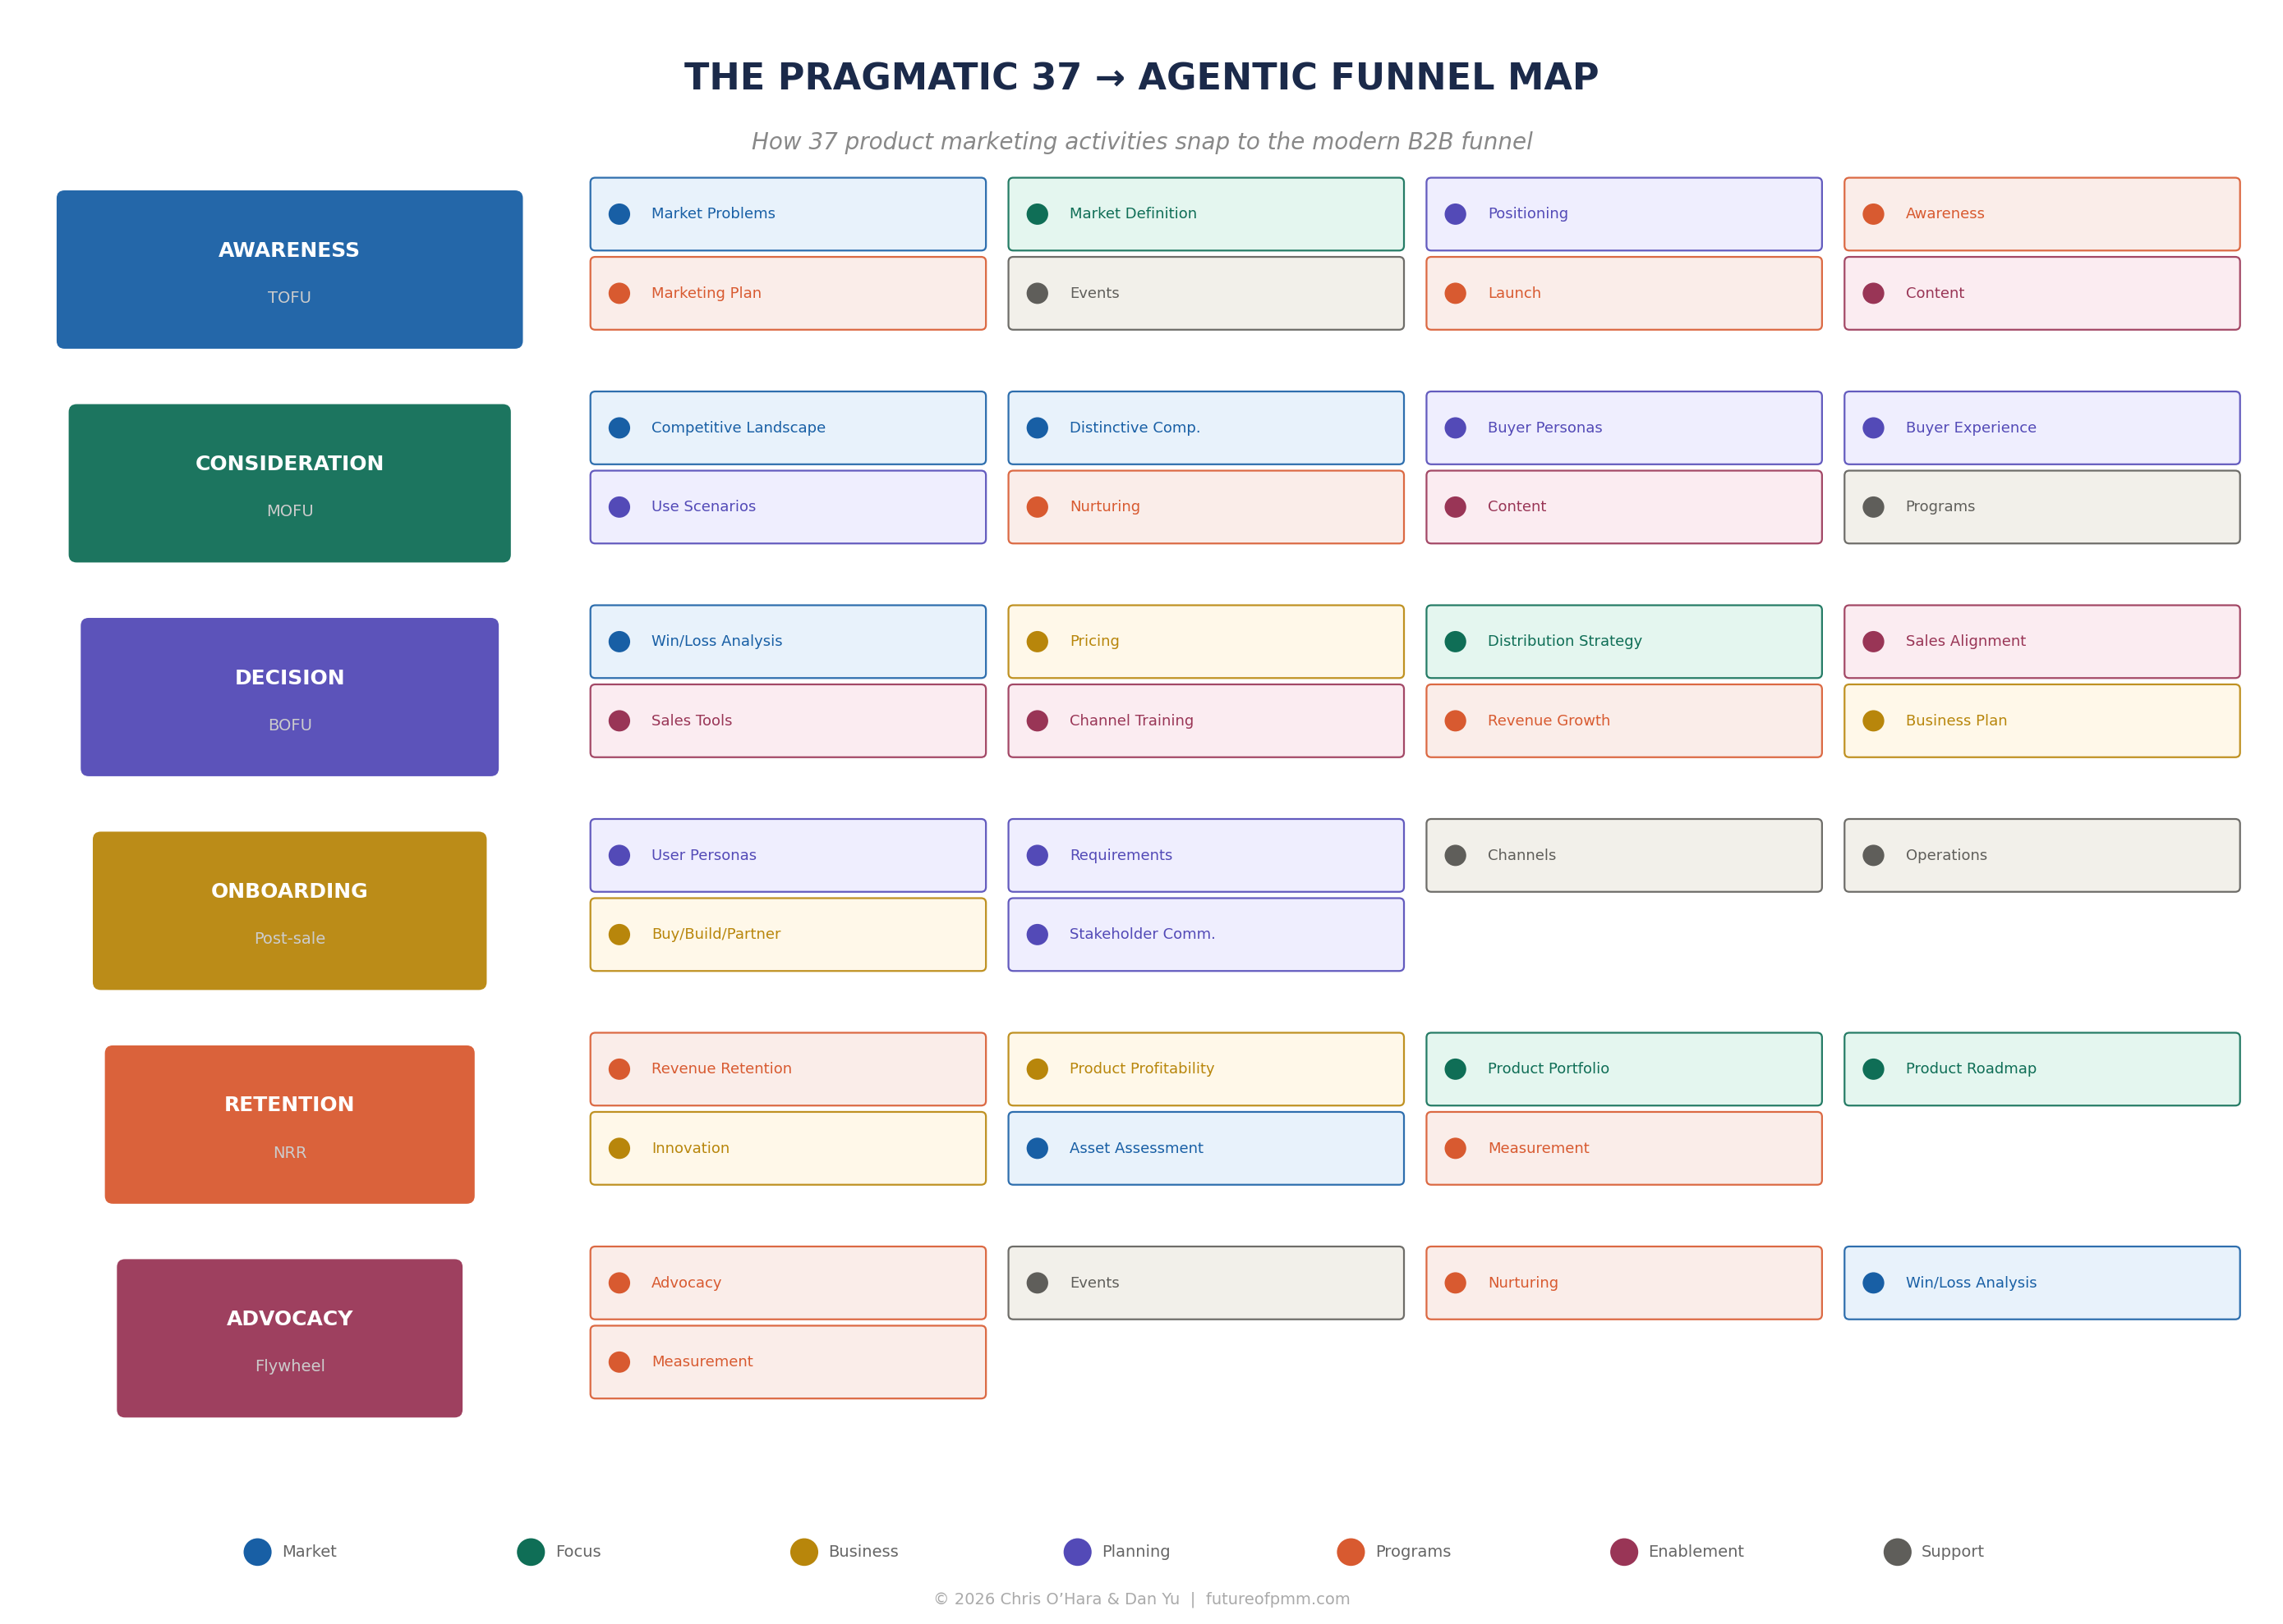
THE CURRICULUM ARCHITECTURE
Figure 4: The Pragmatic 37 → Agentic Funnel Map. All 37 activities mapped to the six-stage funnel, color-coded by Pragmatic category.

Slide 9
THE 10x THESIS
A PMM who automates 20 hours a week of Cluster One work and redirects that time into deeper competitive analysis, more thoughtful positioning, and genuine thought leadership is going to outperform a PMM who's still manually updating battlecards. Not by 20%. By a factor that justifies the title of this book.
What "10x yourself" actually means:
✗ NOT working ten times harder
✗ NOT working ten times faster
✓ Operating at a fundamentally different level of strategic impact
You've offloaded the mechanical work to machines built for it — and you're finally free to do the work that only a human can do.

Slide 10
CMO PERSPECTIVE
The conversation about AI inside marketing departments is almost entirely wrong. It's focused on efficiency — how to produce the same outputs with fewer people. That's a CFO question. The CMO question: how do we produce fundamentally different outputs?
KEY TAKEAWAYS
The agentic shift is a structural transformation, not just a toolkit upgrade
Buyer behavior has already changed — AI agents compress research from weeks to hours
Most PMM content is invisible to agents (the Visibility Gap)
The Pragmatic 37 cluster into: Automated, Augmented, Elevated
The PMM who frees Cluster One hours to invest in Cluster Three operates at a different level
futureofpmm.com · Chris O'Hara & Dan Yu · The Future of Product Marketing

