Slide 1


Slide 2
PowerShell for the Curious
ACCU Conference 2021
Chris Oldwood
Notes:
ACCU member for over 10 years, 25 years as a developer, almost exclusively on Windows, recently done 18 months of Linux.
I’ve used PowerShell since v1.0 and followed the Monad blog even before that.
Hence viewpoint presented here is that of a t-shaped developer – mainly compiled languages with a dash of analysis, admin, ops, etc.
Talk is in two parts with some history first then mostly practical to illustrate its features.

Slide 3
Why PowerShell?
Background material
Notes:
An introduction to PowerShell – what problem was it intended to solve?

Slide 4

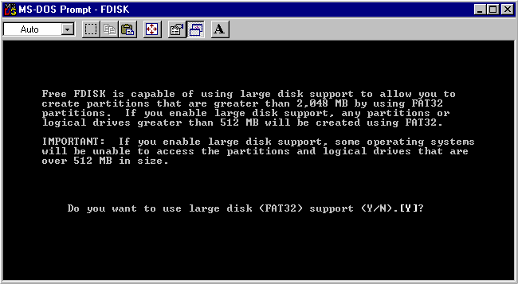
Scripting in the 1990s
https://tinyapps.org/system.html
https://blog-du-grouik.tinad.fr/public/vbscript.png
Notes:
Windows always had weak scripting support until 2000 – cmd.exe derived from DOS and the Active Scripting Engine (WSH).
Applications tended to bespoke, GUI oriented, and solve a specific problem.
WMIC – a shell for managing Windows via WMI (an OO based framework) showed a way forward.

Slide 5
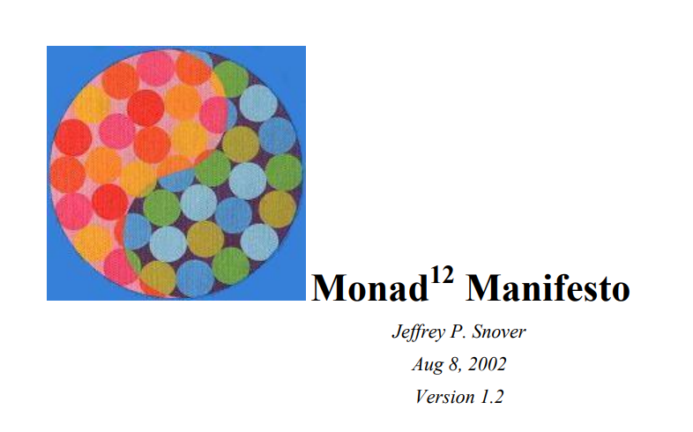
The Monad Manifesto
https://www.jsnover.com/Docs/MonadManifesto.pdf
Notes:
Where it all started – a document describing it’s vision.
Only 16 pages long but covers many different aspects.
The Monad Shell is just one part of the entire ecosystem which encompasses remoting, models, etc.
At PDC October 2003 Monad, then Microsoft Shell.

Slide 6
Target Audience
“Monad leverages the .NET Common Runtime to provide a powerful, consistent, intuitive, extensible and useful set of tools that drive down costs of administration and make the life of non-programmers a lot easier.“
“The goal is that UNIX admins working with Windows will find it easy to learn and migrate their skills to MSH."

Slide 7
Less Boilerplate Code
“Much of the effort is spent rewriting the same functions over and over again by different people in different ways.”
Parse, validate, and encode user input
Document usage
Log activity
Format data, output results and report errors
Operate on remote nodes or sets of remote nodes

Slide 8
Traffic in Objects, not Text
"While the basic model is extremely powerful, its intrinsic flaw is the tight binding of these operations and the use of unstructured text for integration. This requires clumsy, lossy, imprecise text manipulation utilities."

Slide 9

Powered by .Net
https://neosmart.net/blog/wp-content/uploads/2019/06/original-dot-net-logo.gif

Slide 10
Version History
1st Monad Outing October 2003
1st Public Beta June 2005
PowerShell 1.0 November 2006
PowerShell 2.0 October 2009
PowerShell 3.0 September 2012
PowerShell 4.0 October 2013
PowerShell 5.0 February 2016
PowerShell 5.1 January 2017
---
PowerShell Core 6.0 January 2018
PowerShell Core 6.1 September 2018
PowerShell Core 7.0 March 2020
PowerShell Core 7.1 November 2020
PowerShell Core 7.2 (in preview)
Notes:
Exchange and SQL Server ~2007 first to get makeover
Went cross-platform as PowerShell Core on August 2016
PowerShell 7.0 finally takes over from PowerShell 5.1 on Windows

Slide 11
Core -- Supported Platforms
Windows 8.1, and 10
Windows Server 2012, 2012 R2, 2016, and 2019
macOS 10.13+
Red Hat Enterprise Linux (RHEL) / CentOS 7
Fedora 30+
Debian 9+
Ubuntu LTS 16.04+
Alpine Linux 3.8+
Arch
Kali
Raspbian

Slide 12
Tooling
PowerShell REPL
PowerShell ISE
Visual Studio / VS Code
PSScriptAnalyzer
Pester
PSReadLine
Psake
PowerShell Gallery / OneGet
...

Slide 13
The Language
Features by example

Slide 14
Language Basics
Primitive types
Collections
Objects
Type accelerators
$null
.Net methods

Slide 15
Operators
-split
-replace
-match
-like
-join
-f

Slide 16
Cmdlets
Naming conventions
Common verbs
Aliases
Arguments

Slide 17
Functions
Structure
Return values
Parameters
Filters

Slide 18
Pipelines
Objects
Filtering
Projecting
Grouping
Output

Slide 19
Error Handling
(Non-) Terminating Errors
-ErrorAction
$ErrorActionPreference
Trap
Try / Catch / Finally

Slide 20
Scripting
Documentation
Parameters
Safe defaults

Slide 21
Epilogue
Closing remarks

Slide 22
Common Gotchas
Empty sequences are $null not [ ]
Arguments only in () for method calls
Use “& { ... }” to also execute a ScriptBlock
Native tool errors only set $? and $LastExitCode
HashTables need GetEnumerator()
Environment variables from .bat not preserved
Out-File (aka >) writes UTF-16 files by default

Slide 23
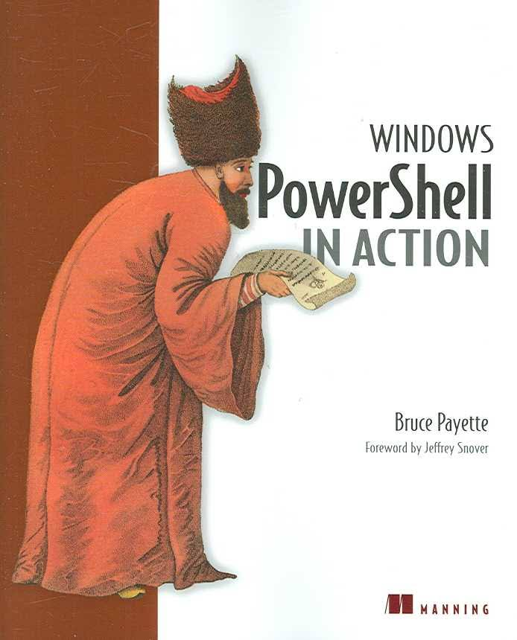

Books

Slide 24
exit 0
Blog:
http://chrisoldwood.blogspot.co.uk
Articles:
http://chrisoldwood.com/articles.htm

