Slide 1
Shipshape and Bristol Fashion
ACCU Early Careers Day 2023
Chris Oldwood
Notes:
Short explanation about the etymology of the term and how that relates to publishing changes.
Going from “works on my machine” to “works on every machine”, assuming we know what “work” even means. (Agile Manifesto.)

Slide 2
“Code Complete”
Done
Done, Done
Shipped
Implement
Validate
Deploy
Monitor
Notes:
Don’t think that once the code is written that’s the end of it – old skool thinking – there’s still lots to do.
Code complete only means “works on my machine” there are still many potential sources of feedback that might need addressing.

Slide 3

Feature Demo
https://miro.medium.com/max/500/1*G_WKPGdh5mIUHS-Cf4aXtA.jpeg
Notes:
Build the right thing vs build the thing right – early feedback from the customer.
Cite Capers-Jones?

Slide 4
Repeatable Build
Clean the workspace
Compile the code from scratch
Run all the tests
Build the deployment package
Deploy the package locally
Notes:
Before passing it on prove we can reproduce the build / artefacts / tests to avoid blocking the delivery pipeline.
(Aside about Trunk Based Development and Merge Debt.)

Slide 5
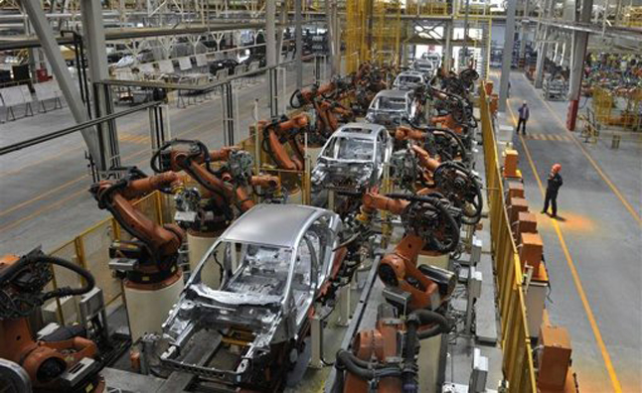
Automation
http://trendingchannel.com/wp-content/uploads/2013/01/China-car-production.jpg
Notes:
Automation is a key enabler to a fast flowing pipeline.
It should be simple to reproduce locally what the delivery pipeline runs so you can be confident and debug it.

Slide 6
Review Changes
Revert unintentional changes
Ensure correlated files are changed
Diff every changed file
Check the diff makes sense
Split-up unrelated changes
Notes:
My commit checklist.

Slide 7
Integrate
Resolve conflicts
Re-build and re-test

Slide 8

Continuous Sharing
https://upload.wikimedia.org/wikipedia/.../1280px-A_Sunday_on_La_Grande_Jatte,_Georges_Seurat,_1884.png

Slide 9
Document
Summarise in one-line
Add any further details
Link to issue tracker

Slide 10
Publish
Push the changes
Deploy them
Monitor for breaks

Slide 11
Bon voyage
Blog:
http://chrisoldwood.blogspot.co.uk
Articles:
http://chrisoldwood.com/articles.htm

