Slide 1
The Art of Code
Chris Oldwood
Software Crafters Meetup 2024
@chrisoldwood / gort@cix.co.uk

Slide 2
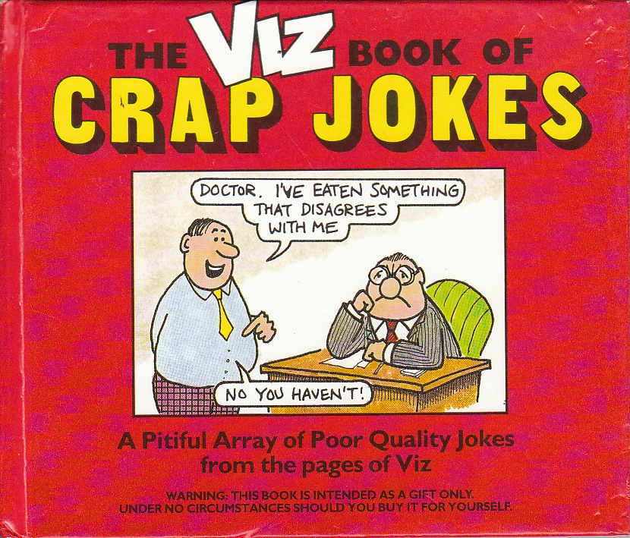
Notes:
One of only two books I carry about – the other is the O-Reilly regular expressions pocket reference.
Used to lighten the mood after ploughing through incomprehensible code.

Slide 3
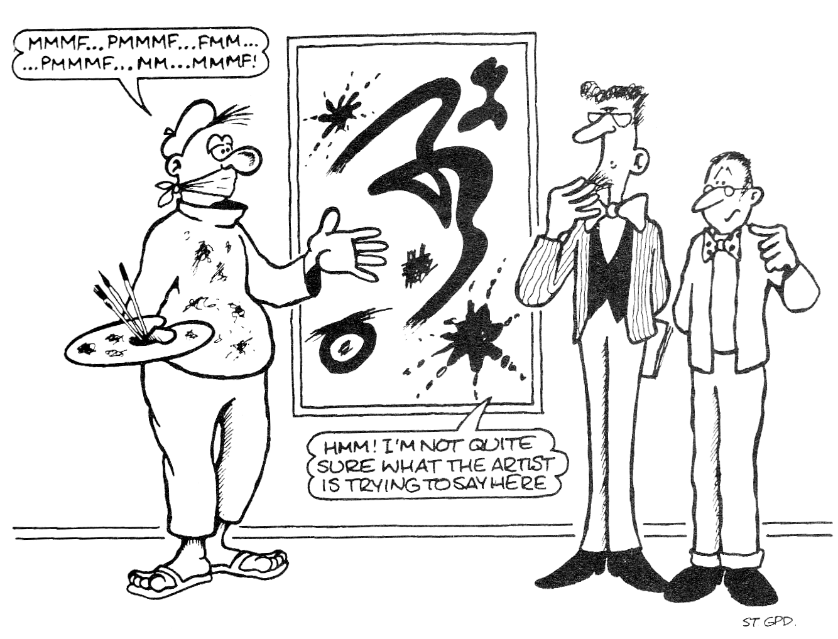
“Hmm! I’m not quite sure what the artist is trying to say here”
Notes:
Substitute “programmer” for “artist”.
Beautiful code is normally about beauty in its structure.
This talk (attempts) to fuse the pun-style titles of modern art with anti-pattern code snippets.

Slide 4
“Programs must be written for people to read, and only incidentally for machines to execute”
-- Hal Abelson
Notes:
Being able to reason about code is key to making changes safely.

Slide 5
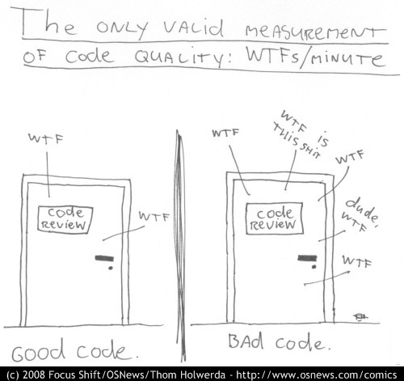
Code Quality: WTF’s / Minute
Notes:
WTF’s per minute

Slide 6
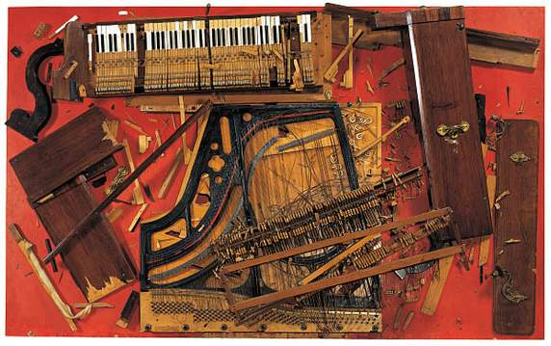
Chopin’s Waterloo
Notes:
Modern art example

Slide 7
The Gallery

Slide 8

No Comment
// Increment value.
value++;
Notes:
Is there any problem domain where a comment might be necessary?

Slide 9
Brace Yourself
if (x == 1) {
if (y == 2)
{
if (z == 3)
{
do_something(x, y, z);
}
}
}
Notes:
Train and maintain a consistent style.
Aim for low cyclomatic complexity.

Slide 10
Inversion of Control
// Automatically generated
// code.
//
// DO NOT EDIT!
Notes:
Don’t let your tools own you.

Slide 11
Cast Away
Man survivor("Tom Hanks");
Island& desertIsland =
reinterpret_cast<Island&>
(survivor);
Notes:
Programming in isolation often leads to unreadable code as there is only one viewpoint.

Slide 12
Pure Garbage
public sealed class Litter
{
public bool IsRecyclable
{
get { return true; }
}
}
Notes:
Don’t do at runtime what you can do at compile time.

Slide 13
The Missing LINQ
var names=new List<string>();
for (int i=0; i!=length; i+=1)
{
string name = customers[i];
names.Add(name);
}
Notes:
Multi-paradigm languages and solutions (i.e. both the OO and Functional styles) are the modern way of programming.

Slide 14
On Reflection
using DependencyInjection;
DI.Container
.RegisterType<Mirror>()
.As
.InstanceOf<IMirror>()
.SingleInstance;
Notes:
Why not just use new?

Slide 15
Logic Bomb
==
Notes:
Equality comparisons in dynamic languages like JavaScript are an accident waiting to happen.

Slide 16
Tabs or Spaces?
Notes:
Herb Sutter Exceptional C++ item 1 – Don’t Sweat the Small Stuff.

Slide 17
Exit Through the Gift Shop
Blog:
http://chrisoldwood.blogspot.com
@chrisoldwood / gort@cix.co.uk
Notes:
No books, just a blog

