Slide 1
A Test of Strength
Nor(Dev):Con 2019
Chris Oldwood
Notes:
I’m a freelance developer working with “enterprise grade” technology.
This is a talk about both the mechanics and psychology of writing good tests.

Slide 2
The Wrong Goal
Optimising for writing
Notes:
An expedited walk through my journey and where I went wrong.
In some senses it’s a Rite of Passage, you may still need to go through it – I can only show you my path.

Slide 3

Tests That Fit in Your Head
https://flic.kr/p/kLgf7V
Notes:
Started out with simpler programs that can (and had to) be manually tested (GUIs).
The test scenarios were fairly small and focused on the feature so regressions were handled by QA.

Slide 4
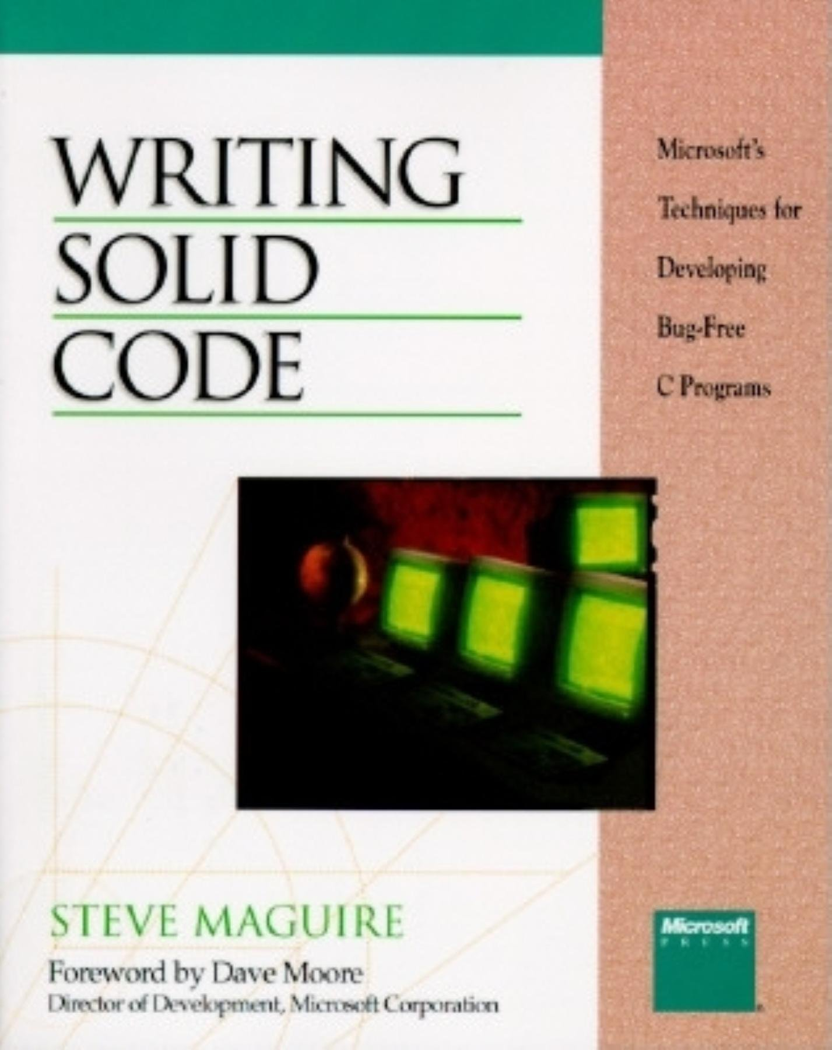
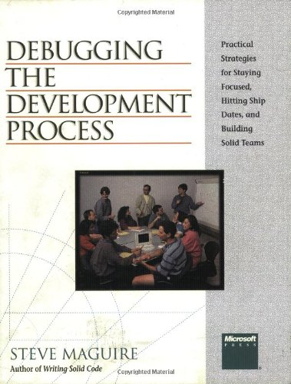
https://www.amazon.com/Steve-Maguire/e/B00DP4BEB2
Notes:
“Unit testing” accomplished by using Steve Maguire's (Writing Solid Code) advice about stepping through the code with a debugger.
Ask yourself 2 questions – How could I have prevented this bug and how could I have automatically detected this bug?
Positive effects on design as it meant you needed to be able to easily get into the debugger in the first place (i.e. test harnesses).

Slide 5
A Watershed Moment
Node ParseXmlNode()
{
- return ToNode(ReadTag());
+ return ToNode(Decode(ReadTag()));
Notes:
Worked this way for nearly a decade and it seemed to work pretty well, by comparison.
Slip-up caused by refactoring not found by manual testing.
Bug found by unrelated, new automated tests that started failing.

Slide 6
class MoneyTest : public CppUnit::TestFixture
{
CPPUNIT_TEST_SUITE( MoneyTest );
...
CPPUNIT_TEST( testAdd );
...
CPPUNIT_TEST_SUITE_END();
};
void MoneyTest::testAdd()
{
const Money money12FF( 12, "FF" );
const Money expectedMoney( 135, "FF" );
Money money( 123, "FF" );
money += money12FF;
CPPUNIT_ASSERT( expectedMoney == money );
CPPUNIT_ASSERT( &money == &(money += money12FF) );
}
Notes:
I was now sold on the idea of automated unit tests, at least, for catching regressions.
But I still had many reservations about the tool and technique – time required for writing tests, not paid too write tests, short term loss of productivity, etc.

Slide 7
{
Core::CmdLineParser oParser(s_aoSwitches, s_aoSwitches+s_nCount);
TEST_TRUE(oParser.GetNamedArgs().empty() && oParser.GetUnnamedArgs().empty());
static tchar* argv[] = { TXT("program.exe"), TXT("-short"), TXT("/short"),
TXT("--long"), TXT("/long"), TXT("-b"), TXT("--both"),
TXT("/both"), TXT("unnamed") };
static int argc = ARRAY_SIZE(argv);
oParser.Parse(argc, argv);
TEST_TRUE(oParser.GetNamedArgs().size() == 3);
TEST_TRUE(oParser.GetUnnamedArgs().size() == 1);
TEST_TRUE(oParser.IsSwitchSet(SHORT_ONLY) && oParser.IsSwitchSet(LONG_ONLY)
&& oParser.IsSwitchSet(SHORT_LONG));
TEST_TRUE(!oParser.IsSwitchSet(FLAG));
static tchar* argv2[] = { TXT("program.exe") };
static int argc2 = ARRAY_SIZE(argv2);
oParser.Parse(argc2, argv2);
TEST_TRUE(oParser.GetNamedArgs().empty() && oParser.GetUnnamedArgs().empty());
}
Notes:
This is a test I wrote for a C++ based command line parser.
What do you think it tests? Note the test (function) name is not missing – the framework allows you to elide it by using scopes instead!
I thought I was being clever and more productive by not being verbose.

Slide 8
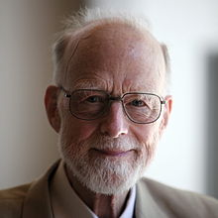
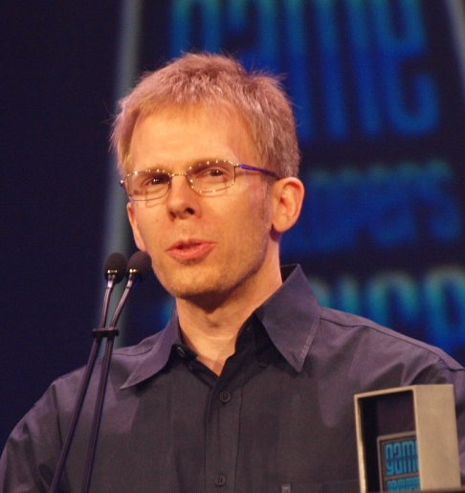
https://en.wikipedia.org/wiki/Tony_Hoare
“Premature optimization is the root of all evil.” -- Tony Hoare
“You can prematurely optimize maintainability, flexibility, security, and robustness just like you can performance.” -- John Carmack
https://en.wikipedia.org/wiki/John_Carmack
Notes:
Premature optimisation does not just relate to software performance, you can prematurely optimise other endeavours too.
In this case I thought I could optimise the process of writing tests by leaving out all the tricky boiler-plate stuff, like the name.

Slide 9
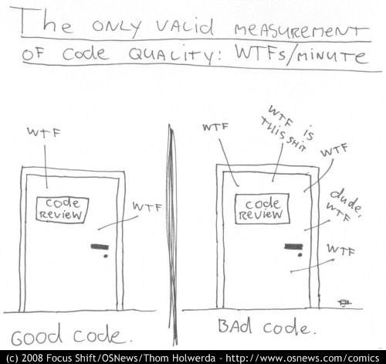
WTFs (Weak Test Functions)
http://www.osnews.com/story/19266/WTFs_m
Notes:
Yes it’s a backronym ☺.

Slide 10
Common Smells of WTFs
Multiple responsibilities
No clear intent
Noise from incidental details
Observing using side-effects
Under or overly prescriptive
Non-deterministic
Unmanaged resources

Slide 11
Towards a Better Goal
Playing the long game

Slide 12
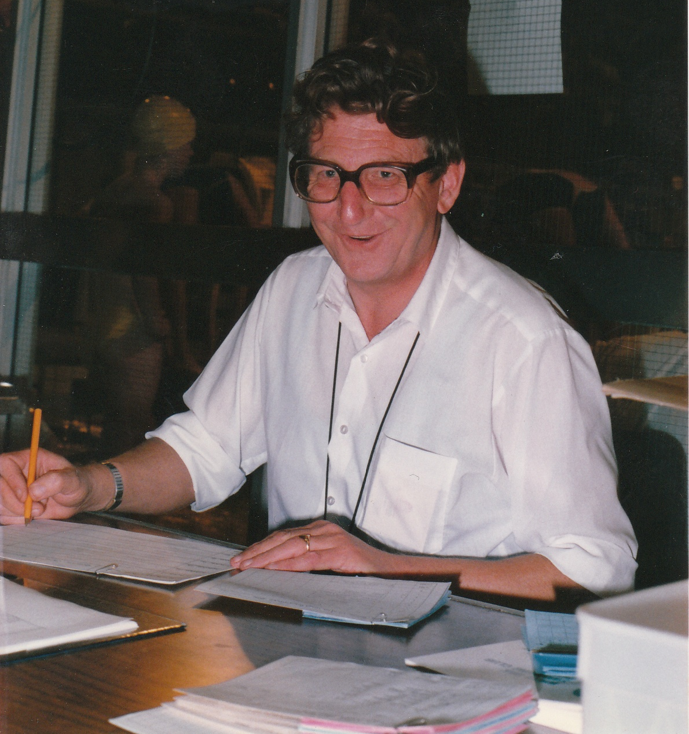
Essential Redundancy
Notes:
My dad who was a bookkeeper and taught me to use different techniques to verify my answers.
Naturally I didn’t listen and tried to skip over the boring stuff to get to more fun things.

Slide 13
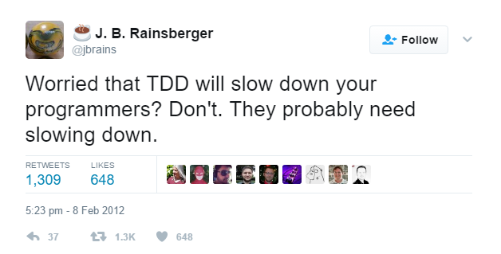
https://twitter.com/jbrains/status/167297606698008576
Notes:
If he’d been a programmer this is what he’d probably have said.

Slide 14
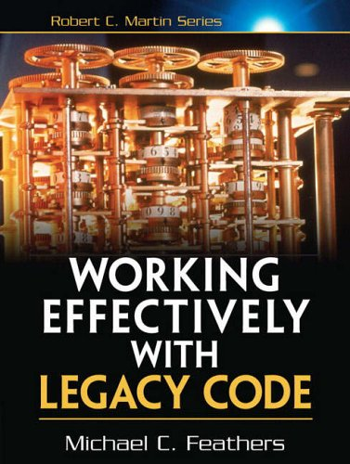
https://www.amazon.co.uk/Working-Effectively-Legacy-Michael-Feathers/dp/0131177052
Notes:
This book finally spoke to me as my life was legacy code, not green-field development.

Slide 15

Design for Testability
https://flic.kr/p/aXBw2i
Notes:
Term comes from the hardware world.
One example is adding a mockable Clock purely so you can write deterministic tests.

Slide 16
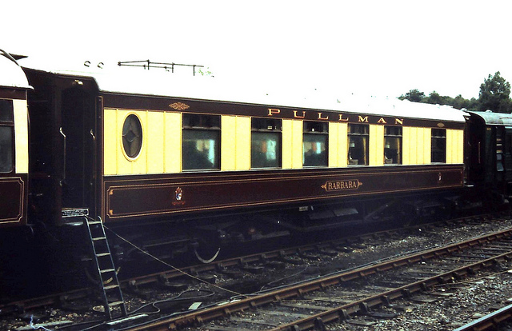
First Class Citizens
https://flic.kr/p/iHwQGJ
Notes:
Tests need as much TLC as production code, they are not an afterthought they are instrumental to delivery.

Slide 17
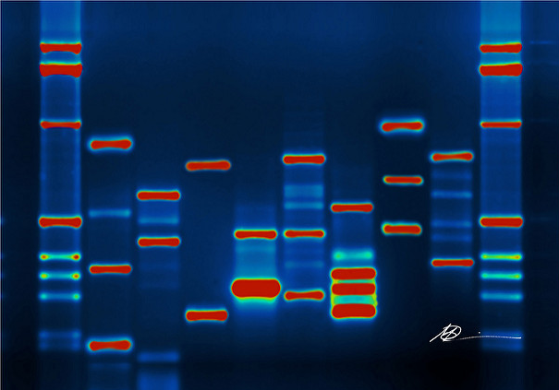
Mutation Testing
https://flic.kr/p/5Gc5h4
Notes:
How do you test the tests?
When you’re not sure what coverage there is you can manually break the code and see how it fails.

Slide 18
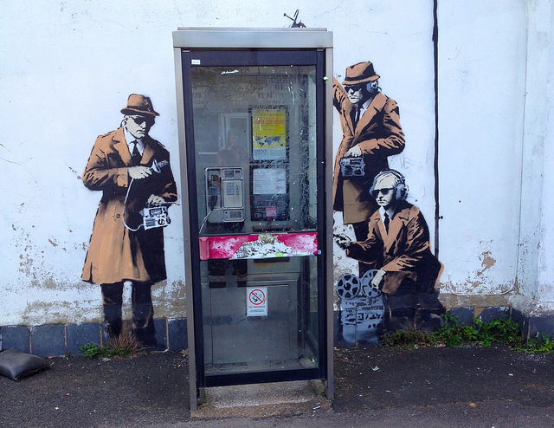
Behaviours, Not Methods
https://flic.kr/p/n6miW6
Notes:
Test behaviours, not methods – how do you test a ctor?
Property based testing puts the emphasis on this rather than canned examples.

Slide 19
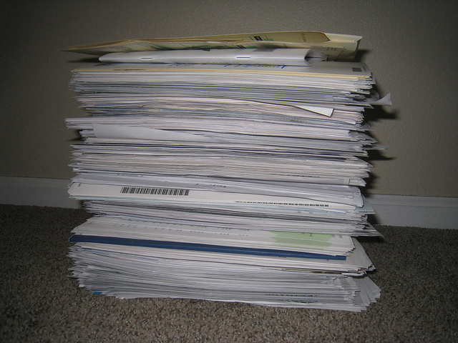
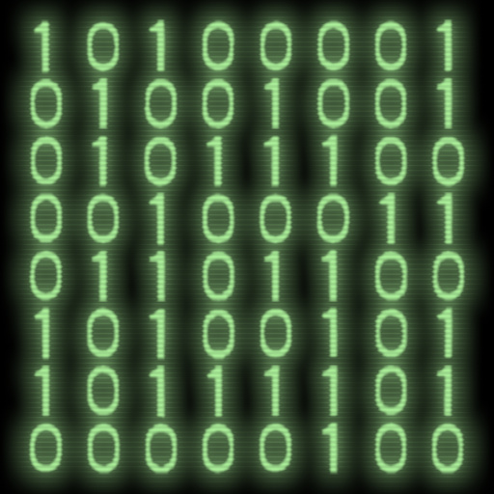
Executable Specifications
https://flic.kr/p/eaQywa
https://flic.kr/p/rzVfcR
Notes:
Replace the swathes of stale, fragmented documentation with the same intent, but in code.
Introduces some overall structure instead of just being an ad-hoc set of test cases.

Slide 20
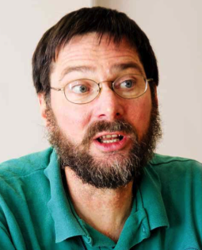
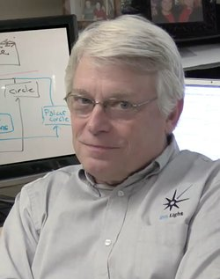
Lack of Consensus
http://blog.jayway.com/wp-content/uploads/2009/05/Picture-883.png
https://images-na.ssl-images-amazon.com/images/I/61b7VTCUEfL._UX250_.jpg
Notes:
Even some of the big names disagree about what approach works best.

Slide 21
The Testing Polygon
Customer Tests
Programmer Tests
Notes:
Is it a testing “pyramid” or just some other kind of “polygon”?
Monoliths and micro-services may have different balances due to smaller scope.

Slide 22
Keeping the Faith
#include <the_world>
Notes:
A short tale about having the courage to try and unit test a small change in a very old codebase.

Slide 23
In Practice
Writing stronger tests

Slide 24
“Naming is hard. Really hard. You just won’t believe how vastly, hugely, mind-bogglingly hard it is.” -- Adam Douglas
Notes:
Probably the most important aspect of writing strong tests is being concise about the behaviour.
Struggling to write the test name is a smell that I’m not sure what I’m supposed to be doing.
When I write code first I’m saying to myself “I don’t know what I’m doing so I’ll just make something up” – that’s not focusing on the problem.

Slide 25
Struggling to name a test is a sign that you don’t know what you’re doing. Listen to that feedback.

Slide 26
Break The Rules
Notes:
Tests don’t have the same rules as production code, they serve a different purpose.
Introduce structure to break up repetition in the scenarios.

Slide 27
public class client_automatically_reconnects
{
public class given_the_service_is_already_running
{
. . .
}
public class when_the_connection_is_lost : given_...
{
public void then_it_logs_a_disconnect_event()
{
. . .
}
public void then_it_reconnects_in_the_background()
{
. . .
}
}
}

Slide 28
public static class client_automatically_reconnects
{
public static class so_the_service_is_happily_running
{
public static void then_the_connection_is_lost()
{
"so it logs a disconnect event".Is(() =>
{
// . . .
}),
"and it reconnects in the background".Is(() =>
{
// . . .
}),
});
}
}

Slide 29
Debugging Using Language
Notes:
Example where I found a bug purely from the test names and assertions.

Slide 30
[Test]
public void write_returns_success_for_good_data()
{
var data = CreateGoodData();
var indicator = Write(data);
Assert.True(indicator);
}
[Test]
public void write_returns_failure_for_bad_data()
{
var data = CreateBadData();
var indicator = Write(data);
Assert.True(indicator);
}

Slide 31
Describe Scenarios

Slide 32
[TestCase("", false)]
[TestCase("12345", true)]
[TestCase("!abc.def?", true)]
[TestCase("(abc) [def]", false)]
public void only_valid_input_accepted(...)
{
Assert.That(Input.IsValid(input), Is.EqualTo(valid));
}

Slide 33
const bool Empty_not_valid = false;
const bool Numbers_are_valid = true;
const bool Punctuation_allowed = true;
const bool Whitespace_is_invalid = false;
[TestCase("", Empty_not_valid)]
[TestCase("12345", Numbers_are_valid)]
[TestCase("!abc.def?", Punctuation_allowed)]
[TestCase("(abc) [def]", Whitespace_is_invalid)]
public void only_valid_input_accepted(...)
{
Assert.That(Input.IsValid(input), Is.EqualTo(valid));
}

Slide 34
[TestCase("", false, "Cannot be empty")]
[TestCase("12345", true, "Numbers are valid")]
[TestCase("!abc.def?", true, "Punctuation is allowed")]
[TestCase("(abc) [def]", false, "Whitespace invalid")]
public void only_valid_input_accepted(...)
{
Assert.That(Input.IsValid(input),
Is.EqualTo(valid), message);
}

Slide 35
[Test]
public void sending_throws_when_service_unavailable()
{
MockRestApi.RespondWith = () =>
{
return new HttpResponse{ StatusCode = 500 };
};
var client = new RestClient();
Assert.That(() => client.SendRequest(),
Throws.Exception);
}

Slide 36
[Test]
public void sending_throws_for_all_server_error_codes()
{
var any5xxStatusCode = 500;
MockRestApi.RespondWith = () =>
{
return new HttpResponse
{ StatusCode = any5xxStatusCode };
};
var client = new RestClient();
Assert.That(() => client.SendRequest(),
Throws.Exception);
}

Slide 37
One Behaviour Per Test
[Test]
public void calculates_the_result()
{
// . . .
Assert.That(result, Is.EqualTo(...));
Assert.That(log.Messages,
Contains.Substring("the calculation took"));
}
Notes:
What underlies the advice about only one assert per test.

Slide 38
[Test]
public void runs_and_instruments_the_calculation()
{
// . . .
Assert.That(result, Is.EqualTo(...));
Assert.That(log.Messages,
Contains.Substring("the calculation took"));
}

Slide 39
[Test]
public void calculates_the_result()
{
// . . .
Assert.That(result, Is.EqualTo(...));
}
[Test]
public void instruments_the_calculation()
{
// . . .
Assert.That(log.Messages,
Contains.Substring("the calculation took"));
}

Slide 40
public class Result<S, E>
{
public Option<S> Success { get; }
public Option<E> Error { get; }
}
[Test]
public void fetching_data_returns_latest_value()
{
var result = SendRequest(...);
Assert.That(result.Success.HasValue, Is.True);
Assert.That(result.Error.HasValue, Is.False);
Assert.That(result.Success.Value, Is.EqualTo(...));
}

Slide 41
Tautologies
[Test]
public void abs_returns_magnitude_of_the_value()
{
var result = Math.Abs(-1);
Assert.That(result, Is.EqualTo(Math.Abs(-1)));
}

Slide 42
[Test]
public void id_generated_during_processing()
{
var expected = Formatter.Format();
var component = new Component();
var result = component.Process();
Assert.That(result.Id, Is.EqualTo(expected));
}
. . .
public class Component
{
public Result Process()
{
var id = Formatter.Format();

Slide 43
[Test]
public void id_generated_during_processing()
{
var component = new Component();
var result = component.Process();
Assert.That(result.Id, Is.Not.Empty);
}

Slide 44
[Test]
public void unique_id_generated_during_processing()
{
const string uniqueId = “unique-id";
var generator = new FakeGuidGenerator(uniqueId);
var component = new Component(generator);
var result = component.Process();
Assert.That(result.Id, Contains.Substring(uniqueId));
}

Slide 45
Overly-Prescriptive
[Test]
public void id_generated_during_processing()
{
DateTime timestamp = new DateTime(2001,3,4,5,6,7);
Clock.NowImpl = () => { return timestamp; };
var component = new Component();
var result = component.Process();
Assert.That(result.Id,
Is.EqualTo("id-20010304-050607"));
}

Slide 46
[Test]
public void generated_id_includes_current_date()
{
DateTime timestamp = new DateTime(2001,3,4,5,6,7);
Clock.NowImpl = () => { return timestamp; };
var component = new Component();
var result = component.Process();
Assert.That(result.Id,
Does.Contain(timestamp.Year.ToString())
.And.Contains(timestamp.Month.ToString())
.And.Contains(timestamp.Day.ToString()));
}

Slide 47
Relying on Side Effects
[Test]
public void refreshes_cache()
{
var log = new InMemoryLog();
Log.Logger = log;
Action.Do();
Assert.That(log.Messages,
Does.Contain("Refreshed cache"));
}

Slide 48
public interface ICache
{
void Refresh();
}
public class MockCache : ICache
{
public bool Refreshed = false;
public void Refresh()
{
Refreshed = true;
}
}

Slide 49
[Test]
public void refreshes_cache()
{
var cache = new MockCache();
Action.Do(cache);
Assert.True(cache.Refreshed);
}

Slide 50
Non-Deterministic Tests
[Test]
public void records_the_current_time()
{
var result = Action.Do();
Assert.That(result.Timestamp, Is.EqualTo(DateTime.Now));
}

Slide 51
public interface IClock
{
DateTime Now { get; }
}
public class FixedClock : IClock
{
public FixedClock(DateTime now)
{
_now = now;
}
public DateTime Now
{
get { return _now; }
}
private readonly DateTime _now;
}

Slide 52
public static class Clock
{
public static DateTime Now
{
get { return Implementation(); }
}
internal static Func<DateTime> Implementation = () =>
{
return DateTime.Now;
};
}

Slide 53
[Test]
public void records_the_current_time()
{
DateTime timestamp = new DateTime(. . .);
Clock.Implementation = () => { return timestamp; };
var result = Action.Do();
Assert.That(result.Timestamp,
Is.EqualTo(timestamp));
}

Slide 54
Unmanaged Resources
public class Cache
{
public Cache()
{
new Thread(() =>
{
...
});
}
}

Slide 55
public class Cache : IDisposable
{
public Cache()
{
backgroundThread = new Thread(() =>
{
...
});
}
public void Dispose()
{
backgroundThread?.Join();
backgroundThread = null;
}
private readonly Thread backgroundThread;
}

Slide 56
public class Cache
{
public void Refresh()
{
...
}
}
public class AutoRefreshingCache
{
public AutoRefreshingCache() { backgroundThread = new Thread . . .
}
private readonly Cache = new Cache();
private readonly Thread backgroundThread;
}

Slide 57
Sync, Not Sleep
[Test]
public void event_logged_when_refreshed()
{
var log = new InMemoryLog();
Log.Logger = log;
var cache = new Cache();
Thread.Sleep(5000);
Assert.That(log.Messages,
Does.Contain("Refreshed cache"));
}

Slide 58
[Test]
public void event_logged_when_refreshed()
{
var log = new InMemoryLog();
Log.Logger = log;
var invoked = new ManualResetEvent(false);
var connection = new MockConnection(invoked);
var cache = new Cache(connection);
invoked.WaitOne(10000);
Assert.That(log.Messages,
Does.Contain("Refreshed cache"));
}

Slide 59
Testing Times
Strength to deliver

Slide 60
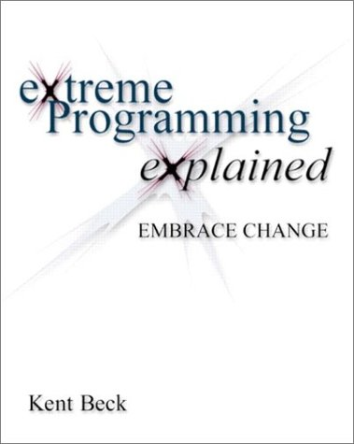
Courage
https://www.amazon.co.uk/Extreme-Programming-Explained-Embrace-Change/dp/0321278658
Notes:
XP’s five values are communication, simplicity, feedback, courage and respect.
Strong tests satisfy four of those five values with the most important one being the courage to make changes.

Slide 61
Assert.True(TheEnd);
Blog:
http://chrisoldwood.blogspot.co.uk
Articles:
http://chrisoldwood.com/articles.htm
Notes:
No book to peddle, but here are some links...

