Slide 1
Monitoring: Turning Noise Into Signal
ACCU Conference 2019
Chris Oldwood
Notes:
I’m a freelance developer working with “enterprise grade” technology.

Slide 2
People
Whose job is it anyway?

Slide 3

The Great Divide
https://flic.kr/p/oW9SZG
Dev
Ops

Slide 4
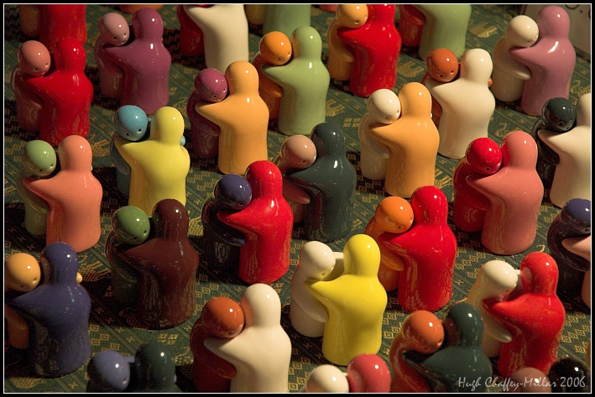
Dev+Ops
https://flic.kr/p/4Camod

Slide 5
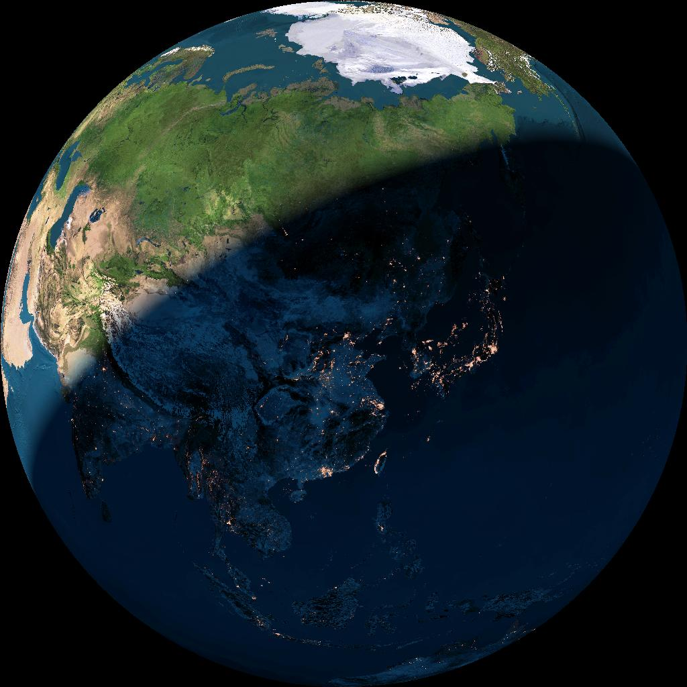
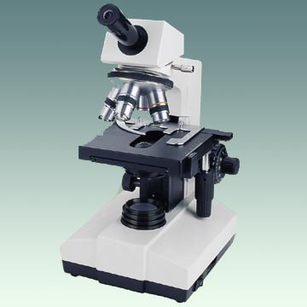
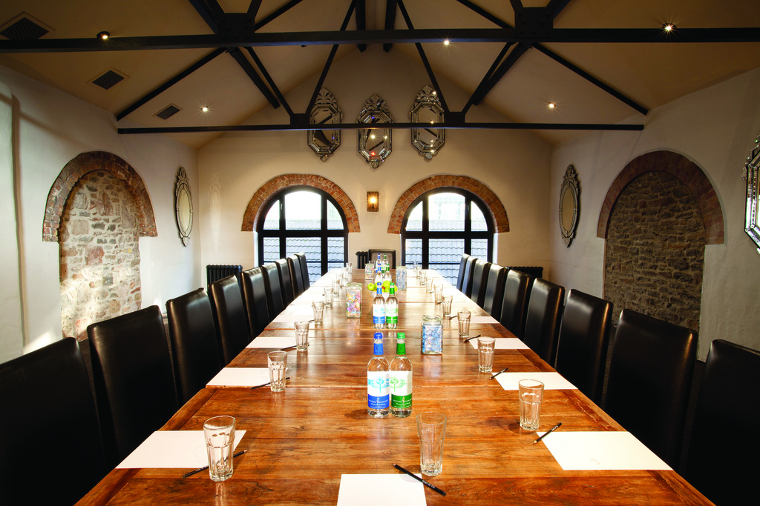
Multiple Narratives
https://flic.kr/p/6LuHMm
https://flic.kr/p/bF8wiG
https://flic.kr/p/bmqFMH

Slide 6
“Full Pipeline Developer”
Architect
Code
Test
Build
Deploy
Monitor
Support

Slide 7
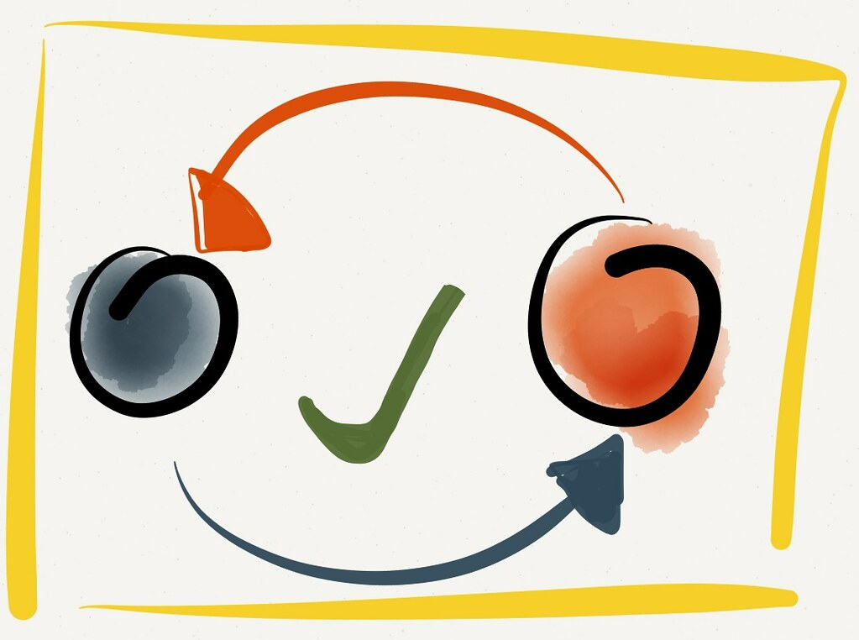
Self-Healing Systems
https://flic.kr/p/k3EHt6

Slide 8
System
What to monitor

Slide 9
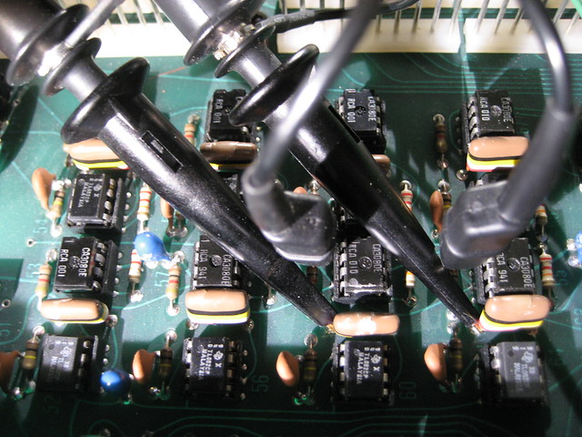
Instrument Everything
https://flic.kr/p/aMBygi
File I/O
Network I/O
Memory consumption
Computation time
Queuing time
Cache efficiency
Pool usage
Query execution times
Feature use
. . .

Slide 10
Transient Blips

Slide 11
Long-Term Trends

Slide 12
Structure
How to record events

Slide 13
Free-Text
21:09:47.245 05 INF Fetching orders for customer #42
21:09:47.290 05 DBG Reusing a pooled connection 21:09:47.740 05 DBG Returning connection to pool 21:09:47.745 05 INF Orders fetched in 505 ms 21:09:47.750 05 PRF [Orders=3;Time=505]

Slide 14
Aggregatable Logging
21:09:47.245 05 INF Fetching orders for customer #42
21:09:47.290 05 DBG Reusing a pooled connection 21:09:47.740 05 DBG Returning connection to pool 21:09:47.745 05 INF Orders fetched in 505 ms 21:09:47.750 05 PRF [Orders=3;Time=505]
Example events:
Persistence performance
Connection pool utilisation

Slide 15
Minimal Event Structure
Timestamp: 21:09:47.740
Name: connection-pool.reuse.count
Value: 1
Timestamp: 21:09:47.750
Name: database.orders.read.duration-ms
Value: 505

Slide 16
Naming
<component...>.<operation>.<type>
database.orders.read.duration-ms
connection-pool.reuse.count

Slide 17
Diagnostic Context
Timestamp: 21:09:47.750
Name: database.orders.read.duration-ms
Value: 505
Context:
CustomerId: 42
CorreationId: 38563-83902
OrdersFetched: 3

Slide 18
Causality
B
A
D
C
E

Slide 19
Local Aggregations
Timestamp: 21:09:56.934
Name: http-request.duration-ms
Value: 390
Summary:
Authentication: 100
Database: 280
Calculation: 10

Slide 20
Noise Reduction
Improving visibility

Slide 21
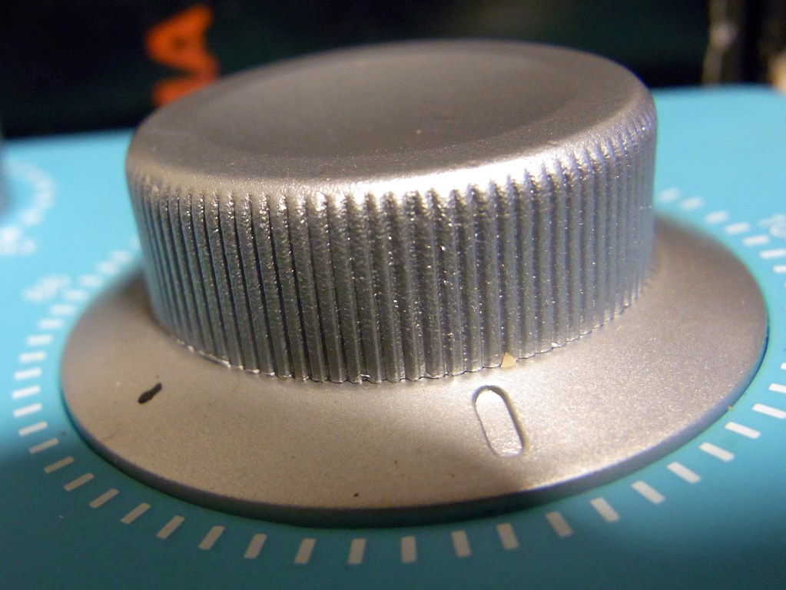
Incremental Improvements
https://flic.kr/p/9mWFaa

Slide 22
{ Event: “Talk.Ended” }
Blog:
http://chrisoldwood.blogspot.co.uk
Articles:
http://chrisoldwood.com/articles.htm

