Slide 1
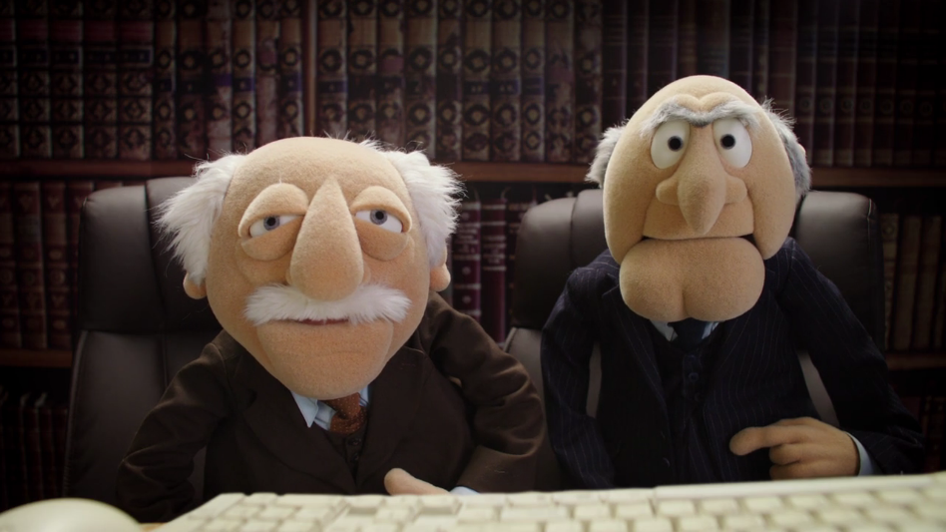
Becoming a Bitter Programmer
@chrisoldwood | gort@cix.co.uk

