Slide 1
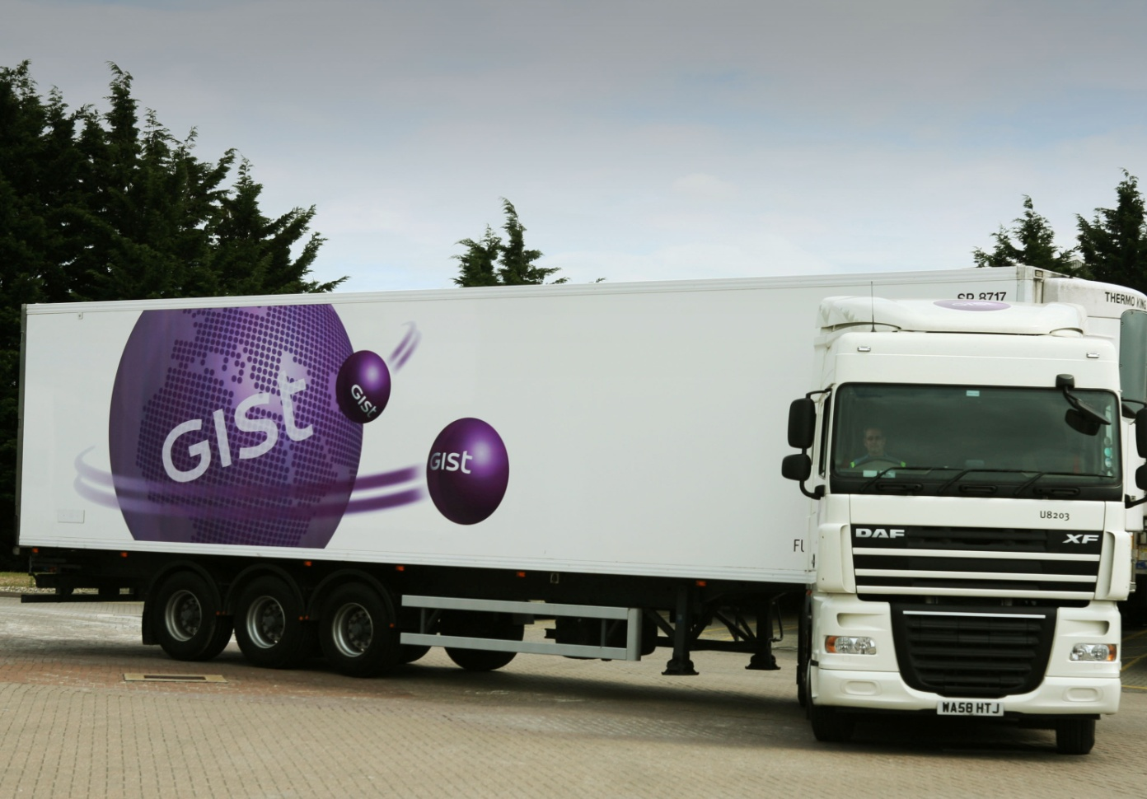
Continuous Delivery
@chrisoldwood | gort@cix.co.uk

