Slide 1
(Re)Reading the Classics
Chris Oldwood
ACCU Conference 2013
@chrisoldwood / gort@cix.co.uk
Notes:
Engineering, not Computer Science background – 7 years of programming micros

Slide 2
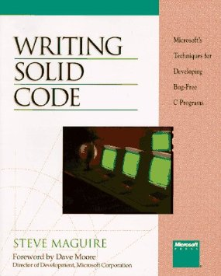
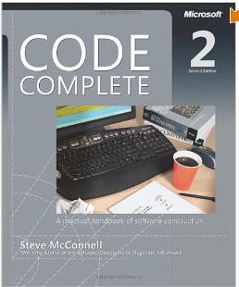
Notes:
Writing Solid Code & Code Complete – checklists of good practices

Slide 3
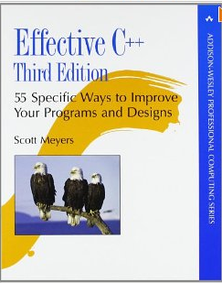
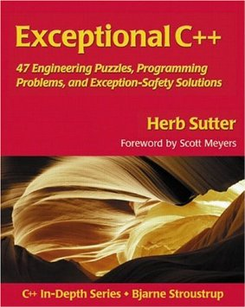
Notes:
Scott Myers & Herb Sutter made checklists of good practices a book style

Slide 4
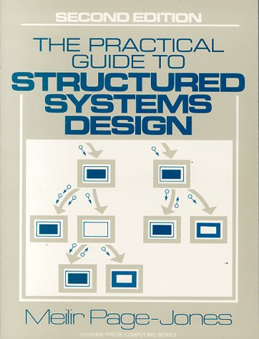
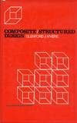
Notes:
Tony Barrett-Powell’s conference talk referenced books from 30 years ago.
I paid 34p for The Practical Guide

Slide 5
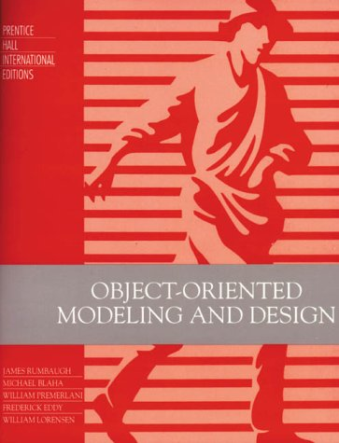
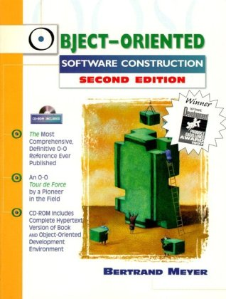

Notes:
No recent books on OO – the old ones still the best it seems
Rumbaughs was rescued from a skip and Riel’s book was suggested by Hubert Matthews

Slide 6
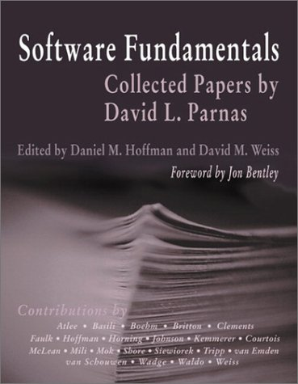
Notes:
Moving back to the 1970’s with David Parnas – Abstract Data Types, exception handling and even TDD.

Slide 7
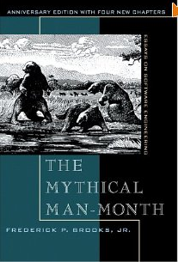
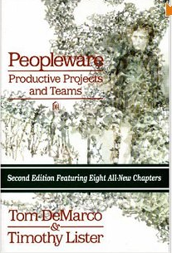
Notes:
Recognised classics

Slide 8
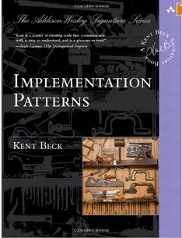
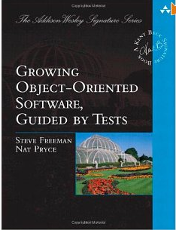

Notes:
Modern classics?

Slide 9
http://chrisoldwood.blogspot.com
@chrisoldwood / gort@cix.co.uk

