Slide 1
Monolithic Delivery
ACCU Conference 2018
Chris Oldwood
Notes:
I’m a freelance developer working with “enterprise grade” technology.
This talk is about the misconception that monolithic architectures are inherently bad, the problem is not necessarily the system’s architecture but might be the method of delivery.

Slide 2
Monoliths
Exploring coupling

Slide 3
Monolith (n)
a large single upright block of stone, especially one shaped into or serving as a pillar or monument. - a very large and characterless building. - a large block of concrete sunk in water, e.g. in the building of a dock.
a large, impersonal political, corporate, or social structure regarded as indivisible and slow to change.
https://www.google.co.uk/search?q=define+monolith
Notes:
What is a “monolith” anyway?

Slide 4

The Archetypal Monolith
https://cdn-images-1.medium.com/max/1200/1*QVCRxfsQwXHIlBlRDxIrLg.png
Notes:
Possibly the most common visual metaphor for a monolith – opaque, impenetrable, undiscoverable, etc.

Slide 5
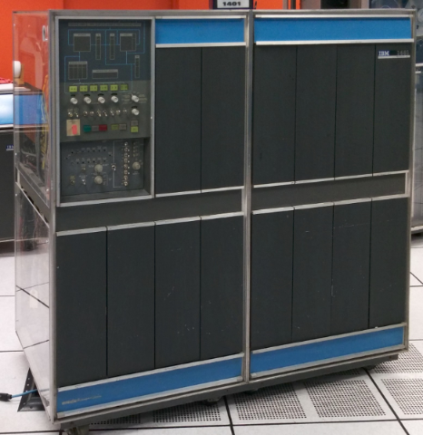
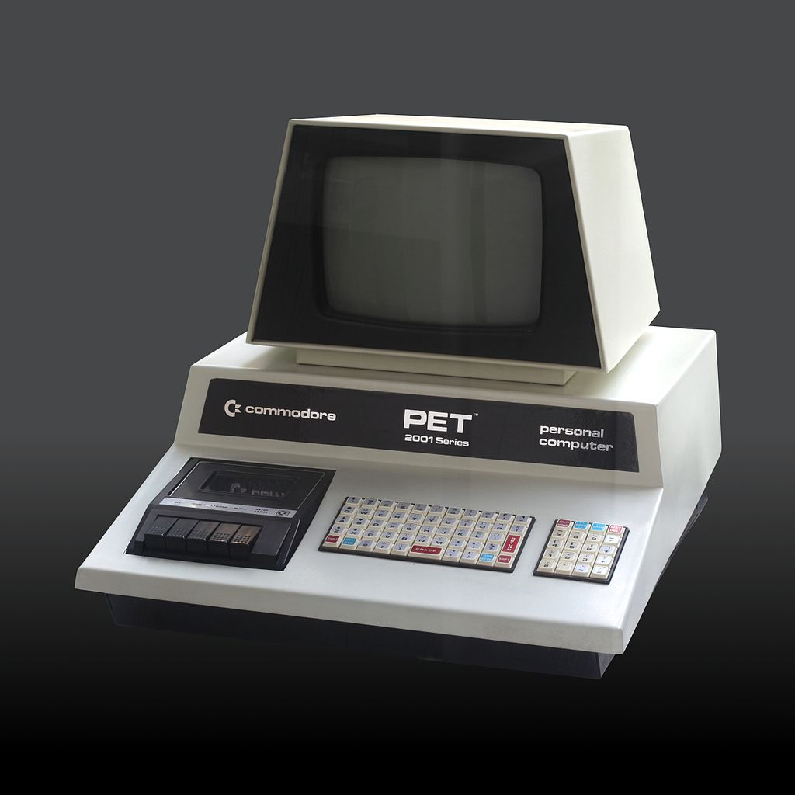
Monolithic Systems
http://static.righto.com/images/IBM_1406_Storage_Unit/machines.jpg
https://en.wikipedia.org/wiki/Commodore_PET#/media/File:Commodore_2001_Series-IMG_0448b.jpg
Notes:
True monolithic systems involved the delivery of a single piece of hardware and software, e.g. a mainframe or home computer.

Slide 6
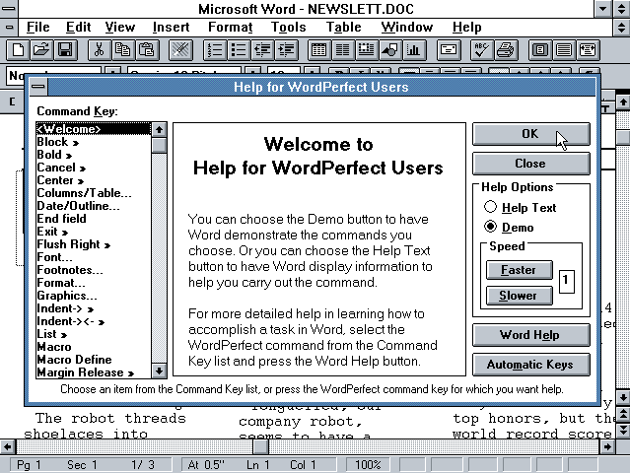

Monolithic Architecture
http://83.133.184.251/winworldpc.com/res/img/screenshots
https://pathowe.co.uk/wp-content/uploads/2017/02/iis-sql-750x503.png
Notes:
What do we mean today by a monolithic architecture?

Slide 7
“The Scheduler”
Monitors upstream data feeds
Decides when to process data feeds
Manages compute grid
Processes data feeds in parallel
Dispatches work to grid
Aggregate results in parallel
Notes:
An example of a monolithic service.

Slide 8

Monolithic Enterprises
http://www.hns.net/assets/img/data-centres/bristol.jpg
Notes:
Is it possible to apply the same rigid approach to an entire suite of services?
Of course – multiple supposedly discrete systems can be tightly coupled by their service contracts.
Example of multiple systems needing upgrading together due to coupling.

Slide 9
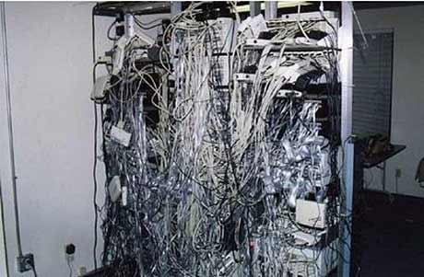
Microservices
https://i.stack.imgur.com/G0Syx.jpg
Notes:
But nobody would design an entire enterprise to be tightly coupled, would they?
Microservices are an organisational pattern intended to decouple delivery by spreading around the jam.

Slide 10
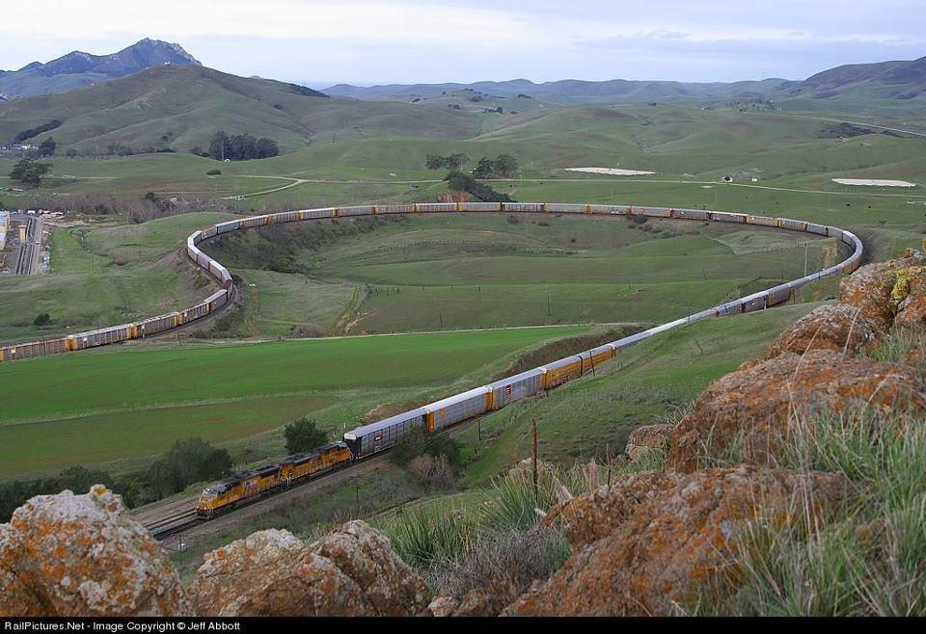
Monolithic Delivery
https://www.aanavandi.com/blog/wp-content/uploads/2016/11/securedownload-44.jpg
Notes:
My message - it’s not the architecture’s fault per-se, it’s the method of delivery that is tightly coupled.

Slide 11
Decoupling Delivery
Techniques for smaller deliveries

Slide 12

Smaller Units of Change
http://parkinsurance.co.uk/wp-content/uploads/2015/06/Josephine-Reitzel-2013-bike-messenger-worlds.jpg
Notes:
Smaller units of work (stories / tasks).
The MVP is not “everything”.
Okay to deliver partially implemented features. Hide behind toggle if necessary.

Slide 13
Always Be Ready To Ship
“A principle (or consequence) of highly iterative software development methodologies is that after the first iteration, the product is always ‘ready to ship’. That is, the product does something useful and is in a releasable state.”
http://wiki.c2.com/?AlwaysBeReadyToShip

Slide 14
Partial Deliveries
An example: sharing loyalty points:
View shared balance
Accrue shared value
Spend shared value
Join customers
Split customers
Notes:
An example of how to decompose into smaller deliverables and how ordering can be overcome.

Slide 15
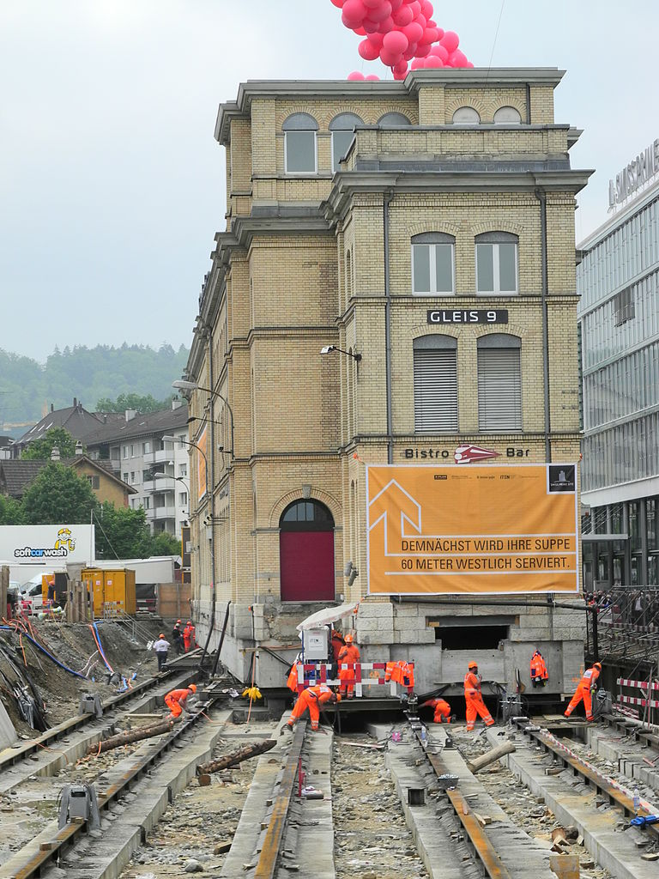
Emergent Design

Slide 16
“Software is not limited by physics, like buildings are. It is limited by imagination, by design, by organization. In short, it is limited by properties of people, not by properties of the world. ‘We have met the enemy, and he is us.’”
-- Ralph Johnson
https://martinfowler.com/ieeeSoftware/whoNeedsArchitect.pdf

Slide 17
v0.1
v1.0
Services
Command line tools
Services
Command line tools
Console app
Scripts
DB
File-system
Notes:
Evolution of calculation engine from single simple console app to multiple services, data stores, scripts, tools, etc.

Slide 18
Emergent Design is the continued borrowing and repaying of short term technical debt to allow practical experience to drive evolution.

Slide 19
Refactor All The Things
“Perfection is achieved, not when there is nothing more to add, but when there is nothing left to take away”
-- Antoine de Saint-Exupery
Notes:
No just functions and methods but the structure and architecture.
See Michael Stal’s blog.

Slide 20

Deploy Frequently
https://qz.com/wp-content/uploads/2018/02/spacex-falcon-heavy-elon-musk-china-europe-esa-nasa-mars-sls-boeing.jpg
Notes:
Even deploying to a development or test environment is deploying – do it regularly.
Minimise the time it takes to get a fix or feature from idea into production.
Deploying regularly gets you good at it and minimises the impact of changes as they are smaller and the time-to-fix is shorter.

Slide 21

Monitoring
https://news.artnet.com/app/news-upload/2016/03/spy-booth-01-e1459190262771.jpg
Notes:
Know your system’s behaviour.
Instrument everything you can afford to – see the trends and compensate before performance drops off a cliff.
Know your clients.
Help your clients to help themselves by providing you with non-functional data, e.g. version number, correlation ID, etc.

Slide 22
Barriers to Delivery
Friction inducing behaviours

Slide 23
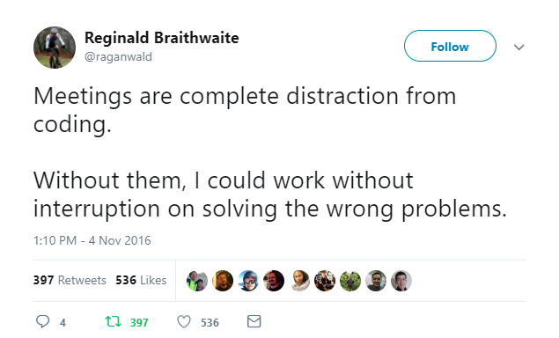
Identify the Real Waste
https://twitter.com/raganwald/status/794527181225357312

Slide 24
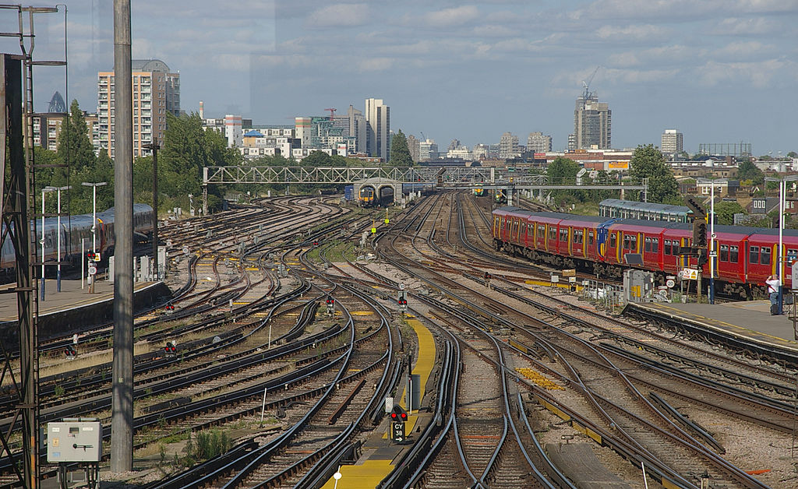
Minimise Branching
https://upload.wikimedia.org/wikipedia/commons/thumb/0/01/Clapham_Junction_railway_station_MMB_03_458XXX_458XXX_450XXX_377XXX_377XXX_455XXX_455XXX_455XXX.jpg
Notes:
Prefer trunk based development by default.
Branching has its uses, but know the costs and keep it short, e.g. Spikes.
If branching for release, do it late, aim for higher quality first to avoid needing to in future.

Slide 25

Shared Binaries
http://www.telford-live.com/2017/08/abandoned-house-in-telford/

Slide 26
References
Sources of inspiration

Slide 27



http://cdn.loot.co.za/static/gallery/previews/f/n/w/fnwc-97-g120/preview.fnwc-97-g120.1.front.0566086654.jpg
http://www.systemsguild.com/tdmbooks/WWBCover.jpg

Slide 28
Q & A
Filling in the gaps

Slide 29
Blog:
http://chrisoldwood.blogspot.co.uk
Articles:
http://chrisoldwood.com/articles.htm

