Slide 1
Test-Driven SQL
Chris Oldwood
Agile on the Beach 2014
@chrisoldwood / gort@cix.co.uk
Notes:
Challenge assumption that SQL development is easy
In particular note that it is still a dark art, e.g. borked query plans and compilation hints – how do you ensure functional correctness?

Slide 2
SELECT * FROM Scope
Preamble
SQL Unit Testing
TDD by Example
Questions
Notes:
OMG he used SELECT *!
Mostly a talk on “how”, but first a bit of “why”…
Breif overview of oscillating procedure and how unit tests could provide some security

Slide 3

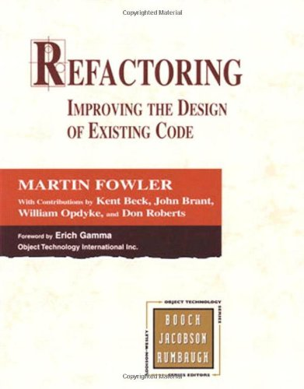

SQL Is Just Code…
Notes:
The examples may be in Java, but the message is equally appicable to SQL code development
Much SQL code is the epitome of legacy code

Slide 4
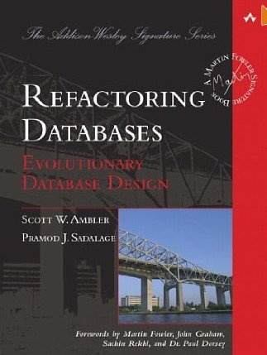
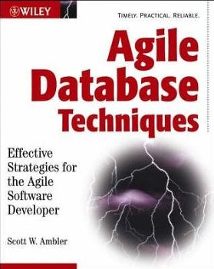
…Mostly
Notes:
Scott Ambler is the main author I’ve come across, trust him if not me.

Slide 5
SQL Unit Testing
Notes:
Unit testing is part of the mechanics of TDD and requires a tightly controlled development environment
Here we are assuming a loosely coupled environment and same language testing for skills portability

Slide 6
Functional Testing
Tests should verify the publicly observable behaviour not the choice of implementation
Notes:
Implementation details should be tested as a by-product of the publicly observable behaviour
If it’s not observable what purpose does it serve?

Slide 7
Development Sandbox
Isolation
Fast feedback
Deterministic
Tooling
Notes:
Need to be isolated from other developers – own database (free Express editions are perfect)
TDD requires fast feedback to keep the steps small – fast running tests require minimal data
Mock out non-deterministic functions like datetime, GUID, etc (more likely used on infrequent writes than reads).
SQL automated test tooling is less mature than other environments but easy to knock up

Slide 8
Example Test
create procedure test._@TestSetUp@_Something
as
-- common arrangement
go
create procedure test._@Test@_Something_ShouldDoAnotherThing
as
declare @arrangement varchar(100) = 'arrangement';
declare @expected int = 42;
declare @actual int = public.ActOnArrangement();
exec ssunit.AssertIntegerEqualTo @expected, @actual;
go
exec ssunit.RunTests;
Notes:
Naming tests is probably the hardest part, and also the most important
3 sections – arrange, act, assert
Many different types of asserts – values, table contents, exceptions
If required introduce helper procedures and functions to keep the arrangement readable

Slide 9
Example Feature
Produce a report showing how many bugs each developer has assigned to them.
Notes:
The Bug Tracking System in this example is the SQL-Unit sample database

Slide 10
Questions?

Slide 11
Want to Know More?
Blog
http://chrisoldwood.blogspot.com
SQL-Unit / SQL-Cop / sql2doxygen
http://www.chrisoldwood.com/sql.htm
http://github.com/chrisoldwood
@chrisoldwood / gort@cix.co.uk

