Slide 1
Waltzing with Branches
Chris Oldwood
Agile on the Beach 2015
@chrisoldwood / gort@cix.co.uk

Slide 2
Cargo Cult Software Engineering
“They go through the motions of looking like effective organizations that are stylistically similar. But without any real understanding of why the practices work […]”
-- Steve McConnell
Notes:
http://www.stevemcconnell.com/ieeesoftware/eic10.htm

Slide 3
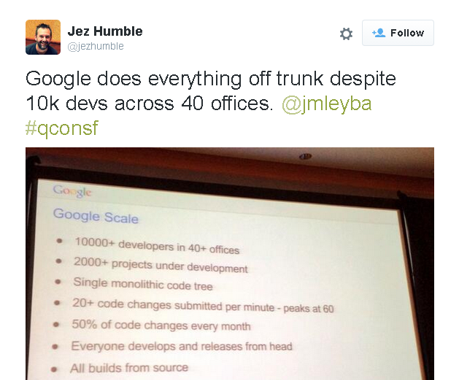
Another cult is born…
https://twitter.com/jezhumble/status/400071665482088448
Notes:
https://twitter.com/jezhumble/status/400071665482088448

Slide 4

Read the small print!
https://twitter.com/jezhumble/status/400071665482088448

Slide 5

Waltzing with Bears

Slide 6
<<<<<<<<<<<<
Knox in box.
Fox in socks.
Knox on fox
in socks in box.
============
Socks on Knox
and Knox in box.
Fox in socks
on box on Knox.
>>>>>>>>>>>>

Slide 7
“RISK MANAGEMENT IS PROJECT MANAGEMENT FOR ADULTS”

Slide 8
Branching is a technique for managing risk, but…

Slide 9
Branching is not the only technique for managing risk

Slide 10
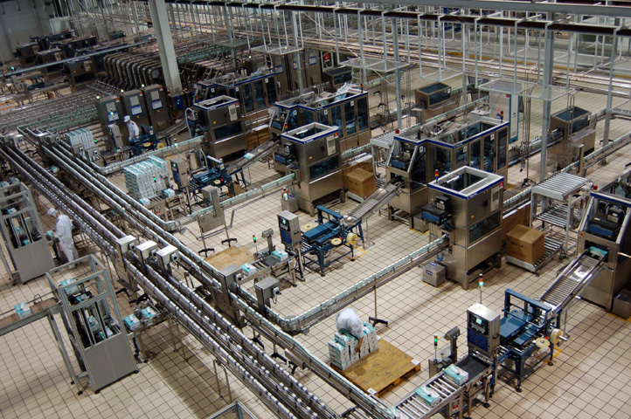
Risk: Loss of Productivity

Slide 11

Risk: Loss of Confidence

Slide 12
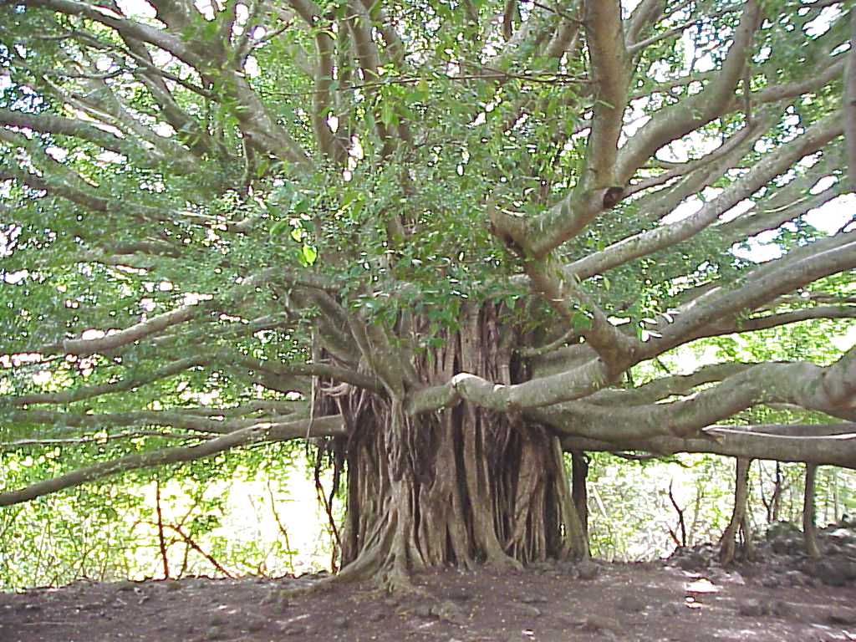
Branching

Slide 13

Merging

Slide 14
Integration/Development Branch
1
2
3
4
5
Notes:
The default branch when VCS doesn’t support branching.
Called different names - trunk/main/master.
A common “Enterprise” anti-pattern is one integration branch per project.

Slide 15
Release Branch
Stable
A
B
3
4
5
6
7
Volatile
Notes:
Reaction to code freeze – branch to avoid holding up development of version N+1.
Ideally trunk still needs to be stable prior to branching – no last minute high-risk changes that might be pulled.
Need integration branch when starting from a label.
Very few, carefully reviewed changes expected - only essential changes.

Slide 16
Branching From a Label
v1.1
v1
X
Y
A
B
3
4
5
6
7

Slide 17
Feature/Task/Private Branch
More Stable
3
4
5
6
7
A
B
C
More Volatile
Notes:
Branch for a specific feature (task) – often volatile in nature, e.g. a spike.
Or the developer may be volatile, e.g. new joiner.
Not necessary a single-developer branch, can allow multiple people to work more freely.
Easy to throw away with no residual effects.

Slide 18
Shelving
3
1
2
4
5
6
Notes:
Very short-lived branch, effectively only one commit.
Put current changes to one side and integrate again later when dust has settled.
Supported natively by some, called stashing in Git, branch from working copy is an alternative in SVN.

Slide 19
Integration Pains
A
B
3
4
5
6
7
X
Y
Z
Notes:
The release merge is easier due to small focused changes.
The feature branch merge can be harder because of the potential volume for change, e.g. refactoring.

Slide 20
Cherry Picking
A
B
C
3
4
5
6
7
Notes:
Undesirable, but often a reaction to an overly long testing phase.
Small, focused commits make it easier to cherry pick as changes are isolated.
Heavy refactoring makes this much harder as the likelihood for dependent changes increases.
Changes can get lost on the merge back at the end.
Record a merge at the end as nothing has changed code-wise but the loop should be closed.

Slide 21
No Branch (Feature Toggles)
Always Ready to Ship
1a
2
1b
3
1c
Notes:
Break task down into much, much smaller tasks.
New code and refactorings don’t require toggling off, only changes (low risk, but not no risk).
Need to schedule clean-up after toggled on permanently.
Toggles can be compile-time (#ifdef) or runtime (.config entries).

Slide 22
Continuous Integration is a mindset, not a tool.

Slide 23
Gatekeeper Workflows
Alice
B
C
D
GK
3
4
5
6
7
X
Y
Z
Bob
Notes:
Pessimistic workflow that uses feature branches and (ideally) automation to manage the risk.
Gatekeeper can be manual (code review) or automated (merge + build + tests).

Slide 24

Manual Checks & Balances

Slide 25
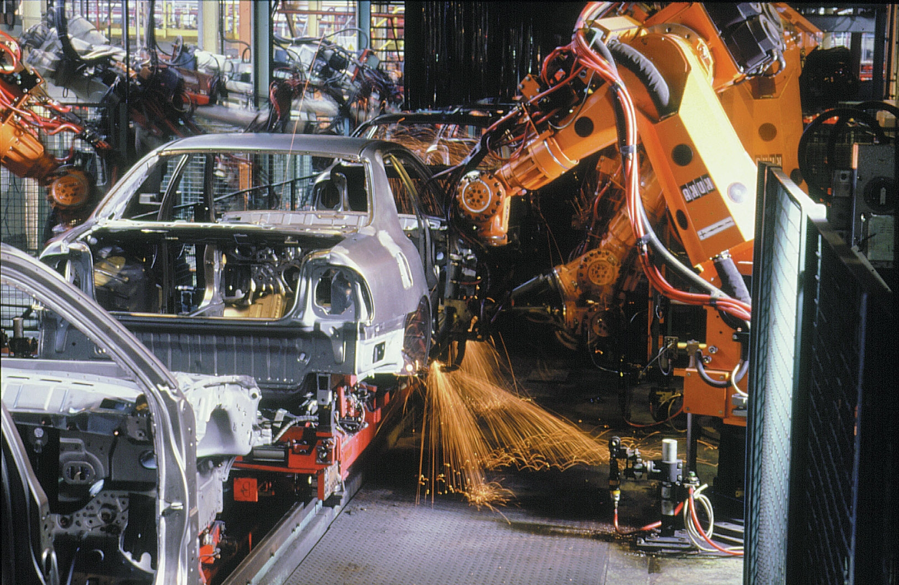
Automation
Notes:
Large amounts of automation are needed on any non-trivial codebase to ensure it remains good.
Commit should trigger the continuous integration server. Might need delay for non-atomic commits.
Optimistic workflow assumes commits are correct and should be ready to ship.
The only breakage should be environmental or long-running tests that can be elided by developers.
Build number should be auto-generated and baked into artefacts where possible.
Wipe workspace if you can afford it, else clean thoroughly to give same effect – no uncommitted hacks should taint the build.

Slide 26
Branching can be used to manage risk, but there are more productive ways.
Notes:
In summary: branches have their uses but managing risk should not be top of the list.

Slide 27
Questions?

Slide 28
Blog:
http://chrisoldwood.blogspot.com
Articles:
http://www.chrisoldwood.com/articles.htm
@chrisoldwood / gort@cix.co.uk
Notes:
No books, just a blog and some articles – one on branching strategies in particular.

