Slide 1
Store Location Allocation Model By: Archika, Chris, Mark and Radhika

Slide 2
Executive Summary
We propose a model to pinpoint the optimal location for a new store with respect to the location of competitor stores, the performance of competitor stores, and the demand potential of a given proposed location
We analyze store-level annual sales figures and socioeconomic factors within the city of Chicago
Our optimizer is employed through Julia

Slide 3
Project analysis slide 4
Agenda
Business Use Case
Background
.
PROJECT
Data Preparation
Models – Demand, L Julia
.
Graph Databases
Result

Slide 4


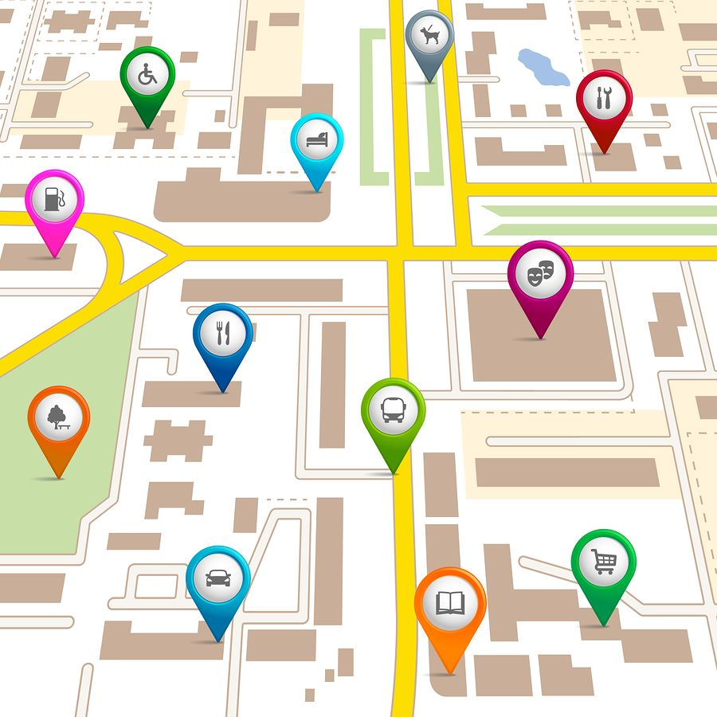




Business Use Case
With competition within the industry becoming more fierce, optimal site selection of new locations is key to achieving a competitive advantage
The performance of a store suffers if the business selects a sub-optimal location, for example: Companies blindly followed their rivals from city to city or country to country as in case without analyzing whether that same situation is right for them
Store location optimization shall give a strong foothold to an entrant

Slide 5
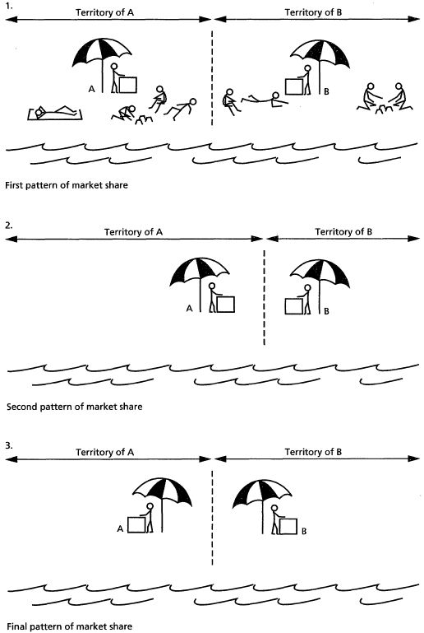
Background: Hoteling's Dilemma
Assumptions :
Evenly distributed Customer base / demand
linear city structure
Our Case:
Uneven distribution of Customer base in different neighborhoods
grid city structure

Slide 6



Data Source
Historic Business Data
Sales Volume
• Analyze market trends, economic growth, or specific industries
• Access categories including Company Name, Geocodes, SIC/NAICS codes, Census TRACT and more
2018 Crime
GIS Data
Property Valuation Data

Slide 7

Data Ingestion and Preparation
Neighborhood shape and lat-long files
Neigh Property Value
$β$ – Demand Model Store
$⍺$ - Demand model Neighborhood
GIS
Avg Zest/Neigh
Neo4j
Linear
Regression
Optimization Model
Surrounding neigh prop value
Zestimates/sqft at house-level
Property Value
Neigh crime Value
Store Matrix
Sum of crimes/ Neigh
Neo4j
Sum total of property related crimes by location
Crime
Surrounding neigh crime value
Neighborhood Matrix
Store level sales of all grocery stores
Sales
Distance Matrix

Slide 8

Graph Database – Neo4j
Geospatial data is hierarchical in nature: The socioeconomic features of a neighborhood to not exist in a void
We define neighborhoods as nodes, with each node having socioeconomic attributes, e.g. avg. property values, number of crimes , etc
We subsequently define bidirectional edge relationships (e.g. “IS_NEXT_TO”) between neighborhood nodes in order to understand the large context in which a given neighborhood exists

Slide 9

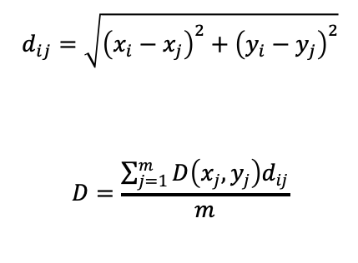
Demand Model – Store level
We are going to estimate our demand function’s fitted regression line using linear regression analysis
The beta coefficients are going to be used to determine the predicted sales values in the second part of the project
$D\left(x_{j},y_{j}\right)=β_{0}+β_{{n_crime}_{N}}x_{{crime}_{\left(x_{j},y_{j}\right)}}+β_{{n_crime}_{sur_N}}x_{{crime}_{\left(x_{j},y_{j}\right)}+ }β_{{sales}_{\left(x_{j},y_{j}\right),y−1}}x_{{sales}_{\left(x_{j},y_{j}\right),y−1}}$+ $β_{{propvalue}_{_n}}x_{{propvalue}_{\left(x_{j},y_{j}\right)}}$+ $β_{{n_propvalue}_{_sur}}x_{{propvalue}_{\left(x_{j},y_{j}\right)}}$
$β_{{sales}_{\left(x_{j},y_{j}\right),y−1}}$: 2017 sales for each grocery store
$β_{{propvalue}_{T}}$ : property value per sq foot of neighboring areas
$β_{{crime}_{T}}$ : no. of crime incidents in the neighborhood
which include (theft, trespass, destruction)
$\text{W}\text{e} \text{also} \text{take} \text{into} \text{consideration} \text{the} \text{distance} \text{of} \text{a} \text{store}\text{ (}\text{from}\text{ 1000 }\text{store} \text{sample}\text{) }\text{from} \text{all} \text{the}\text{ 1088 }\text{store}$
$$d_{ij}=\sqrt{{\left(x_{i}−x_{j}\right)}^{2}+{\left(y_{i}−y_{j}\right)}^{2}}$$
$$D=\frac{\sum_{j=1}^{m}{D\left(x_{j},y_{j}\right)d_{ij}}}{m}$$
The distance is going to be used as weight of the demand, hence we get a weighted demand forecast for a coordinate

Slide 10
Demand Model – Neighborhood level
$\text{W}\text{e} \text{use} \text{the} \text{betas} \text{from} \text{the} \text{demand} \text{model} \text{to} \text{get} \text{the} \text{L} \text{where} \text{L} \text{is} \text{going} \text{to} \text{be} \text{the} \text{predicted} \text{sales} \text{value} \text{for} \text{the} \text{point} \text{on} \text{map} \text{lat} \text{lang}$
L$\left(x_{j},y_{j}\right)=β_{0}+β_{{n_crime}_{N}}x_{{crime}_{\left(x_{j},y_{j}\right)}}+β_{{n_crime}_{sur_N}}x_{{crime}_{\left(x_{j},y_{j}\right)}+ }$ $β_{{propvalue}_{_n}}x_{{propvalue}_{\left(x_{j},y_{j}\right)}}$+ $β_{{propvalue}_{_n_sur}}x_{{propvalue}_{\left(x_{j},y_{j}\right)}}$

Slide 11
Objective Function Intuition
Core ideas:
1. The further we are from existing stores, the better, so as to more optimally allocate demand across the entire city
2. The more predictive the local socioeconomic conditions are of demand, the more attractive said locality is for site location
3. The interactive effect of distance and other stores’ demand is that, potential stores sites are rewarded for being far away from high-demand stores in comparison to lower-demand stores; likewise, if a potential store site is close to a high demand store, it will be more rewarded than a potential store site that is close to a low demand store.

Slide 12
Julia Model
The problem type: maximization, Integer Programming
The objective function: D + L
Variable and constraint:
Variable: X[ 1:n ]
Type: binary
Size: (number of locations to choose the best location from, 1)
Constraint: sum(X[ 1:n ]) = 1
Intuition: this column vector acts as a selector, and the goal is to find the X[ i ] where the objective function is largest, set the X[ i ] to 1, and the rest to 0, so as to pinpoint the location.
1
n

Slide 13
Julia Model
The problem type: maximization , Integer Programming
The objective function: D + L
D:
3
4
n
1
2
1
p
X
a
X
X
1
p
a
n
a: the number of existing stores;
p: the number of estimated parameters in the D demand model;
n: the number of locations (coordinates) to choose the best location from.
1: the coefficients from the D demand model, describing the effect of each predictor on the demand of each existing store
2: the value of the predictors with respect to each existing store
1 X 2: the demand with respect to each existing store
3: the distance between each existing store and each location of consideration
4: the variable of the objective function

Slide 14
Julia Model
The problem type: maximization , Integer Programming
The objective function: D + L
L:
7
7’
1
1
6
5’
6’
5
q
X
b
X
q
X
a
X
1
q
b
1
q
a
b: the number of existing neighborhoods;
q: the number of estimated parameters in the D demand model;
5: the coefficients from the L demand model, describing the effect of each predictor on the demand of each neighborhood
6: the value of the predictors with respect to each neighborhood
5 X 6: the demand with respect to each neighborhood
7: the variable of the objective function

Slide 15
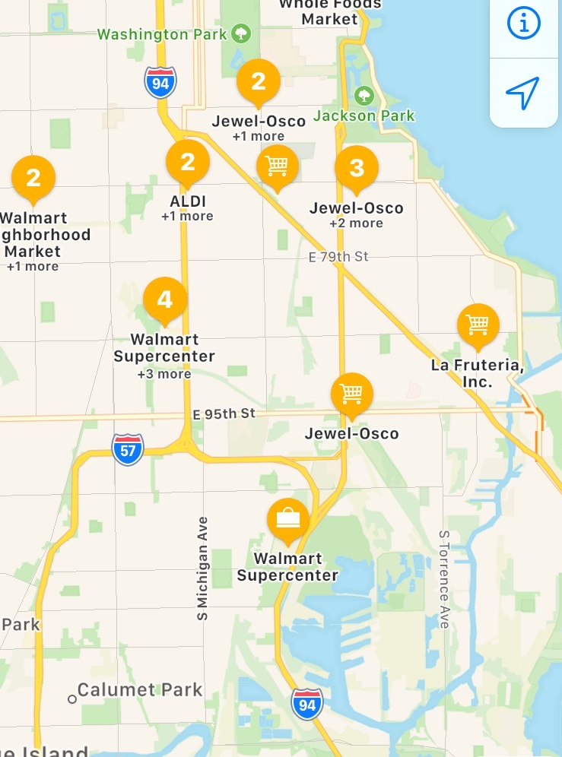
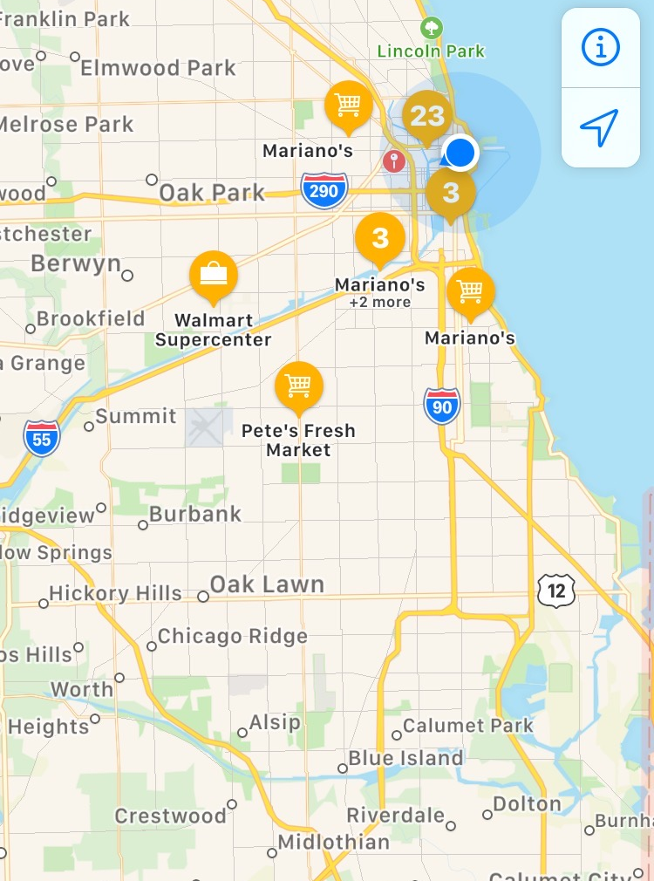
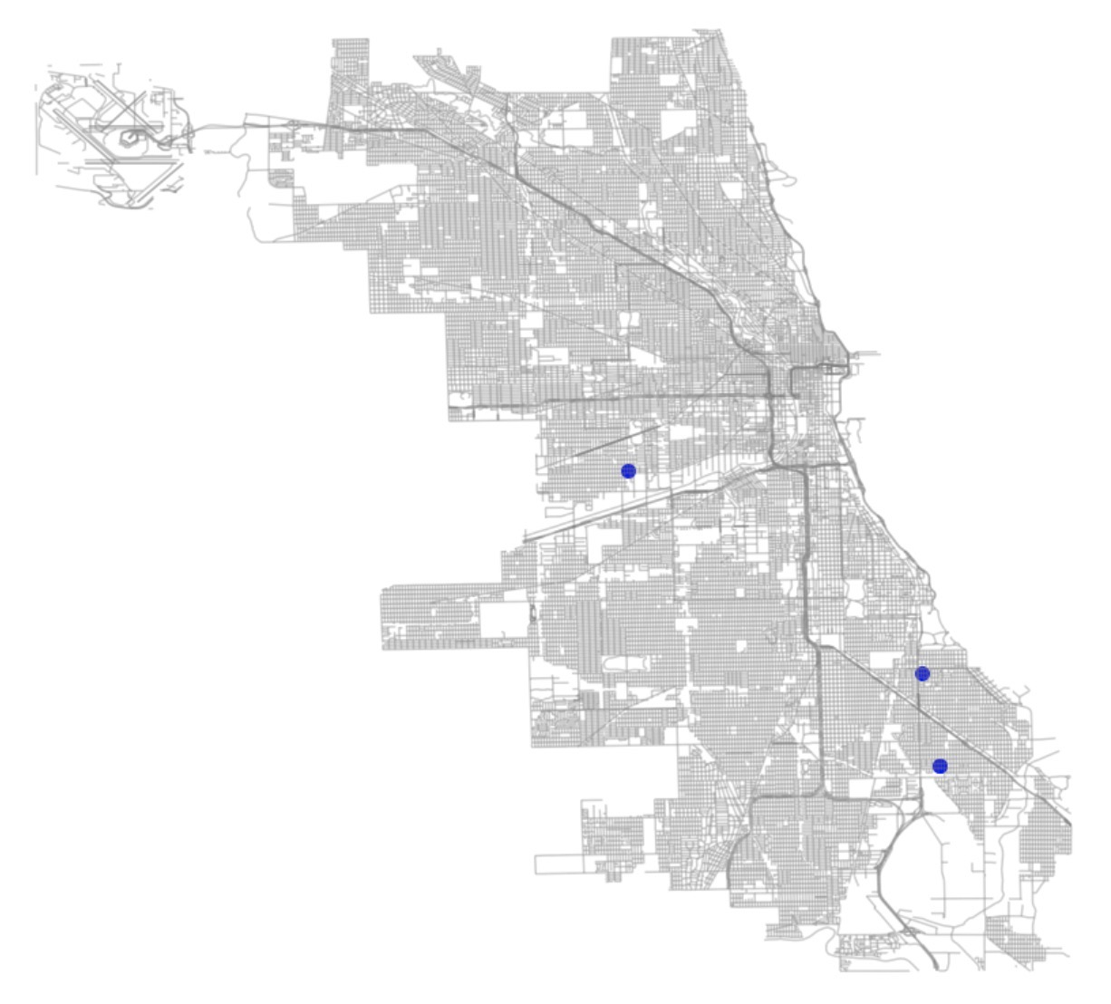
Results
Optimal Grocery store location

Slide 16
Thank You

