Slide 1




Slide 2
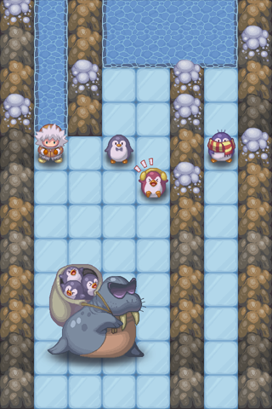
Thin Ice Rescue
Rescue baby penguins trapped on thin ice, but watch out - the ice behind you breaks with each step you take!
A variety of different penguins and ice types keeps the game interesting
Integration with Apple’s Game Center
Launch Date: 2010
Available on iPad and iPhone
In production

Slide 3
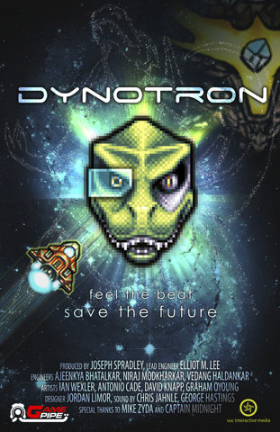
Dynotron
Unique Vertical Scrolling Rhythm-Based Shooter
Combined Use of Accelerometer and Touch screen
Features Ambient, Electronic Soundtrack
Powered by Cocos2D
OpenFeint/Apple Game Center Leaderboards
Launch Date: 2010
Available on iPad and iPhone
In production

Slide 4
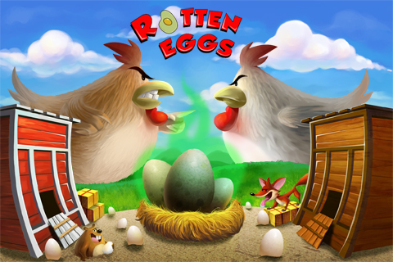
Rotten Eggs
Players defend their coop by rolling eggs through the farm maze to splat opposing chickens while avoiding gophers, fox and very hungry plants
Use of the accelerometer to roll eggs
Facebook CONNECT enabled, Send TO Friend; powered by Cocos2D
Launch date: 2011
Available on iPad and iPhone
In production

Slide 5
Sumo vs Zombies
Players attempt to stay alive as a lone sumo wrestler in a sea of never-ending zombies
Use of the touch-screen for movement and powerups
Facebook CONNECT enabled, Send TO Friend; powered by Unity3D
Launch date: 2011
Available on iPhone and iPad
In production
Artwork to be delivered next week

Slide 6
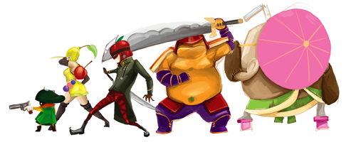
Fruits Vs Veggies
A twist on the popular tower defense genre
Use a combination of unique units and trap cards to send your troops into enemy territory and prevent them from getting to your side
In-game micro transactions to purchase new card packs
Launch Date: 2010
Available on iPad and iPhone
In production

