Slide 2
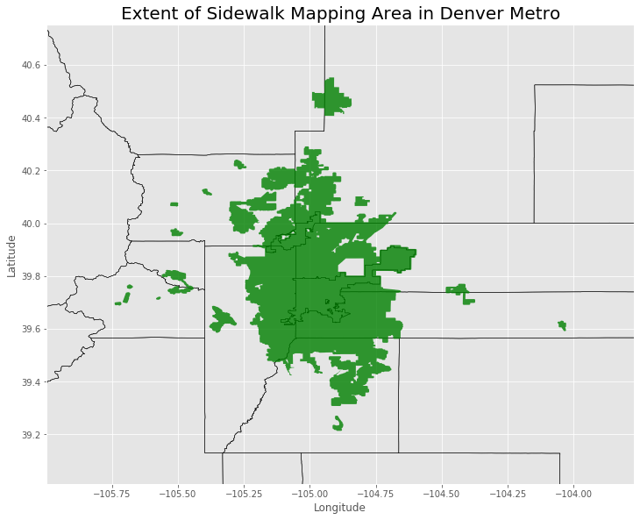
Data Scope:

Slide 3
Image Downloading Class
Class to download images with Latitude, Longitude, Heading, and Label
Generate Random point within survey region
Query streetview API for nearest image point
Confirm point is within “street” polygon
Find nearest street polygon edge & convert to direction
Test if sidewalk exists in direction within set distance
Save parameters and download image

Slide 4
Example Images with Validation

Slide 5
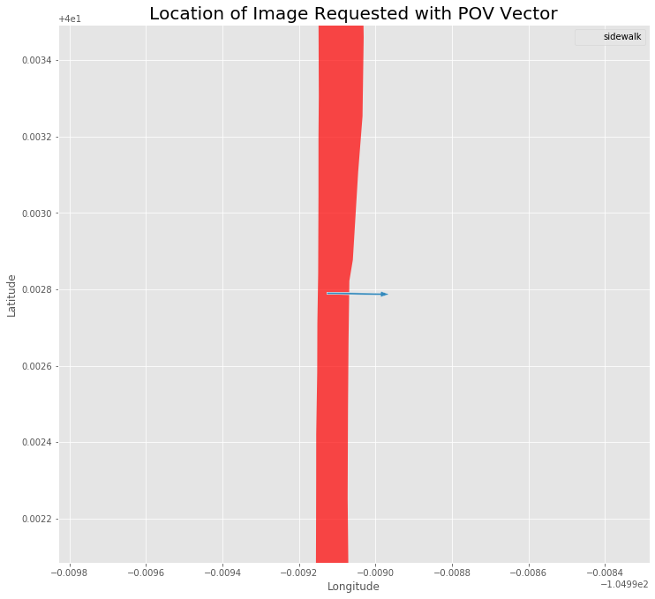
[268.79833469817083, [40.00278986277844, -104.9991271379266], 'no_sidewalk’]

Slide 6
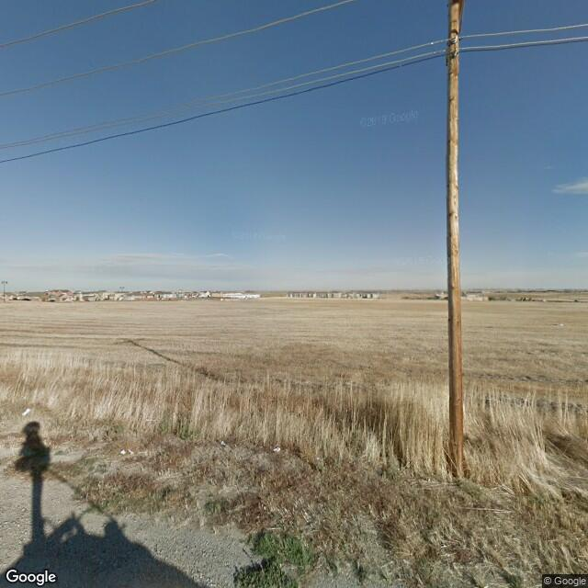
[268.79833469817083, [40.00278986277844, -104.9991271379266], 'no_sidewalk’]

Slide 7
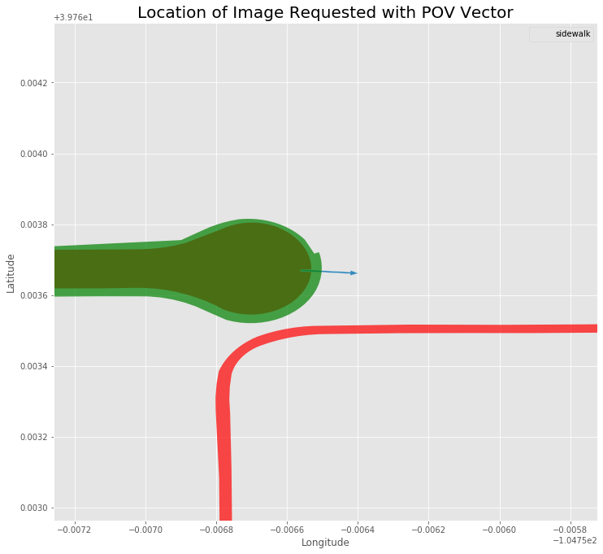
[93.8101431467257, [39.7636699, -104.7565609], 'sidewalk']

Slide 8
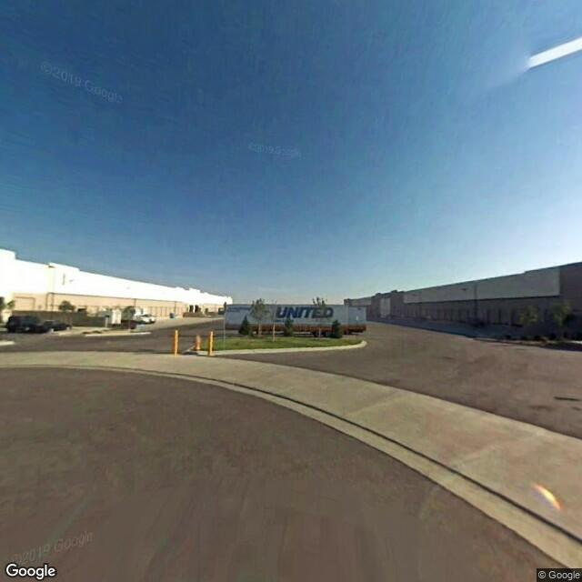
[93.8101431467257, [39.7636699, -104.7565609], 'sidewalk']

Slide 9
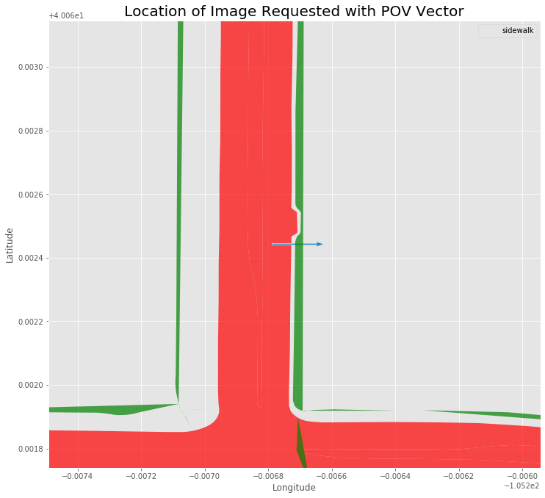
[269.9812922349449, [40.06244274355016, -105.2067883010862], 'sidewalk']

Slide 10
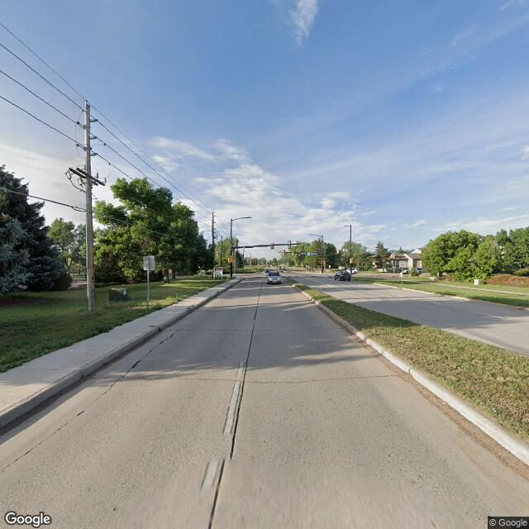
[269.9812922349449, [40.06244274355016, -105.2067883010862], 'sidewalk']

Slide 11
Issues with acquired data: Around 15% of the images acquired had incorrect labels. This could be for multiple reasons:
new construction in last several years
partial sidewalk, where only a bit is in an image. How should we classify "partial sidewalk" in a binary classification task?
ambiguous 'sidewalks' - there are a range of slightly angle pavement edges to asphalt streets that could be considered curbless sidewalk, or just shoulder or open gutter.
some panoramas from google are rotated up to 90 degrees so may include part of the opposite road

Slide 12
Data Results:
The images covered most of the region
Non-sidewalk images generally were from outlying areas
Non-sidewalk images were less distributed

Slide 13
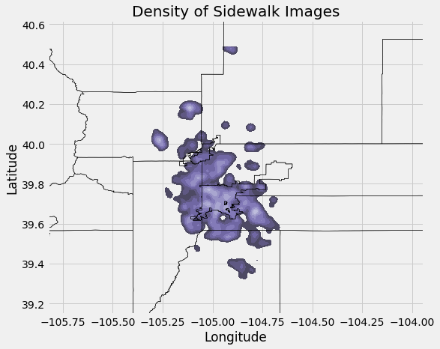
Data Results:

Slide 14
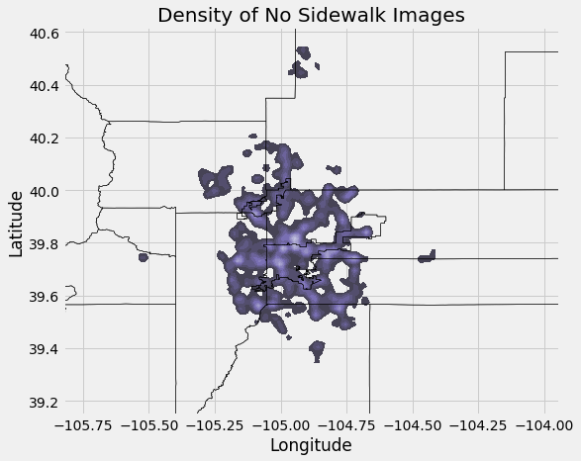
Data Results:

Slide 15
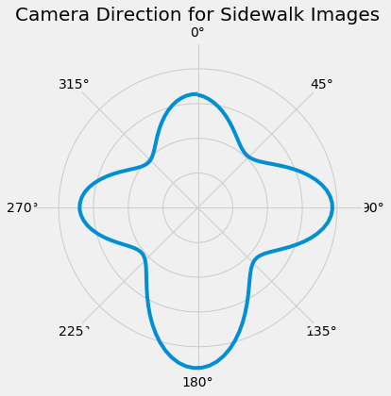
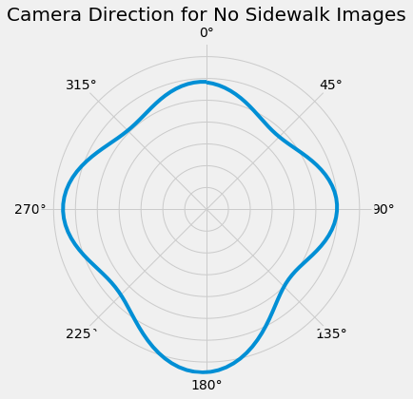
Data Results:

Slide 16
Modelling: Classification
Use tf.keras to build models:
Model with several convolutional layers
Pretrained models:
Mobilenetv3
Xception

Slide 17
Modelling: Classification
Convolutional Model

Slide 18
Modelling: Classification
Mobilenetv3

Slide 19
Modelling: Classification
Xception

Slide 20
Modelling: Image Segmentation
U-net Model
Encoders and Decoders, with skip connection

Slide 21
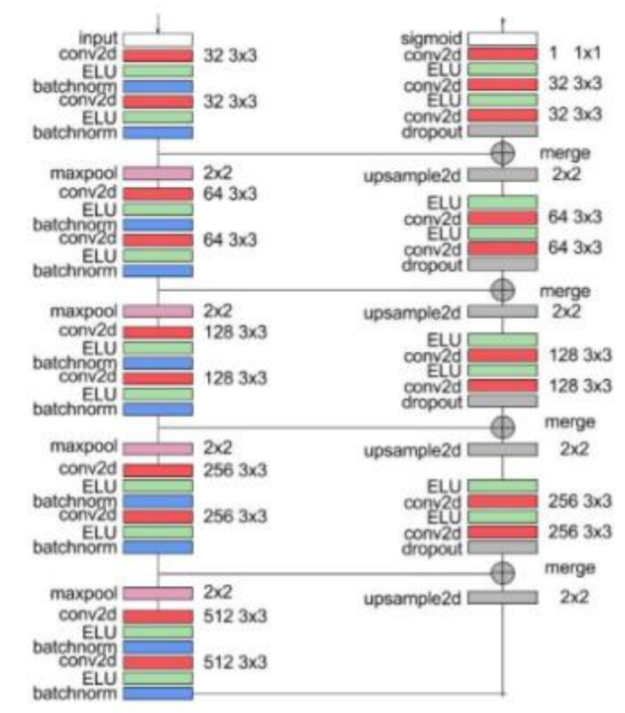
Architecture Design:
Ref: http://cs230.stanford.edu/files_winter_2018/projects/6937642.pdf

Slide 22
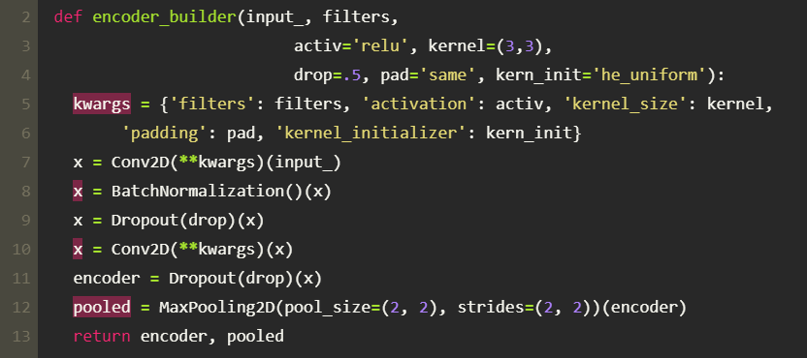
Modelling: : Image Segmentation
Encoder Block:

Slide 23
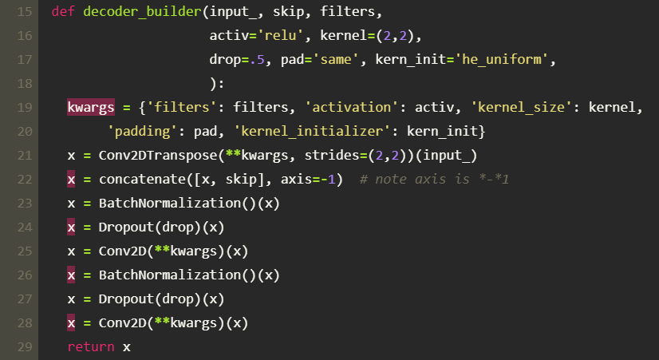
Modelling: Image Segmentation
Decoder Block:

Slide 24
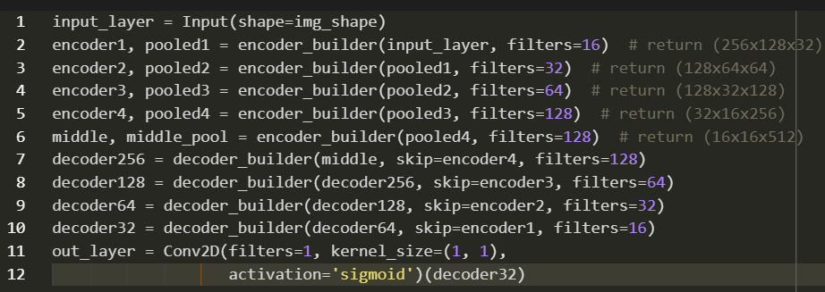
Modelling: Image Segmentation
Overall Structure:

Slide 25
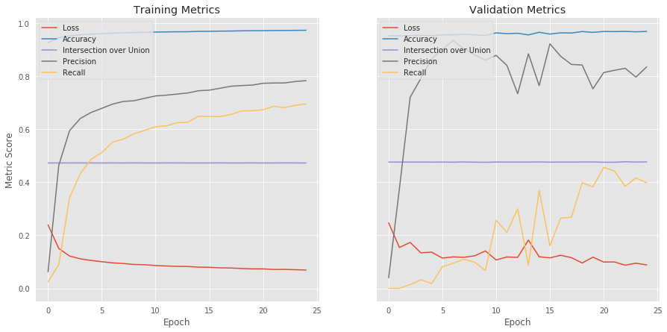
Modelling:

Slide 26
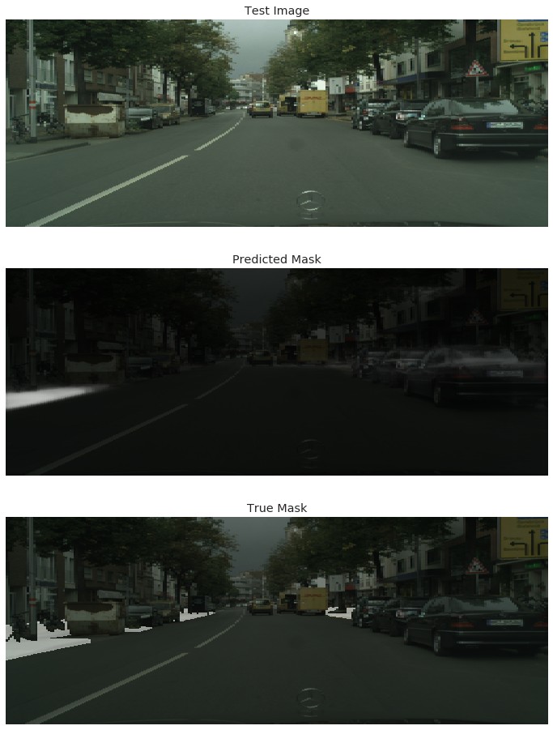
Modelling: Image Segmentation

Slide 27
Modelling: Image Segmentation

Slide 28
Modelling: Image Segmentation

Slide 29
