Slide 1

Machine Learning & Content Analytics Argumentation Mining on Scientific Publications
Team: Data -19
PANTELAKIS GEORGIOS f2822011
PAPADAKIS ATHANASIOS MARIOS f2822012
PORIKIS CHRISTOS f2822014

Slide 2


Contents
Project Goals
Data Collection
Explorative Analysis
Data preprocessing
Model architecture & Evaluation
Model Comparison
Clustering

Slide 3
Project Goals
Creation of a heuristic classifier with lexicon
Train argumentation mining classifiers (fastText, MLP, CNN)
Automate the procedure of arguments (Evidence/Claim) & Structure (Background, Objective, Method, Results & Conclusion) label prediction
Cluster Abstracts

Slide 4
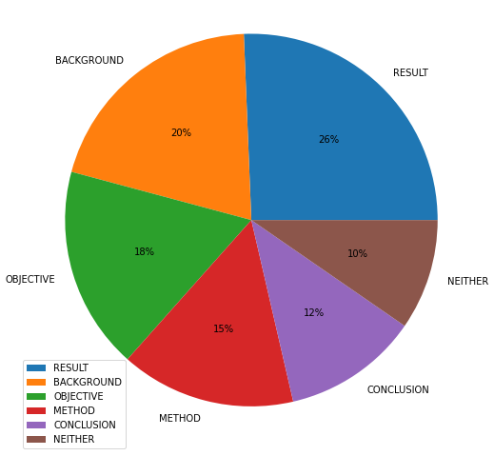
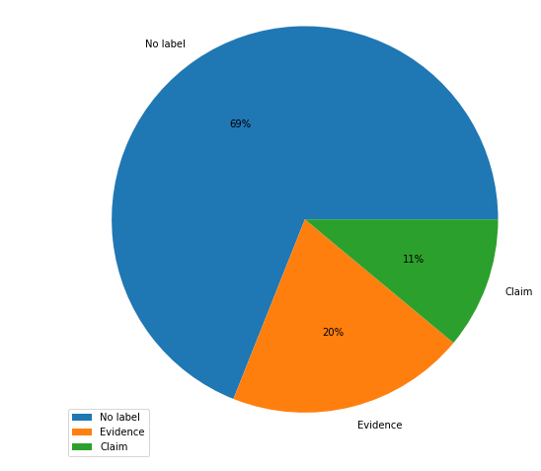
Data Collection & Overview
115 abstracts per team
- Labeling abstracts with Structure (labels background, aim/objective, method, results, conclusion) & Arguments (evidence, claim) Labels
Pre-existing data with argument labels

Slide 5
Data preprocessing
Tokenization of words
Removal of English stopwords
Lemmatization of words
Function for cleaning the text (symbols, punctuations, shorthand of words)
Split into training (80%) and validation (20%)
Stratification method was used (equality of all three labels)

Slide 6
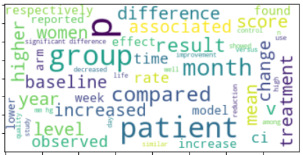

Heuristic Model Evaluation
Top words of Evidence arguments Top words of Claim arguments
Labels | Actual Labels | Predicted Labels
Neither | 4.258 | 3.483
Evidence | 1.234 | 910
Claim | 681 | 1.780
 | Accuracy | 55%

Slide 7
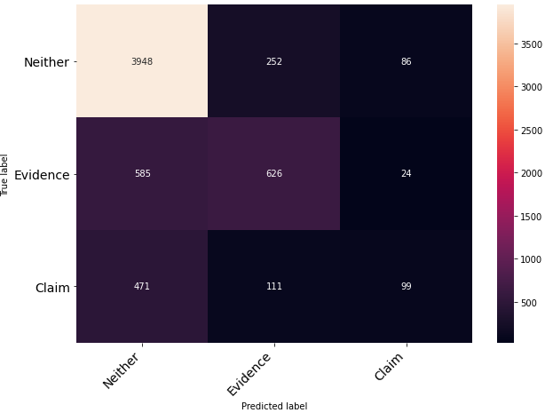
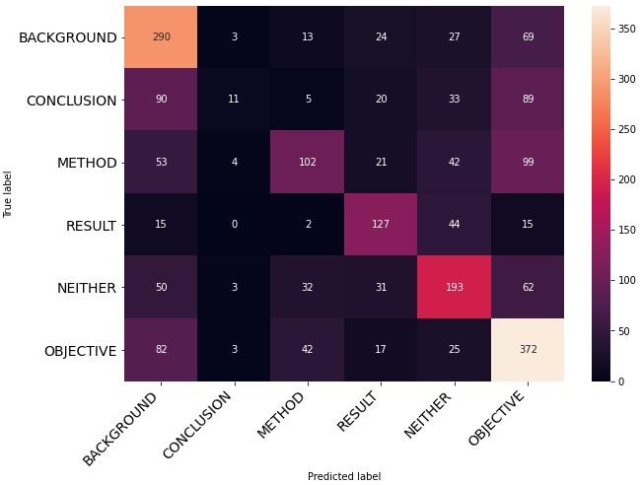
Model Evaluation Fasttext
lr=0.1, epochs=4, wordNgrams=1
lr=0.1, epochs=7, wordNgrams=1
Accuracy : 77.6 %
Accuracy : 57.7 %

Slide 8
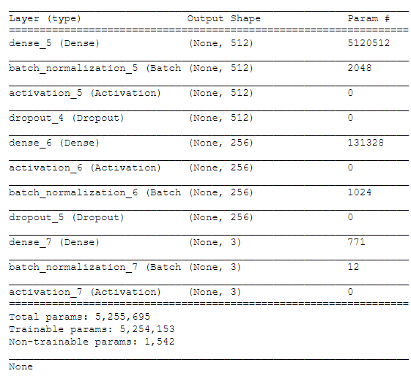
Model Architecture MLP
Parameters Tuning:
Max words: 10.000
Number of classes: 3
Number of epochs: 20
Batch size: 32
loss: “categorical crossentropy”, since we have categorical output values
optimizer: “adam”
metrics: “categorical accuracy” & “Mean absolute error”
Regularization techniques:
Dropout rate: 0.5
Batch Normalization: Before the activation function of the 1st layer and after the activation function of the 2nd layer
Early Stopping: 5 patience
Class weights

Slide 9
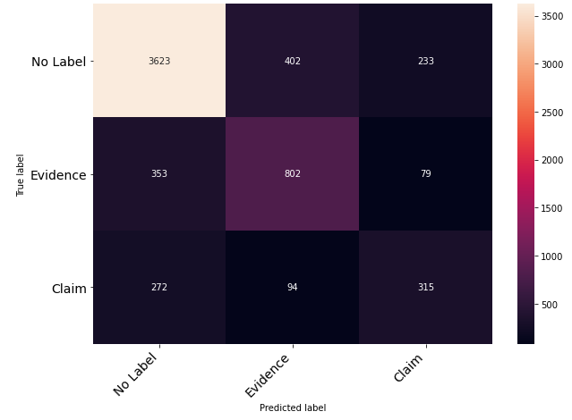
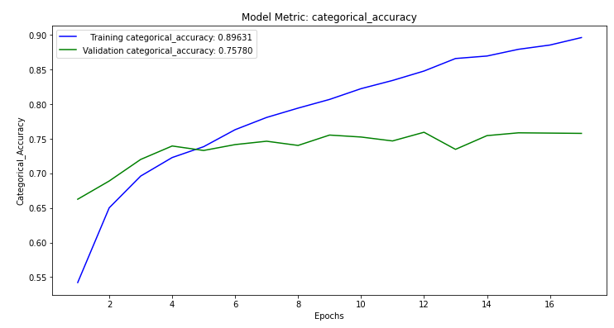
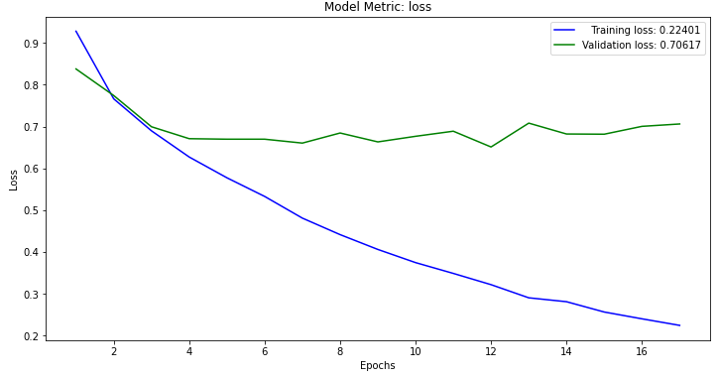
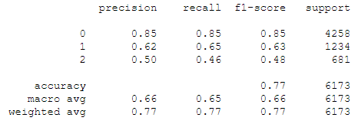
Model Evaluation MLP

Slide 10
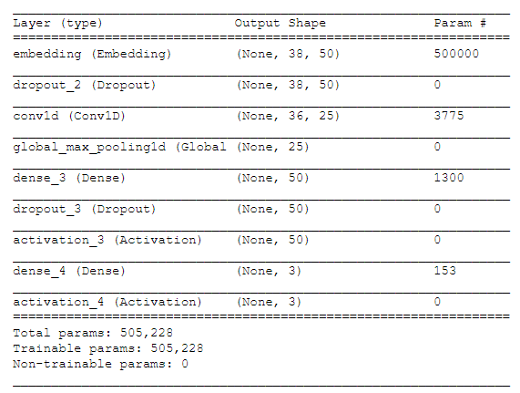
Model Architecture CNN
Parameters Tuning:
Max len: 38 (90th percentile of all lengths of our sentences)
Regularization techniques:
Dropout rate: 0.5
Embedding dimensions: 50
Number of filters: 25
Kernel size: 3
Hidden dimensions: 50
Number of classes: 3
Number of epochs: 100
Batch size: 128
loss: “sparse categorical crossentropy”, since we have sparse categorical output values
optimizer: “adam”
metrics: “accuracy”
Batch Normalization: Before the activation function of the 1st layer and after the activation function of the 2nd layer
Early Stopping: 5 patience
Class weights

Slide 11
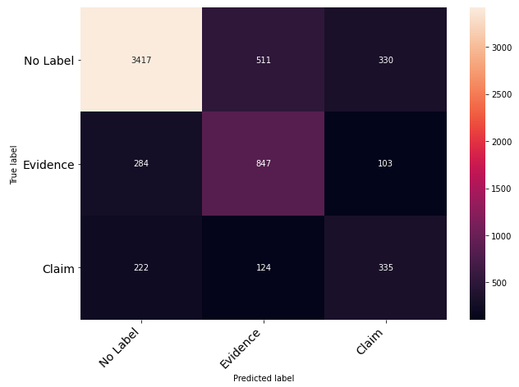
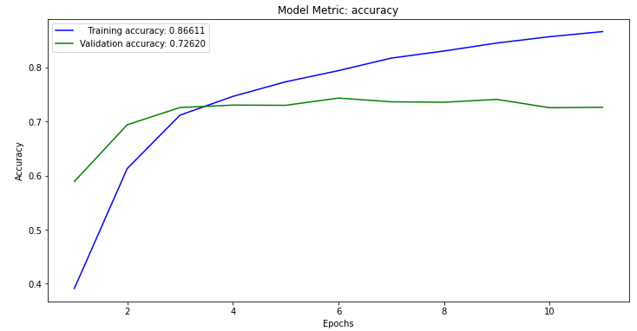
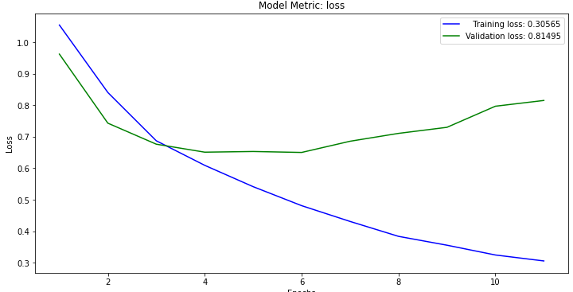
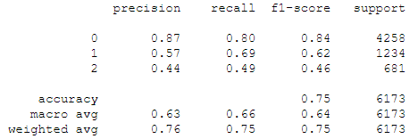
Model Evaluation CNN

Slide 12
Model Comparison
Correct Predictions
Model | No Label | Evidence | Claim | Accuracy
MLP | 3.623 | 802 | 315 | 77%
CNN | 3.417 | 847 | 335 | 75%
FastText | 3.948 | 626 | 99 | 77%
Best Model: MLP

Slide 13
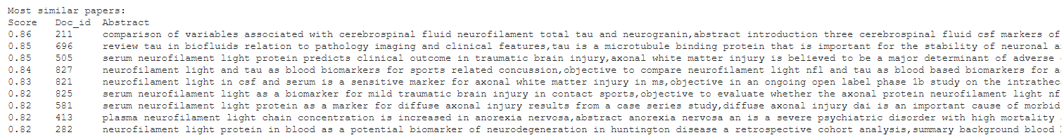
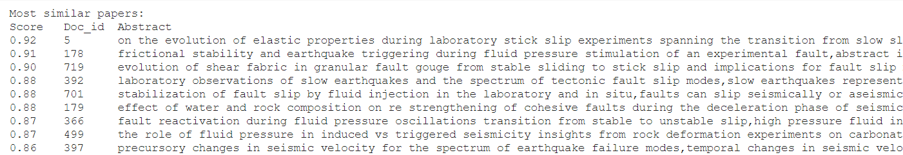
Model Evaluation Transformer
Transformer Model: Allenai-Specter

Slide 14
Clustering (1)
K-means algorithm was used
Three phase procedure: clustering with one feature (sentence), clustering with two features (sentences, EU_call), clustering with three features (sentences, EU_call, argument embeddings)
Different cluster numbers were tried (best results were with n = 6)
Found the top words for each cluster

Slide 15
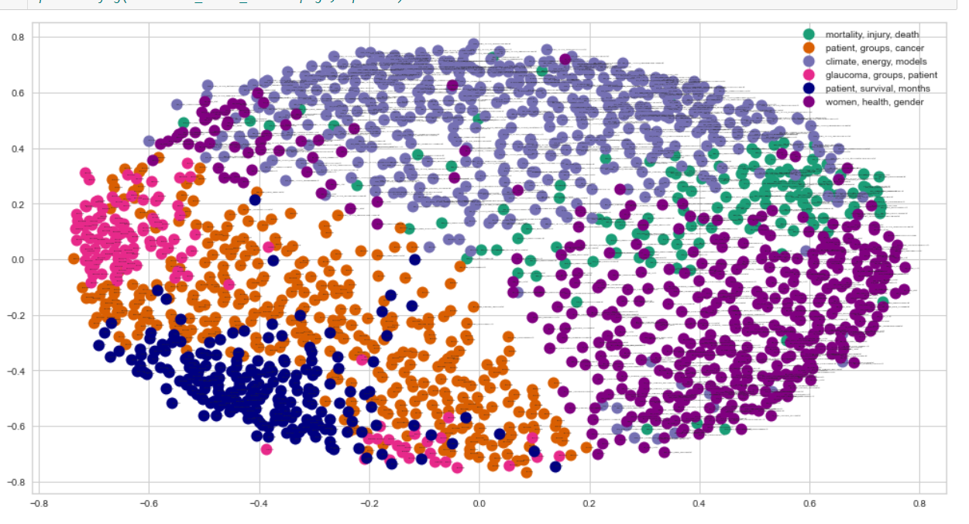
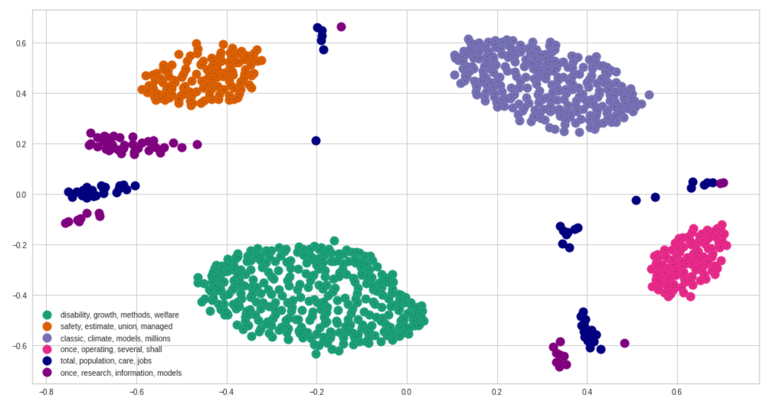
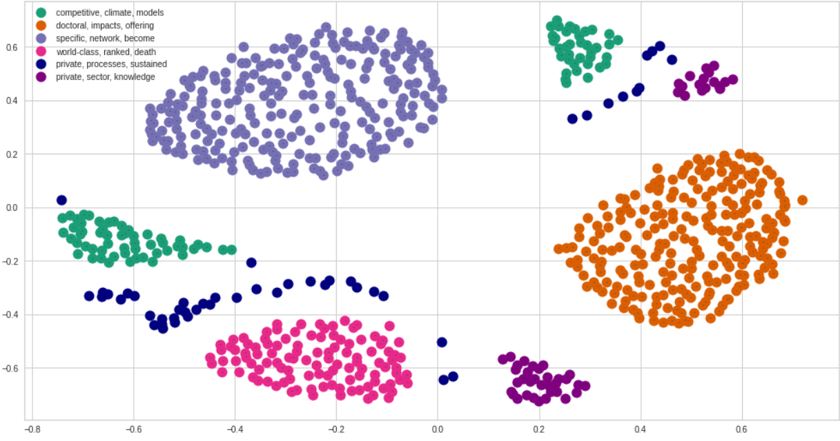
Clustering (2)
Clustering with one feature MSS: 0.037 Clustering with two features MSS: 0.295 Clustering with three features MSS: 0.185

Slide 16
The team
George: Computer Science
Thanos: Marketing & Communication
Christos: Economics Science

Slide 17

Thank you!

