Slide 1
GCOO Store

Slide 2
Overview
Card re-design
Problem & proposed solution
Card organization/hierarchy
Proposed alternative frameworks
Extra information & purchase
Problem & proposed solution
History tab & card design
Proposed alternative frameworks

Slide 3
Problems

Slide 4
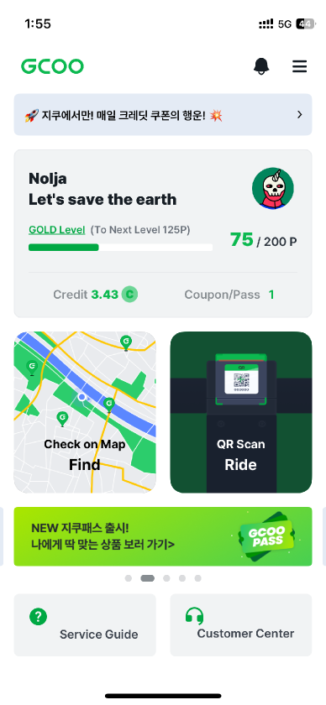
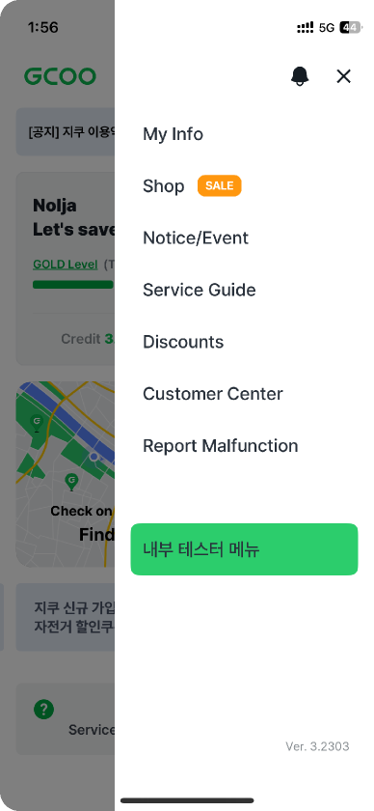
Store page: Navigation
It’s currently very challenging to find the store without the ad banner.

Slide 5
Store page: Navigation to Store Page
It’s currently very challenging to find the store without the ad banner.
It’s currently very challenging to find the store without the ad banner.
The GCOO Pass option is only displayed sometimes vs. being statically present on the home page

Slide 6
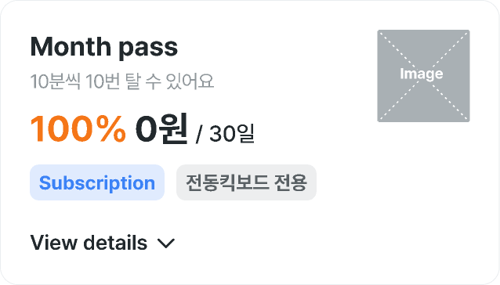
Item card: Density of information

Slide 7

Item card: Density of information
Pass names and descriptions are potentially confusing to the users
Image is too much of a focal point
Discount indication is confusing
Label system is too much to digest

Slide 8
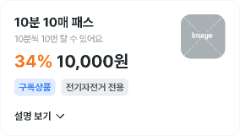


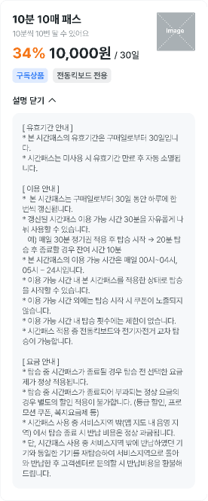
Store page: Density of information
상품
구매내역

Slide 9

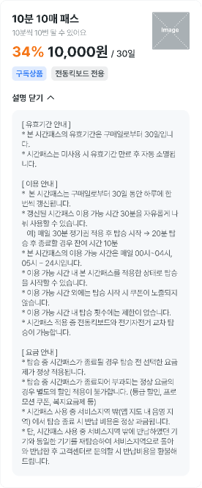
Store page: Density of information
상품
구매내역
Dropdown disrupts the user experience by moving the other card upon opening the dropdown
Dropdown has a lot of information that is difficult for average GCOO user to read

Slide 10



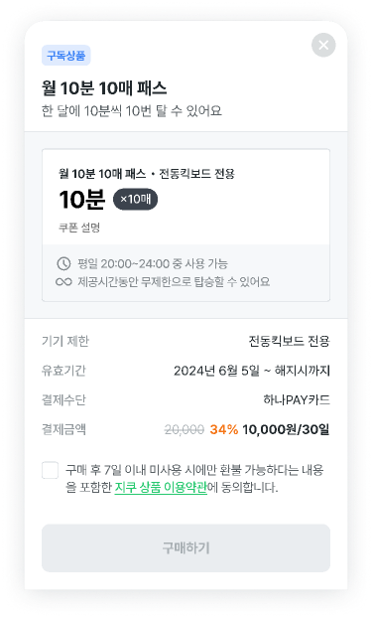
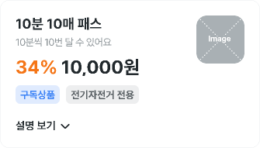
Store page: Repetitive Information
상품
구매내역

Slide 11

Store page: Repetitive Information
상품
구매내역
Purchase UI is repetitive and potentially confusing to the user

Slide 12
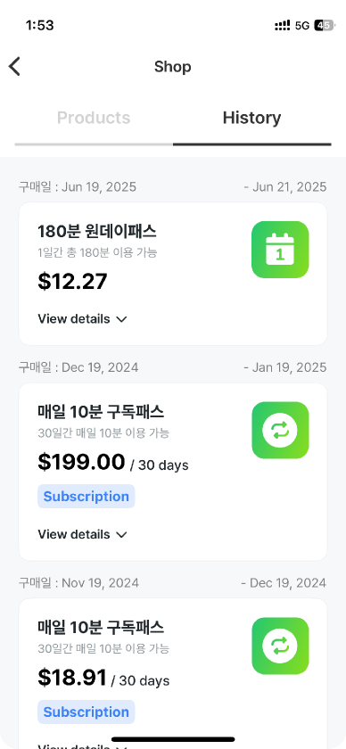
Store page: History Tab

Slide 13
Store page: History Tab
History tab/page is not utilized in the most effective way
Card design has a lot of detail but not enough value to make the amount of detail relevant

Slide 14
Proposed Solutions

Slide 15
Card Re-Design

Slide 16
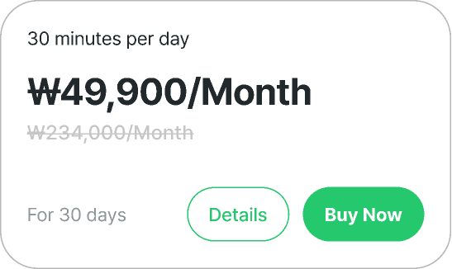
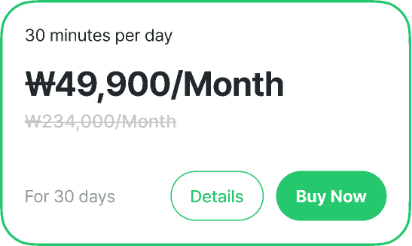
Card Concept 1
Unselected Variant
Selected Variant

Slide 17


Card Concept 1
Unselected Variant
Emphasis on the pricing so the user knows how much they are paying
Distinct buy and details buttons
Selected Variant

Slide 18
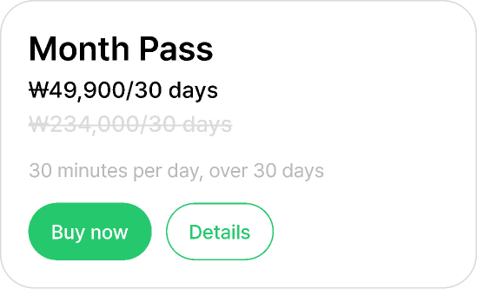
Card Concept 2

Slide 19

Card Concept 2
Emphasis on the name of the pass; but similar to Concept 1

Slide 20
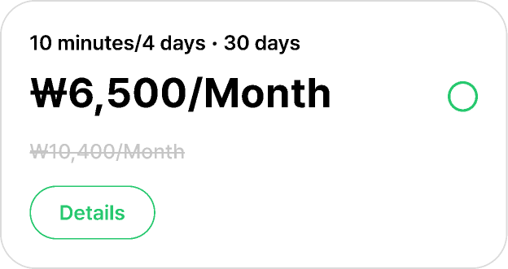
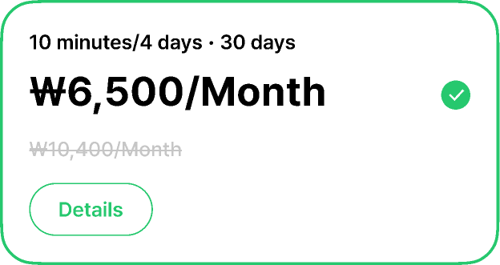
Card Concept 3
Unselected Variant
Selected Variant

Slide 21


Card Concept 3
Unselected Variant
Displaying the details of the pass as an emphasis
No buy button; instead the card itself is the buy button
Selected Variant
Upon selection selected state turns checkmark on

Slide 22
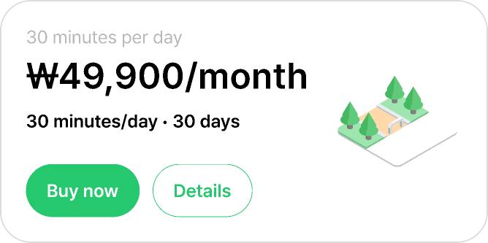
Card Concept 4

Slide 23

Card Concept 4
Icon is meant to display the nature of the pass; for example, having a beach front may insinuate tourism purposes or a long road may represent a longer subscription pass

Slide 24
Store Organization
& Pass Names
Notes:
Potentially making it a point to make it distinctly a month and a week pass instead of a 4 days - 30 days and a 30 day pass

Slide 25
Store Organization Names
Month Pass
Monthly Pass
Lite Month Pass
Lite Monthly Pass
10 Minute Bundle Pass
10 Minute Bundle Pass
180 Minute Pass
180 Minute Pass
30 Minute Pass
30 Minute Pass
30 Minute Month Pass
30 Minute Monthly Pass
10 Minute Month Pass
10 Minute Monthly Pass
10 Minute Bundle Pass
10 Minute Bundle Pass
180 Minute Pass
180 Minute Pass
30 Minute Pass
30 Minute Pass

Slide 26
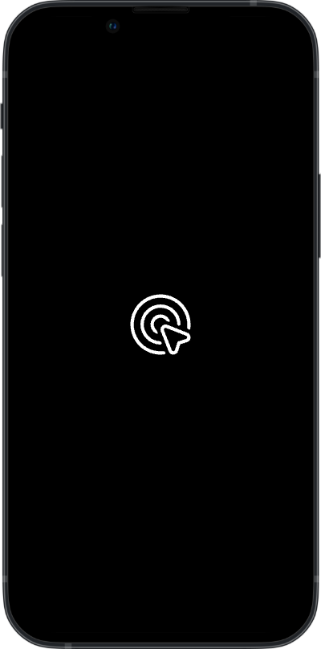
Store Organization Prototypes

Slide 27
Store Organization Prototypes Continued

Slide 28
Extra Information
& Purchase Re-Design
Notes:
x-button vs the drag bar difference

Slide 29
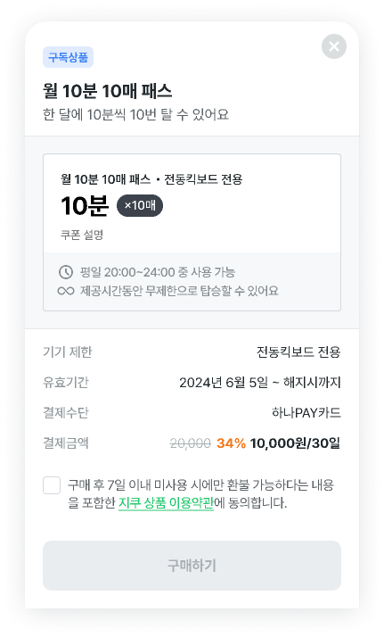


Purchase Overlay Re-Design
Old
New
Month Pass
Available for 30 minutes per day for 30 days
Device Restrictions
Electric Kick board
Expiration
June 5, 2024 ~ Termination
Payment Method
Mastercard
Payment Amount
₩10,000/30 days
I agree to GCOO Product T&Cs

Slide 30
Purchase Overlay Re-Design
New
Month Pass
Available for 30 minutes per day for 30 days
Device Restrictions
Electric Kick board
Expiration
June 5, 2024 ~ Termination
Payment Method
Mastercard
Payment Amount
₩10,000/30 days
I agree to GCOO Product T&Cs

Slide 31
Purchase Overlay Re-Design
New
Month Pass
Available for 30 minutes per day for 30 days
Design cuts out the repetitive parts of the old design
Device Restrictions
Electric Kick board
Expiration
June 5, 2024 ~ Termination
Payment Method
Mastercard
Payment Amount
₩10,000/30 days
I agree to GCOO Product T&Cs
Emphasis on the buy button to catch user attention

Slide 32
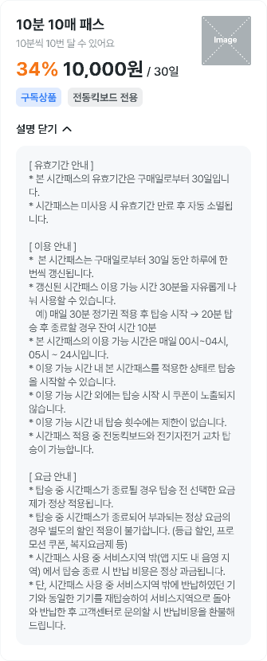


Extra Information Re-Design
Old
New
30 minutes per day
Validity Period Information
* The validity period of this time pass is 30 days from the date of purchase
* The time pass will automatically expire after the validity period if not used
Usage Information
* This time pass can be renewed once a day for 30 days from the date of purchase
* The renewed time pass allows you to freely divide the available time of 30 minutes
* Example: After applying the daily 30-minute pass and starting the ride → If you finish after riding for 20 minutes, you will have 10 minutes remaining
* The available usage times for this time pass are from 00:00 to 04:00 and from 05:00 to 24:00
* You can start your ride while the time pass is active during the available usage times
* Coupons will not be displayed when starting a ride outside of the available usage times
* There is no limit to the number of rides during the available usage times
* Cross-riding between electric scooters and e-bikes is allowed while using the time pass
Fee Information
* If the time pass expires during your ride, the regular fare selected before the ride will apply
* Regular fares charged after the time pass expires cannot be discounted (e.g., tier discounts, promotional coupons, welfare rate plans, etc.)
* If you finish your ride outside the service area (in shaded areas on the app map) while using the time pass, the return fee will be charged at the regular rate
* However, if you return the same device that was returned outside the service area and re-ride it back to the service area, and then contact customer service, the return fee will be refunded

Slide 33
Extra Information Re-Design
New
30 minutes per day
Validity Period Information
* The validity period of this time pass is 30 days from the date of purchase
* The time pass will automatically expire after the validity period if not used
Usage Information
* This time pass can be renewed once a day for 30 days from the date of purchase
* The renewed time pass allows you to freely divide the available time of 30 minutes
* Example: After applying the daily 30-minute pass and starting the ride → If you finish after riding for 20 minutes, you will have 10 minutes remaining
* The available usage times for this time pass are from 00:00 to 04:00 and from 05:00 to 24:00
* You can start your ride while the time pass is active during the available usage times
* Coupons will not be displayed when starting a ride outside of the available usage times
* There is no limit to the number of rides during the available usage times
* Cross-riding between electric scooters and e-bikes is allowed while using the time pass
Fee Information
* If the time pass expires during your ride, the regular fare selected before the ride will apply
* Regular fares charged after the time pass expires cannot be discounted (e.g., tier discounts, promotional coupons, welfare rate plans, etc.)
* If you finish your ride outside the service area (in shaded areas on the app map) while using the time pass, the return fee will be charged at the regular rate
* However, if you return the same device that was returned outside the service area and re-ride it back to the service area, and then contact customer service, the return fee will be refunded

Slide 34
Extra Information Re-Design
New
30 minutes per day
Validity Period Information
* The validity period of this time pass is 30 days from the date of purchase
* The time pass will automatically expire after the validity period if not used
Stronger hierarchy of information through color and size
Usage Information
* This time pass can be renewed once a day for 30 days from the date of purchase
* The renewed time pass allows you to freely divide the available time of 30 minutes
* Example: After applying the daily 30-minute pass and starting the ride → If you finish after riding for 20 minutes, you will have 10 minutes remaining
* The available usage times for this time pass are from 00:00 to 04:00 and from 05:00 to 24:00
* You can start your ride while the time pass is active during the available usage times
* Coupons will not be displayed when starting a ride outside of the available usage times
* There is no limit to the number of rides during the available usage times
* Cross-riding between electric scooters and e-bikes is allowed while using the time pass
Overlay instead of a dropdown for consistency
Fee Information
* If the time pass expires during your ride, the regular fare selected before the ride will apply
* Regular fares charged after the time pass expires cannot be discounted (e.g., tier discounts, promotional coupons, welfare rate plans, etc.)
* If you finish your ride outside the service area (in shaded areas on the app map) while using the time pass, the return fee will be charged at the regular rate
* However, if you return the same device that was returned outside the service area and re-ride it back to the service area, and then contact customer service, the return fee will be refunded

Slide 35

Prototype Concept

Slide 36
History Tab Re-Design

Slide 37




History Tab Card Re-Design
Products
History
Products
History
Monthly Passes
Monthly Passes
Purchase date: June 5, 2024
-July 4, 2024
Purchase date: June 5, 2024
30 minutes per day
Simplified card design
30 minutes per day
Buy again
Distinct buy again button as the main focal point for the user
₩49,900/30 days
₩49,900
Purchase date: June 5, 2024
-July 4, 2024
Purchase date: June 5, 2024
30 minutes per day
30 minutes per day
₩49,900/30 days
Buy again
Daily Passes
₩49,900
Daily Passes
Purchase date: June 5, 2024
-July 4, 2024
30 minutes per day
Purchase date: June 5, 2024
₩49,900/30 days
30 minutes per day
Buy again
Purchase date: June 5, 2024
-July 4, 2024
₩49,900
30 minutes per day
Purchase date: June 5, 2024
₩49,900/30 days
30 minutes per day
Buy again
₩49,900

Slide 38
Prototype Concept

Slide 39
Thank You

